Slide 1





The Sullivan Review: Independent review of data, statistics and research on sex and gender
Professor Alice Sullivan, University College London
alicealic

Slide 2
Background and scope
Loss of data on sex
Questions over data collection on gender identity
Notes:
I was commissioned by the government to carry out an independent review on data and statistics on sex and gender. Published march this year.

Slide 3

Terms of reference
Identify trends and obstacles to accurate data collection on sex and on gender identity.
1
Provide guidance for how to collect data on sex and gender identity.
2

Slide 4
Accurate data matters for
Research
Equalities monitoring
Safeguarding
Service provision and care
Notes:
Building knowledge, Avoiding harm and shaping effective policymaking.
Addressing people as they wish is compatible with holding sex data.

Slide 5
Data and statistics on sex and gender: Methods
Review of data collection policies, guidance, datasets and statistics on sex
Review of questions about gender identity
Interviews with 30+ stakeholders
Public call for evidence (268 responses)
Legal opinion
Notes:
Methodologically broad ranging, largely qualitative. Very different from my usual research.
We carried out a review of policies, guidance, datasets and statistics, including administrative data, major flagship surveys, independent academic studies, clinical trials, polling data, and marketing exercises.
We held over 30 stakeholder interviews with organisations ranging from government departments, regulators and other public sector organisations to fieldwork agencies and those campaigning for the rights of women and LGBT advocacy groups.
We held an open call for submissions, which ran from 7 May to 1 July 2024. Individuals were invited to submit examples of UK data collection on sex and/or gender identity which they perceived as inadequate or flawed.
We commissioned a legal opinion to ensure recommendations were compliant with relevant legal frameworks, such as GDPR and ECHR Article 8 rights.

Slide 6
Sex and gender questions in surveys held by the UK Data Service, 1946 to 2023
Notes:
The loss of data on sex is a relatively recent phenomenon. Our analysis indicates that in the context of data collection, the term ‘gender’ gained traction as a synonym for sex in the 1990s. More fundamental changes have taken place within the last decade, which has seen both the reframing of ‘gender’ as a synonym for gender identity, and the replacement of sex questions with gender-identity questions. Figure 1 below shows these trends, based on a review of over 500 surveys and questionnaires lodged with the UK Data Service.

Slide 7
Losing data on sex: examples
Crime: Police forces recording crimes by men as though they were committed by women at the request of the perpetrator
Health: replacement of actual sex with gender id on NHS records at the patient or parent’s request
Education: UCAS dropped on ‘sex’ in 2015
Gender pay gap: Govt Equalities Office advise that data should be categorised by gender identity, and data on non-binary people excluded

Slide 8
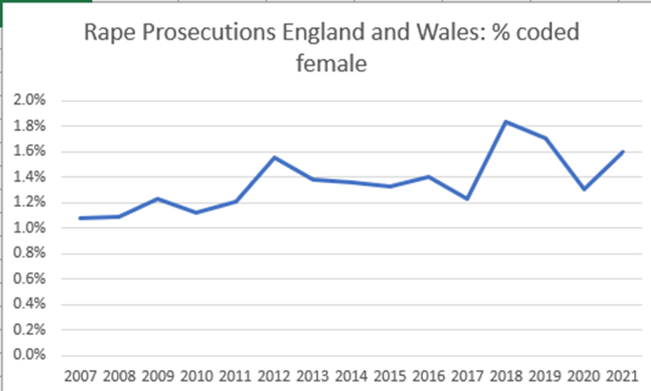
Real change or data error?
Notes:
CPS data. No data held prior to 2006 according to FOI. Is this an increase in females charged with rape as accomplice, or an increase in males charged as females. Starts at 1.1% in 2007. Highest number of rapists coded female in any year was 83.

Slide 9
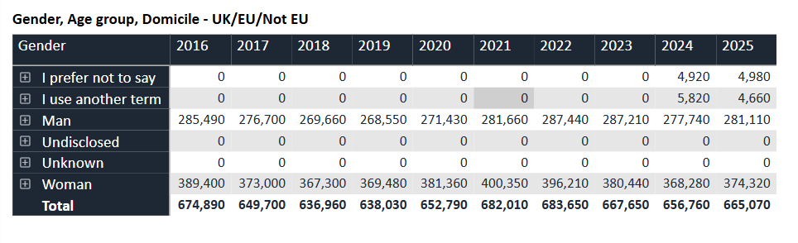
UCAS: University admissions

Slide 10
Sex and the England and Wales Census
Census has included information on sex since its inception in 1801
2017: ONS proposed to make sex question voluntary in 2021 Census. Backlash.
2019: Proposed self-id guidance for the sex question.
This was despite new voluntary gender-id question.
February 2021: Judicial review. ONS argued: sex is an ‘umbrella term’; risk of breach of ECHR Article 8 on respect for private and family life.
Judgment found these arguments ‘insufficiently persuasive’

Slide 11
Call for evidence
Examples from a wide range of organisations including: service providers, employers, cultural sector, education, government
  Failing to collect data on sex
  Combining sex and ‘gender’
  Failing to correctly identify protected characteristics
  Inappropriately requesting intrusive medical information
Notes:
Grimsby fishing heritage centre.
Depth of responses. E.g. rape crisis centres asking only about gender identity, not sex. Computer systems.

Slide 12
Stakeholder interviews
Stakeholders recognised the importance of collecting data on sex
Legal uncertainty was seen as a barrier
Government departments were interested in data on gender identity as a protected characteristic

Slide 13
Recommendations
✓
Collect sex by default
✓
Collect trans status as a distinct variable
✗
Do not muddle sex and gender identity

Slide 14
Sex
What is your sex?
Response categories: Female, Male
Guidance: ‘This question is about your sex at birth’

Slide 15
Supreme Court Judgment (2025)
Sex, for the purposes of EA2010, means biological sex
Data collection to uphold PSED must be on biological sex
Addendum to review: https://sullivanreview.uk/addendum.php

Slide 16
Gender identity
Decide first what you want to know:
The protected characteristic of gender reassignment
Trans identification
Identification as trans and/or gender diverse.

Slide 17
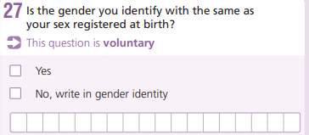
The ONS ‘gender’ question has been de-accredited
Notes:
In Scotland The question was “Do you consider yourself to be trans, or have a trans history?”. People were asked to tick “No” or “Yes”. People who ticked “Yes” were asked to describe their trans status (for example, non-binary, trans man, trans woman).

Slide 18
Gender Identity question
2021 Census of England and Wales revealed a surprisingly high prevalence of transgender identities among adults who spoke English poorly and among those with no qualifications (Biggs).
ONS initially resisted criticism of the GI question, suggesting patterns could be explained by high numbers of transgender refugees.
2024: De-accredited on recommendation of OSR.
Inaccurate data distorts our understanding of minority groups.

Slide 19
Never ask questions which confuse sex and ‘gender’, e.g.
Do you identify as:
  Man
  Woman
  Non-binary
  Intersex
  Other

Slide 20
Myths about DSD
“As common as red hair”. (Actually estimated at 0.017%)
A third sex or “between the sexes”
Part of LGBQTI+
An identity rather than a condition
Expansion to include conditions such as PCOS
ONS guidance for the 2019 Census rehearsal stated ‘If you would like to record that you have variations of sex characteristics, sometimes also known as intersex, you can use this write-in box. If you would like to, you can also write in your gender (for example: ‘intersex, non-binary’).’ This guidance was dropped following an ethical review.

Slide 21
Sex and gender data references
UKSA Inclusive Data Taskforce (2021): data on ‘sex, age and ethnic group should be routinely collected and reported in all administrative data and in-service process data, including statistics collected within health and care settings and by police, courts and prisons’.
OSR Guidance (2024): Sex and gender identity should not be conflated or combined
Sullivan Review (2025): Provides recommended questions
Supreme Court Judgment (2025): Provides clarity on the meaning of sex as a protected characteristic.
Notes:
ONS have ongoing programme of work, but as far as sex question is concerned, this should now be easy.

Slide 22
Links
Sullivan Review https://www.gov.uk/government/publications/independent-review-of-data-statistics-and-research-on-sex-and-gender
All documents including Supreme Court Judgment Addendum https://www.sullivanreview.uk/documents.php
OSR Collecting and reporting data about sex and gender identity in official statistics (2024) https://osr.statisticsauthority.gov.uk/publication/collecting-and-reporting-data-about-sex-and-gender-identity-in-official-statistics-a-guide-for-official-statistics-producers/
UKSA Inclusive Data Taskforce Report (2021) https://uksa.statisticsauthority.gov.uk/wp-content/uploads/2021/09/1618-Inclusive-Data-Taskforce-Recommendation-Report-web-v1-00.pdf
Email: Alice.Sullivan@ucl.ac.uk

