Slide 1
–
What was Shewhart’s intent for SPC?
I will go back in time to 1924, where we will revisit the Shewhart SPC chart and the assumptions Shewhart made, resulting in robust method to display and understand variation. I will also discuss the role of Jennett in the development of SPC.
Jonathan Smyth-Renshaw of the RSS Quality Improvement Section

Slide 2
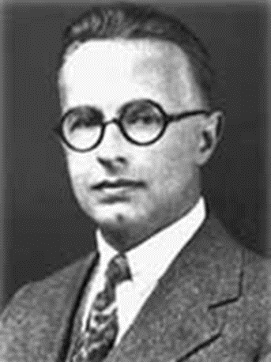
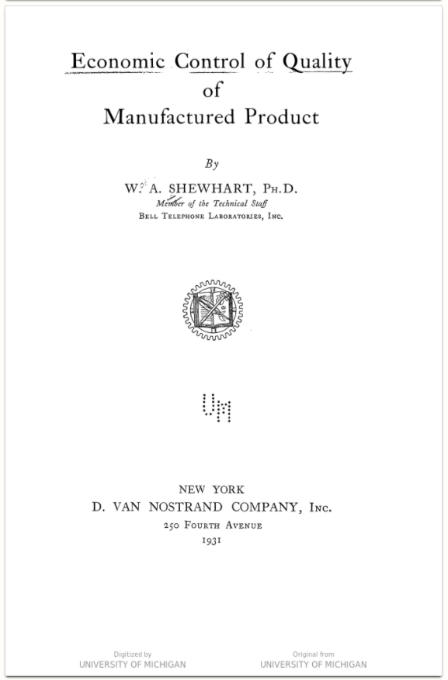
Shewhart
Economic not Statistical
Notes:
We know how Shewhart and his colleagues think based on his book 1931

Slide 3
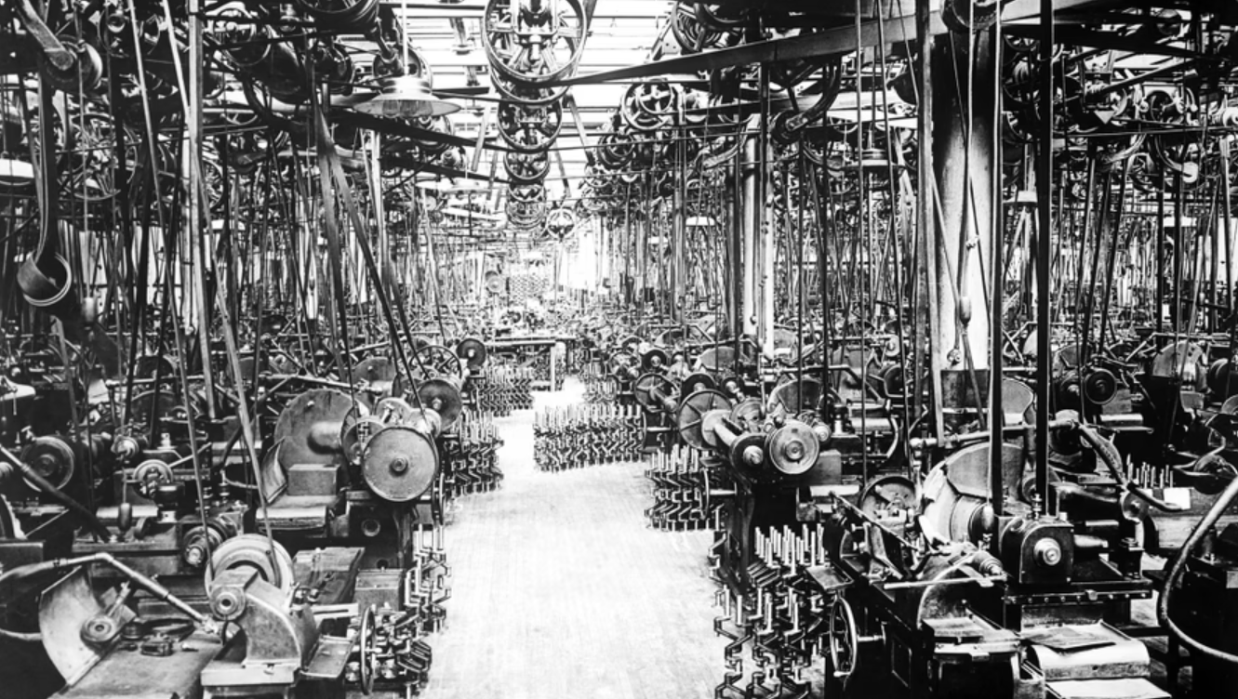
"April 7, 1924 – Highland Park, Michigan. Crankshaft grinding department in the Ford plant at Highland Park."
Notes:
Automotive standards

Slide 4
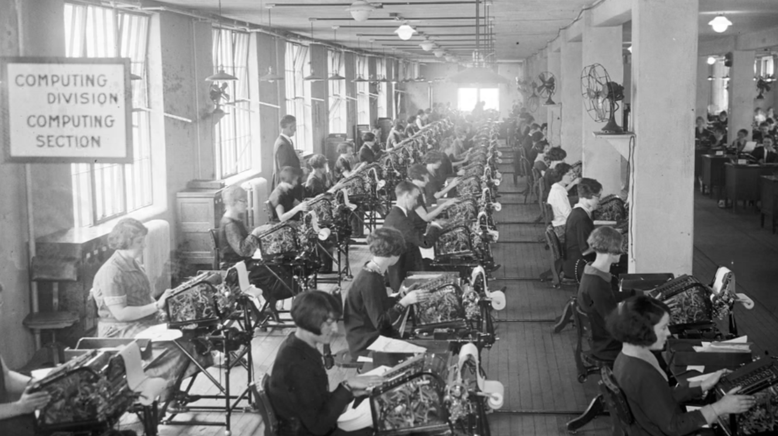
U.S. government clerks use new calculating machines to determine the bonuses for World War I veterans
Notes:
The Computer

Slide 5
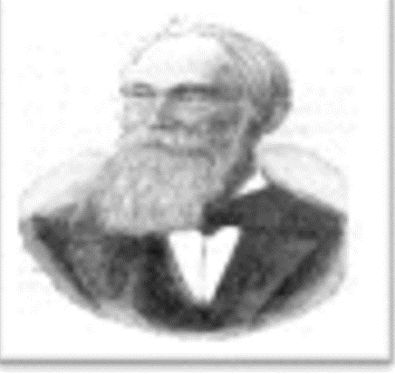
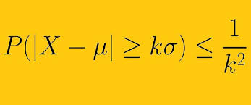
Notes:
Chebychev’s work is used through the book.
As an aside it looks like an area where there is opportunities for research to use statistics and economic aspects in a positive way to achieve greater engagement.
What do Shewhart do ?

Slide 6
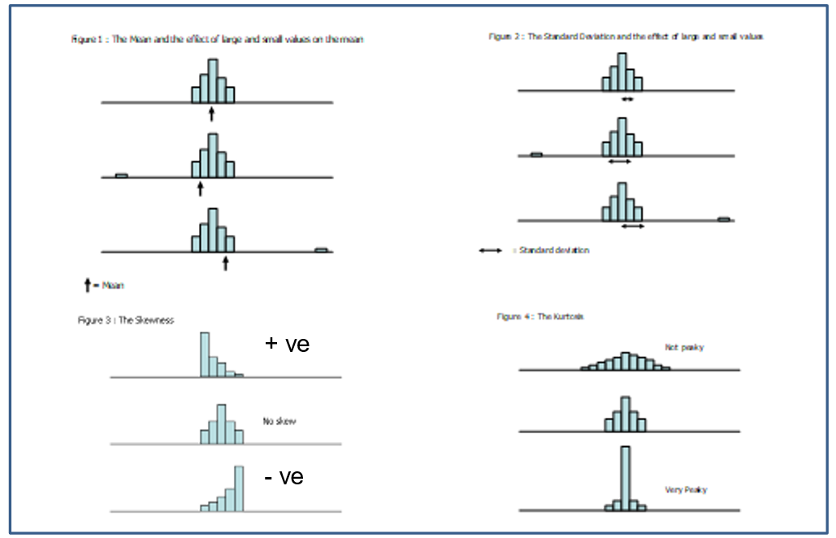
Standard
deviation
mean
skew
kurtosis
Notes:
Shewhart et al set the scene and many references to economic approach and Chebychev’s work it is referenced in the Index the greatest number of times.

Slide 7
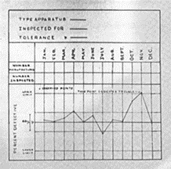
Shewhart
Experiment of ‘a’
Proportion charts 1st
X bar R charts (n>1)
Autocorrelation - OK
Empirical - Chebychev’s
Rational subgroups
Assignable variation
Neither Shewhart or Deming were able to ‘see’ the mR (moving range) used for individual charts today.
Notes:
What Shewhart did wrt control charts ?
So, if you check on the internet – who invented the ImR chart? You will see Shewhart – but this is not true.
The experiment of a write a 10 times compare the a’s and compare with another person – rational subgroups.

Slide 8
Rational sampling
Remember Shewhart’s a’s
  Coupled pairs
  ‘...measurements of phenomena in both social and natural science for the most part obey neither deterministic nor statistical laws until assignable causes of variability have been found and removed.’
  —Walter A. Shewhart
  Don’t plot ‘what you know is different’ and expect to learn some new insight.
Notes:
Look at you’re a’s and look at the person next to you and ask them to add one a to you’re a’s

Slide 9
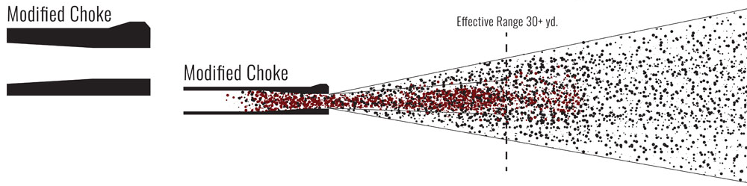
Successive differences or mR
1894 E. Vallier – successive differences linked to determining range of field artillery.
1919 C. Crane and K. Becker – moving range (mR) again field artillery.
1941 John von Neumann – successive differences
Notes:
After Shewhart -

Slide 10
ImR or XmR chart - timeline
No mention of XmR chart
1942
W.J. Jennett worked for MO Valve Co. co-authored book Quality Control Chart
1950
L.H.C. Tippett book – mentioned with examples
1951
ASTM Committee E-11 on Quality Control of Materials
1953
Joan Keen and Denys Page – Article with examples
1956
Western Electric Statistical Quality Control Handbook
1986
D. Chambers and D. Wheeler - Understanding Statistical Process Control
1993
D.Wheeler – Understanding Variation – the Key to Managing Chaos
(plus, credit to Jennett)

Slide 11

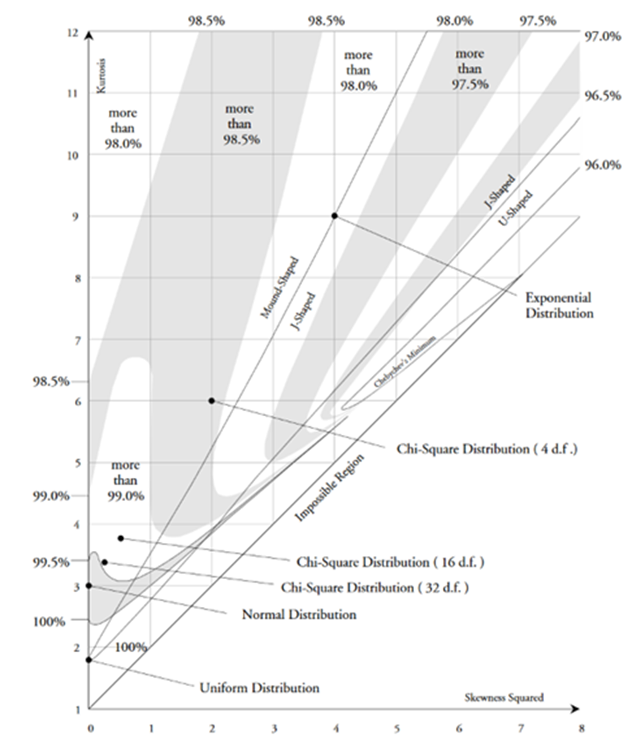





Reference: - D.Wheeler
Notes:
Use of statistical distribution – normal distribution etc is not necessary.
So the ImR chart today in particular I charts

Slide 12
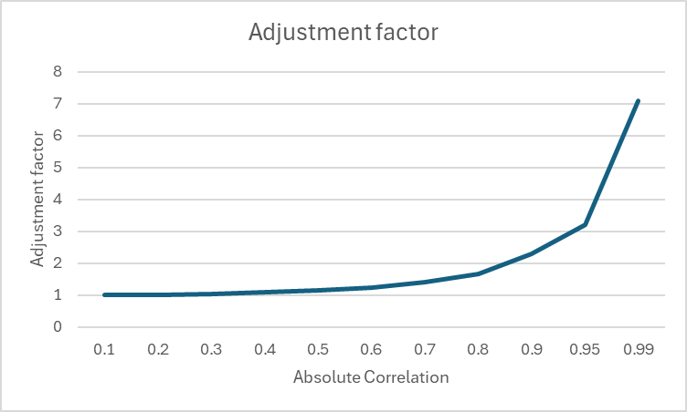

Auto - correlation
AF $=\frac{1}{\sqrt{{1 −r}^{2}}}$

Slide 13

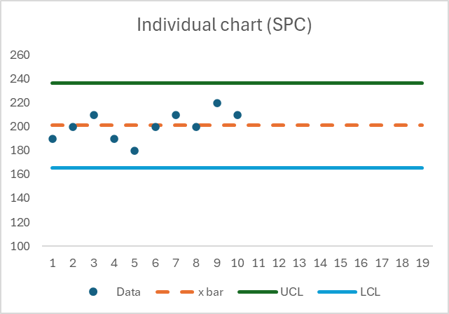
The construction of the chart
Notes:
Originally paper
But now paper is rarely used
Action Research, I have undertaken where I have compared paper and using Excel. I concluded that Excel to preferred in this modern time.

Slide 14
The calculations
UCL = x bar + (2.66 mR bar)
LCL = x bar – (2.66 mR bar)
σ ≈ mR bar/1.128

Slide 15
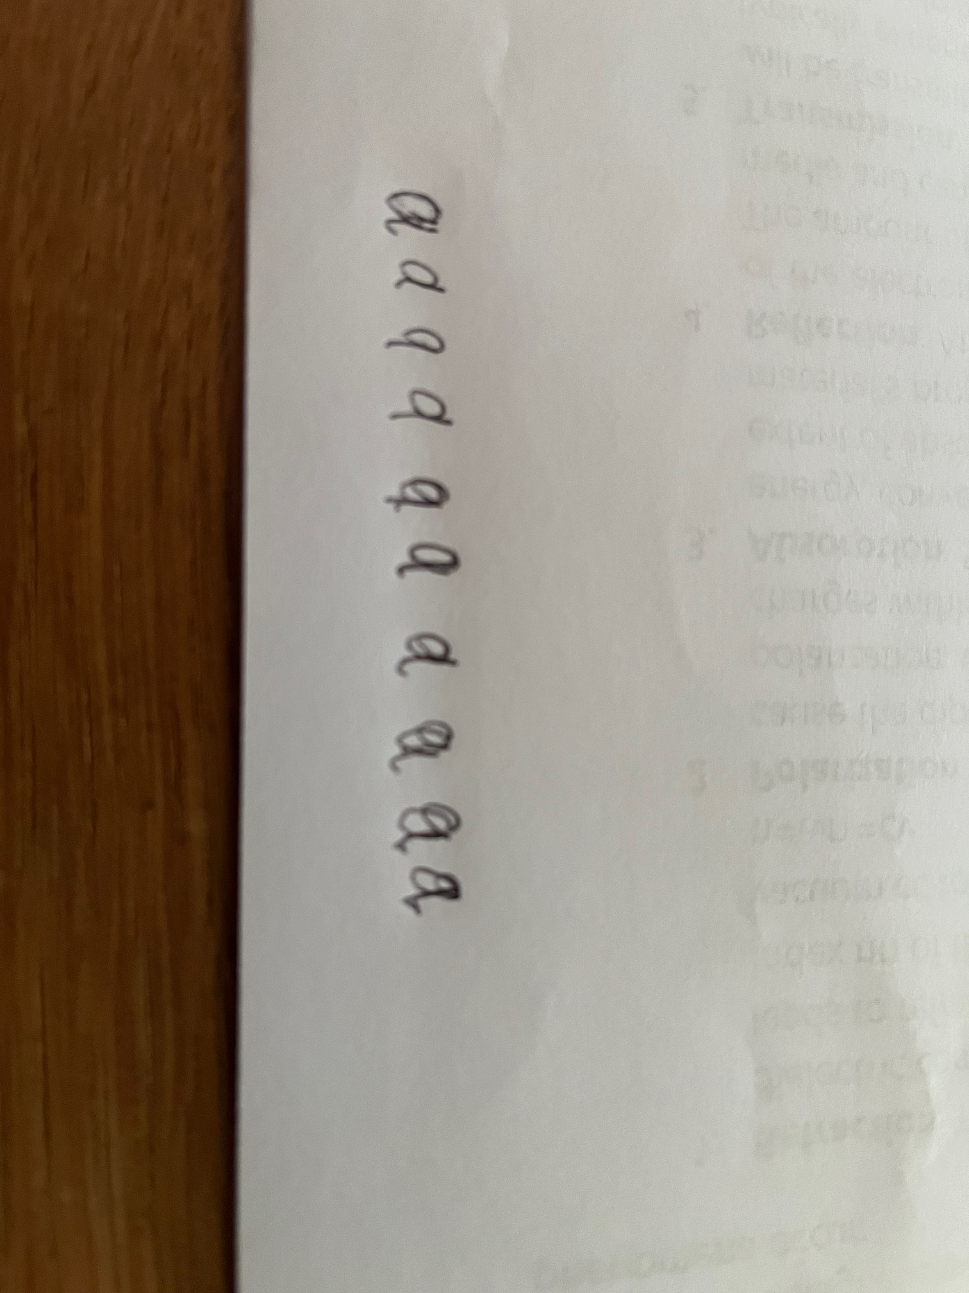
The construction of the chart
UCL
LCL
Plot the same feature in time order

Slide 16
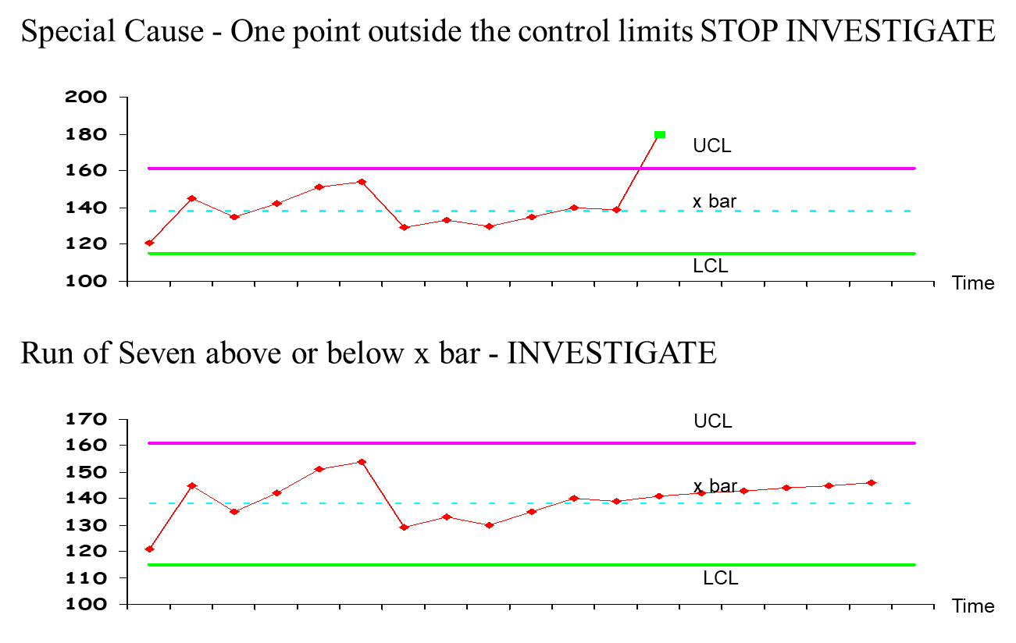
ImR chart (XmR chart)
Notes:
The rules

Slide 17
Summary
Shewhart et al demonstrated the power of the control chart 100 years ago
ImR charts were developed in the 1940’s
‘As a man, he was gentle, genteel, never ruffled, never off his dignity. He knew disappointment and frustration, through failure of many writers in mathematical statistics to understand his point of view.’ Deming (Shewhart’s obituary)
If you are going to use control charts don’t disappoint its creator!
Notes:
Thank you
Hand over to Roland to explain the use of control charts and some important lessons .

