Slide 1
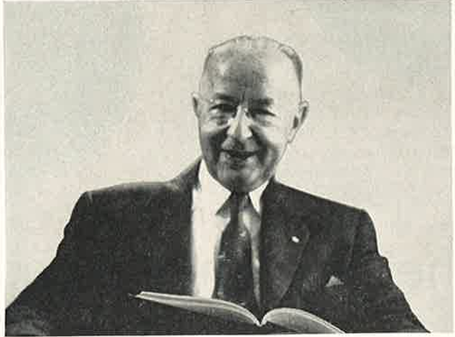


Walter Shewhart and a Century of the Control Chart:
Epiphany, Evolution, Eclipse
Penny S Reynolds PhD
University of Florida
10 December 2024

Slide 2
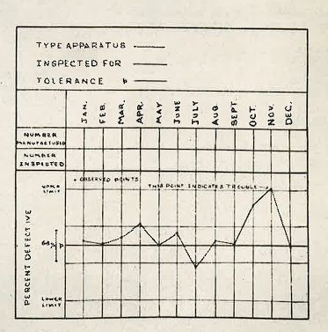
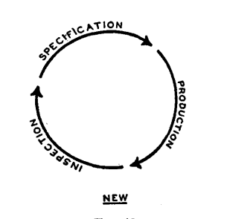
Shewhart’s Big Ideas
What is quality?
How do we achieve quality?

Slide 3
Road map: Shewhart, the control chart, SPC
Epiphany: “Gradually, then suddenly”
Evolution: Major influences on Shewhart’s later thinking
Eclipse: Why did SPC take so long to catch on?

Slide 4
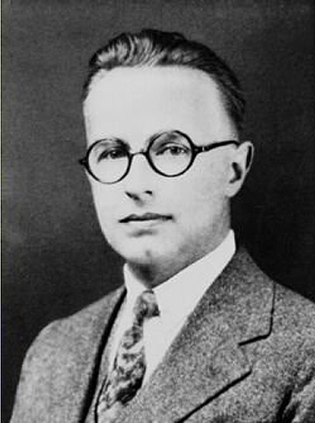
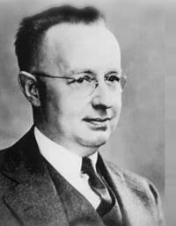
Walter Shewhart (18 Mar 1891- 11 Mar 1967)
American physicist, statistician
1891 – 1918 Early years:
University of Illinois-Urbana
University of California–Berkeley
1918 – 1940 Research years:
Western Electric
Bell Telephone Laboratories
1941 – 1967 Consultant, committee years
Notes:
Strong emphasis on experimentalism and research system design.

Slide 5
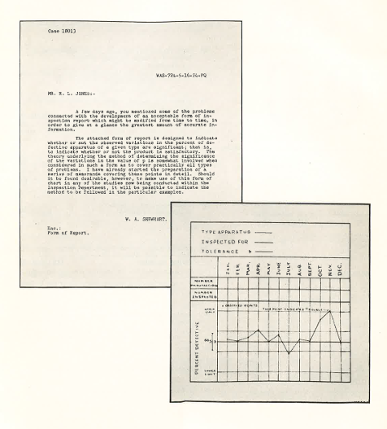
Part I: Epiphany: “Gradually, then suddenly”

Slide 6
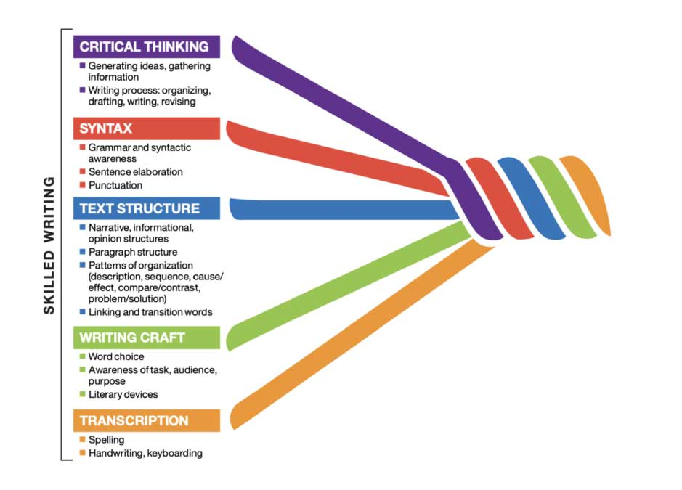
Four key insights over 10 years
The control chart was not really an “overnight” phenomenon
Variation ≠ Anomaly
What is ‘anomaly’ anyway?
Utility of data-driven priors
‘Cutting edge’ not always ‘useful’

Slide 7
Insight 1: Variation ≠ Anomaly
1916 Variation in natural processes (time series)
Doctors: Body temperature fluctuations are a TB marker
He wasn’t ill
Solution: Took serial measures of his own & other people’s temperatures

Slide 8
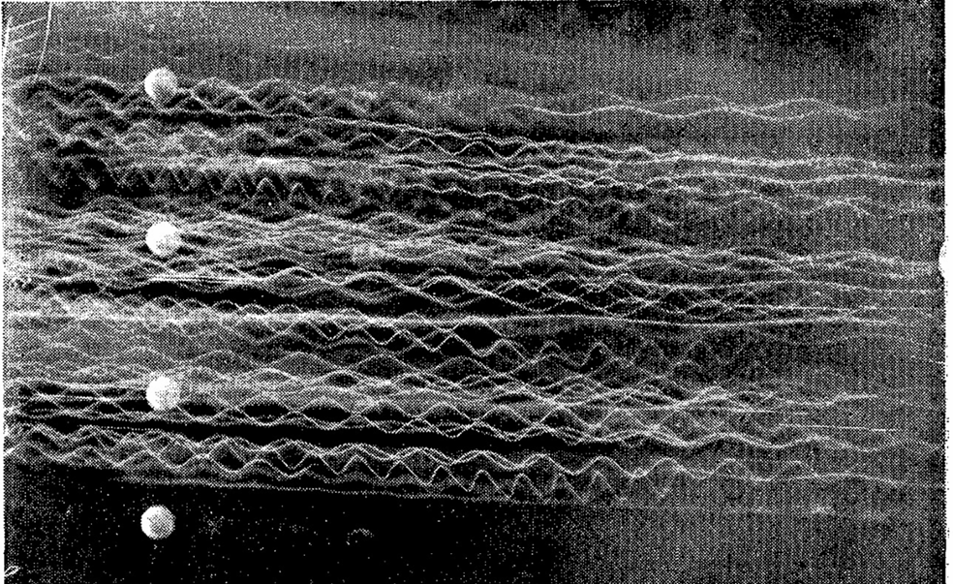
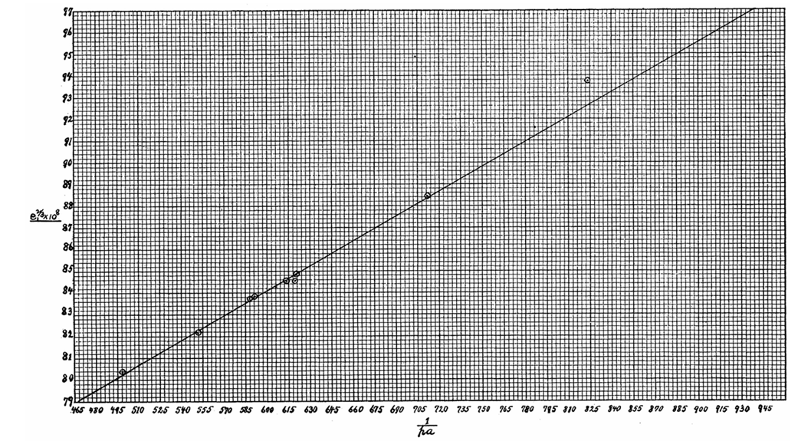
Insight 2: What is “anomaly”?
1917 PhD UC-Berkeley 1917
Extension of Robert Millikan’s oil drop experiment – added sound waves
Primary verification:
Straight-line relationships
Tabulated comparison of expected with observed values
BUT
No formal measure of variation
No explanation of “error”
Notes:
Oildrop expt affirm atomic quantum theory by measuring the charge of an electron
Measured how force of gravity for a stream of electrons could be equilibrated by an opposing counterforce that combined an electrical charge and the viscosity of air.
Later revelations: Millikan ‘tidied up’ his data; he didn’t do very much of the work – it was mostly down to Harvey Fletcher

Slide 9
Insight 3: Utility of data-driven priors
1918 Western Electric – Hawthorne facility (operations arm; Bell System)
Job assignments: Product development, improvement
Project: Soundproof aviation helmet shield
Problem: Determine specifications for different human head sizes
“by tomorrow”
Solution:
Read a statistics book all night (King)
Measured 100 heads of employees → “normal” variation
Notes:
Any data is better than no data

Slide 10
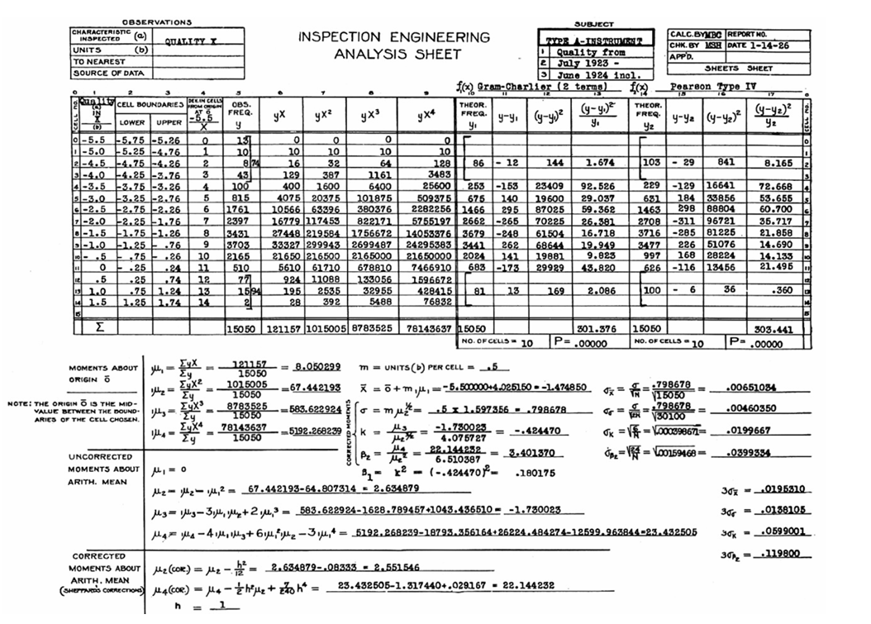
Insight 4: ‘Cutting edge’ methods not always ‘useful’
1920s Bell System early adopter of
Probability applications → “quality”
  Malcolm Rorty; Ed Molina
  2. Charts → “defects”
  Problems:
  Hard to use, hard to understand
  Could not operate in real time: End of the line inspection, time consuming
  No prescription for action
Shewhart 1926 Bell System Technical Journal 5: 593-603.
Notes:
if observations are not sufficiently Gaussian to use the probability integral then what

Slide 11
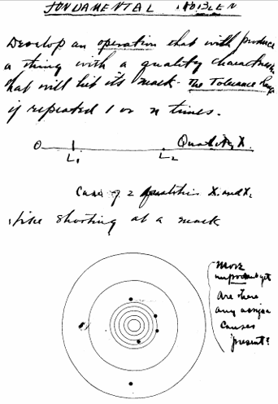
Shewhart’s ideas crystallise
Fundamental problem
Develop an operation that will produce a thing with a quality characteristic that will meet its needs – the tolerance range if repeated 1 or n times
1. Start with the process, not the specifications
2. Process should be
stable
repeatable
3. Quality = “Prediction within limits”
Shewhart. Quality Control in Industry.
Rochester Engineering Society, ASME 16 Oct 1941

Slide 12
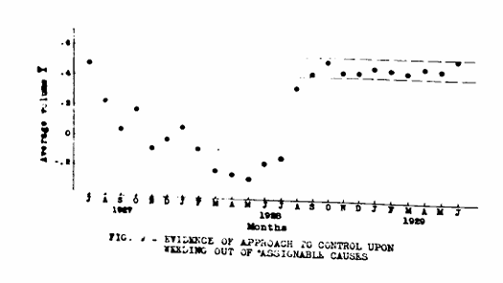
Part 2: Evolution

Slide 13
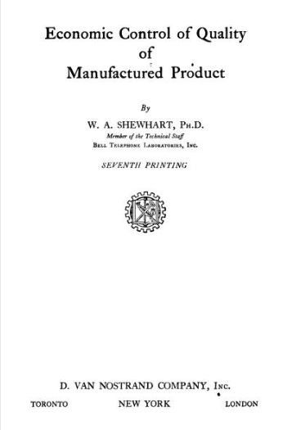
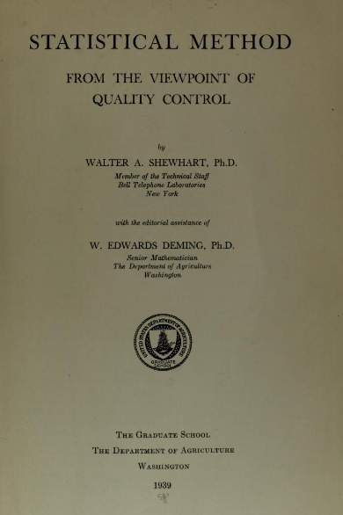
After the control chart memo…
10 technical reports 1925-1929
Summarised in two books
1931 Economic Control of Quality of Manufactured Product
1939 Statistical Method from the Viewpoint of Quality Control (with WE Deming)

Slide 14
Shewhart’s ideas evolve
Definitions of ‘variation’
Statistical operationalization
Data visualisation
Concept of statistical control

Slide 15
Big Idea 1
All processes exhibit variation → but not all variation is the same
Total variation
Common/ ‘chance’ cause
Assignable/ ‘special’ cause
NO ACTION
TAKE ACTION
Discriminate between ‘types’ of variation → Achieving statistical control
Maintaining statistical control → Predict future output; economically manage processes.

Slide 16
Big idea 2
Process can be statistically operationalized
Shewhart applied cutting-edge statistical theory = “revolutionary”
Pioneering use of statistical methods to
characterize the system
judge the system
How can we tell if deviations d are
“real” [=signal] or “chance” [= noise]?
= Statistical limits

Slide 17
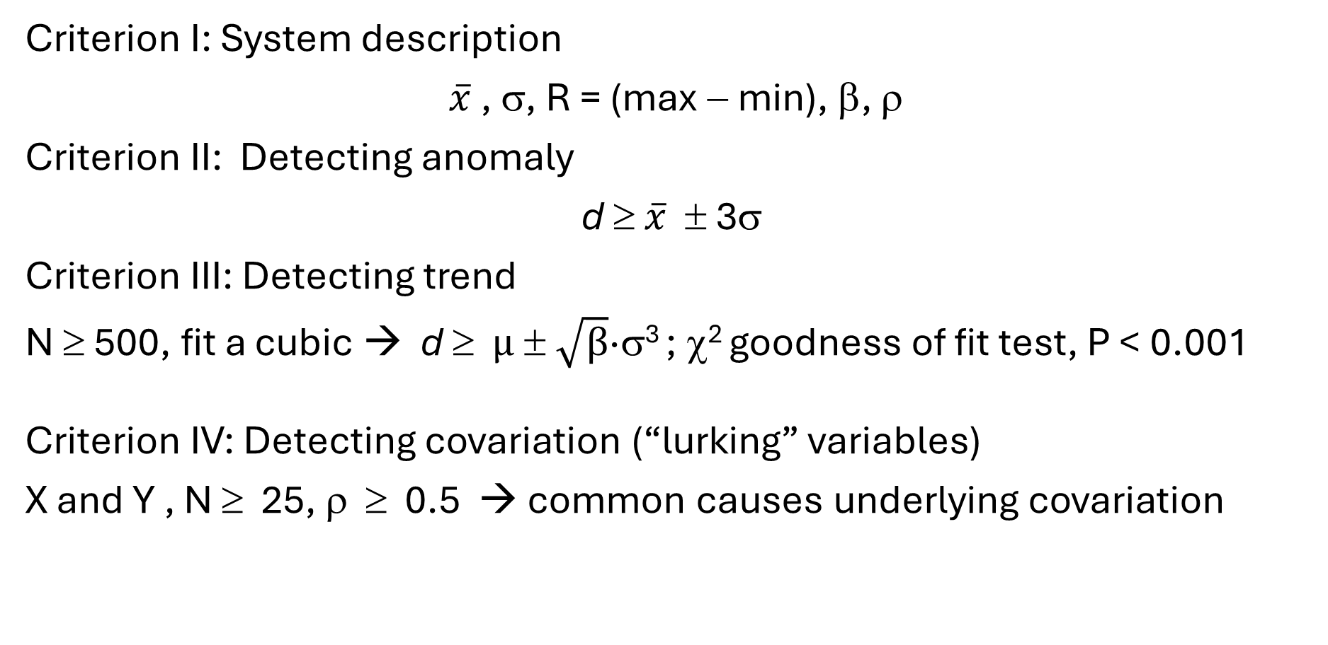
Shewhart’s four “criteria”
Criterion I: System description
$\overline{x}$ , σ, R = (max − min), β, ρ
Criterion II: Detecting anomaly
d ≥ $\overline{x}$ ± 3σ
Criterion III: Detecting trend
N ≥ 500, fit a cubic → d ≥ $μ ± \sqrt{β}$·σ³ ; χ² goodness of fit test, P < 0.001
Criterion IV: Detecting covariation (“lurking” variables)
X and Y , N ≥ 25, ρ ≥ 0.5 → common causes underlying covariation

Slide 18
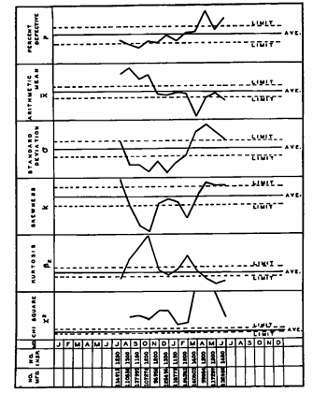
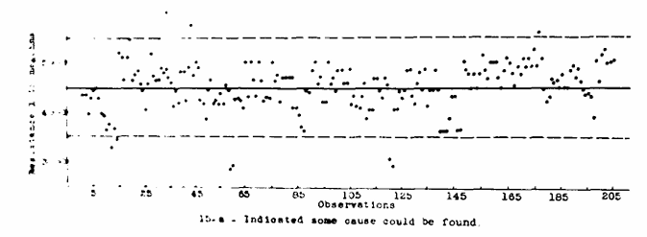

Big Idea 3
Data visualisation is key to system control
Complementary charts identify problems
%
$$\overline{X }$$
σ
Skewness
Trend β
χ²
Shewhart 1926 Bell System Tech J 5, 593-603

Slide 19
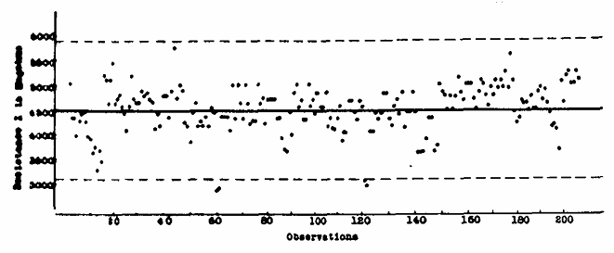
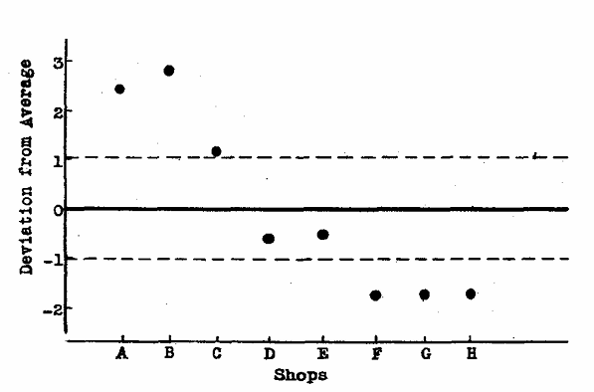
Big Idea 4
Statistical control = a rule of behavior
Q. When does the operator need to act?
When the process goes outside statistical ‘limits’
Case 2: “Average” is meaningless except as a gauge of performance consistency
Case 1: Process average and limits
Shewhart 1929 When must a thing be left to chance? 35 pp

Slide 20
Influences on Shewhart’s thinking
Mathematical statistics
Understanding variation
Philosophy:
Conceptual pragmatism
Theory of knowledge

Slide 21
1. The role of mathematical statistics
Shewhart was a voracious reader of statistical references
WI King, H Secrist (economists): “statistical method”; “statistical regularity”
Bowley, Edgeworth, Karl Pearson: “theory of probable error”
1919 Wanted to study with Karl Pearson
Dissuaded by HL Rietz (top man in statistics in America):
“Do not take up statistics as a profession – it’s not likely to offer good prospects”
Notes:
King The Elements of Statistical Method 1912

Slide 22
Shewhart was one of the few up to speed
“…One of the few writers on statistical subjects who are sufficiently acquainted with the revolutionary developments of the theory in the past two decades to make effective use of the new discoveries” − Hotelling 1932
Describing the system Distributions, central tendency, variation
Discriminating patterns Correlation, χ² goodness of fit
Defining thresholds Tolerance vs confidence intervals
  Pearson-Neyman lemma: type I and type II errors
Data from physical processes are rarely Gaussian BUT High production throughput = large N → normal distribution
    Chebyshev's inequality: sets bounds for any probability distribution
    Pr(y > kσ)

Slide 23
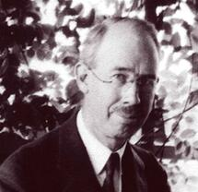
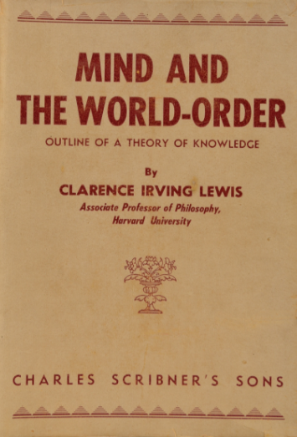
2. The role of philosophy
How do we “know” something?
  Clarence Irving Lewis (12 Apr 1883 − 3 Feb 1964)
  Mind and the World-Order: Outline of a Theory of Knowledge (1929)
  Major influence on Shewhart & Deming
American philosopher
Major contributions to symbolic logic, epistemology
Founder ‘Conceptual Pragmatism’
  Overlapped with Shewhart at University of California–Berkeley 1911-1920

Slide 24
Lewis’ Big Ideas
“Knowledge” is “Facts With Context”
Prior context aka ‘Hypothesis’ is necessary → even if tentative
  = what Shewhart called “operational definitions”
2. “Knowledge” requires judgement of sequences of events
  The future comes from the past → the past has predictive knowledge
  What matters for the future is the present → Does the present conform or depart from the past?
  Knowledge is iterative → Continuous comparison & updating
3. “Knowledge” requires action
How do we act on our “knowledge”? Decision criteria
Notes:
No such thing as facts without context
“Knowledge” requires judgement –based on sequences of events

Slide 25
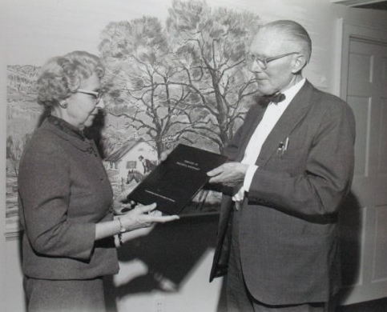
Part 3: Eclipse
Why did SPC spread and adoption take so long?

Slide 26
Control chart memo
16 May 1924
Epiphany
Evolution
PhD
UC-Berkeley
1917
ASA Annual Meeting Sessions
On Quality
Reads Karl Pearson
Reads
C I
Lewis
Visits Karl & Egon Pearson
UCL
Deming: USDA lectures
Meets Deming
MIT
lectures
1915 1920 1925 1930 1935 1940 1945
WWI
Great Depression
WWII
ASTM Manual
ASTM Supp
ASAT Z War Standards
Begins works at Western Electric
First published description
Bell System Tech J
1926
Economic Control of Quality of Manufactured Product
1931
Statistical Method from the Viewpoint of Quality Control
1939

Slide 27
Post-WWII: Momentum fizzles out in the US
Deming goes to Japan
US wakes up to SQC
SQC in Japan
Visits
Mahalanobis
SQC in India
First Shewhart Medal
ASQC founded
Death
1967
Deming
“Out of the Crisis”
Retires
1945 1950 1955 1960 1965 1970 1980s
ASQC
tribute
President ASA
Western Electric Quality Control Handbook
published
Energy crisis
Wald, Barnard
Sequential ratio tests
Hotelling
T² chart
Ewan Page CUSUM

Slide 28
Control charts and SPC were not intuitive
→ How does practice innovation gain traction?
Motivation
Influence (“networks”)
Communication
Rogers Diffusion of Innovation Theory 1962

Slide 29
1. Motivation
Status quo bias: Without a crisis there are no incentives to change
US manufacturing powerhouse: No competition = Complacency
  Wartime: Efficiency and effectiveness prioritized
  Post-war: Shift from military→ suburban “luxury” items
  Goal: Make money → Maximise production = Quality takes a back seat
  1970s Energy crisis; US auto industry realizes Japan is eating their lunch
  1980 NBC documentary “If Japan Can, Why Can't We?” → Deming-mania

Slide 30
2. Influence (“networks”): Who are the stakeholders?
Loved it
Specialists: statisticians, mathematicians, engineers;
Military, government
Professional recognition:
  ASA, ASQ, RSS
  President ASA, IMS;
  Speaking gigs: UCL, India, MIT …..
So-so
Tech bros
“Some people like that sort of thing. Anyone who likes that sort of thing would like that sort of thing very much."
Hated it
Production line workers, bosses
Different incentives
  Workers paid for piece work
  Leadership not invested in quality
  Production = profits
  Quality slowed things down
  Control charts used to punish workers

Slide 31
3. Communication
Deming: “Shewhart had an uncanny ability to make things difficult”
Juran: “Like talking to someone from another planet”
Out of touch
    Shewhart's ideas were no help to workers on the floor
  Shewhart had never worked in a factory → no street cred
Unskilled workers (mostly immigrants, women), sweatshop conditions
Opaque: Too math-y & complicated
Charts: Maths forced back to the boffins (process engineers, industrial statisticians) = process bottleneck
Writing: Like CI Lewis: obscure, repetitive, overly-detailed, disorganised
Notes:
told deming when he writes, he must make it foolproof → Deming said that he had made it so foolproof that no one would understand it.

Slide 32

Fortunately
Shewhart had two champions……

Slide 33
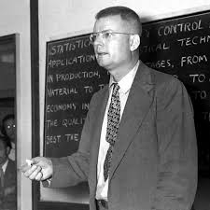
Proselytizer: W Edwards Deming
Made Shewhart’s writings intelligible, practical
Over 50 years extended Shewhart’s ideas to US and Japanese census, administration, management.
1900-1993
Notes:
1927 Met Shewhart as summer intern at Western Electric
1937 Revised 1934 paper on measurement error after reading Shewhart → life-long collaboration

Slide 34
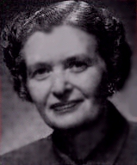
Popularizer: Bonnie Small (1909-2000)
Explained Shewhart better than Shewhart
Control charts “worked just like magic to tell you what was going on”
1930 University of Wisconsin-Madison: Classics & physics
1930s read Shewhart → used control charts in her cousin’s photography business
1942 Joined WE-Hawthorn as first quality manager
Project leader 1956 Western Electric Quality Control Handbook
1956-1962 Use of control charts 0 → 5000+
Fellow ASQC

Slide 35
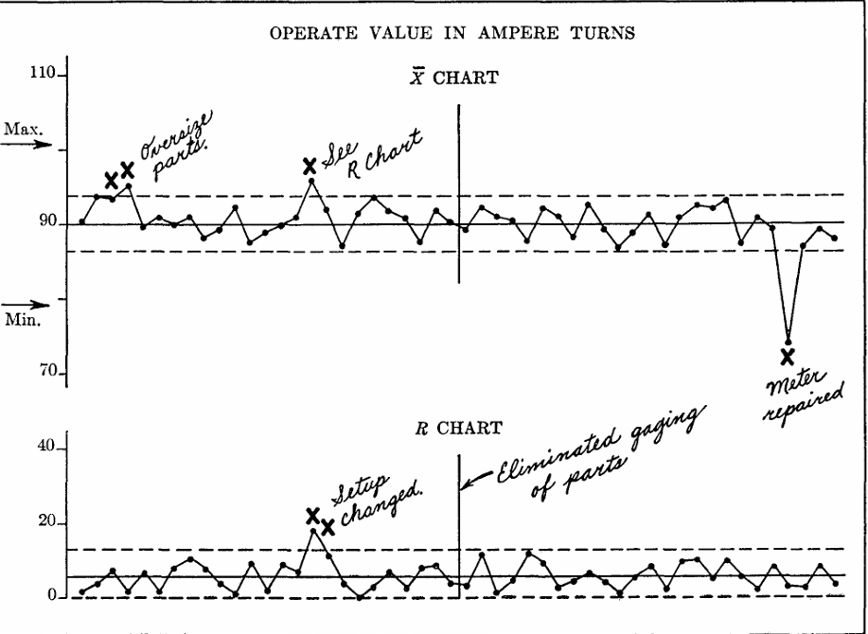
Small and the role of system knowledge
Shewhart slow to appreciate that statistical methods are not enough
Hidden anomalies are revealed by statistical analysis
BUT
“Causes” are identified by knowledge of the system
WE Handbook
Simplified Shewhart’s methods so production teams could perform correctly & consistently
‘Western Electric Rules’ for detecting “out-of-control” conditions
Anomalies disappeared after repair

Slide 36
What can we learn?
1. Power of statistical method
  Data-driven decision making
  Variation reduction
  Importance of standardization
  Continuous improvement
  BUT
  2. Brilliant statistical methods alone are not enough
  Change needs
  clear communication
  champions
  crisis

Slide 37
Further reading
** Shewhart online library, Indian Statistical Institute http://library.isical.ac.in:8080/jspui/handle/10263/6508
Best K, Neuhauser 2006, BMJ Quality & Safety 15(2), 142-3
Bradford P, Miranti P 2019 Information & Culture 54,179–219.
Bayart D 2005 Chap 72 Landmark Writings in Western Mathematics, 1640–1940
Deming WE1967 American Statistician 21(2), 39-40
Mahalanobis PC 1948. Sankhyā 9(1), 51-6
Montgomery DC 2024. J Quality Tech 56(1), 2-4
https://deming.org/the-influence-of-c-i-lewis-on-walter-shewhart-and-w-edwards-deming/
ASQC Special Publication 1967 https://qualityleadershipblog.com/wp-content/uploads/2020/08/walter-shewhart-quality-control-asqc-1967.pdf

