Slide 1
Weapons of Statistical Instruction
Professor Rhys C Jones
ADE FHMS UoS

Slide 2
Purpose
In 2017, the Teaching Statistics Trust (TST) established an annual lecture series for teachers of statistics in all subjects, whether specialist or non-specialist, in secondary schools, colleges and early years of university

Slide 3
TST lecture 2021/22
 | The Teaching Statistics Trust
The purpose of the lectures is to encourage new thinking and exciting approaches in teaching statistics, with the ultimate aim that teachers and students gain a deeper understanding of the subject

Slide 4
Let's talk about Stats and DS
1
Me!
2
My teaching philosophy
3
Visualizations & Software – let’s make things look pretty ☺
4
Context & challenging data
5
Telling stories with data & SL

Slide 5
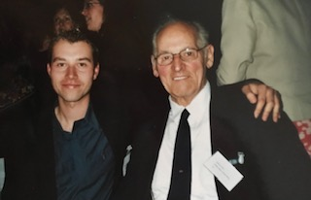
Me! Pepeha ☺
Raised by grandparents in Wales
Passion for science, curiosity and asking lots of questions!
First person to go to university in the family – almost dropped out in first year!

Slide 7
Other adventures
LD and challenging behaviours support worker – 5 years
Stepped onto a plane at 21- worked in summer camps for 10 months over 2 years in the USA
Lived in NZ, USA, Scotland and all over England (and Wales☺)!

Slide 8
My journey
Academic pathway: Biology, Biomedical Science and Medical Biochemistry (Cancer Biology), Immunology (Allergy and Asthma), PGCE FE, EdD (co evolution of contextualized transdisciplinary courses)
Taught on a range of courses in FE and HE (mostly)
UoA Stats 10x, Science Scholars
Student partners and curriculum design, creation and delivery

Slide 9
“A democratic society is precisely one in which the purpose of education is not given but is a constant topic for discussion and deliberation”
Gert Biesta

Slide 10
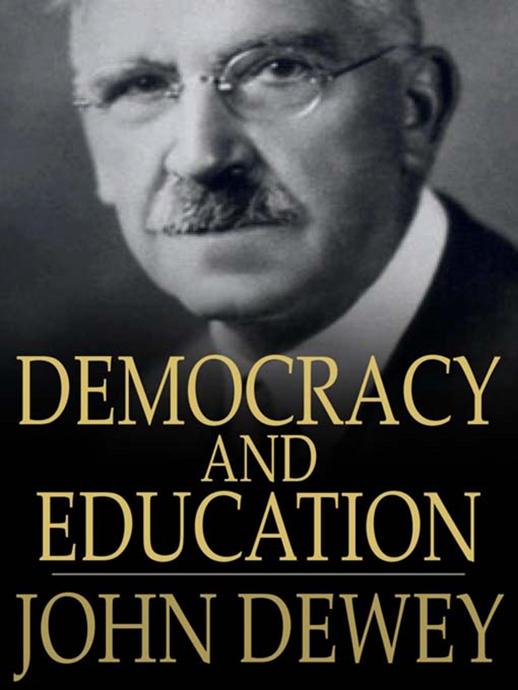

Slide 11
Progressivism in Education – Democracy and Education (1916)
Learner-centered, education as a process of personal growth and self-realization
Active learners, learning by doing, deep understanding
Holistic learning, curriculum connected to local social and physical environment
Social, collaborative learning

Slide 13
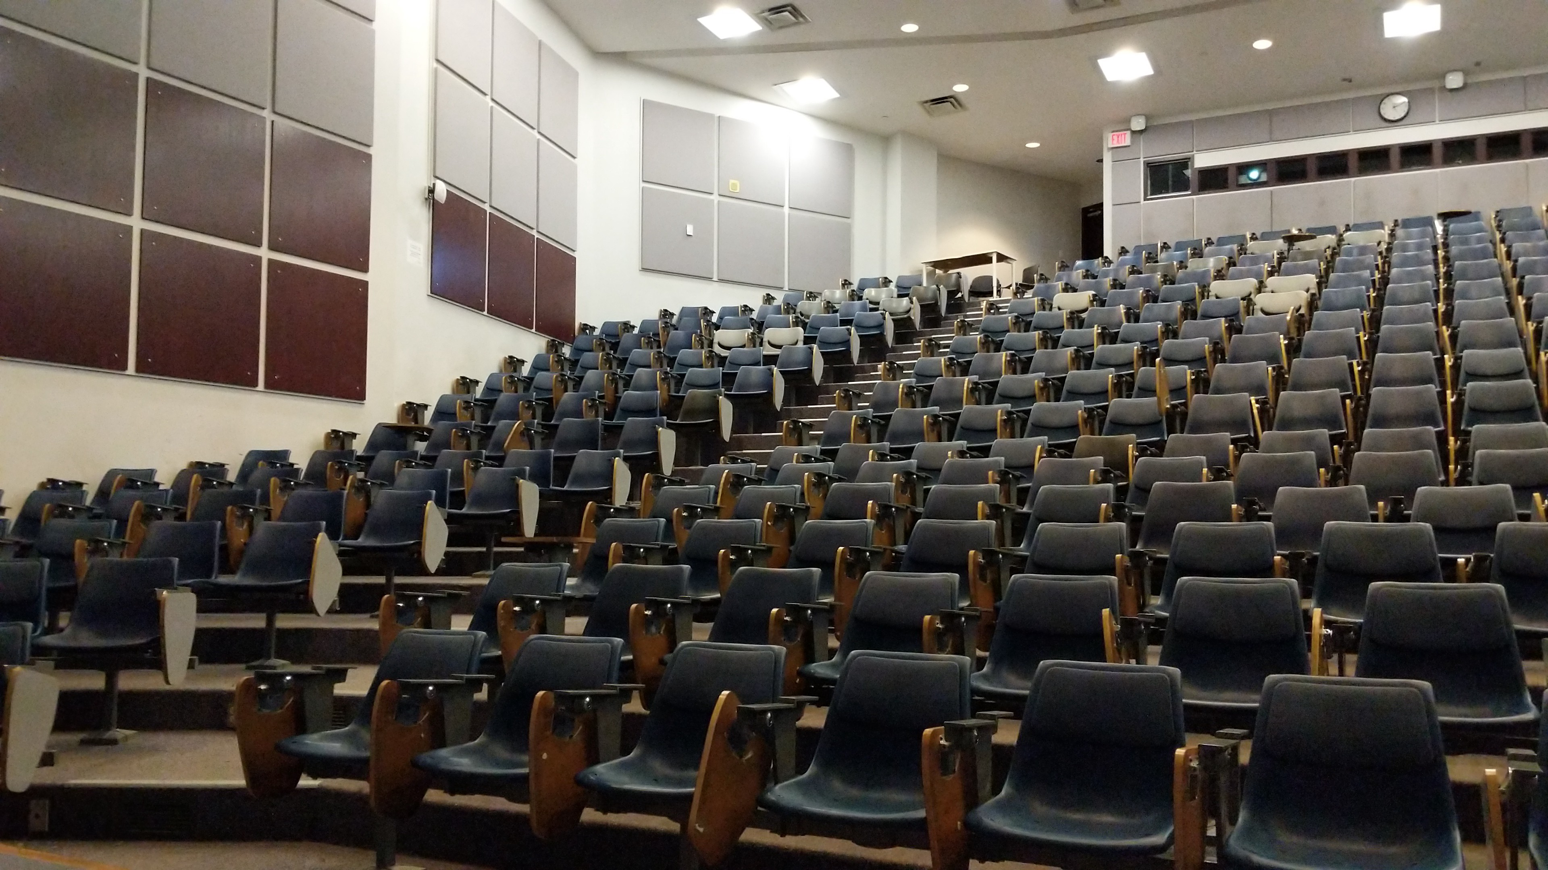

Slide 14
Notes:
Pose as a question – what do you think Stats is?
Is this cat doing stats?

Slide 18
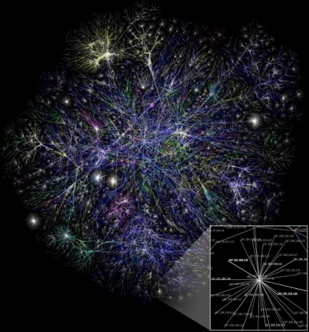

Slide 19
Visualizations and iNZight

Slide 20
"The best thing about being a statistician is you get to play in everyone's back yard" - John Tukey
HM

Slide 21
Engaged and motivated learners
Embedded tasks and activities, not always related to course content
FUN STUFF!
Has an indirect effect of engaging students with the course content
Promotes a safe and inclusive learning environment
Shows I value their contributions and use them!

Slide 22
Intro TO stats S1 2020 – large scale modules (hybrid)
Suggestions for things to do to keep us uplifted and entertained!
Auckland Uni VLE: Canvas page
Answer to Frederick's and Jessabella's riddles!
Stuff I don't understand – create vid to address this

Slide 23
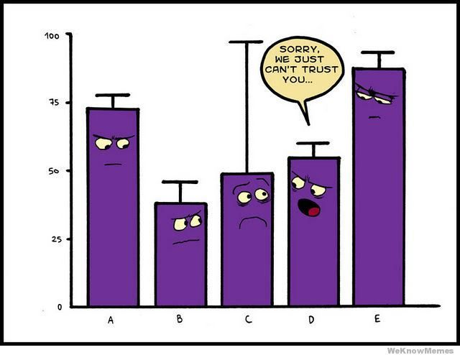
Looking at graphs/plots
• What are the main features I can see in the graph?
• What does this mean?
• What other details are useful for understanding the variable or answering any questions that I may have?
• What other questions do I have? Assumptions

Slide 24
Examples S1 2021(online)
Stream name – students rearranged sheet themselves!
Where are you from?
Taking a sample – some prefer doing it with paper
Pics of whanau
iNZight – DEMO (Where are you from data) – assumptions and bootstrapping options

Slide 25
Examples
Breast feeding
Kiwi fruit
iNZight used in secondary school’s
Students will play around in their own time (flying time)!

Slide 26
Hi Rhys,
I'm in STATS 108 and I was dreading it, to be honest. It’s now my favourite course this semester and I just wanted to thank you for that :)
Thanks! I know my friends agree with me - I look forward to coming to stats again in two weeks :)

Slide 27
https://telod.auckland.ac.nz/project/engaging-and-motivating-large-student-cohorts-during-remote-learning/.

Slide 28
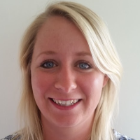
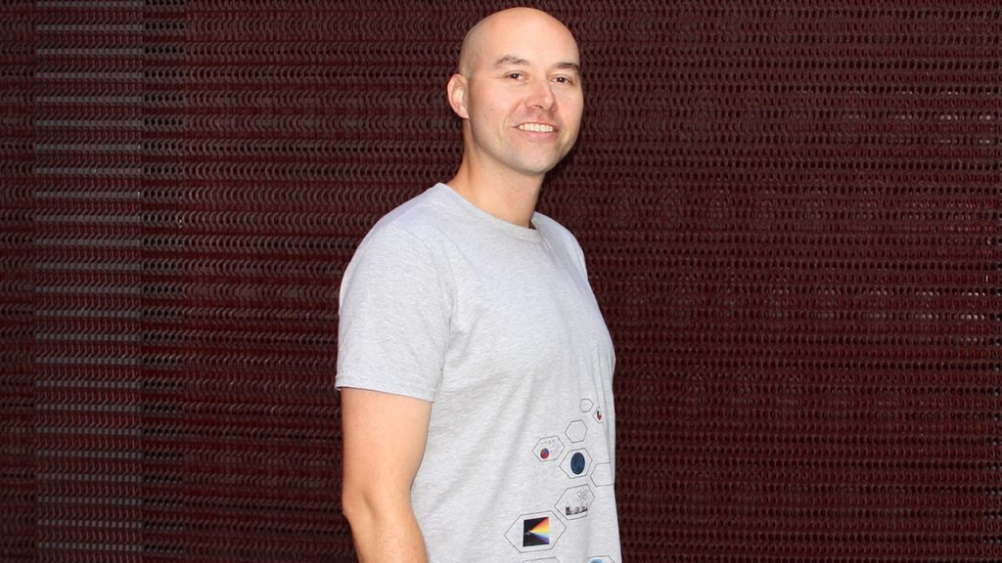
Emma Lehrke
Anna Fergusson
Rhys C Jones
The SEED(lings)

Slide 29
Go big or go home
bit.ly/statsinteract
Webpage outlining activities we have used, with links to journal articles for more details

Slide 30
Reflections
Remote learning activities (and delivery) take TIME!
Students LOVE and appreciate these activities
Student’s take greater ownership of their own learning
Greater satisfaction (for everyone!)
Students will see you differently

Slide 31
Challenging data (CD) sets and context

Slide 32
"The best thing about being a statistician is you get to play in everyone's back yard" - John Tukey
BUT! What are those back yards like?!
Do we want to be in them?!

Slide 33
The world is full of data, that can often include controversial or sensitive topics

Slide 34
What are CD?
Data can come in many different forms, and can be used in a variety of contexts
The same data can be used to explore many different contexts
Context and subject matter can give data a new lease of life, used to convey a message or set of ideas
Different contexts and subjects can mean different things to different people, both on an individual level and to different cross sections of society

Slide 35
Challenging data
Challenging data is defined as any data set that is assigned to a controversial or potentially sensitive topic, that can be emotionally triggering, upsetting or cause distress

Slide 36
Why deal/teach with CD?
Have a chat! (3 mins)
Post ideas here: bit.ly/3CEYKsQ.

Slide 37
Dealing with cd and context: example: Media article
What is the topic assigned with the “CHALLENGING DATA”? For example, is it to do with gender diversity? Or religion? Politics? Health? Ask yourself how does this topic make you feel? Does it mean something personal to you?
Why do you think it has been chosen? Try to think about what it can tell us about the world we live in. Is it interesting? What issue is it tackling or getting you to think about?

Slide 38
Dealing with cd and context: example: Media article
When looking at the data, think about why it was collected, and how it is being used in the report or story. What is the agenda of the author of the report or story you are looking at, and can this be used to explain their perspectives or views being portrayed?
Finally, think about the intended audience of the report or story

Slide 39
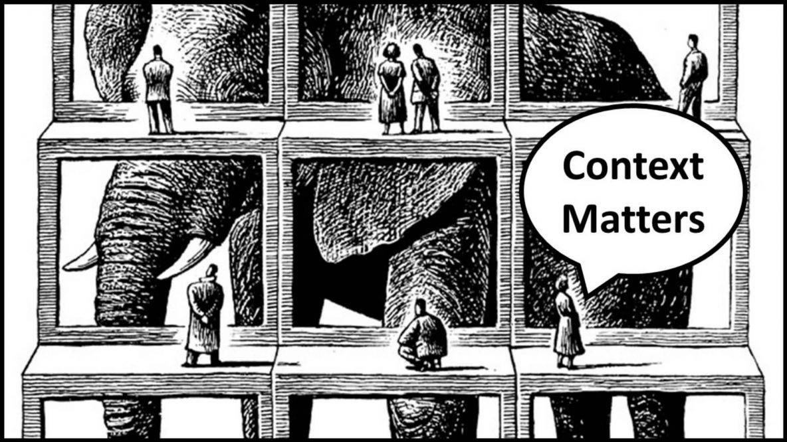
Is context king/queen?

Slide 41
"The best thing about being a statistician is you get to play in everyone's back yard" - John Tukey

Slide 42
How is information created?
What is it?
How is it created?
Do you trust it?
What are we willing to accept as legitimate knowledge?
What about the ways we collect data and then create new knowledge?

Slide 43
Ontology
Epistemology

Slide 48
What topics do you use when teaching statistics? How do you choose them?
.
Have a chat! (3 mins)
bit.ly/3EQ0HVm

Slide 49
Context in Statistics – have a chat!
Why spend time finding interesting context?
What’s interesting?
Advantages of taking these approaches
Concerns? Challenging Data

Slide 51
Context is King/queen?
Context is SUPER important in any sort of statistical investigation (Holmes 1997, Wild & Pfannkuch 1999, Porkess 2013).
Which contexts do you choose? Interdisciplinary contexts? (Roth 2014)
Interesting to students or to you? Or what you think students will find interesting (Swan, 2005)?
Confidence in using the context correctly, as well as the mathematical or statistical terms being used (Schleppegrell 2007)
Can students make the conceptual leaps/relational understanding (Skemp 1976)? Can they weave info from different disciplines together?
What does this do to the identity of statistics? (Pre-university can be seen as a mathematical subject)

Slide 52
Active learning
Exploratory learning
Engages and motivates
Can be familiar or unfamiliar
Direct application of more conceptual ideas
Critical thinking development

Slide 53
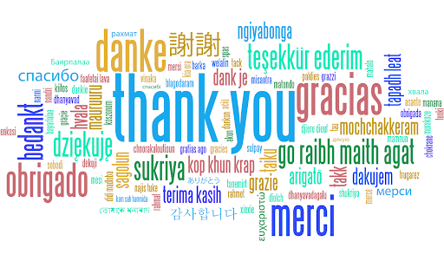
We all Say Thank You
Does anything surprise you about this video?

Slide 54
On a scale of 1-10 (1 being not often and 10 being a lot) – how would you rate yourself in terms of giving praise to others?
Who are you more likely to give praise to?
Why?
What makes a “Thank You” genuine?

Slide 56
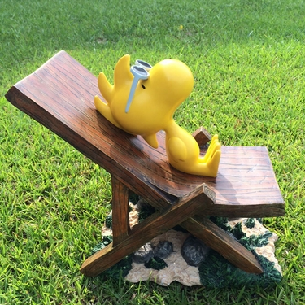

Slide 57
This morning UK
Should you Sunbathe Naked in Your Own Garden?
Who is the most convincing?

Slide 59
Can I call you love or darling?
Who was the most convincing?

Slide 60
Can I call you Love or Darling?
Design an experiment or observational study to investigate whether people like being called darling/love or not.
Think about your own Research Questions and what you’re measuring to help answer them.

Slide 61
Research Questions PPDAC cycle
Scientific research requires careful consideration of the available facts/information
Designing research questions is hard! (supervising Hons, masters and doctoral students)
Using existing data, views, own judgement to back up claims, look for gaps, know the area well (this can take time!)
Thinking critically - relational understanding (Skemp 1976)

Slide 62
Using the clip
Before the clip prompt students/get them to think about specific aspects of the video which could be linked to skills you’d like them to develop
In these example – you could ask:
How would you investigate this phenomenon further?
What RQ’s would you ask?
What is the parameter of interest? How do we define it?
What methods would you use?
Ethical considerations?

Slide 63
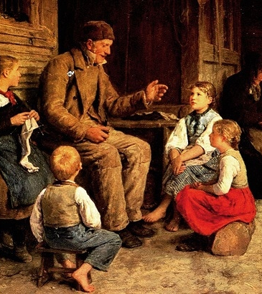
Telling stories with data (Statistical literacy)

Slide 64
Statistical Literacy: What is it?

Slide 65
the ability to understand and reason with statistics and data

Slide 67
Why tell data stories?
Telling a data story involves the incorporation of a narrative, which can include an account of a series of events and/or facts, given in an order that enables the reader to make connections between them
Data on its own can be just a collection of numbers, which requires an explanation as to what is happening with the data
Data stories also enable the author to draw the reader’s attention to a particular section of the data being presented, helping to convey a certain message or set of messages
Using data visualizations can help reveal patterns in the data, enabling the reader to make connections between any relevant conclusions or comparisons that are made

Slide 70
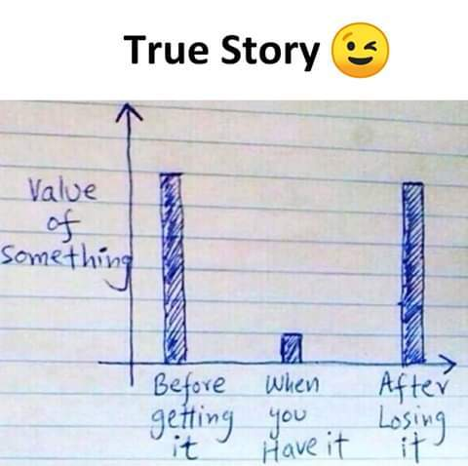

Slide 71
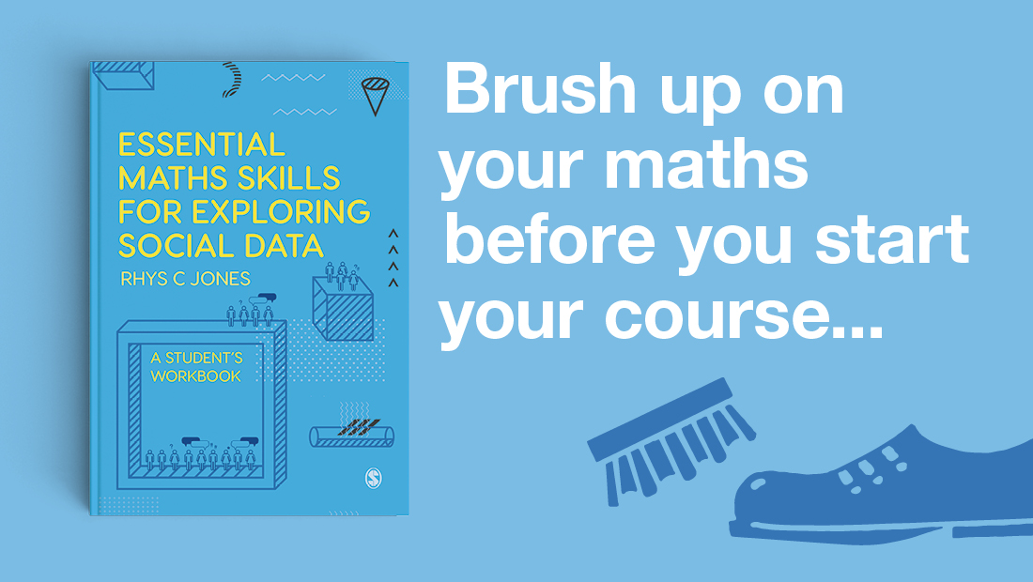

Slide 72
The building blocks: Essential Maths skills for exploring data
Builds on essential maths skills to help increase confidence to handle and describe data
Introduction to descriptive data, variables and levels of measurement
Provides skills needed to be statistically literate
Real world data sets

Slide 73
Using descriptive data
The art of using descriptive data, which can help to craft a beautifully coherent data story, is often overlooked by authors
Using descriptive data can include the use of frequencies of a variable of interest (e.g., number of tattoos)
It can also include a description of central values and how spread out the data are
The main advantage of using descriptive data is that most people understand this type of data and can interpret simple graphs and tables that display this information
Explained well, descriptive data can bring a story to life, producing a more compelling point of view or set of conclusions

Slide 74
Using descriptive data
Data come in many different forms, which means the data can be presented in a variety of ways
Being able to identify data and the types of variables being dealt with are important first steps in deciding what to do with the data

Slide 75
‘Wouldn’t it be great if we could teach students the things they need to do (i.e., the human side of “doing stats” which could be producing good RQ’s, interpreting data, figuring out the types of variables they are working with), versus things a computer can do (i.e., calculate a test statistic, or variance)’
Me ☺

Slide 76
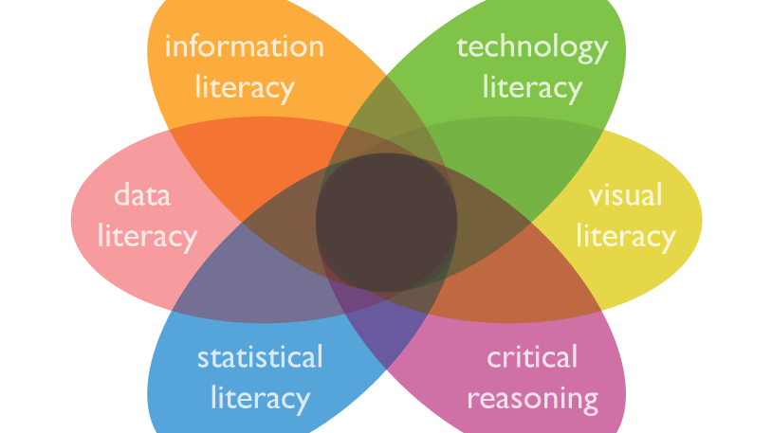
Statistical Literacy: A beginner's guide

Slide 80
References
Holmes, P. (1997). Assessing project-based work by external examiners. In: Gal, I. and Garfield, J. (ed.) The Assessment Challenge in Statistics Education, pp. 153–164Amsterdam: IOS Press.
Jones, R. C. (2019). Statistical investigation measuring intelligence and creativity. Teaching Statistics; 41 (1), 36-40. 10.1111/test.12169
Jones, R. C. (2020). Telling stories with descriptive data and graphs. In P. A. Atkinson, S. Delamont, R. A. Williams, A. Cernat, J. Sakshaug (Eds.) SAGE research methods foundations. London, U.K, Sage.
Jones, R. C. (2020). Using video clips to kick-start statistical thinking – research questions and study design. Statistics & Data Science Educator, 1-7. https://sdse.online/posts/SDSE20-002/.
Porkess, R. (2013). A world full of data. Statistics opportunities across A’ Level subjects. Accessed 07 January, 2019. http://www.rss.org.uk/Images/PDF/influencing-change/A-world-full-of-data.pdf.
Renelle, A., Budgett, S.C., & Jones, R.J.C. (2019). Recognition of random processes from simulated auditory experiences. Paper presented at Kuala Lumpur, Malaysia, 12 Aug 2019 - 16 Aug 2019. Decision Making Based on Data. Proceedings of the Satellite conference of the International Association for Statistical Education (IASE).
Renelle, A., Budgett, S., & Jones, R. (2020). New Zealand teachers' generation problem misconceptions. Teaching Statistics. doi:10.1111/test.12248
Renelle, A., Budgett, S.C., & Jones, R.J.C. (2020). New Zealand Teachers’ Perceptions When Hearing Waiting-Time Distributions. In: P Arnold (Ed.), New Skills in the Changing World of Statistics Education Proceedings of the Roundtable conference of the International Association for Statistical Education (IASE), July 2020, Online. Voorborg, The Netherlands. ©2020 ISI/IASE iase-web.org/ConferenceProceedings.php.

Slide 81
Roth, MW. (2014). Interdisciplinary Approaches in Mathematics Education. Encyclopaedia of Mathematics Education; 317-320.
Schleppegrell, M.J. (2007). The Linguistic Challenges of Mathematics Teaching and Learning: A Research Review. Reading and Writing Quarterly: Overcoming Learning Difficulties; 23(2): 139-159.
Skemp, R.R. (1976). Relational understanding and instrumental understanding. Mathematics Teaching; 77, 20-26.
Swan, M. (2005). Improving learning in mathematics: Challenges and strategies. Sheffield: Teaching and Learning division, Department for Education and Skills Standards Unit.
Wild, C.J. and Pfannkuch, M. (1999). Statistical thinking in empirical enquiry. International Statistical Review; 67(3), 223–248.

