Slide 1
Population ageing in the UK and globally
Ageing Analysis Team
Centre for Ageing and Demography
@RichPereira_ONS

Slide 2
Population ageing

Slide 3
Who we are and where we sit
The Office for National Statistics (ONS) has five Centres which focus on areas of significant policy interest to produce new analysis and insights which are often cross-cutting and in partnership with other government departments, academics and external bodies.
Centre for Ageing and Demography
    Population estimates and projections
    Population ageing
    Fertility and mortality
    Families and households

Slide 4
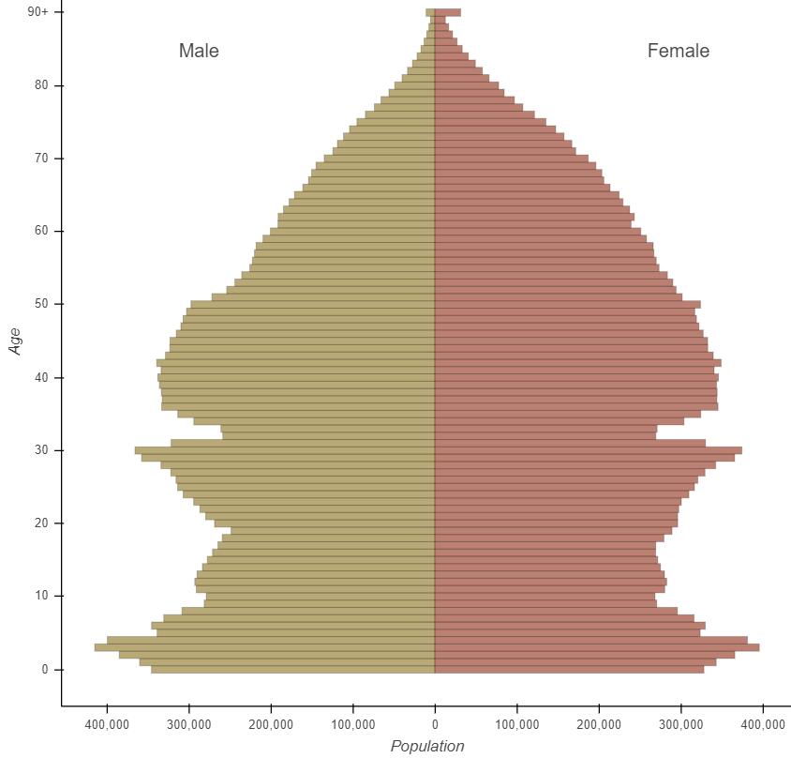
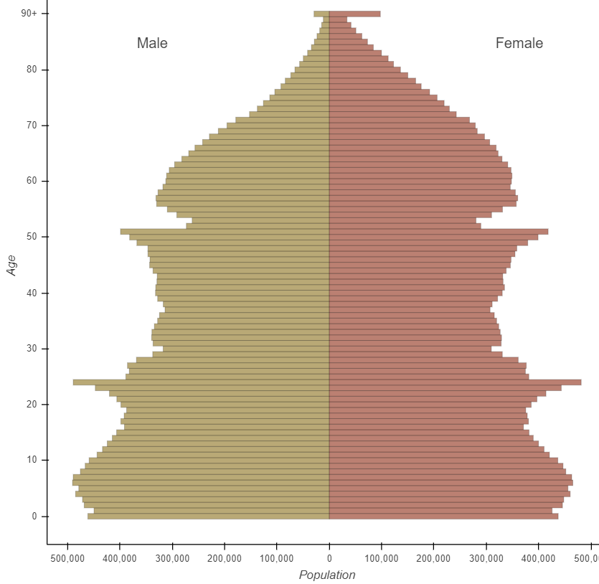
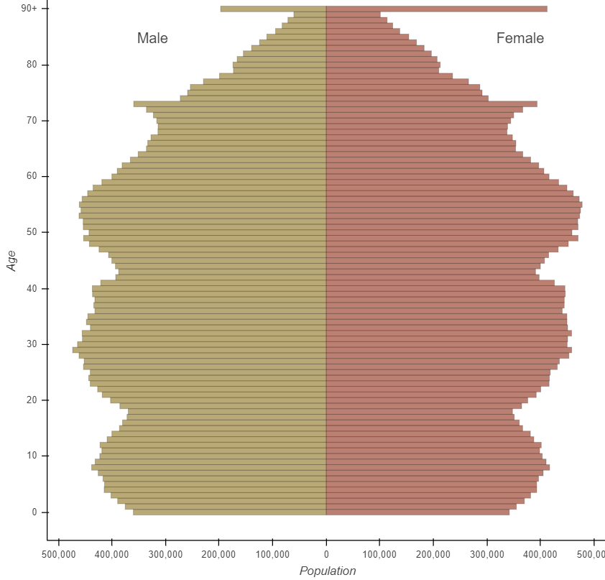
Population by single year of age and sex, UK
The UK population is ageing
Mid-1951
Mid-1971
Mid-2020
Source: Office for National Statistics, National Records of Scotland, Northern Ireland Statistics and Research Agency

Slide 5
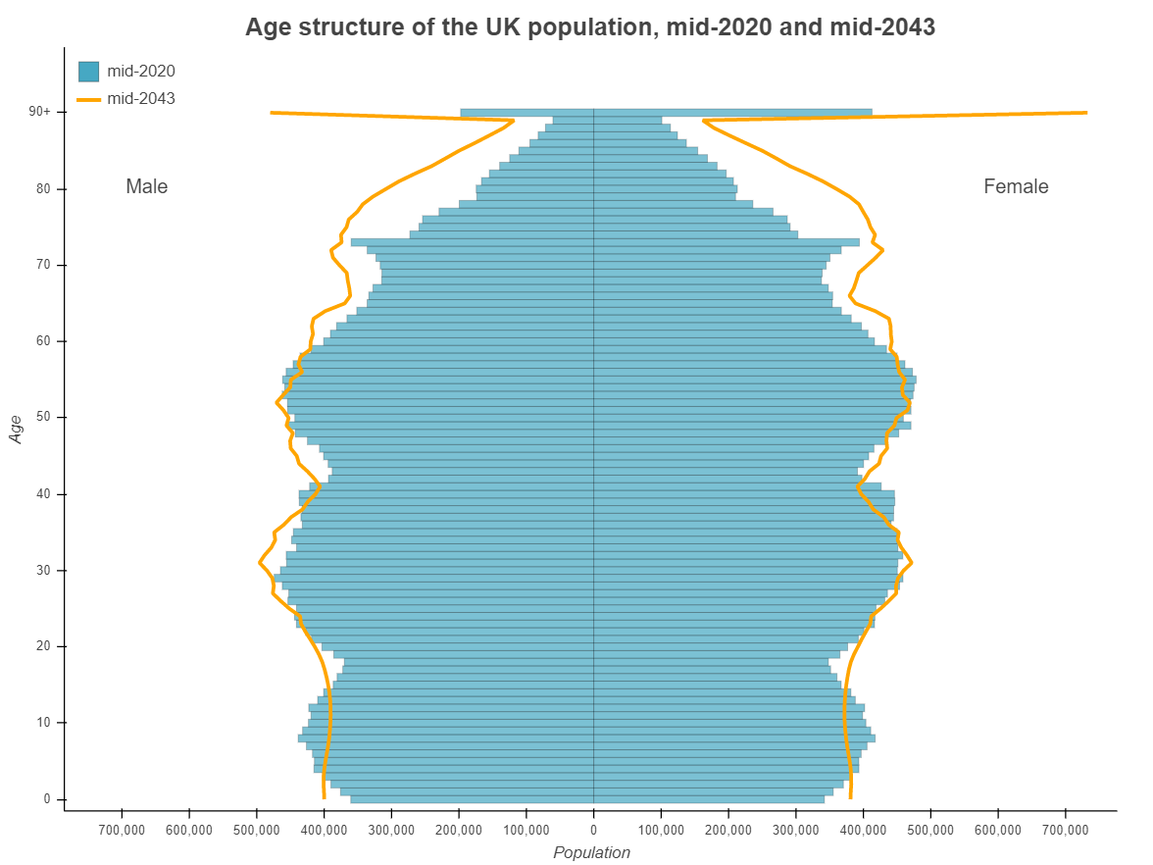
Population by single year of age and sex, mid-2020 and projected mid-2043
The population is projected to continue to age
Source: Office for National Statistics, National Records of Scotland, Northern Ireland Statistics and Research Agency

Slide 6
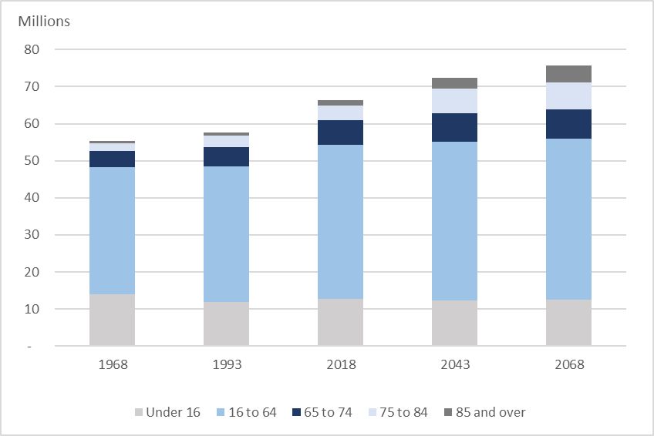
The older population is growing faster than younger age groups
Population by age group, selected years UK
In mid 2020, there were 1.7 million people aged 85 and over; by mid 2043, this is projected to increase to 3.0 million
Source: Office for National Statistics, Population estimates & National population projections

Slide 7
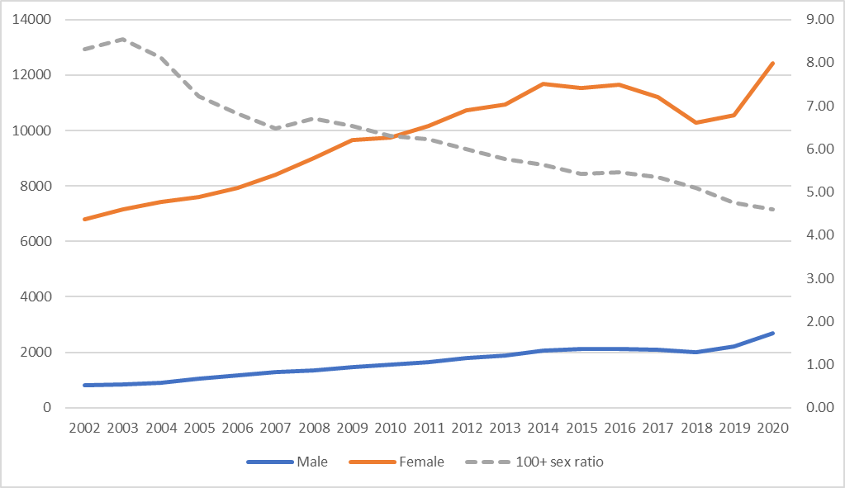
The population aged 100 years and over has increased rapidly
Number of people aged 100 years and over, UK, 2002 to 2020
Source: Office for National Statistics, National Records of Scotland, Northern Ireland Statistics and Research Agency

Slide 8
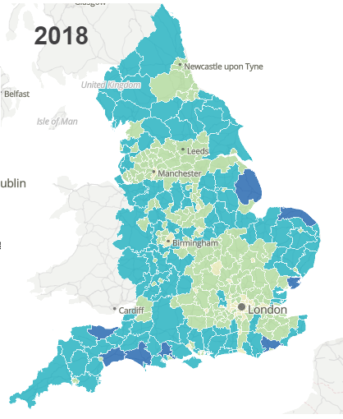
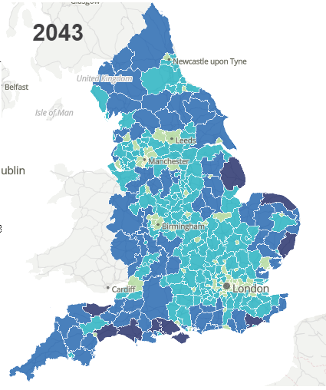

There is variation in the ageing population across local areas.
A heat map of proportion of people aged 65 years and over by local authority, 2018 and 2043
Source: Office for National Statistics, Subnational population projections for England: 2018-based

Slide 9
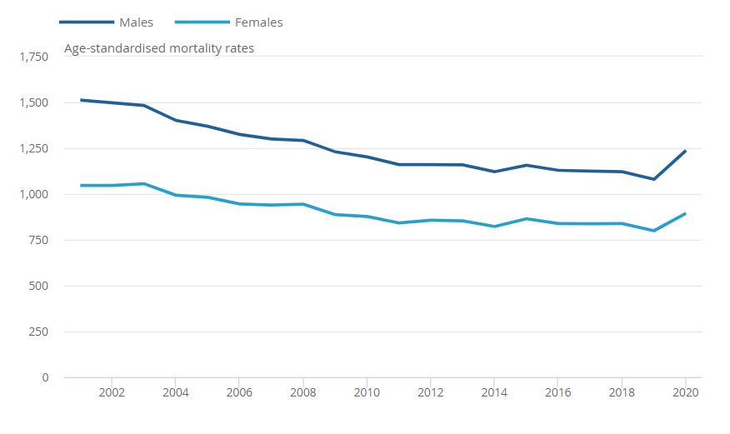
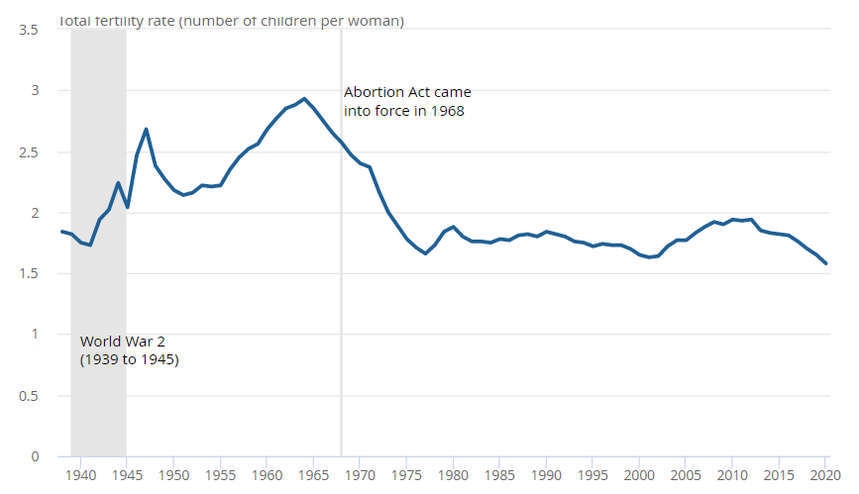
Declining mortality and fertility rates have caused population ageing.
Age-standardised mortality rates, England and Wales, 1994 to 2020
Total Fertility Rate, England and Wales, 1938 to 2020
Total fertility rate (number of children per woman)
Source: Office for National Statistics, Deaths registered in England and Wales: 2020
Source: Office for National Statistics, Births in England and Wales: 2020

Slide 10
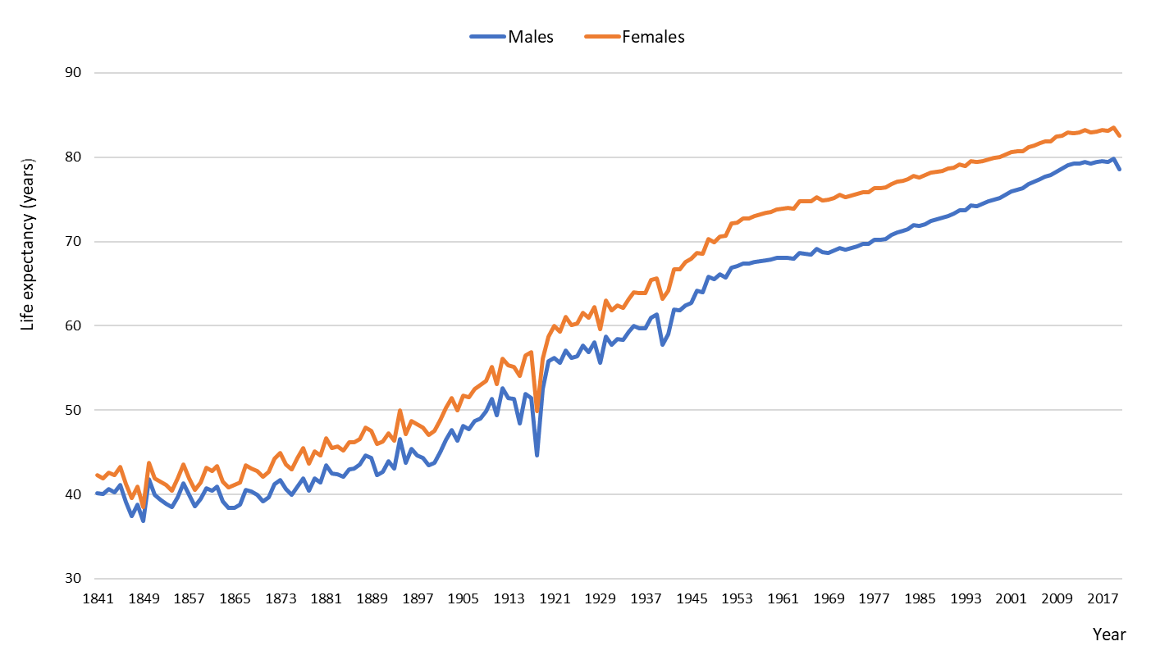
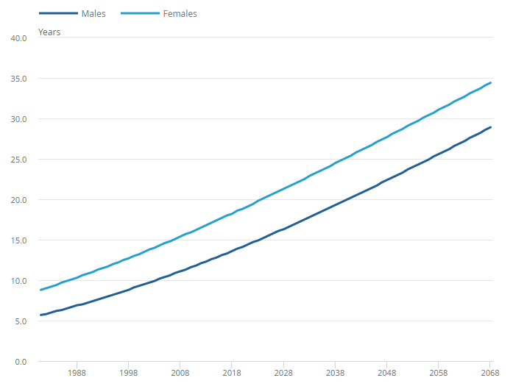
Life expectancy has had long-term improvements
Period life expectancy at birth, England and Wales, 1841 to 2020
Percentage of new-borns expected to survive to age 100 years by year of birth, males and females, UK, 1981 to 2068
%
Source: Office for National Statistics, Past and projected period and cohort life tables, 2018-based, UK: 1981 to 2068
Source: Office for National Statistics, National Life Tables

Slide 11
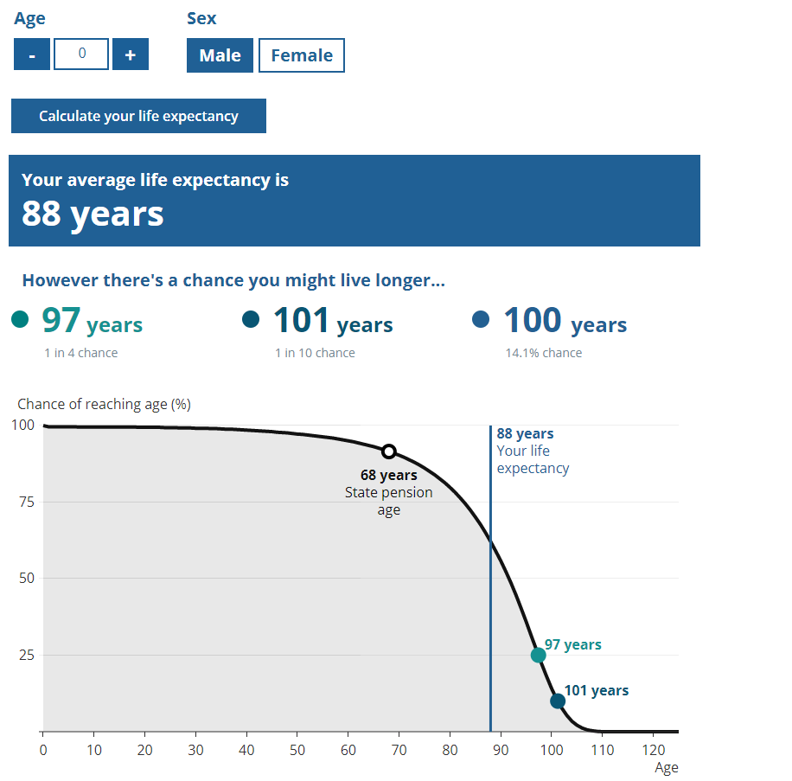
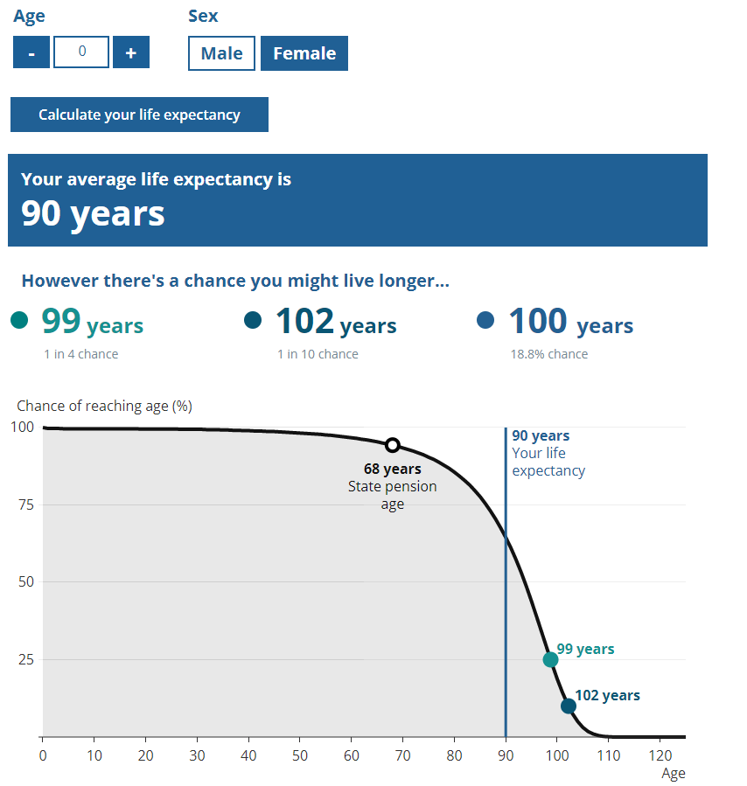
Life expectancy calculator
Source: Office for National Statistics, National Life Tables
Life expectancy calculator

Slide 12
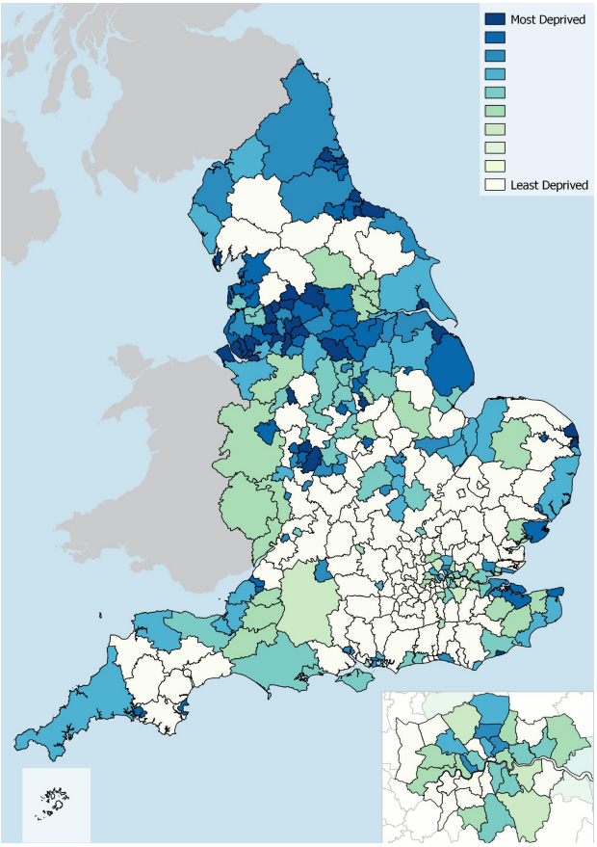
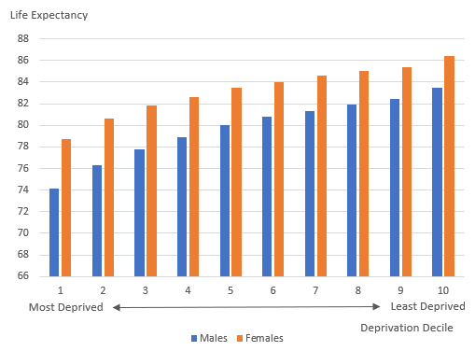
Variation of life Expectancy by Index of Multiple Deprivation
Life expectancy at birth for Males and Females, England, 2017 to 2019
Distribution of the Index of Multiple Deprivation (IMD) 2019 by local authority
based on the proportion of their neighbourhoods in the most deprived decile nationally
Source: Office for National Statistics, Health state life expectancies by national deprivation deciles, England: 2017 to 2019
Source: Ministry of Housing, Communities & Local Government, The English Indices of Deprivation 2019 - Statistical Release

Slide 13
Ageing is a cross-cutting issue with implications for multiple policy areas
Economy and finance
- Older workers - Pensions
- Labour force structure - Tax
- Job availability - Financial Decisions
Services and needs
- Health requirements - Housing needs
- Social Care - End of life
- Transport - Accessible cities
Society and the individual
- Digital inclusion - Crime
- Wellbeing - Communities
- Intergenerational issues

Slide 14
UK focus – recent work
How do the post-World War baby boom generations compare? 2018
Living Longer and old age dependency- what does the future hold?, 2019
Living Longer and why it matters, 2018
Living longer: Caring in later working life, 2019
Living Longer: is age 70 the new age 65?, 2019
Living Longer: implications of housing tenure in later life, 2020
Living Longer: Implications of childlessness among tomorrow's older population, 2020
Living Longer: changes in housing tenure over time, 2020
Subnational ageing tool
Living Longer: Older workers during the coronavirus (COVID-19) pandemic, 2021
Living Longer: Impact of working from home on older workers, 2021
Estimates of the very old (Sept every year)

Slide 15
Q&A
Contact info: pop.info@ons.gov.uk

Slide 16

UN Titchfield City Group on Ageing and Age Disaggregated Statistics
International collaboration to improve measurements of ageing and older people
22 November 2021

Slide 17
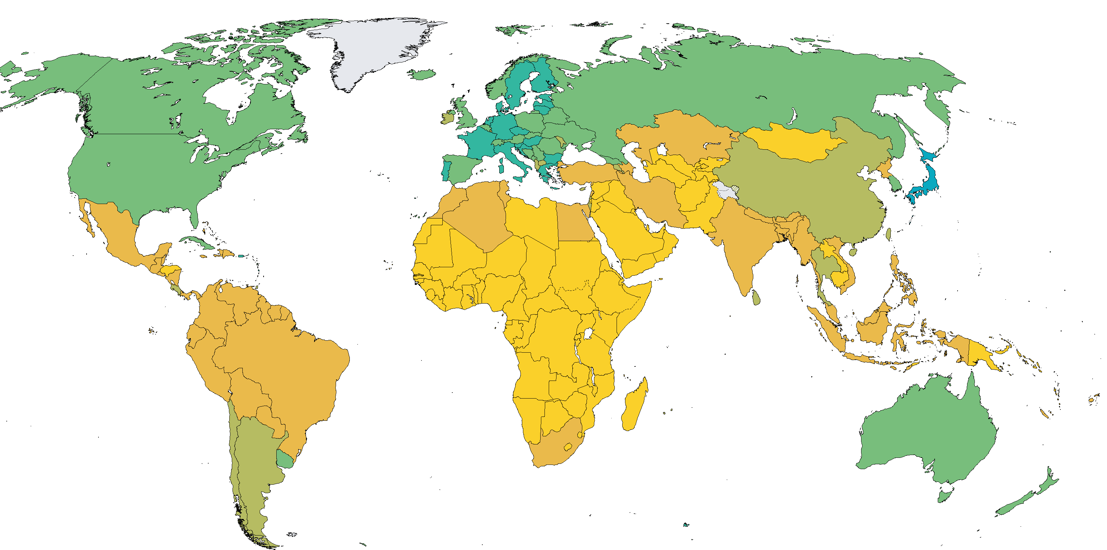
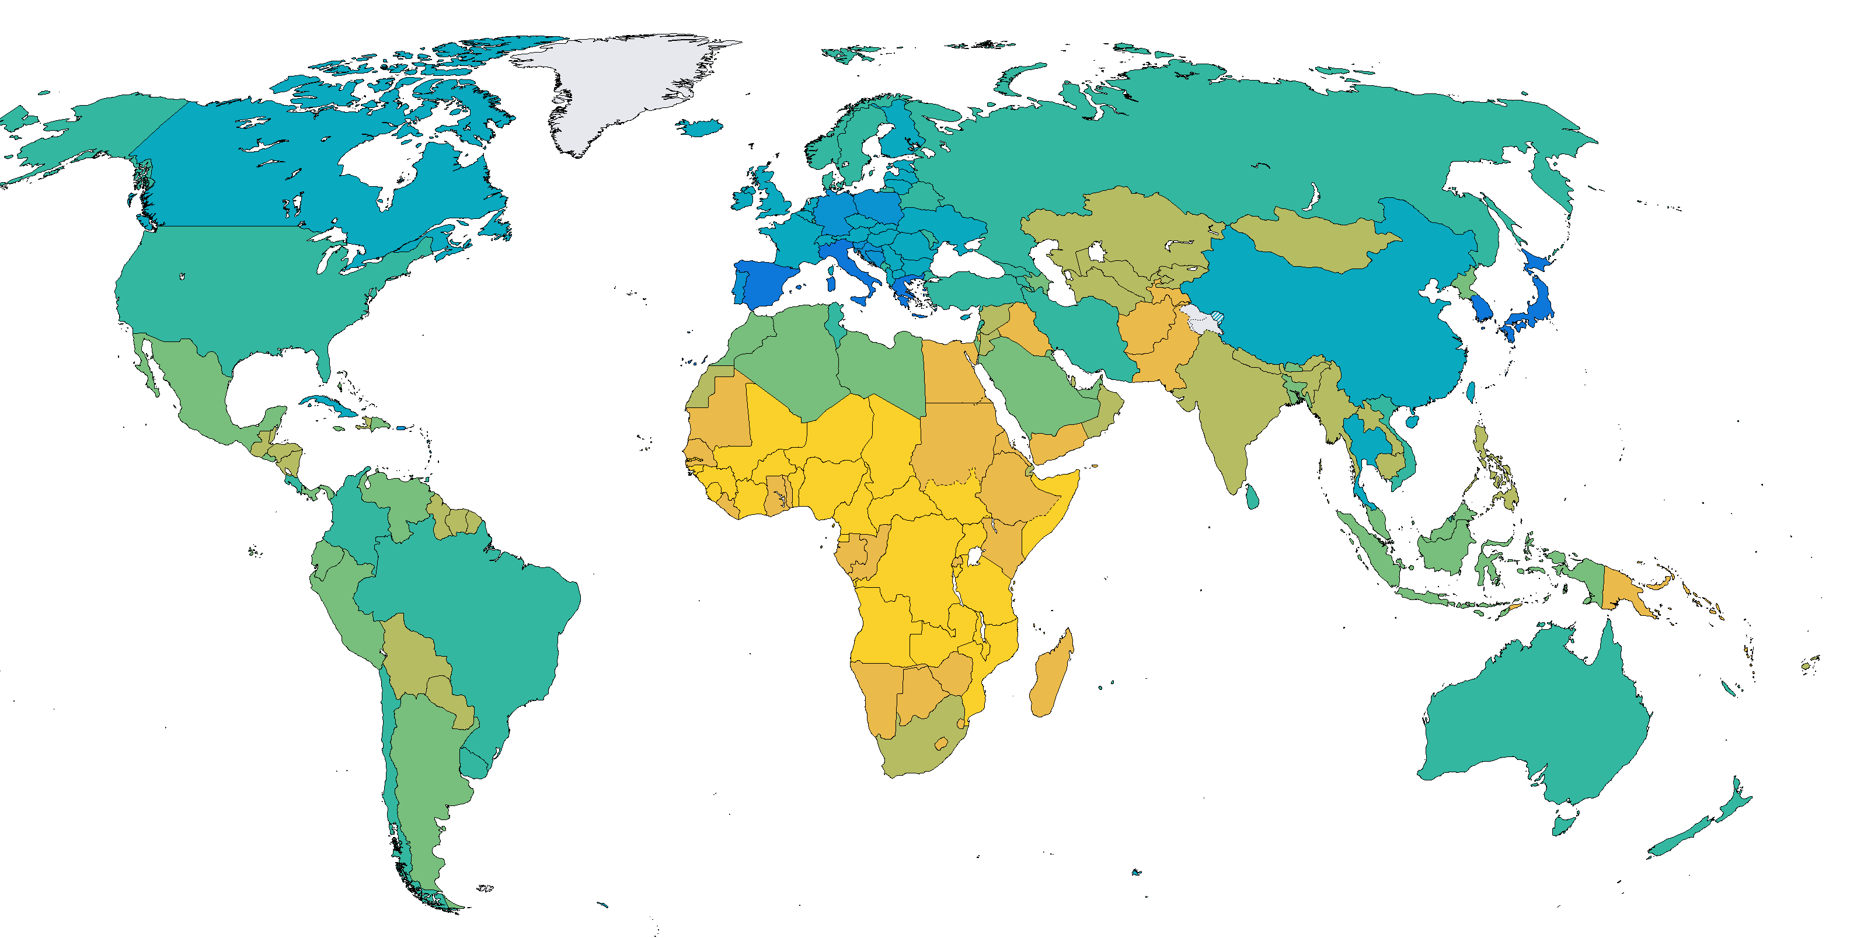
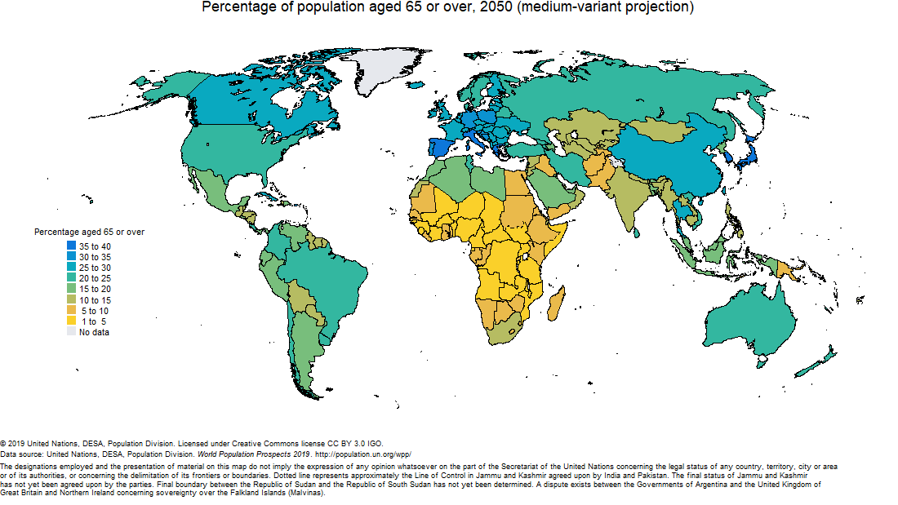
Population ageing is happening globally
Percentage of the population aged 65 and over, 2020
Percentage of the population aged 65 and over, 2050
Source: UN World Population Prospects, 2019

Slide 18
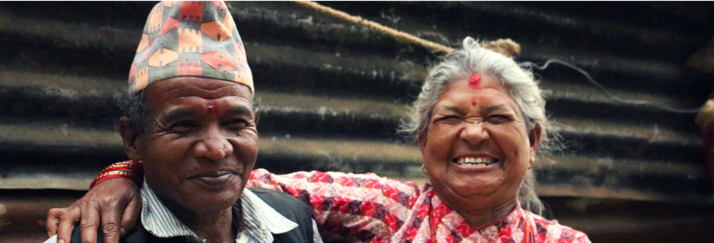
Data issues in measurement of older people’s lives

Slide 19



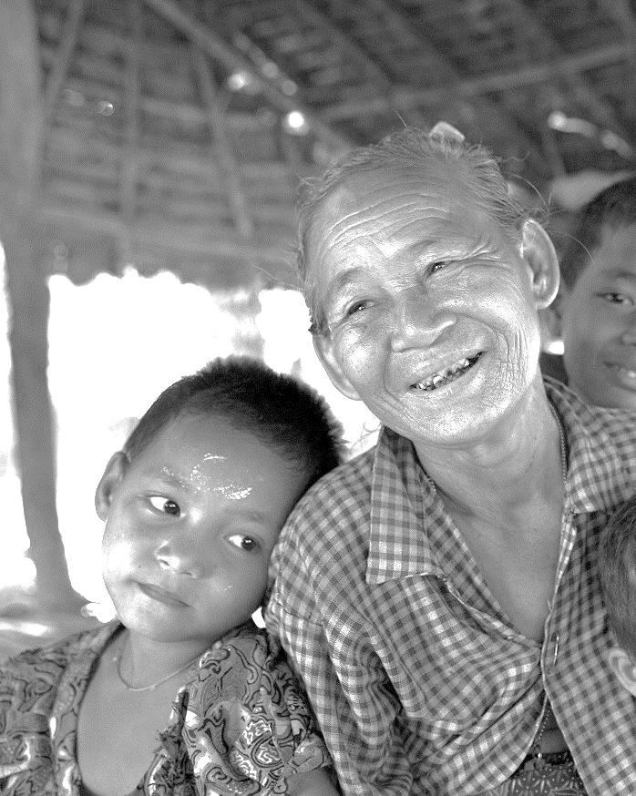




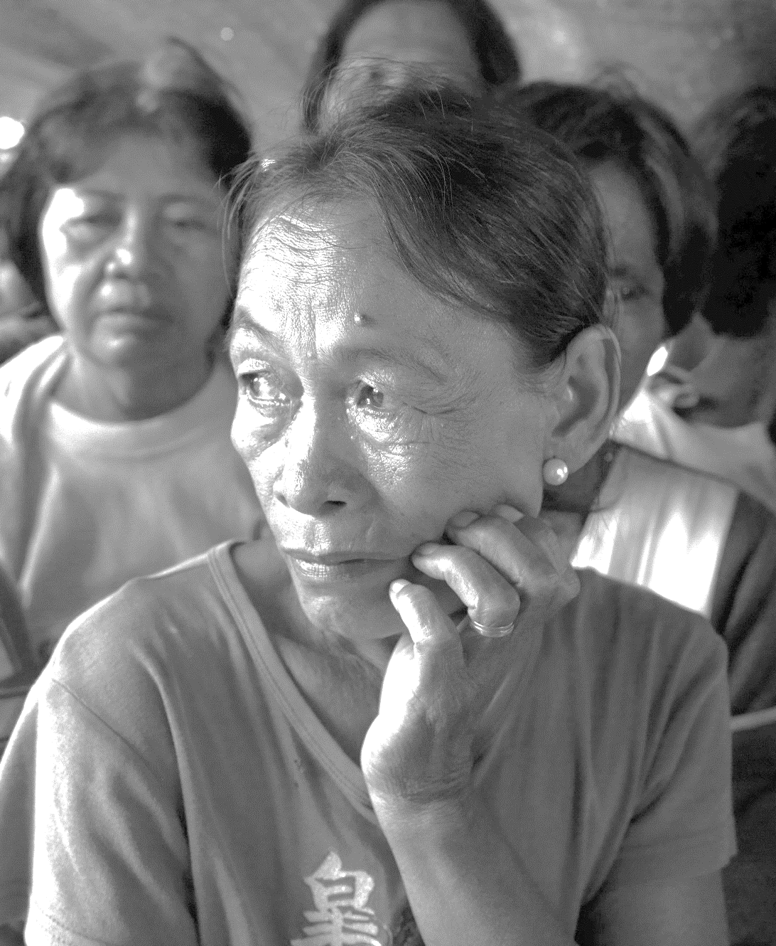
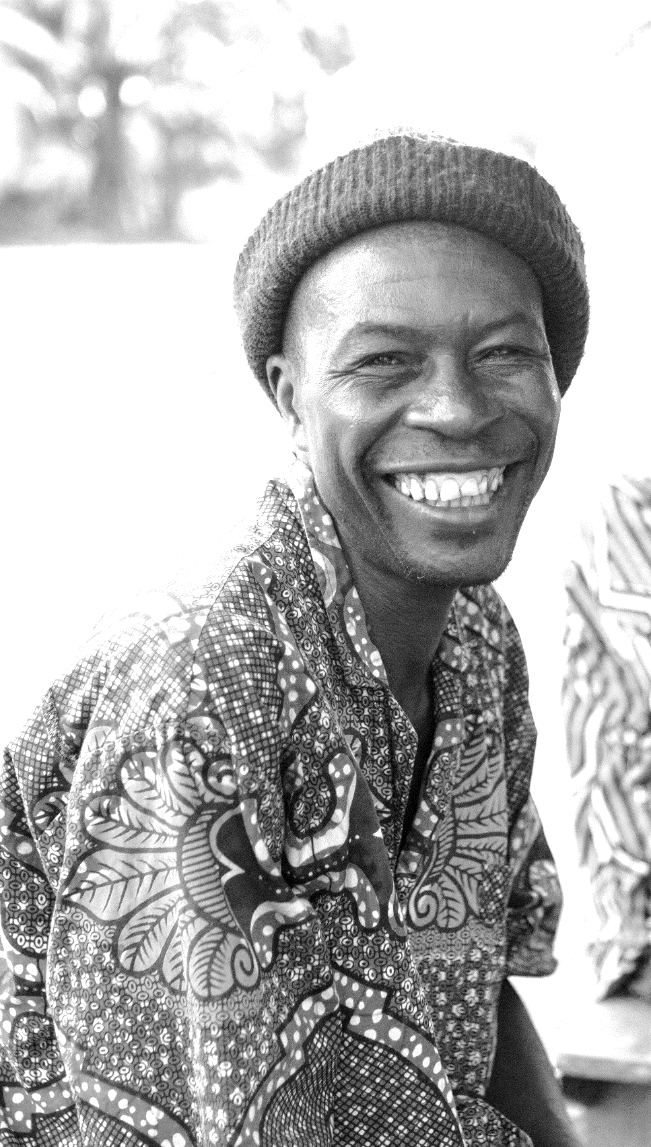


1
5
8
The foundations are laid
2
UK Office for National Statistics comes on board at the World Data Forum
The Winchester Seminar brings everyone together
Pre 2015
The Sustainable Development Goals create new opportunities
22 – 24 August 2017
Demand for evidence based data and statistics on older persons has been called for since the adoption of the Madrid International Plan of Action on Ageing in 2002. Various initiatives, including the UNECE Task Force on Ageing-Related Statistics, continued to document and call attention to these gaps over the subsequent years.
15 – 18 January 2017
The informal core group held a first meeting as the ‘Proposed Titchfield Group’ in the UK in August 2017 to discuss the scope of the group’s work and decide on the important elements of the report and proposal that the UK would present to the Statistical Commission in March 2018.
At the first World Data Forum in Cape Town, the core group – then ONS, DFID, HelpAge, UN Women and UNDP – convened a meeting with various country statistical offices and representatives of other agencies and held bilateral discussions to bring statistical offices on board. Following the World Data Forum the United Kingdom Office for National Statistics (ONS) offered to lead the proposed City Group and several statistical offices joined.
2015
© Hereward Holland/Age International
The adoption of the SDGs in 2015 and the pledge to Leave No One Behind stimulated a global conversation about how progress could be measured. Space opened up to talk about the significant gaps in ageing statistics and age-disaggregated data and the need for concrete solutions.
9
The City Group is agreed at the 49th Session of the United Nations Statistical Commission
7
6 – 9 March 2018
© Jonas Wresch/HelpAge International
Preparations start for UN Statistical Commission 2018
ONS presented the report on ageing related statistics and age-disaggregated data to the Commission, including a proposal to establish the Titchfield Group. The proposal was accepted by the Commission with strong support and no opposition.
4
Summer 2017
Throughout 2017 the core group grew and began meeting regularly to prepare for the 49th session of the United Nations Statistical Commission and planning a seminar in Winchester.
Widening the circle
©Peter Caton/HelpAge International 2013
2016
Throughout remainder of 2016, DFID and HelpAge explored the City Group option and worked to build support for the idea of a UN city group with a wider group of agencies. Several partners came on board, including UNDP, UNICEF, UN Women and WHO.
6
DFID brings people together around data disaggregation and ageing
A City group first raised at the 48th Session of United Nations Statistical Commission
10
3
The first formal meeting takes place in Chichester
February – August 2016
7 – 10 March 2017
Recognising the significant issues, DFID launched an Open Policy Making Initiative on age disaggregation across the life course. This culminated in a conference with CSO partners, representatives of UN agencies and USAID where the idea of a city group was first proposed. DFID & CSO participants continued to work together to consider how to drive forward this important agenda – which lead to DFID’s development of its Data Disaggregation Action Plan with a commitment to work towards a city group on age and ageing data.
At the Statistical Commission in 2017, the City Group was first proposed by ONS and the Commission agreed that it could be added to the agenda of the 2018 Statistical Commission.
June 2018
© Simon Rawles / Age International
The first formal meeting takes place to discuss and agree the work plan and ways of working.

Slide 20

Sustainable Development Goals (with underlying pledge to ‘leave no one behind’)
Timely and reliable data across all ages is required for the implementation of the 2030 Agenda for Sustainable Development

Slide 21
TCGA -
“The overall objective of the proposed Titchfield Group is to develop standardized tools and methods for producing both data disaggregated by age and ageing-related data, and to encourage countries to do so, by playing a leading role in the development and communication of new standards and methodologies”
(Report to UNSC 49th session)

Slide 22

TCGA representation

Slide 23

Introducing the work plan
Conceptual and analytical framework (WS3)
Analysis of available evidence (WS1)
Standardisation and harmonisation (WS5)
Alignment to SDG goals and other work (WS4)
Horizon scanning (WS2)
Platform for sharing data and information (WS6)

Slide 24
Timelines for priority workstrands: Short-term
By March 2022
  Think pieces on key constructs (WS3)
  TCGA/WHO report ‘SDG Indicators: Making older persons visible (WS3)
  Report on availability of evidence on SDG indicators relevant to older people (WS1)
  Assessment of current levels of harmonisation/standardisation (WS5).
  By March 2023
  Analytical framework finalised (WS3)
  Stocktake of data sources for additional non-SDG indicators related to conceptual and analytical framework (WS1)
  Identify and draw on lessons from organisations who have already harmonised measures and developed guidelines (WS5)

Slide 25
Longer-term outputs
Final report on gaps in evidence and relation to government policies
Library of tools for countries for use in data collection and analysis and guidance to facilitate standardisation and harmonisation and enable global comparisons
Launch of digital platform for sharing best practice internationally
Report on suitability of data sources and outputs for the future and recommendations to address shortfalls

Slide 26
Getting involved
We want to hear about….
  Your data sources on older people
  New ideas for generating data on older people
  Methodological or digital opportunities for filling gaps
  Opportunities to lead remaining workstrands
  Email: TCGA@ons.gov.uk

Slide 27
Alternative measures of population ageing

Slide 28
Alternative measures
Prospective ageing - age at which someone has 15 years remaining life expectancy
Active dependency ratio - ratio of the economically inactive population compared with the economically active population

Slide 29
Background

Slide 30
Population ageing and its measures
Older people defined as being aged 65 and over
Measures:
  Numbers and proportion of older people in the population
  Median age
  Old Age Dependency Ratio (OADR)
According to traditional measures of ageing, the population is ageing rapidly
Implications for multiple areas, particularly increased demand for health, adult social care services and public state pensions (public spending).

Slide 31
Percentage of people aged 65 years and over, 75 years and over, and 85 years and over, 1950 to 2050, GB.
Population Ageing
The population of Great Britain has aged since the middle of the 20th century and is projected to continue to age.
Source: Office for National Statistics

Slide 32
Problems with traditional methods of measuring population ageing
The proportion of people aged 65+ is not comparable over time as people are living longer, healthier lives than in the past
Is a 65 year old man as ‘old’ as a 65 year old woman? Women live longer!
People do not become ‘old’ on their 65th birthday

Slide 33
Prospective measures of ageing
Sergei Scherbov and Warren Sanderson proposed an alternative definition of old age: the age at which someone has 15 years of Remaining Life Expectancy (RLE 15)
As life expectancy increases over time, age at which RLE is 15 increases
Age at which there is 15 years of remaining life expectancy, GB
 | 1911 | 2017 | 2066
Men | 57 | 70 | 75
Women | 60 | 72 | 77
Source: Office for National Statistics

Slide 34
Number of people aged 65 years and over, and with RLE15, 1981 to 2017, GB.
Prospective measures of ageing
In 1981, the number and proportion of people aged 65 years and over matched those with RLE15 years or less.
While the number of those aged 65 years and over has increased, the number with RLE 15 has decreased.
Source: Office for National Statistics

Slide 35
According to prospective measures of ageing, the population is ageing far more slowly
Source: Office for National Statistics

Slide 36
Is age 70 the new age 65?
In terms of prospective ages (RLE)…
A man aged 70 years in 2017 is equivalent to a man aged 65 years in 1997.
A woman aged 70 years in 2017 is equivalent to a woman aged 65 years in 1981
Age at which remaining life expectancy is 15 for men, and 17 for women, selected years, Great Britain
 | Men (age at RLE 15) | Women (age at RLE 17)
1911 | 57.8 | 57.4
1951 | 59 | 60.6
1981 | 62 | 65
1997 | 65 | 66.8
2017 | 70 | 70
2037 | 72.9 | 72.3
2057 | 75 | 74.1
Source: Office for National Statistics

Slide 37
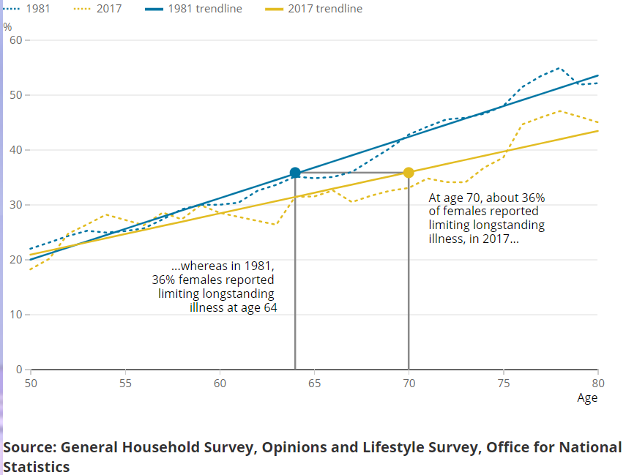
Is age 70 the new age 65 in terms of health? (Women)
Percentage of women reporting limiting longstanding illness, 1981 and 2017, GB
Levels of poor general health among women aged 70 in 2017 were around the same as for women aged 60 years in 1981.
Levels of limiting longstanding among women aged 70 in 2017 were around the same as for women aged 64 years in 1981.
Source: Office for National Statistics

Slide 38
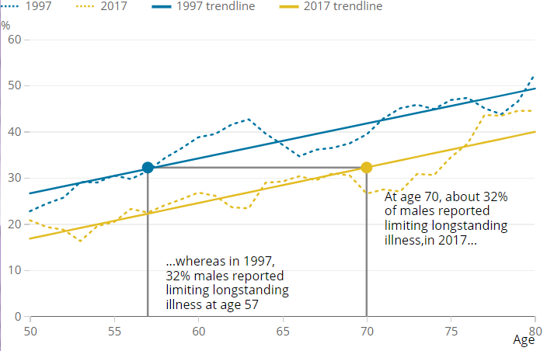
Is age 70 the new age 65 in terms of health? (Men)
Levels of poor general health among men aged 70 in 2017 were around the same as for men aged 65 years in 1997.
Levels of limiting longstanding among men aged 70 in 2017 were around the same as for men aged 57 years in 1997.
Percentage of men reporting limiting longstanding illness, 1997 and 2017, GB.
Source: Office for National Statistics

Slide 39
Implications and limitations
Implications:
  Prospective measures provide a different perspective on population ageing and may provide a better indication of the health of an ageing population than the proportion of people in the population of a set chronological age.
Limitations:
  health measures used are self-reported and may not have been interpreted consistently by people over time or at different ages
  Larger sample sizes and more consistent data over time would be needed to fully assess the questions we have posed and draw firm conclusions
  Data sources, method and analyses used, including limitations of the data are fully reported in Living longer: is age 70 the new age 65? Methodology guide

Slide 40
Old-Age Dependency Ratio
The Old Age Dependency Ratio (OADR) is a ratio of the population who are of current State Pension age (SPA) and higher relative to the size of the population aged 16 years and over and under SPA. Given that SPA shifts in line with legislation, the OADR is expressed as follows:

Slide 41
Historical and principal projection of OADR, UK, 1992 – 2069
Source: Office for National Statistics

Slide 42
Active Dependency Ratio
The Active Dependency Ratio (ADR) is a ratio of the adult population who are economically inactive relative to the size of the adult population who are economically active. The ADR is expressed as follows:

Slide 43
Active Dependency Ratio for the aged 16 years and over population, UK, 1993 to 2020
Source: Office for National Statistics

Slide 44
Percentage of population economically active by age group, UK, 1993 to 2020
Source: Office for National Statistics

Slide 45
In summary

Slide 46
Conclusions
Increases in economic activity at older ages may help to offset the impact of population ageing on the economy in the future
Increasing SPA has contributed to increased participation at older ages, but uncertainty around whether this trend will continue
Health is a key factor in future participation rates at older ages

Slide 47
Q&A
Contact info: pop.info@ons.gov.uk
Publications:
Living longer: is age 70 the new age 65? Methodology guide
Living longer and old-age dependency – what does the future hold?

Slide 48
Living Longer: The implications of childlessness among tomorrow's older population
Article link

Slide 49
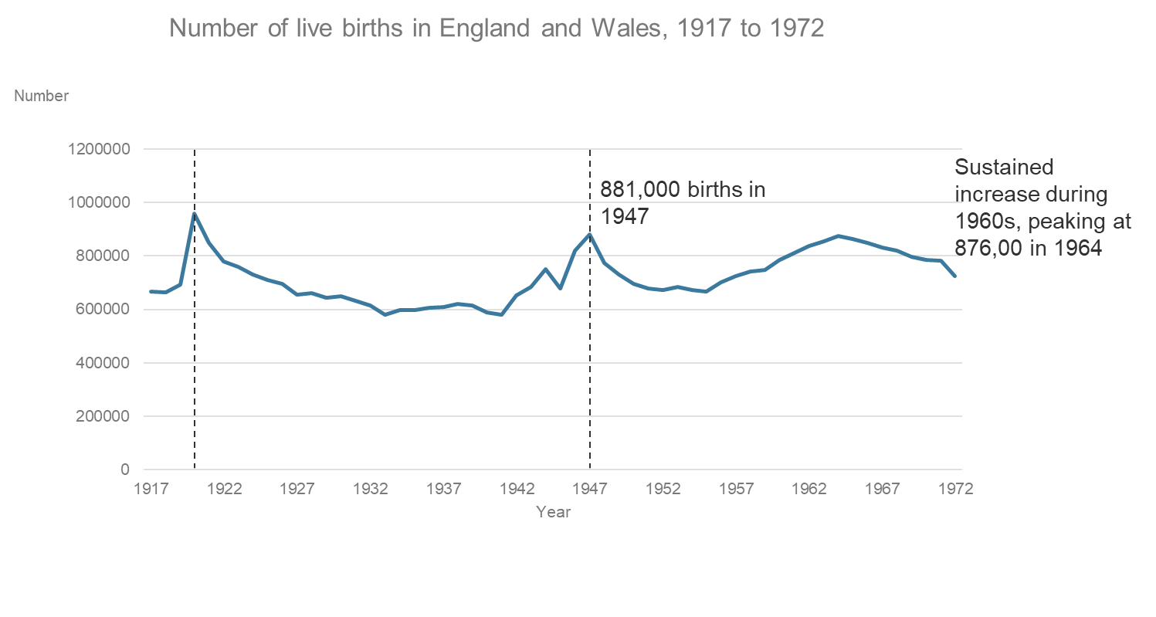
Numbers of births peaked post-WW1, post-WW2 and in the 1960s
958,000 births in 1920
Source: Office for National Statistics

Slide 50
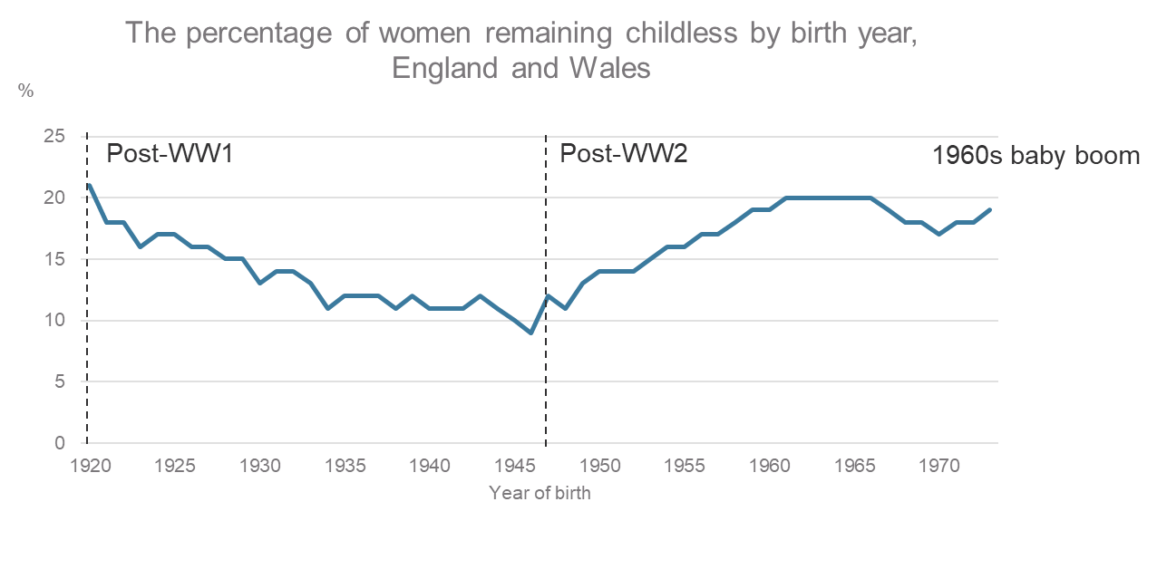
Differences in childlessness in the three large 20th century birth cohorts
Post-WW1 – 1 in 5
Post-WW2 – 1 in 10
1960s – 1 in 5
Source: Office for National Statistics
1960s cohort twice as likely to remain childless than the post-WW2 cohort

Slide 51
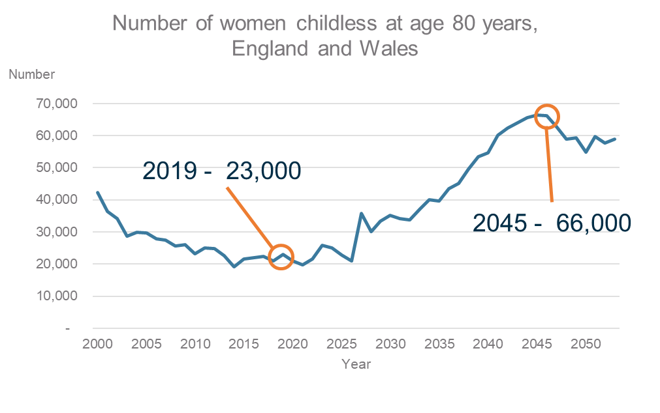
The number of women reaching old age without children
Projected increase in the number of women reaching old age without children as the large 1960s cohort turn 80
Source: Office for National Statistics

Slide 52
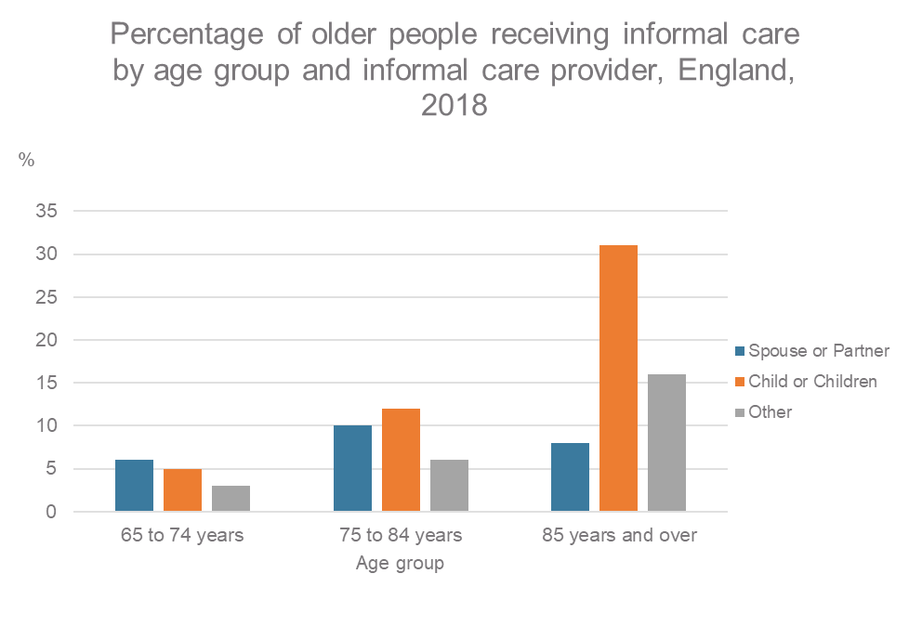
What are the informal care implications of high levels of childlessness?
Adult children are the most common providers of informal care at the oldest ages
31% of those aged 85 years and over receive informal care from a child/children
20% receive informal care solely from a child/children
Source: Health Survey for England, 2018

Slide 53
What are the informal care implications of high levels of childlessness?
Those aged 65 years and over without children are less likely to be in receipt of informal care and more likely to receive formal care
 | No children | Have children
Informal care | 16% | 21%
Formal care | 12% | 7%
All care | 23% | 24%
Source: English Longitudinal Study of Ageing, Wave 8, 2016 to 2017

Slide 54
Differences by ethnicity and socio-economic classification
18% of those aged 65 and over in Black, Asian and minority ethnic groups receive informal help from their adult children compared with 10% in White groups.
Of those receiving care from a child, 44% in a Black, Asian and minority ethnic group receive care from a child living in the same household compared with 18% of those from a White group.
Older people from routine and manual occupation groups are more likely to receive informal care than those previously in managerial and professional occupations

Slide 55
Contributing factors to provision of care
Proximity to their nearest child is similar: 48% of the post-WW2 and 42% of the1960s cohorts live within 15 minutes
However 10% of both cohorts live more than 2 hours from their nearest child
Over half of the post-WW2 cohort (58%) and just under half of the 1960s cohort (49%) meet up with their children at least once a week.

Slide 56
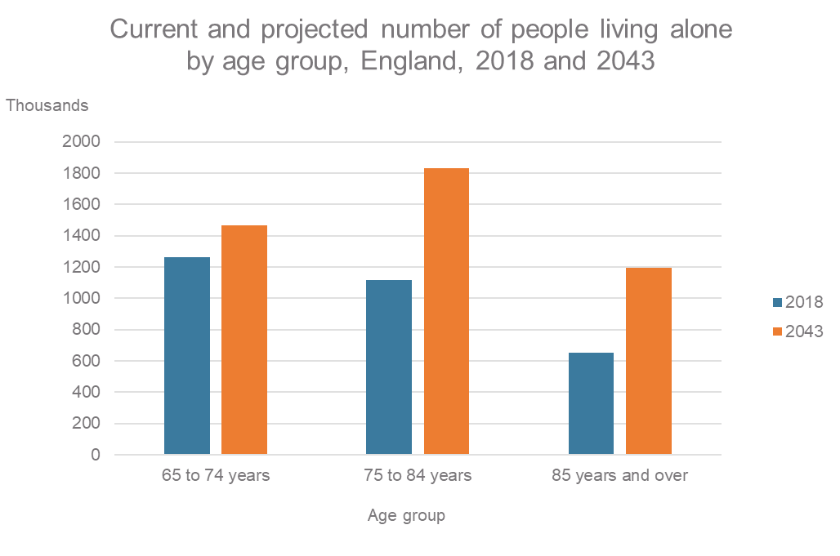
Are we meeting the care needs of the current older population?
There is currently unmet care needs: 41% of those ages 80 years and over have an unmet care need
Large numbers of older people in the future are projected to live alone
Source: Office for National Statistics

Slide 57
Summary
There will be much larger numbers of older people in the future who do not have children
30% of those aged 65 and over without children considered themselves to have a high likelihood of needing formal care in the future, compared with 22% of those with children
Higher levels of childlessness among the older population in the future implies demand for formal care will increase

Slide 58
Thank you for listening
Contact: pop.info@ons.gov.uk
Website: Ageing topic page

