Slide 1
Official Statistics Section ONS Health Index
The webinar will start at 12 noon

Slide 2
Official Statistics Section ONS Health Index
February 11 2021, 12.00-1.30pm

Slide 3
Housekeeping
All participants, apart from speakers, will be muted during the webinar
Questions can be submitted via chat. Please put QUESTION at the start, and the speaker to which this is directed.
No photos or screenshots please. All presentations will be available afterwards.
A recording of the session will be available on the RSS web site

Slide 4
Speakers
Myer Glickman, Office for National Statistics
Greg Ceely, Office for National Statistics

Slide 5
Health Index for England (beta)
Introduction to the Health Index and its purposes
Methodology and data visualisation
Next steps, and questions for you

Slide 6
Introduction to the Health Index and its purposes

Slide 7
Origins
Dame Sally Davies’ 2018 annual report: Health 2040 – Better Health Within Reach.
“We need to track progress in improving health and health outcomes, to and beyond 2040 with a new composite health index that reflects the multi-faceted determinants of the population’s health and equity in support of ensuring health is recognised and treated as one of our nation’s primary assets. This index should be considered by Government alongside GDP and the Measuring National Well-being programme.”
“…a composite index that is inclusive of health outcome measures, modifiable risk factors and the social determinants of health…”

Slide 8
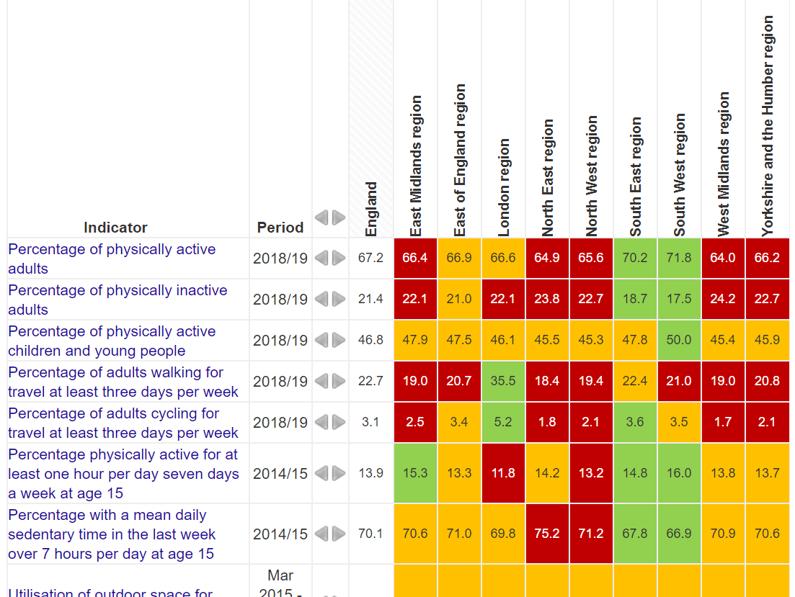
Existing sources of health data
Public Health England’s Fingertips tool

Slide 9
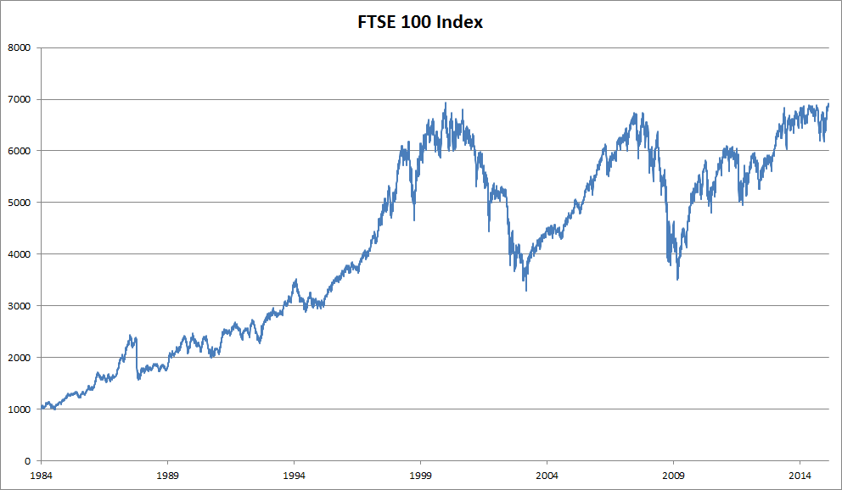
Existing accepted indices
FTSE 100
GDP
Human Capital Index
https://en.wikipedia.org/wiki/FTSE_100_Index#/media/File:FTSE_100_index_chart_since_1984.png

Slide 10
Analysis a Health Index enables
Media and general public
Present and see headline measures as indicators of change and inequality
Policymakers in government and local government
Clearly identify areas for improvement
Measure health impacts consistently in policy appraisal
Other analysts: academics, think tanks, VCSOs
Improves the body of evidence on different aspects of health

Slide 11
Developing the Health Index
Expert Advisory Group featuring central and local government officials, academics and health-related organisations
Streamlined advisory group organised for development of the ‘beta’ Health Index

Slide 12
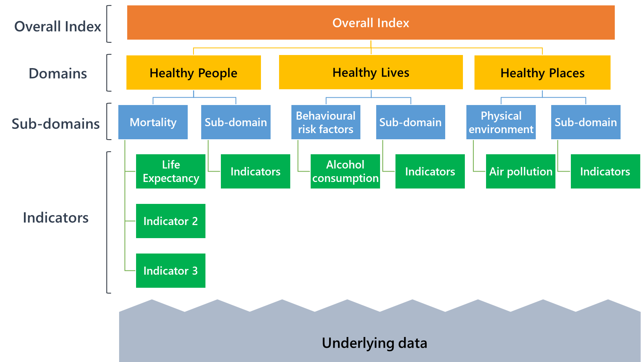
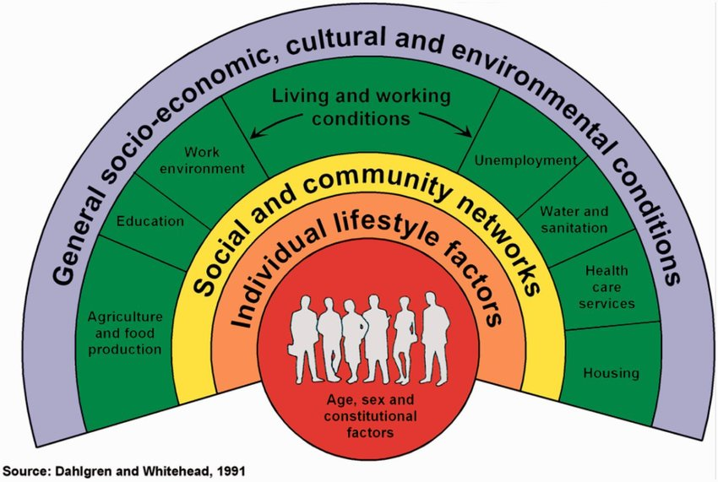
Definition of health, and structure

Slide 13
Methodology and data visualisation

Slide 14
Data selection
Review of data landscape across concepts within definition of health
Data inclusion principles:
Allows time series 2015-2018
Clear direction of health improvement (incidence versus prevalence)
Can be disaggregated to UTLA level
Measuring health rather than health services
For beta, publicly available data only due to time constraints
58 indicators total in the beta version

Slide 15
Methodology and weighting
Limited methods for weighting and scaling data for a composite index which needs to:
Have a national figure that can be tracked over time
Have scores for lower geographies which can be compared to the national figure and to other geographies, both in relative and absolute terms
Allow relative and absolute changes in those lower geographies’ scores to be trackable over time

Slide 16
Methodology and weighting
Imputation, then normalisation, then standardisation
For the beta, each domain represents 1/3 of the total Index score.
All subdomains have the same weight within each domain
Division of indicators into subdomains, and weights for indicators within subdomains, informed by factor analysis
Aggregated to England values using population size

Slide 17
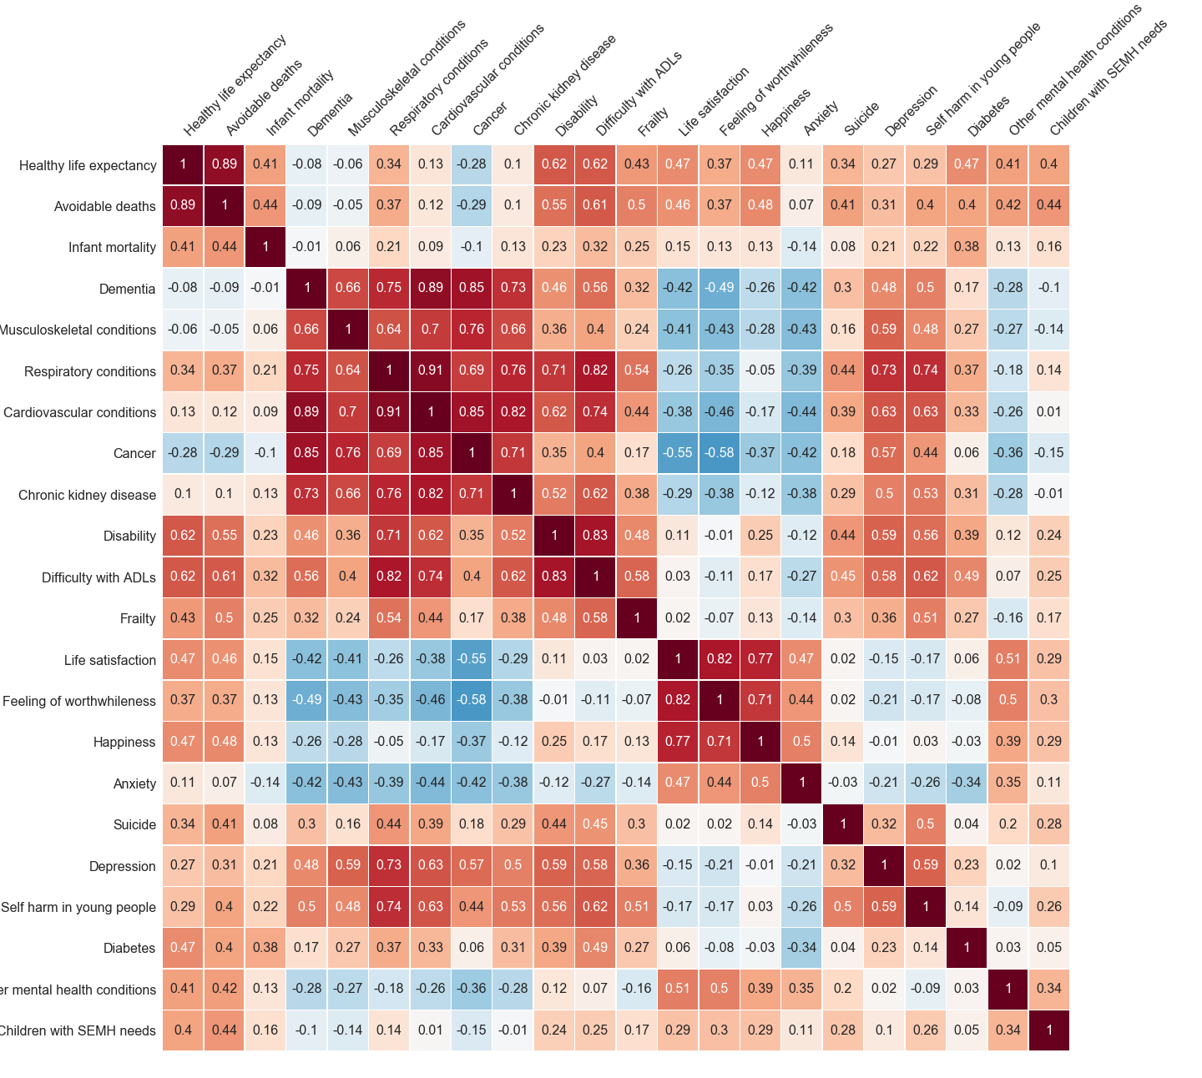
Mortality
Healthy life expectancy
Avoidable deaths
Infant mortality
Well-being
Life satisfaction
Feeling of worthwhileness
Happiness
Anxiety
Physical health conditions
Dementia
Musculoskeletal conditions
Respiratory conditions
Cardiovascular conditions
Cancer
Chronic kidney disease
Mental health
Suicide
Depression
Self harm in young people
Physical impairment
Disability
Difficulty completing Activities of Daily Living (ADLs)
Frailty
Other
Diabetes
Children with social, emotional and mental health needs
Other mental health conditions

Slide 18
Mortality | Weights
Healthy life expectancy | 38.5%
Avoidable deaths | 42.3%
Infant mortality | 19.2%
Well-being | Weights
Life satisfaction | 29.6%
Feeling of worthwhileness | 27.5%
Happiness | 26.3%
Anxiety | 16.5%
Physical health conditions | Weights
Dementia | 17.2%
Musculoskeletal conditions | 13.6%
Respiratory conditions | 17.5%
Cardiovascular conditions | 19.2%
Cancer | 16.5%
Chronic kidney disease | 15.9%
Mental health | Weights
Suicide | 24.9%
Depression | 29.3%
Self harm in young people | 45.7%
Physical impairment | Weights
Disability | 34.5%
Difficulty completing Activities of Daily Living (ADLs) | 41.4%
Frailty | 24.1%

Slide 19
Domains and subdomains
Healthy People
Mortality
Physical health conditions
Difficulties in daily life
Personal wellbeing
Mental health
Healthy Lives
Physiological risk factors
Behavioural risk factors
Unemployment
Working conditions
Risk factors for children
Children and young people’s education
Protective measures
Healthy Places
Access to green space
Local environment
Access to housing
Access to services
Crime

Slide 20
Outputs
ONS website:
Article explaining the Health Index purpose, structure and findings from the beta (England, 2015-2018), with interactive time series and map graphics
Blog introducing the statistic, its purpose and its future
Technical report detailing methodology and data selected
Data on the index, each domain, sub-domain and indicator at national and UTLA level
Lane Clark Peacock LLP:
Interactive web tool for visualising the index
Citizen Space:
Public consultation questionnaire on index use, value and recommendations for improvement
Consultation document: concise summary for lay users outlining aims and structure; comprehensive annex detailing methods and data (including those not chosen and why)

Slide 21
LCP’s Health Index Explorer
https://healthindex.lcp.uk.com

Slide 22
Next steps, and questions for you

Slide 23
Next (and current) steps
3rd Dec 2020
Health Index beta release
LCP explorer tool release
Consultation launched
By 26th May 2021
Summary of consultation responses published
3rd Mar 2021
Consultation closes
June/July 2021
‘Full’ Health Index released
Early Health Projections model released for iterative development
Longer term:
Health Index UK, and international applications of Health Index framework
Exploration of more frequent Health Index updates

Slide 24
Key questions
What do you think of the concept of a health index?
How likely are you to use the Health Index for your own analysis?
Which elements of its structure, data and content, or methodology could improve for you to be more likely to use it?
How would you want others to use the Health Index?
Would you be interested in a Health Index for lower geographies, or more frequently than annual, at the expense of some indicators?

Slide 25
Thank you for attending
The slides and other material will be placed on the Official Statistics Section’s page on the RSS web site
ONS’ consultation closes March 3
Please respond with your views

