Slide 1
Infant Cognitive Scores Prediction with Multi-stream Attention-based Temporal Path Signature Features
Dr. Xin Zhang
South China University of Technology
2020.08.26
Notes:
Dr. Xin Zhang
South China University of Technology
2020.08.26

Slide 2
01
PART ONE
Motivation and Challenges
Notes:
第一个要展示的是“研究概述”

Slide 3

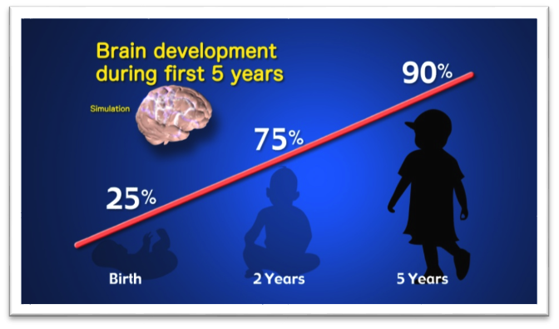
01
Background and Motivation
There is stunning rapid development of human brains during the infancy and toddler years.
Li, G., Wang, L., Yap, P.T., Wang, F., Wu, Z., Meng, Y., Dong, P., Kim, J., Shi, F., Rekik, I.: Computational neuroanatomy of baby brains: A review. NeuroImage, 185, 906{925 (2019)
Notes:
Studies have revealed the tight connection between cognitive skills and cortical morphology in this period.

Slide 4
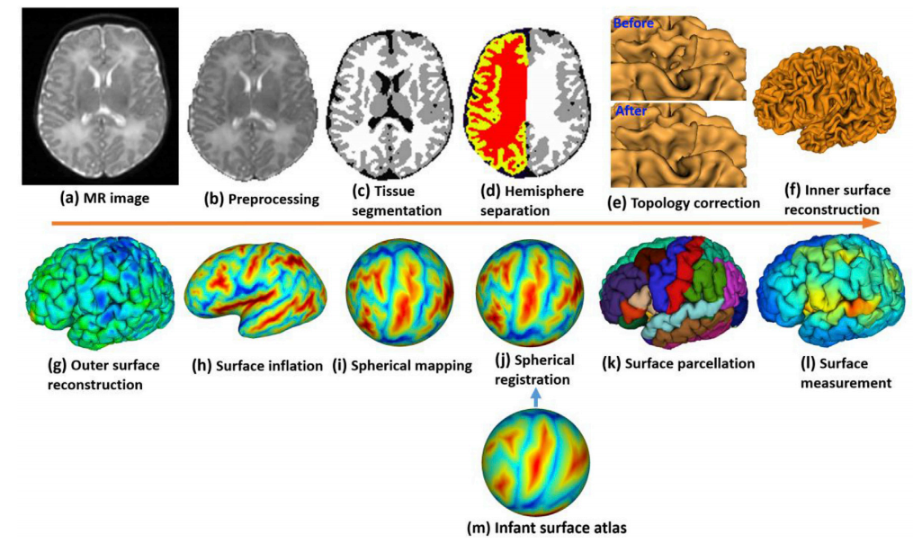
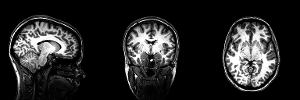
01
Background and Motivation
With the advancement of magnetic resonance imaging (MRI) and image processing techniques, the early brain cortical structure and its development can be measured and studied.
Li, G., Wang, L., Yap, P.T., Wang, F., Wu, Z., Meng, Y., Dong, P., Kim, J., Shi, F., Rekik, I.: Computational neuroanatomy of baby brains: A review. NeuroImage, 185, 906{925 (2019)

Slide 5
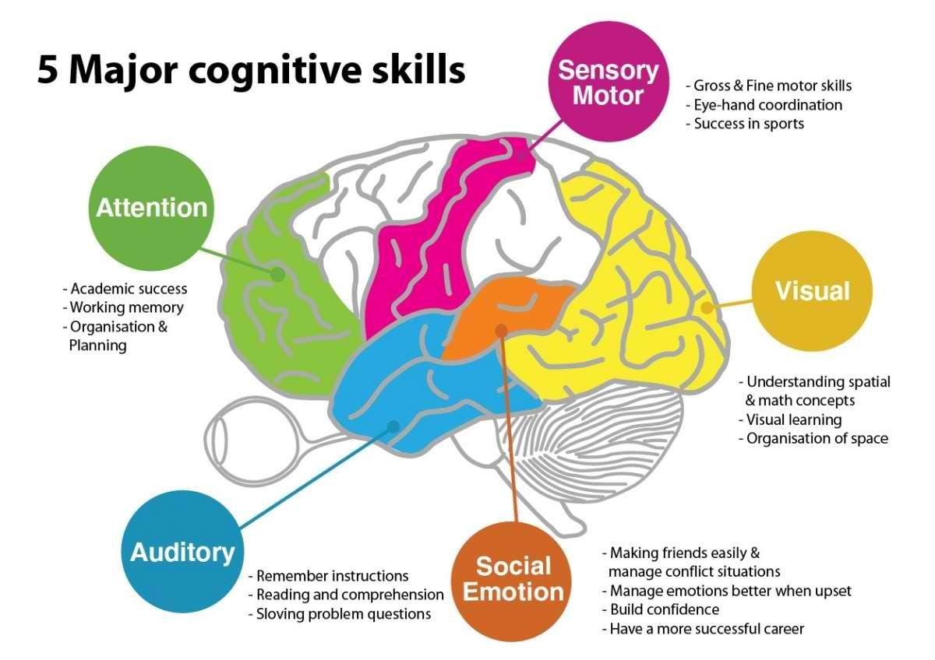
01
Background and Motivation
Cognitive skills, (also called cognitive functions, cognitive abilities or cognitive capacities), are brain-based skills that encompass the domains of perception, attention, memory, learning, decision making and language abilities.
Braaten, E.B.: Mullen scales of early learning. The SAGE Encyclopedia of Intellectual and Developmental Disorders 34(4), 379{382 (2018)
Notes:
Studies have revealed the tight connection between cognitive skills and cortical morphology in this period.
Cognitive skills are the core skills your brain uses to think, read, learn, remember, reason, and pay attention.

Slide 6

01
Background and Motivation
The Mullen Scales of Early Learning (MSEL) is designed to measure development in infants and preschoolers.
Usually, five cognitive scales are estimated including:
Visual Receptive Scale (VRS)
Fine Motor Scale (FMS)
Expressive Language Scale (ELS)
Receptive Language Scale (RLS)
Early Learning Composite (ELC)
Braaten, E.B.: Mullen scales of early learning. The SAGE Encyclopedia of Intellectual and Developmental Disorders 34(4), 379{382 (2018)
Notes:
The Mullen Scales of Early Learning (MSEL; 1995) is an assessment battery designed to measure development in infants and preschoolers, ages birth to 68 months. The 124 items measure specific domains including gross motor functions, visual reception, fine motor skills, receptive language, and expressive language. The four cognitive scales (visual reception, fine motor, receptive language, and expressive language)

Slide 7
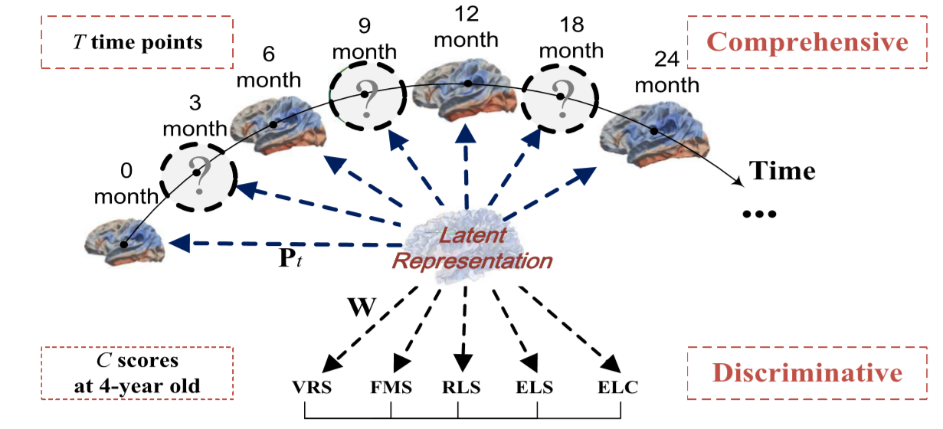
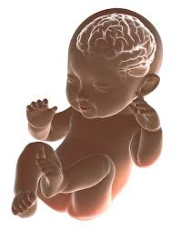
01
Background and Motivation
Our research goal is to understand the quantitative relationship between morphological features of infant cerebral cortex and cognitive skills with the machine learning methods.

Slide 8
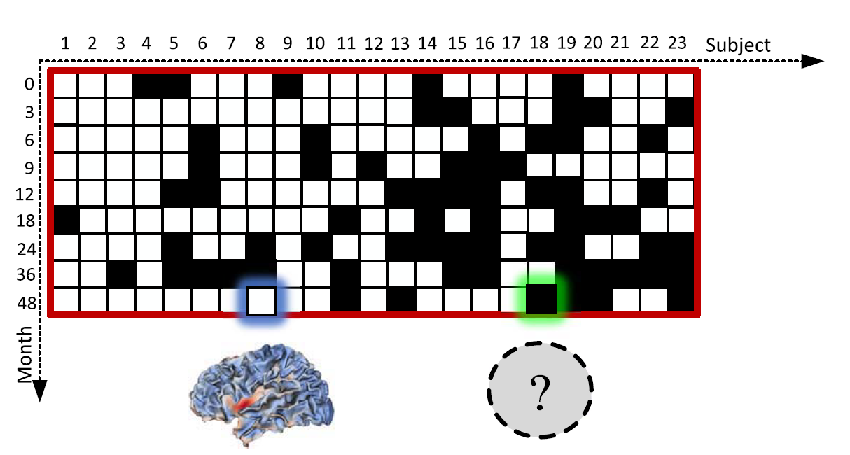
01
Motivation and Challenges
Challenges:
Small data set: we have 23 normal infants with their T1w and T2w MRI.
Missing data issue: every subjects are supposed to have 9 scans at 0, 3, 6, 9, 12, 18, 24, 36 and 48 months after birth. However, not all participants are able to show up at all scheduled time points.
Notes:
Challenges:
Small data set: 23 normal infants with their T1w and T2w MRI.
Missing data: every subjects are supposed to have 9 scans at 0, 3, 6, 9, 12, 18, 24, 36 and 48 months after birth. However, not all participants are able to show up at all scheduled time points.
High dimensional features: we process the data following an infant MRI computational pipeline

Slide 9
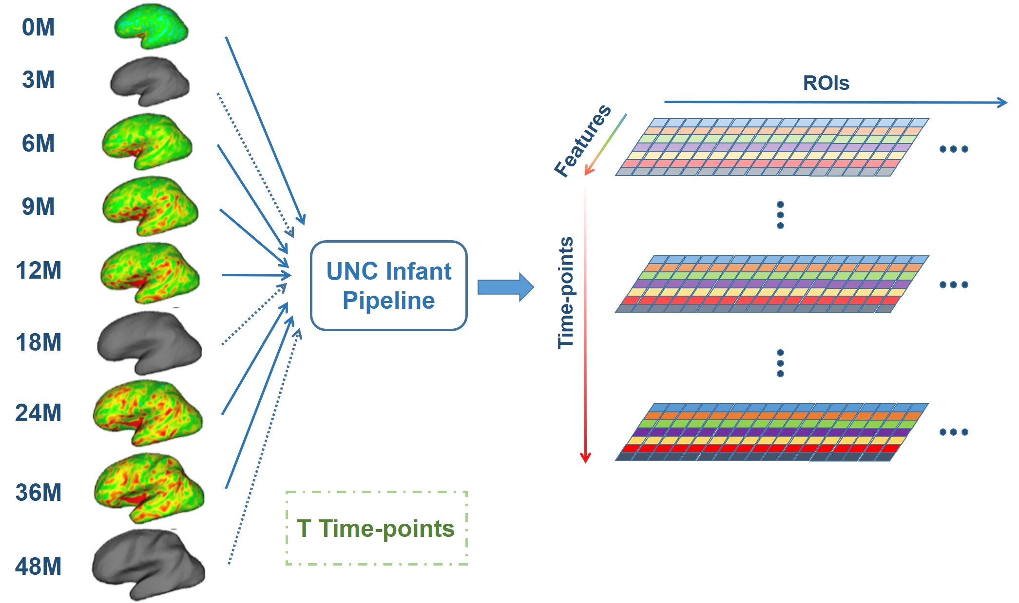
01
Motivation and Challenges
Challenges:
Small data set
Missing data issue
High dimensional features: we process the data following an infant MRI computational pipeline. At each time points, we parcellate the cerebral cortex into 70 anatomically meaningful regions of interest (ROIs) and compute 7 different morphological cortical measurements.
Notes:
Challenges:
Small data set: 23 normal infants with their T1w and T2w MRI.
Missing data: every subjects are supposed to have 9 scans at 0, 3, 6, 9, 12, 18, 24, 36 and 48 months after birth. However, not all participants are able to show up at all scheduled time points.
High dimensional features: we process the data following an infant MRI computational pipeline

Slide 10
02
PART TWO
RELATED WORK
Notes:
第二个需要展示的部分是我们研究用到的相关“背景算法”

Slide 11
02
Related Work
Early work mainly relies on statistical analysis
Factor analysis and relate theories are used to qualitatively evaluate the impact of different cortical structure on cognition function and illustrate the highly correlation between the anatomical differentiation of white matter fiber and cognitive development.
Nevertheless, for the lack of quantitative formulation, they are incapable to predict the quantified cognitive scales directly.

Slide 12
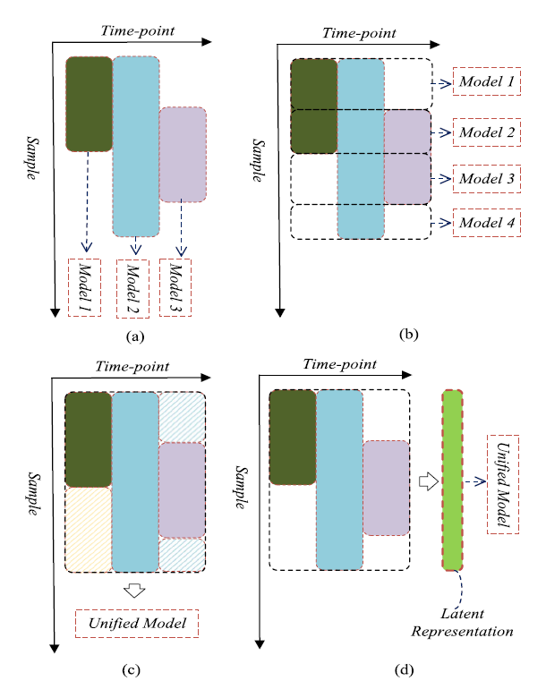
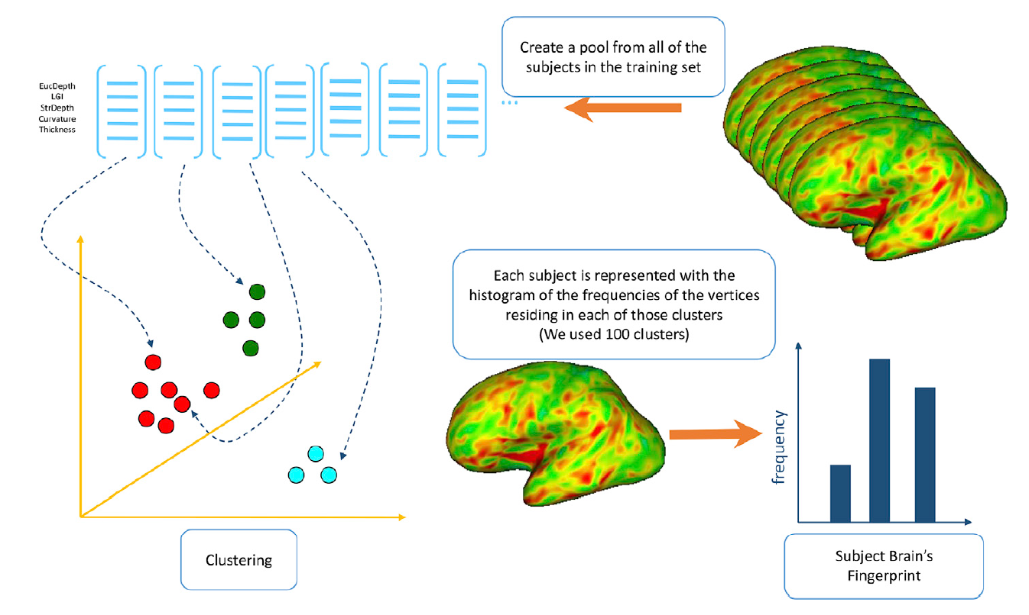
02
Related Work
Recent works involve more machine learning theories
[1] Bags-of-Words (BoW) based method was employed to slash the overlarge dimensionality of neuroimaging data.
[2] A nonlinear latent representation for each subject was generated by multi-view representation learning.
[1] Adeli, E., Meng, Y., Li, G., Lin, W., Shen, D.: Multi-task prediction of infant
cognitive scores from longitudinal incomplete neuroimaging data. NeuroImage 185,
783{792 (2019)
[2] Zhang, C., Adeli, E., Wu, Z., Li, G., Lin, W., Shen, D.: Infant brain development
prediction with latent partial multi-view representation learning. IEEE Transactions on Medical Imaging 38(4), 909{918 (2019)
Notes:
Not analyze correspondence
No temporal analysis

Slide 13
03
PART THREE
PATH SIGNATURE AND ITS APPLICATIONS
Notes:
第二个需要展示的部分是我们研究用到的相关“背景算法”

Slide 14
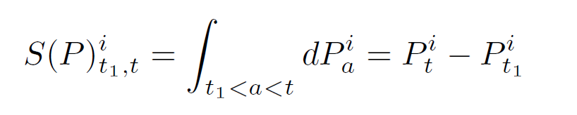
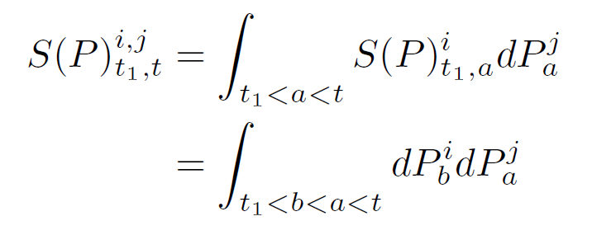
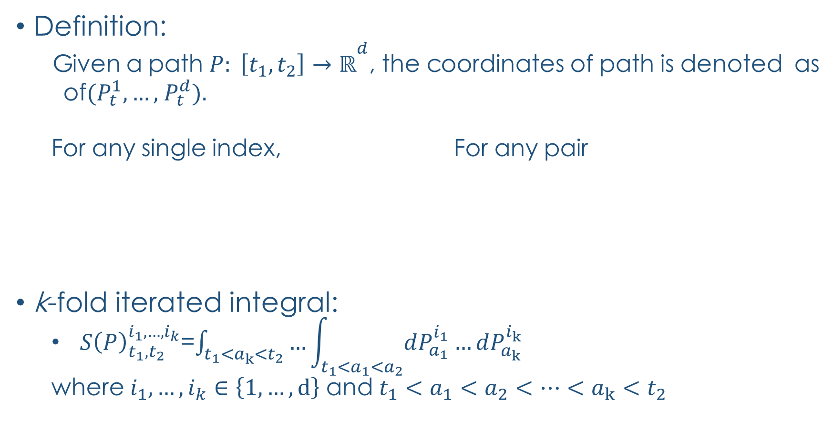

Path Signature (PS) Feature:
Definition:
  Given a path $P: \left[t_{1}, t_{2}\right]→{ℝ­}^{d}$, the coordinates of path is denoted as
  of$(P_{t}^{1},…,$ $P_{t}^{d}).$
  For any single index, For any pair
k-fold iterated integral:
  ${ S\left(P\right)}_{t_{1},t_{2}}^{i_{1},…,i_{k}}$=$\int_{t_{1}<a_{k}<t_{2}}{…}\int_{t_{1}<a_{1}<a_{2}}{dP_{a_{1}}^{i_{1}}…dP_{a_{k}}^{i_{k}}}$
  where $i_{1},…,i_{k}∈\left\{1,…,d\right\}$ and $t_{1}<a_{1}<a_{2}<…<a_{k}<t_{2}$
$$i,j∈\{1,…,d\}$$
[1] Hambly, B., and Lyons, T. 2010. Uniqueness for the signature of a path of bounded variation and the reduced path group. Annals of Mathematics 109–167.
[2] Lyons, T.; Caruana, M.; and L´evy, T. 2004. Differential equations driven by rough paths. Ecole dEt´e de Probabilit´es de Saint-Flour 34:1–93.

Slide 15
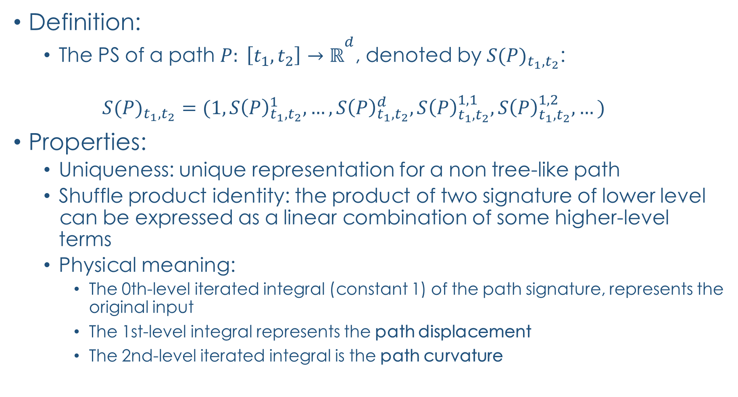
Path Signature (PS) Feature:
Definition:
  The PS of a path $P: \left[t_{1}, t_{2}\right]→{ℝ­}^{d}$, denoted by ${S(P)}_{t_{1},t_{2}}$:
  $${S(P)}_{t_{1},t_{2}}=(1,{S\left(P\right)}_{t_{1},t_{2}}^{1},…,{S\left(P\right)}_{t_{1},t_{2}}^{d},{S\left(P\right)}_{t_{1},t_{2}}^{1,1},{S\left(P\right)}_{t_{1},t_{2}}^{1,2},…)$$
Properties:
  Uniqueness: unique representation for a non tree-like path
  Shuffle product identity: the product of two signature of lower level can be expressed as a linear combination of some higher-level terms
  Physical meaning:
    The 0th-level iterated integral (constant 1) of the path signature, represents the original input
    The 1st-level integral represents the path displacement
    The 2nd-level iterated integral is the path curvature

Slide 16
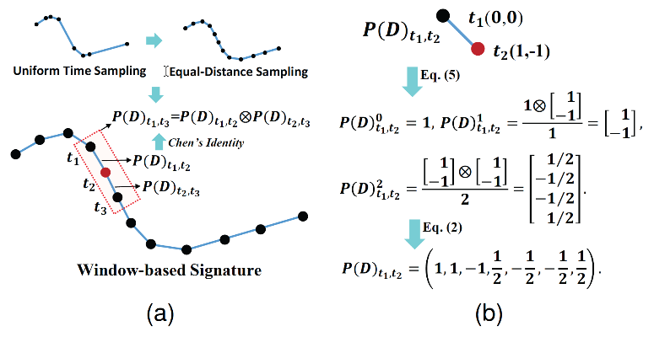
03
Path Signature
An online handwritten character consists of strokes
Let denote the i-th point on a stroke at time t, the corresponding m level signature can be computed by:
where is an interval window parameter (e. g. = 3~8)
Repeat the above procedure for every point on the stroke, stroke by stroke

Slide 17
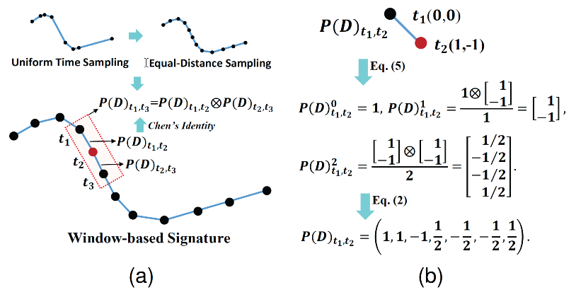
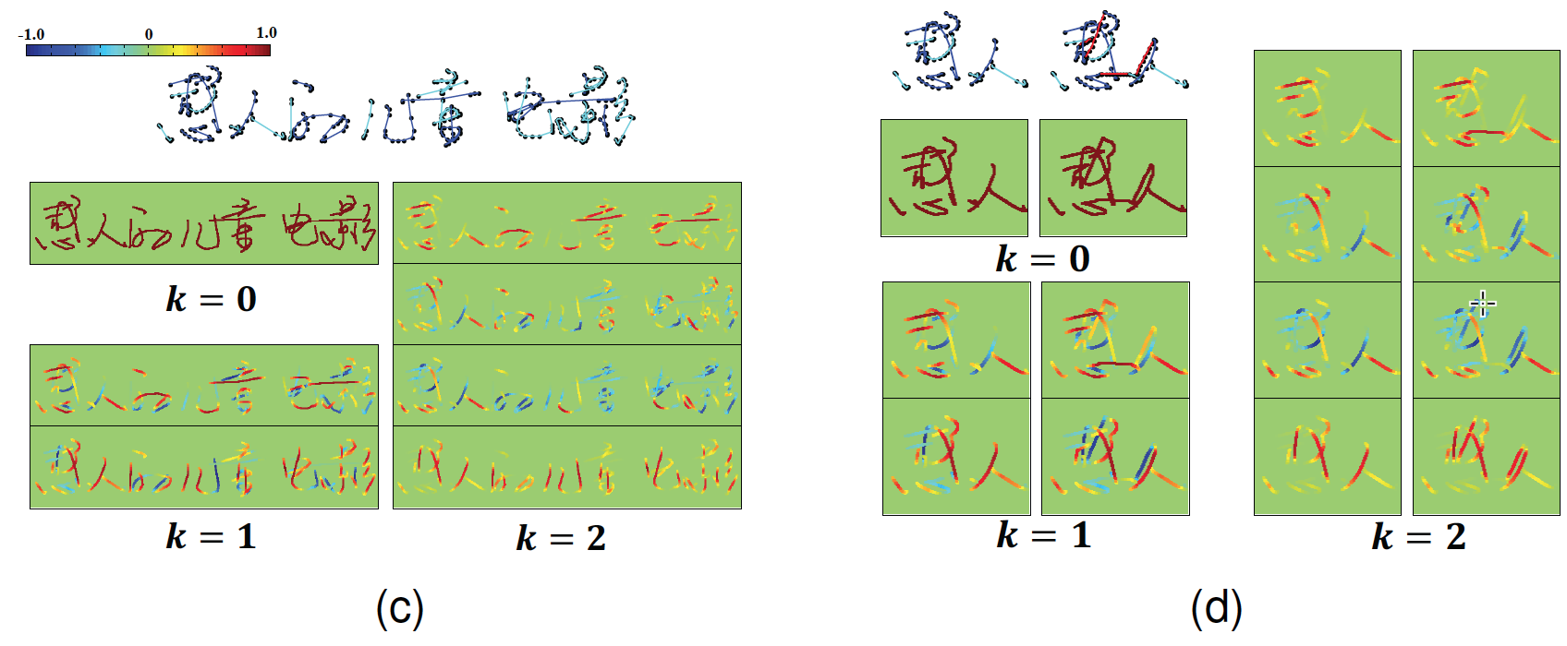
03
Path Signature Feature Maps
ZC Xie, ZH Shun, LW Jin, H Ni, T Lyons, IEEE TPAMI, 2018.

Slide 18
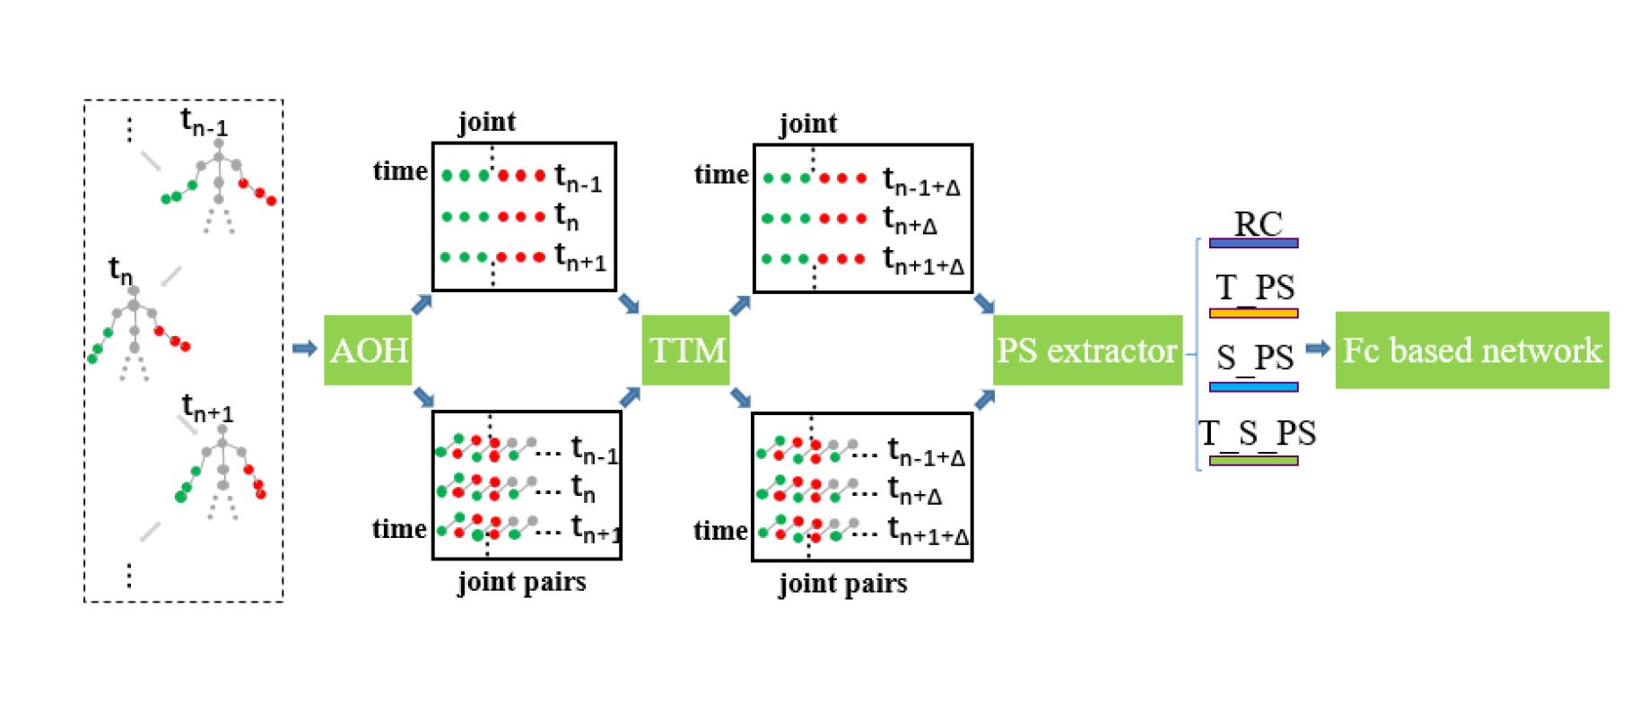
03
Path Signature
Hand gesture is defined on whole hand movement. Hand trajectory is considered as path.
Chenyang Li and Xin Zhang,“Skeleton-based Gesture Recognition Using Several Fully Connected Layers with Path Signature Features and Temporal Transformer Module”AAAI 2019 (acceptance rate: 16.8%), https://arxiv.org/abs/1811.07081

Slide 19
03
Path Signature
Hand gesture is defined on whole hand movement. Hand trajectory is considered as path.
Feature types: (path of signature is denoted as PS)
  Raw coordinates (RC): the xyz coordinates of 6 joints on both hands.
  Temporal PS (T-PS): the temporal dyadic PS over the evolution of each joint.
  Spatial PS (S-PS): the PS of each pair of joint (spatial pathlet ).
  Spatial-temporal PS (S-T-PS): the PS of each dimension of spatial PS.
Chenyang Li, etc., “Skeleton-based Gesture Recognition Using Several Fully Connected Layers with Path Signature Features and Temporal Transformer Module”AAAI 2019 (acceptance rate: 16.8%), https://arxiv.org/abs/1811.07081

Slide 20
04
PART FOUR
PROPOSED METHOD: BRAINPSNET
Notes:
第三部分的展示，是我们课题的具体研究内容

Slide 21
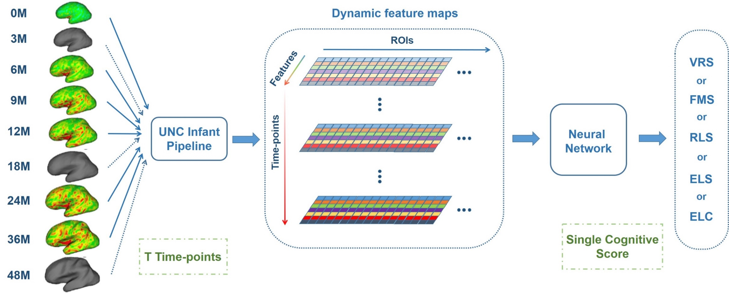
4.1
General Ideas
We formulate it as the neural network-based regression problem.
We define the longitudinal data as the “temporal path”.
We focus on feature extraction, selection and redundancy removal.
Notes:
Neural network based regression problem
Define the longitudinal data as the “temporal path”

Slide 22
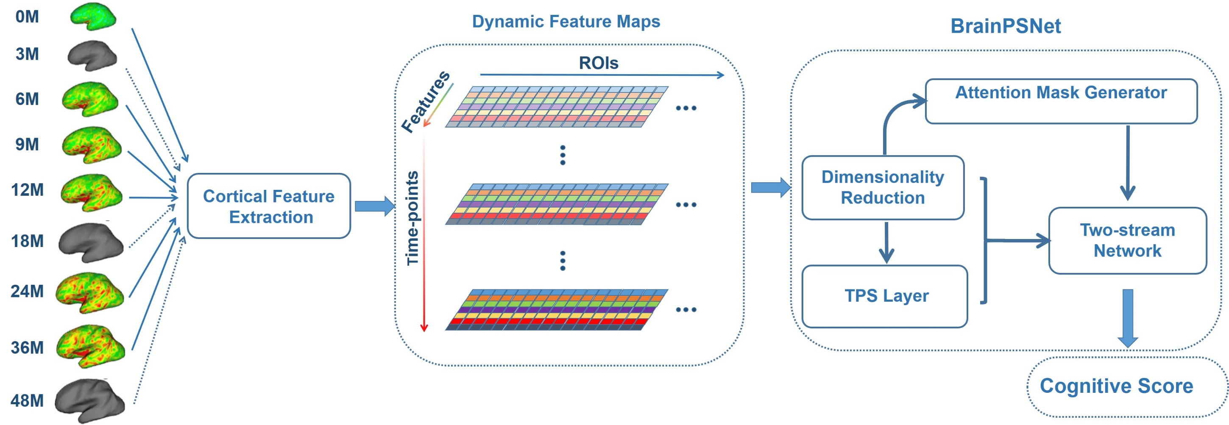
4.1
General Framework
TPS: temporal path signature
Notes:
TPS: temporal path signature

Slide 23
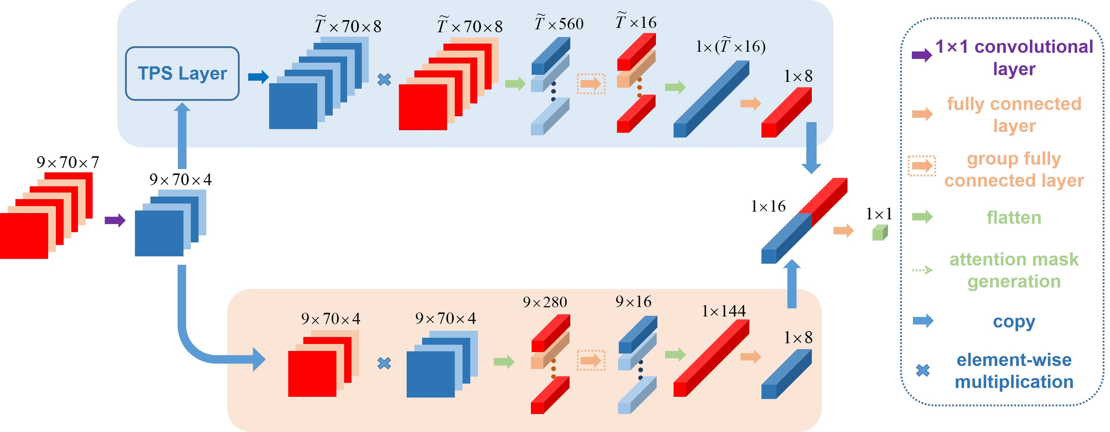
4.2
BrainPSNet
Two-stream Network
Dimensionality
Reduction
Notes:
Dimensionality Reduction

Slide 24
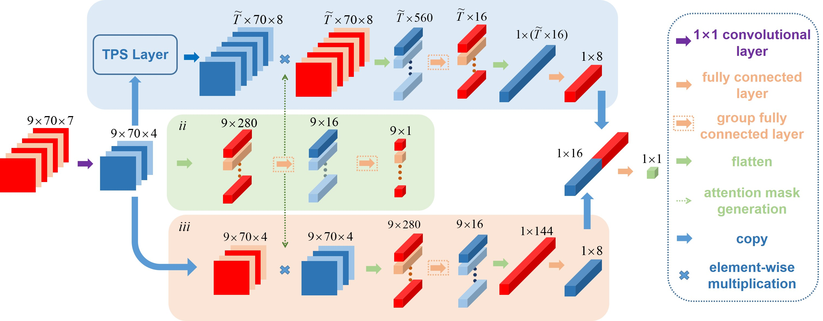
4.2
BrainPSNet
Attention Mask Generator

Slide 25
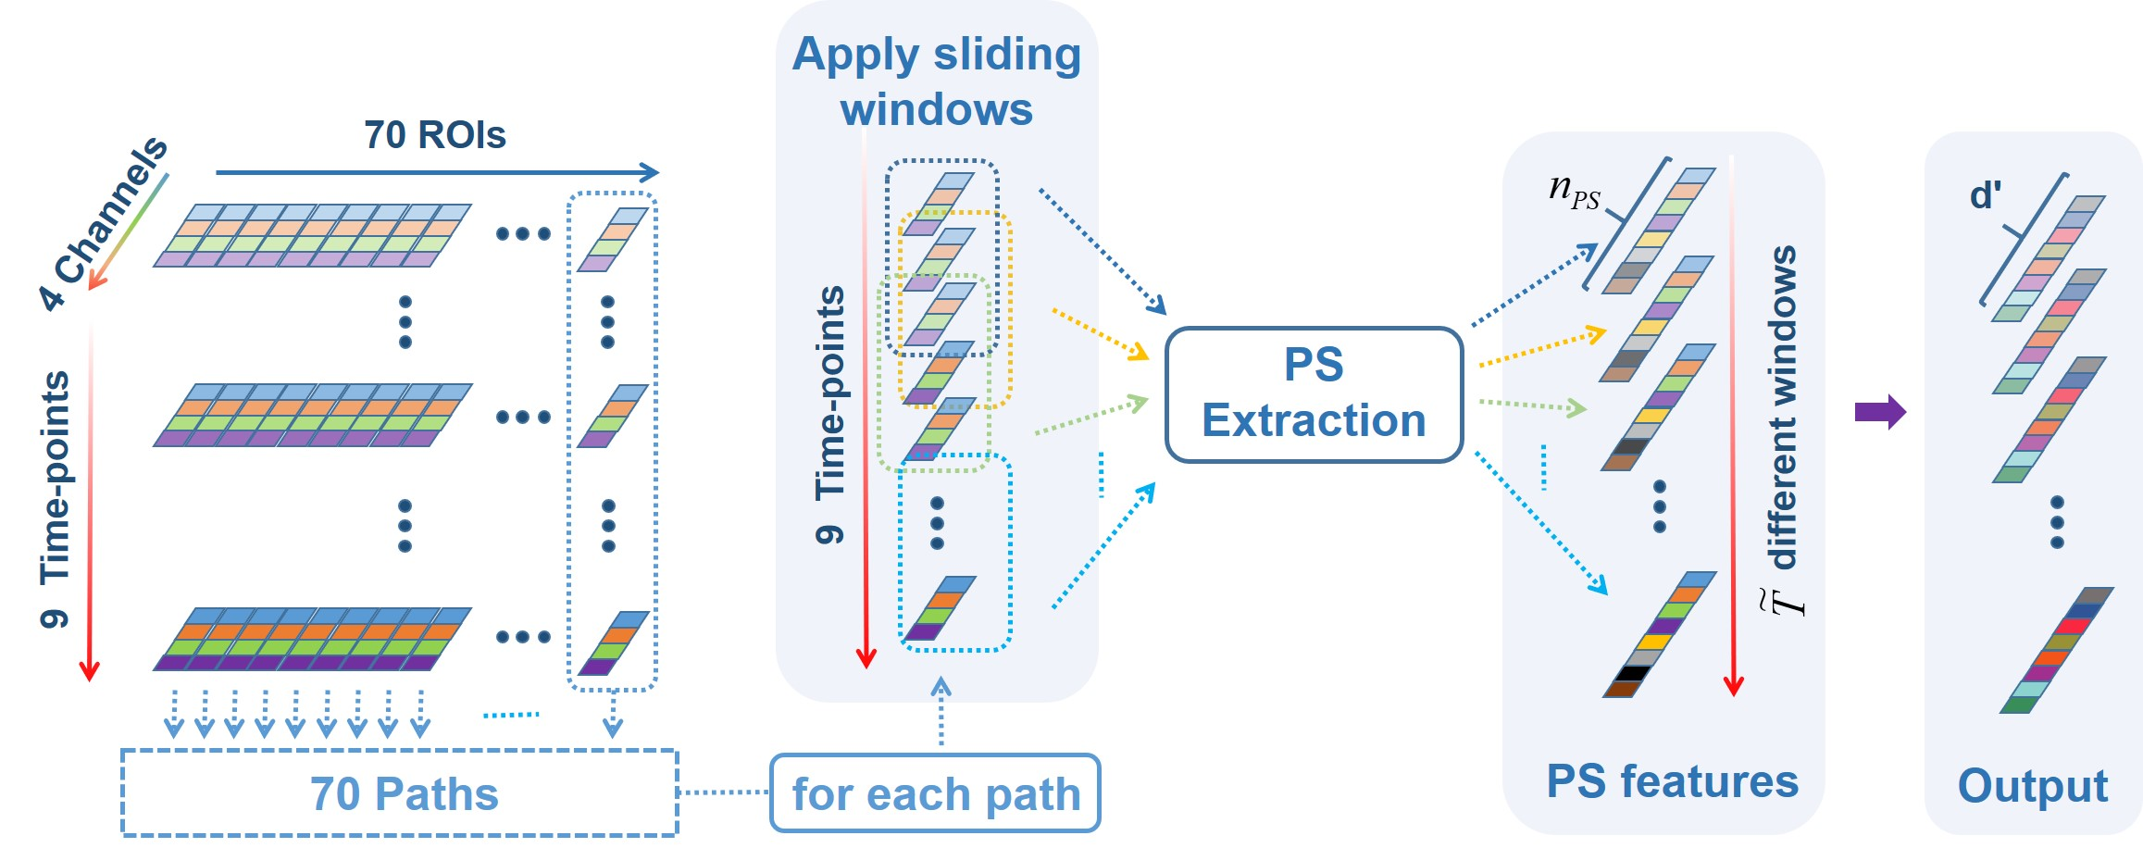
4.3
Temporal Path Signature Layer
1×1 convolutional layer
Why do we use longitudinal data as the path? Why not others?
Notes:
Why do we use longitudinal data as the path?

Slide 26
04
PART FOUR
EXPERIMENTAL RESULTS

Slide 27
4.1
Experimental Results
Parameters of path signature feature computation
Ablation study
Effectiveness of the temporal path signature feature
Comparison with the state-of-the-art methods
Relationship between cognitive scores and brain regions.
Notes:
Parameters of path signature feature computation
Ablation study
Effectiveness of the temporal path signature feature
Comparison with the state-of-the-art methods

Slide 28
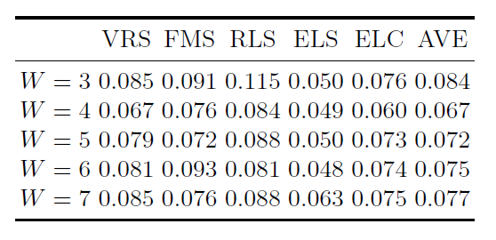
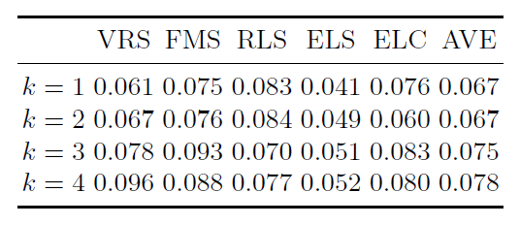
4.2
PS Parameters
We compared the performance of our model (1) different sliding window sizes with a fixed k = 2; (2) different truncated level with fixed window size W=4.
We set W=4 and k=2 in this work.
Notes:
W=4 and k=2

Slide 29
4.3
Ablation Study
The ablation study shows that path signature features and attention module both bring improvements to the final estimation result (in terms of RMSE).
 | VRS | FMS | RLS | ELS | ELC |  | AVE
w/o TPS | 0.059 | 0.100 | 0.103 | 0.066 | 0.089 |  | 0.084
w/o Attention | 0.092 | 0.108 | 0.162 | 0.077 | 0.103 |  | 0.108
Proposed | 0.046 | 0.075 | 0.095 | 0.063 | 0.057 |  | 0.067
Notes:
The ablation study shows that path signature features and attention module both bring improvements to the final result.

Slide 30

4.4
Effectiveness of TPS Layer
Performance comparison between the TPS layer and other sequential feature extraction models. In the last column, we calculate the total time cost for 1200 epochs of our method with different substitutes.
Methods | Metrics | VRS | FMS | RLS | ELS | ELC | Average | Time
Transformer | RMSE | 0.076 | 0.090 | 0.134 | 0.066 | 0.075 | 0.088 | 578s
 | R-square | 0.637 | 0.719 | 0.556 | 0.527 | 0.732 | 0.634
LSTM | RMSE | 0.084 | 0.084 | 0.120 | 0.037 | 0.081 | 0.081 | 2147s
 | R-square | 0.738 | 0.773 | 0.689 | 0.928 | 0.795 | 0.785
TPS Layer | RMSE | 0.046 | 0.075 | 0.095 | 0.063 | 0.057 | 0.067 | 405s
 | R-square | 0.893 | 0.801 | 0.714 | 0.714 | 0.892 | 0.803
Notes:
1. 为了公平比较，我们将模型中的TPS Layer 等效置换为LSTM或Transformer，其余部分不变，对比模型效果。
2. 从表中可以看出，对于稀疏采样的时间序列数据而言，TPS layer的实验效果在5项指标中的3项优于LSTM 和 Transformer。且由于LSTM 无法并行计算。TPS Layer 的计算时间比LSTM要少接近一半。

Slide 31
4.5
SOTA Comparison
Performance comparison of BrainPSNet (in terms of RMSE)
 | VRS | FMS | RLS | ELS | ELC |  | AVE
TrMTL (2009, ICML) | 0.279 | 0.276 | 0.192 | 0.217 | 0.136 |  | 0.220
MtJFS (2007, NIPS) | 0.276 | 0.273 | 0.189 | 0.214 | 0.134 |  | 0.217
NN | 0.219 | 0.259 | 0.165 | 0.196 | 0.182 |  | 0.204
RMTL (2011, ACM-KDD) | 0.146 | 0.200 | 0.178 | 0.188 | 0.137 |  | 0.170
LPMvRL (2019, IEEE TMI) | 0.162 | 0.189 | 0.139 | 0.165 | 0.138 |  | 0.158
Proposed method | 0.046 | 0.075 | 0.095 | 0.063 | 0.057 |  | 0.067

Slide 32
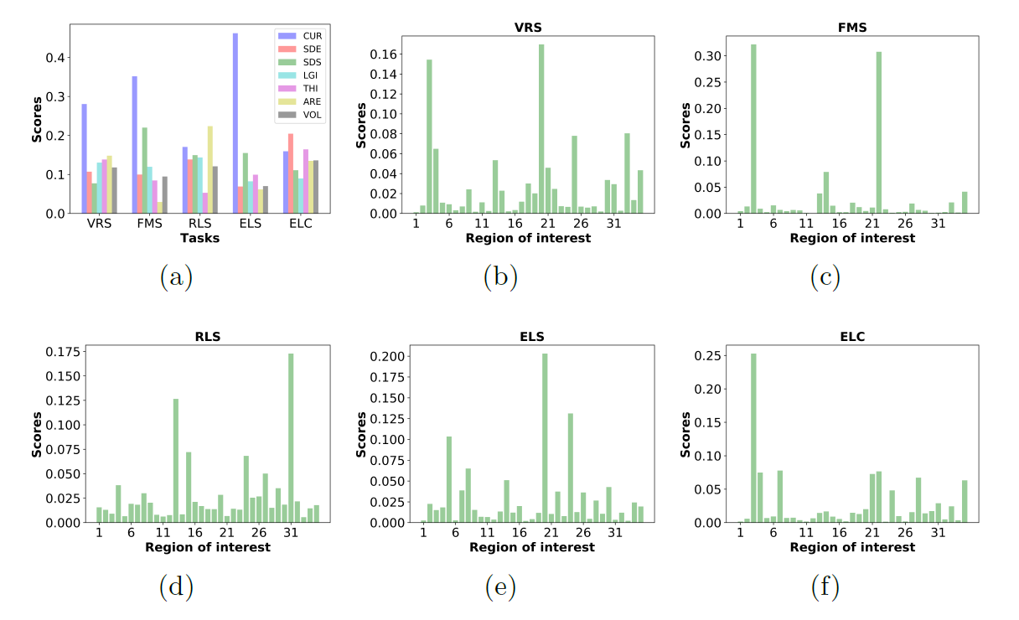
4.6
Brain Region Analysis
Most cognitive skills strongly related to the cortical curvature feature, and other features have various importance.
Notes:
+ 大部分认知能力指标都更为重视CUR（大脑皮层表面平均曲率），而其余各项指标重要程度不等。

Slide 33
4.6
Brain Region Analysis
Top 5 most important brain regions for each cognitive skill
ROIs | VRS | FMS | RLS | ELS | ELC
Bank of the Superior Temporal Sulcus |  | ✔ | ✔ | ✔
Entorhinal Cortex | ✔ |  | ✔
Fusiform Gyrus | ✔ | ✔ | ✔ | ✔ | ✔
Inferior Parietal Cortex | ✔
Lateral orbital frontal cortex | ✔ | ✔ | ✔ | ✔ | ✔
Lingual gyrus |  |  | ✔
Parahippocampal gyrus | ✔ | ✔ |  | ✔ | ✔
Pars triangularis |  |  |  |  | ✔
Pericalcarine cortex |  | ✔ | ✔ | ✔ | ✔
Posterior-cingulate cortex |  |  | ✔

Slide 34
05
PART FIVE
SUMMARY

Slide 35
05
SUMMARY AND FUTURE WORK
Summary
We propose a novel model, BrainPSNet, to predict cognitive scores using longitudinal cortical features during infancy and reach the state-of-the-art result.
For the first time, the path signature feature is introduced to explore hidden anatomical and geometric properties of the cortical developmental trajectories by a TPS layer.
The relationship between brain regions and cognitive scores are discussed.
Future work
Further brain region selection strategy might be helpful.
Different temporal path or spatial path could be considered.

Slide 36
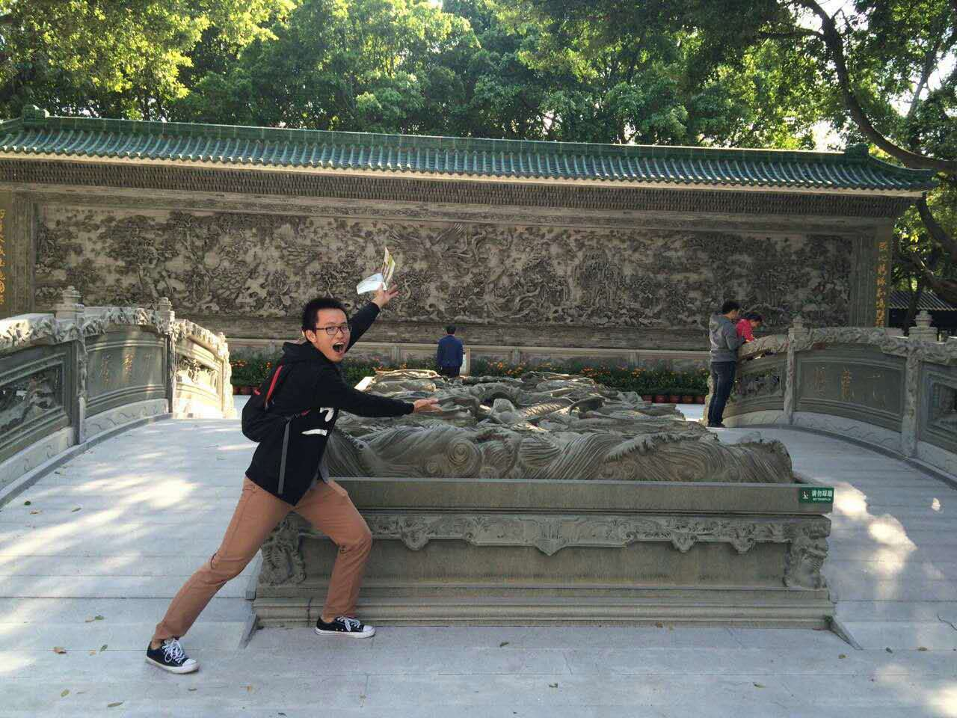

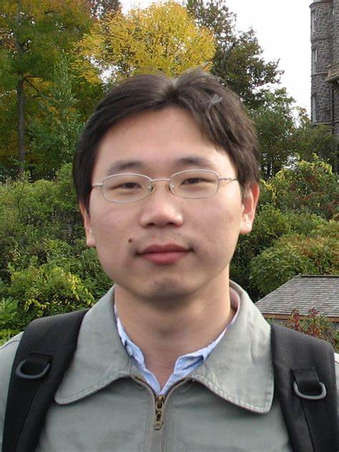
ACKNOWLEDGEMENT
This work was done when I was the visiting scholar at IDEA Lab in University of North Carolina at Chapel Hill (UNC). It is the joint work with my undergraduate student Jiale Cheng, Dr. Hao Ni from UCL, Dr. Gang Li from UNC.
The presented work is accepted by MICCAI 2020 as “Infant Cognitive Scores Prediction With Multi-stream Attention-based Temporal Path Signature Features”.
Notes:
This work is done when I was the visiting scholar at IDEA Lab in University of North Carolina at Chapel Hill (UNC).

Slide 37
THANK YOU!
Contact: eexinzhang@scut.edu.cn

