Slide 1
Using Rough Path Theory
Terry Lyons
Mathematical Institute, Oxford
Alan Turing Institute
https://www.datasig.ac.uk/datasig-team-members
Action recognition: Weixin Yang, Hao Ni, Cordelia Schmid, Lianwen Jin

Slide 2
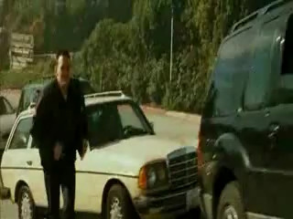
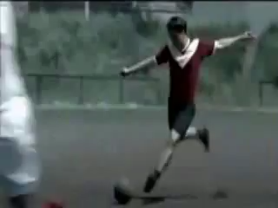
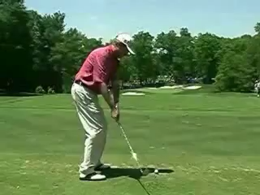
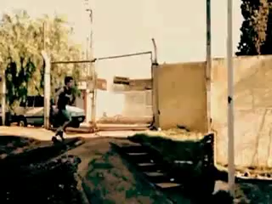
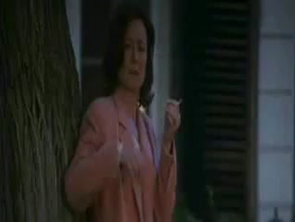
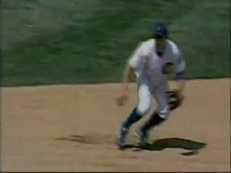
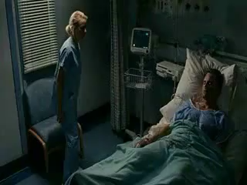
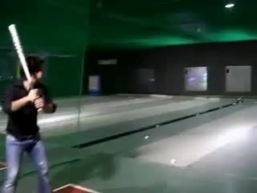
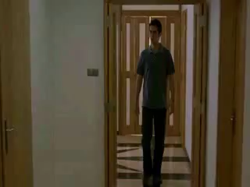
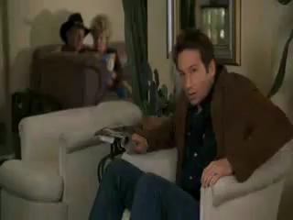
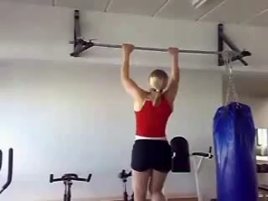
Human Activity in Video
Jhuang, H., Gall, J., Zuffi, S., Schmid, C. and Black, M.J., 2013. Towards understanding action recognition. In Proceedings of the IEEE international conference on computer vision (pp. 3192-3199).

Slide 3
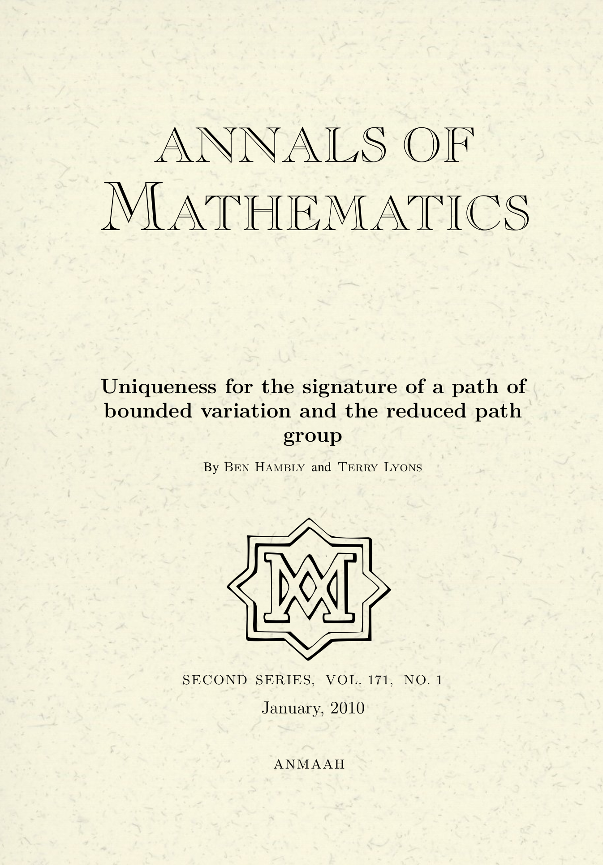
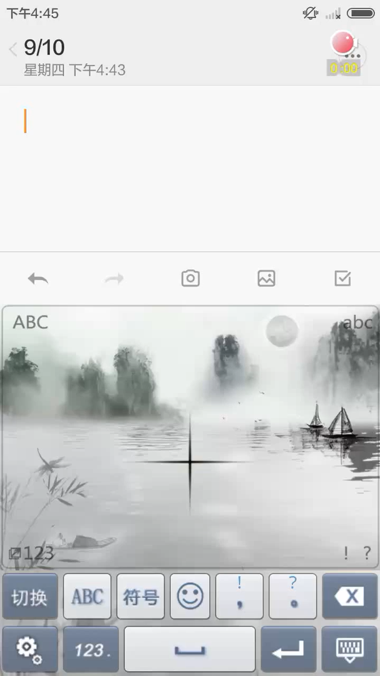
Technology underlying research
Main Technology :
An area in mathematics known as Rough Path Theory (60L), and a mathematical tool known as the ‘path signature’ provide a way of adding value to conventional machine learning to better ‘understand’ evolving data streams.
The goal is to develop a powerful mathematical framework for the systematic understanding of patterns in evolving multimodal data and for the classification of these patterns; and build tools for PyTorch, TensorFlow etc. to learn from multimodal streams.
A significant example early application of this approach was to the online Chinese handwriting problem. Ben Graham won the ICDAR competition. SCUT (Lianwen Jin) then engineered an app that works well on CASIO, ICDAR and real world contexts.
Notes:
Explain what path signatures are (glossary says patterns in video data)
Include in talk over of slide why its cutting edge, difficult, not yet solved, why do the research now – e.g.reference to Rough Path Theory and the fact its new/cutting edge

Slide 4
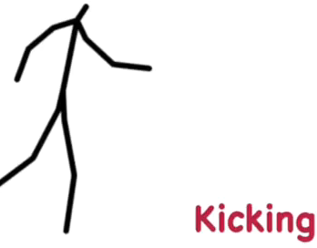
Technology underlying research
Our primary focus today:
We will look at core mathematical reasons why the path signature brings something new. We will also introduce some applications.
One application is to create generic methodology that can classify the movement of an individual using only de-identified “landmark data” with modest samples and training. The approach is robust enough to accept input from automated pose identification software such as alpha-pose and open-pose with reasonable success.
This technology enables recognition of human actions from video data without using personally identifiable data. Moreover the method does not use deep learning and provides interpretable output.
Notes:
Explain what path signatures are (glossary says patterns in video data)
Include in talk over of slide why its cutting edge, difficult, not yet solved, why do the research now – e.g.reference to Rough Path Theory and the fact its new/cutting edge

Slide 5
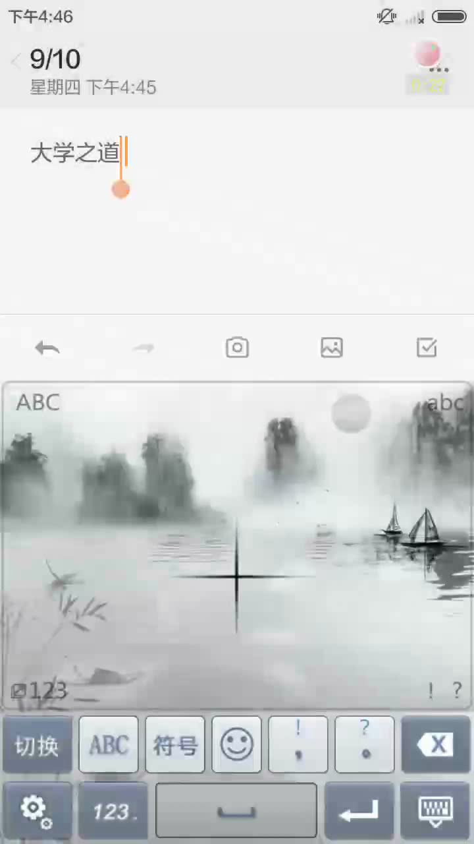
Rough paths - streamed data
      a finger drawn character on the Mate or iPhone
      a financial order book
      a piece of text
      a patient record at a hospital
      astronomical data
      crop growth in different fields
      an evolving stream of emotions
Notes:
Not stationary
Not large sample
Many challenges
Identify fraudulent transactions
Link outcomes to patterns of medication and wellbeing
Capture transient events
Better understand and help people in pain with mental illness

Slide 6
Rough paths - streamed data
  Period of rapid change
    in our understanding and modelling of data
    in the role of optimisation
    In how we use information
  A data scientist might ask what is left for mathematics to say?
  A statistician might ask what is left for mathematics to say?
    In this presentation explain how the mathematics of rough path theory adds new perspectives
    We will focus on two (there are several more):
      removing an infinite dimensional invariance (gauge invariance)
      capturing data more robustly (continuity of control)

Slide 7
Mathematics - Not magic
Rough path theory
    toolset for working with evolving systems
      highly oscillatory
      non-stationary
      multimodal
    captures multimodal streams
      concise and mathematically well posed (no arbitrariness)
      captures the order in which things happen
      does not require or ask for parametrisation

Slide 8
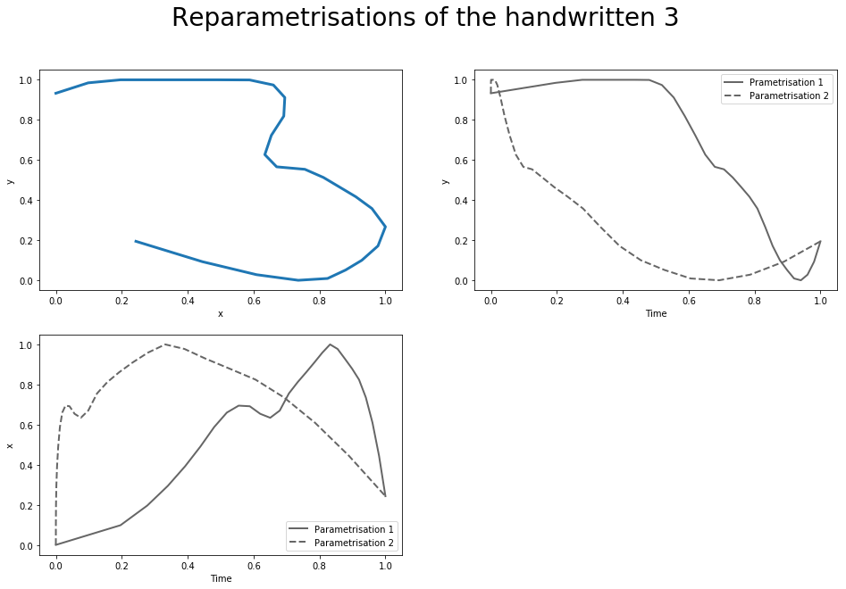
Rough paths: streamed data
      The letter “3” is drawn from top to bottom
Notes:
27secs on

Slide 9
Rough paths: streamed data
      The letter “3” is drawn from top to bottom
      The x coordinate of the evolving symbol plotted against time at different speeds
      This is the classic Kolmogorov approach. But it is very unstable.
Notes:
27secs on

Slide 10
Rough paths: streamed data
      The number “3” x, y coordinates – same picture drawn at two different speeds
      No consistent wavelets
      Reparameterizations do not form a linear space!
Notes:
27secs on

Slide 11
Rough paths: streamed data
      the letter “3” is drawn from top to bottom
      how does one describe the three or any path modulo the symmetry of parametrisation?
      describe the curve
Notes:
27secs on

Slide 12
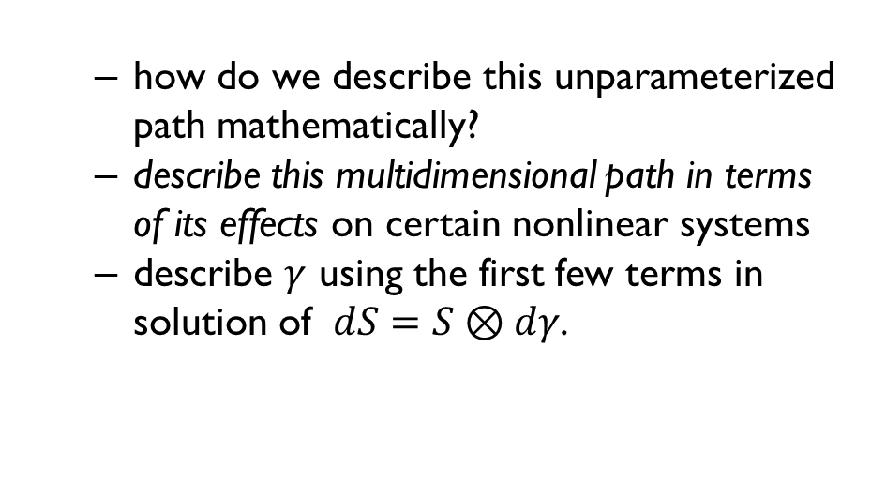
Rough paths: streamed data
      how do we describe this unparameterized path mathematically?
      describe this multidimensional path in terms of its effects on certain nonlinear systems
      describe $γ$ using the first few terms in solution of $dS=S⊗dγ$.
Notes:
27secs on

Slide 13
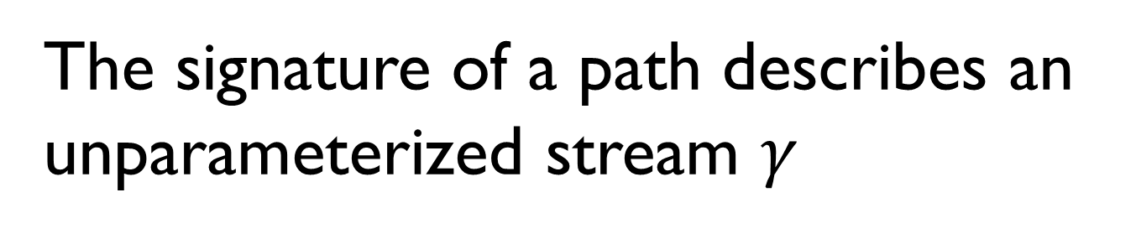
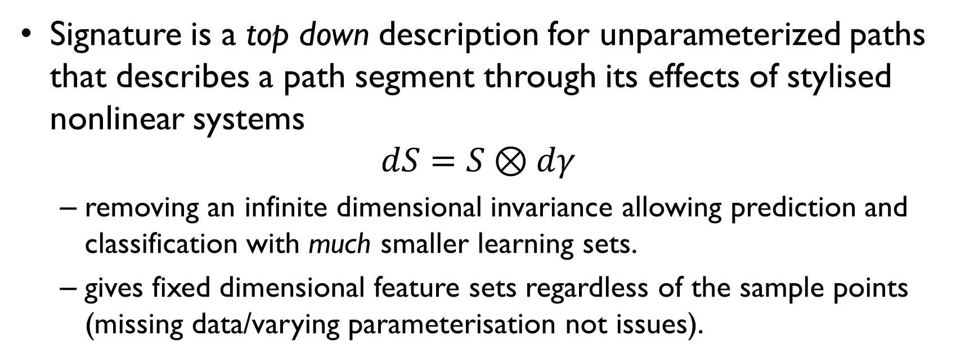
The signature of a path describes an unparameterized stream $γ$
Signature is a top down description for unparameterized paths that describes a path segment through its effects of stylised nonlinear systems
$dS=S⊗dγ$
  removing an infinite dimensional invariance allowing prediction and classification with much smaller learning sets.
  gives fixed dimensional feature sets regardless of the sample points (missing data/varying parameterisation not issues).

Slide 14
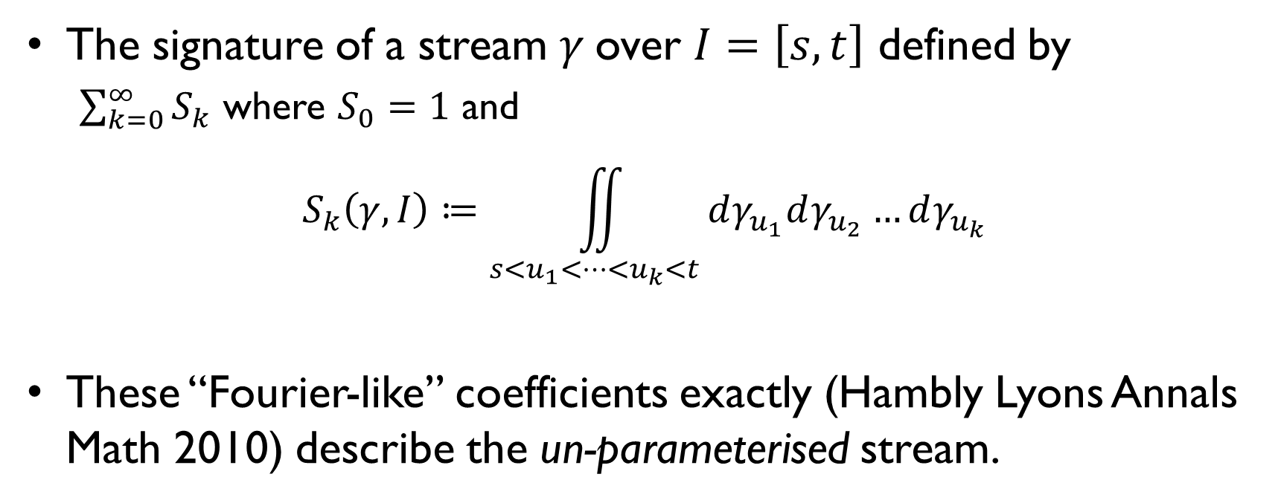
The signature – faithful and universal features describing an unparameterised stream
The signature of a stream $γ$over $I=\left[s,t\right]$ defined by
  $\sum_{k=0}^{∞}{S_{k}}$ where $S_{0}=1$ and
  $$S_{k}\left(γ,I\right)≔\iint_{s<u_{1}<…<u_{k}<t}{dγ_{u_{1}}dγ_{u_{2}}…dγ_{u_{k}}}$$
These “Fourier-like” coefficients exactly (Hambly Lyons Annals Math 2010) describe the un-parameterised stream.

Slide 15
The signature – top down, faithful and universal features describing an unparameterized stream
Fundamental tool in Rough path theory
  redefines discussion of interacting paths; extends calculus of Newton and Ito to new range of complex interacting systems. An under-pinning contribution to Fields medal winning mathematical work of Hairer.
  for data applications:
    a generating function for the space of functions on streams
    it removes parametrisation and can reduce the dimensionality of streamed data quite dramatically.
    there is a world (PyPi) Python packages “esig,iisignature, signatory”.

Slide 16
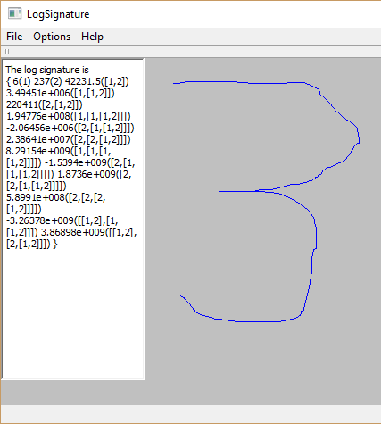
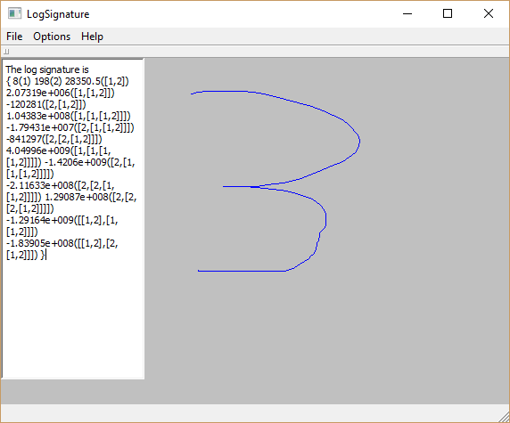

Slide 17
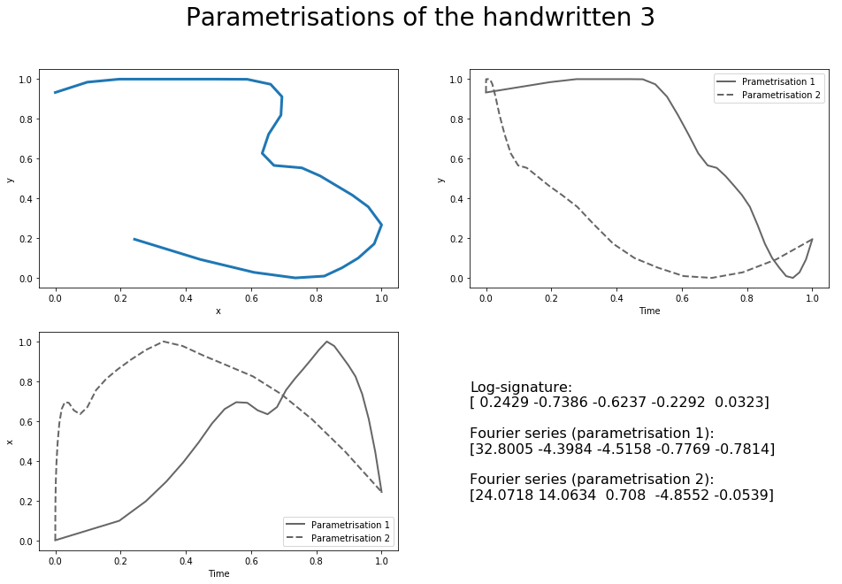
Rough paths: streamed data
      Fourier Series
      Intrinsically unstable
        Cameron Clark
        Dickinson
      n-dimensional linear summaries predict effects O(1/n^1/2)
      signatures O(1/(n/2)!)
Notes:
27secs on

Slide 18
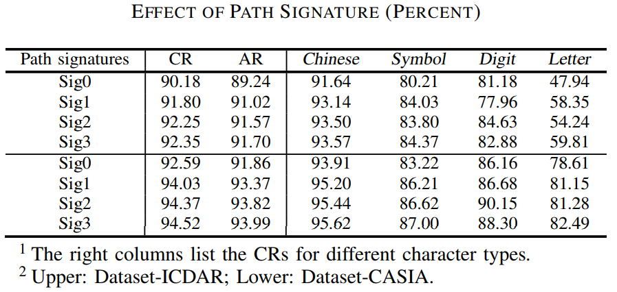
Handwriting Textline Recognition on ICDAR and CASIA dataset
Z. Xie, Z. Sun, L. Jin, H. Ni, and T. Lyons, “Learning spatial-semantic context with fully convolutional recurrent network for online handwritten Chinese text recognition,” IEEE transactions on pattern analysis and machine intelligence (IEEE TPAMI), 2017.
Notes:
Using path signatures made a difference

Slide 19
SCUT gPen, Sogou IME
      https://itunes.apple.com/cn/app/scut-gpen-shou-xie-shu-ru-fa/id957809824?l=en&mt=8
      Sogou IME, https://itunes.apple.com/cn/app/id917670924
      https://play.google.com/store/apps/details?id=net.hciilab.scutgPen.IME&hl=en 1-5 million downloads
      Sogou IME: https://play.google.com/store/apps/details?id=com.sohu.inputmethod.sogou 10-50 million downloads
Notes:
The work of Ben Graham, and then SCUT lead to viable engineering outcomes

Slide 20
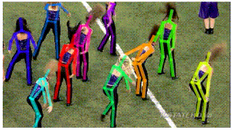
Rough paths: streamed data
Many typed of stream
Reducing video to landmarks and pose is now feasible!
The matchstick men and women are data streams in 30-75 dimensions
  Still need to make sense of the data!
  Starting times shift
  Speed varies
http://mvig.sjtu.edu.cn/research/alphapose.html
Notes:
27secs on

Slide 21
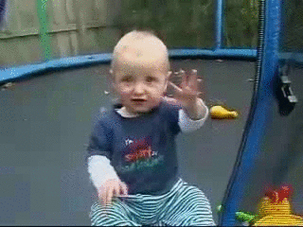
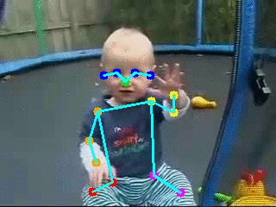
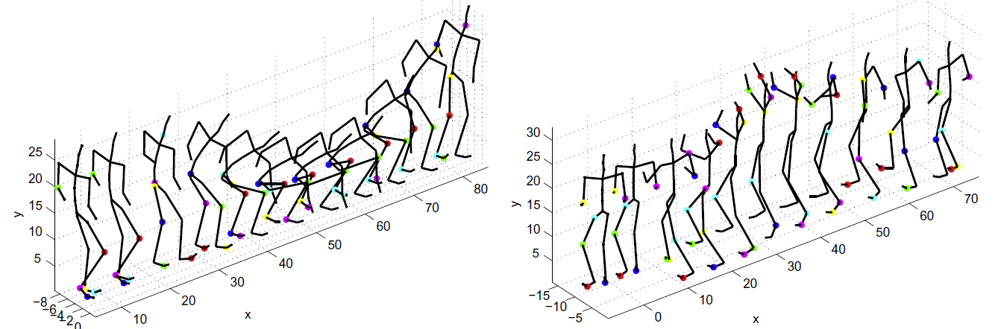
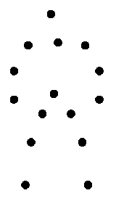
Action recognition
To assign action label to video clip
Pose Estimation
Action Recognition from RGB data
“Clapping”
Action Recognition from landmark data

Slide 22
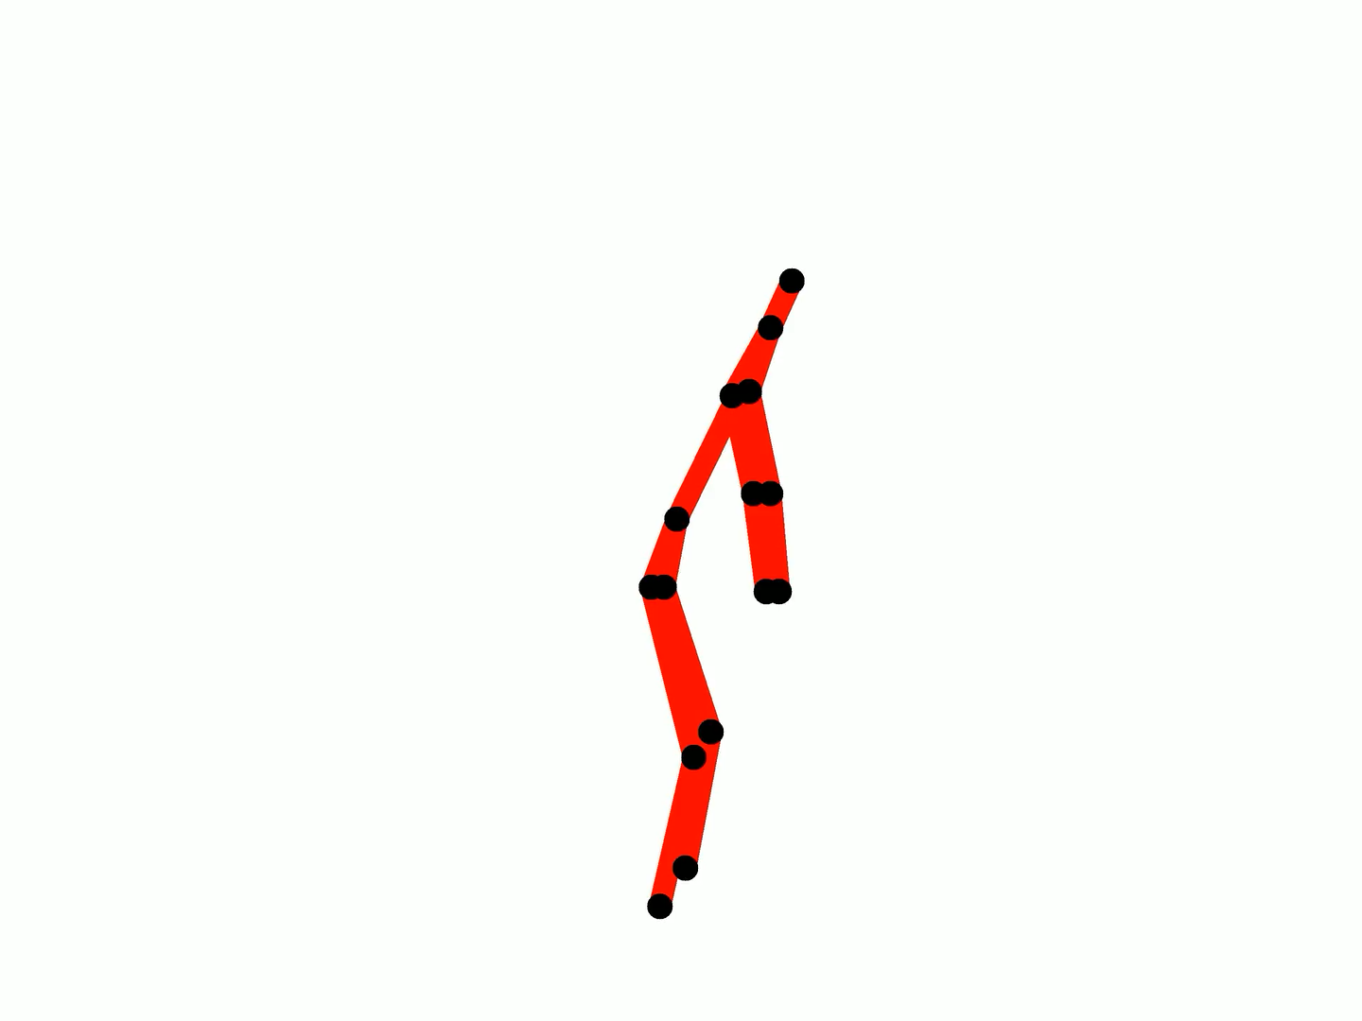

Slide 23
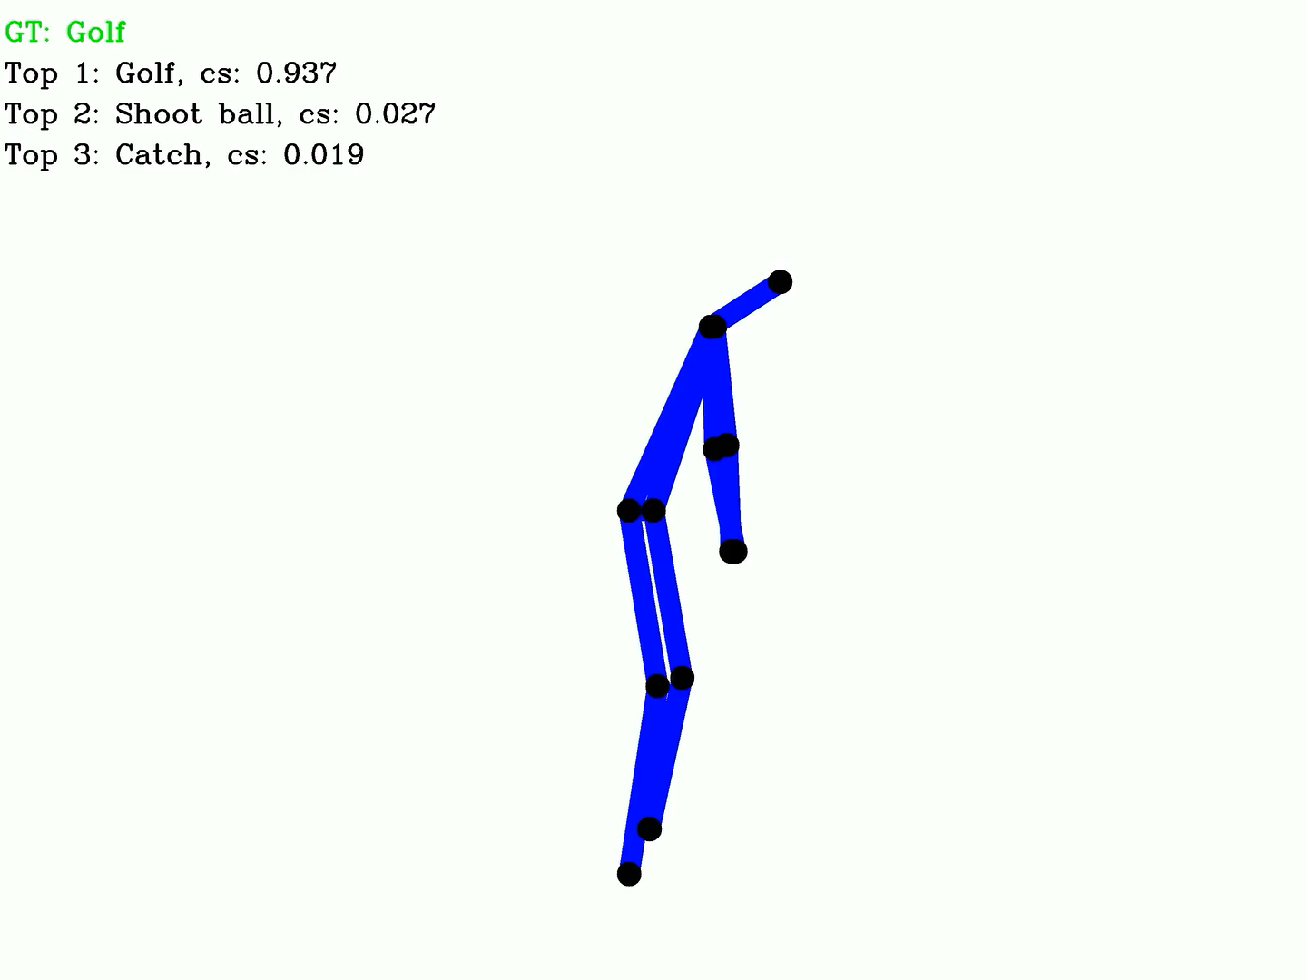
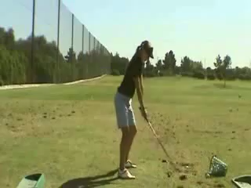
GOLF

Slide 24
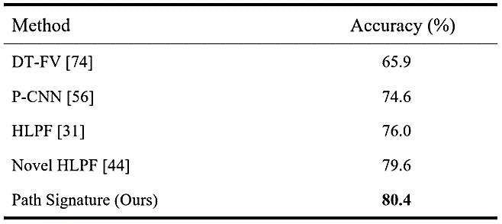
Experimental results
JHMDB dataset
(2D, Ground Truth Pose)
#classes: 21
#samples: 928

Slide 25
Experimental results
Method | Ground Truth Pose | Estimated Pose
 |  | pose only |  | with extra clues
MST [CVPR-14] | - | - |  | 45.3 (RGB)
HLPF [ICCV-13] | 78.2 | 52.9 |  | -
JointAP [CVPR-15] | - | 61.2 |  | -
P-CNN [CVPR-15] | 72.5 | - |  | 66.8 (RGB)
PA-AP [89] | - | 61.5 |  | 74.7 (RGB)
Hierarchical | - | 66.9 |  | 77,5 (RGB)
JDD [IJCAI-16] | 81.9 | - |  | 77.7 (RGB)
RPAN [ICCV-17] | - | - |  | 78.6 (RGB)
Path signature (Ours) | 84.2 | 68.2 |  | 75.7 (confidence)
Sub-JHMDB
#classes: 12
#samples: 319
Privacy

Slide 26
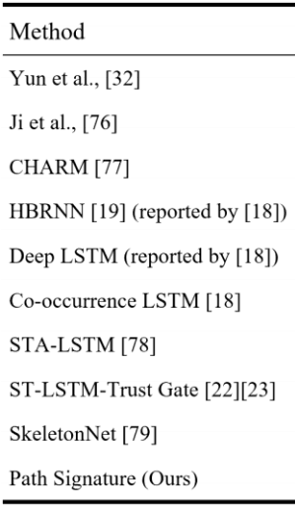
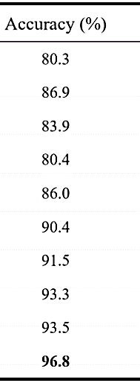
Experimental results
SBU Interaction Dataset (Kinect 3D)
#classes: 21
#samples: 300
Privacy

Slide 27
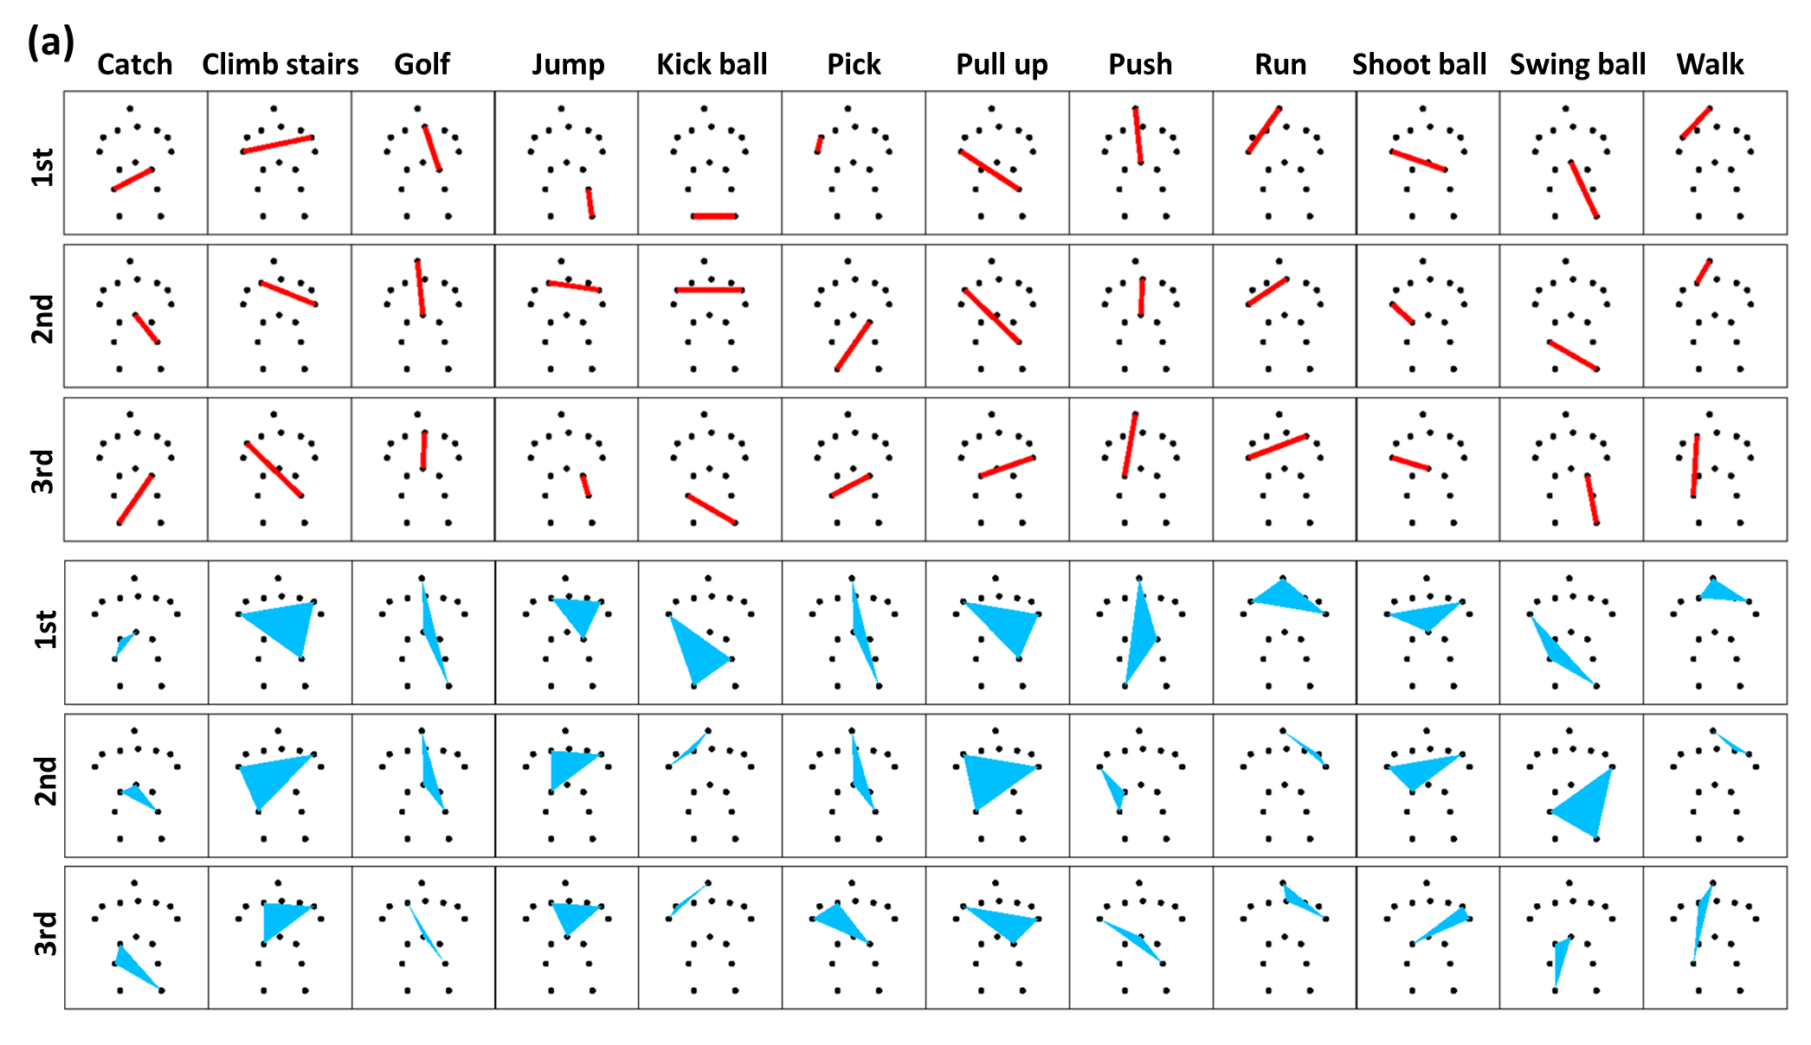
Toward understanding action recognition
For Spatial Structure：
Top-3 most “important” Pairs/Triples on sub-JHMDB dataset

Slide 28
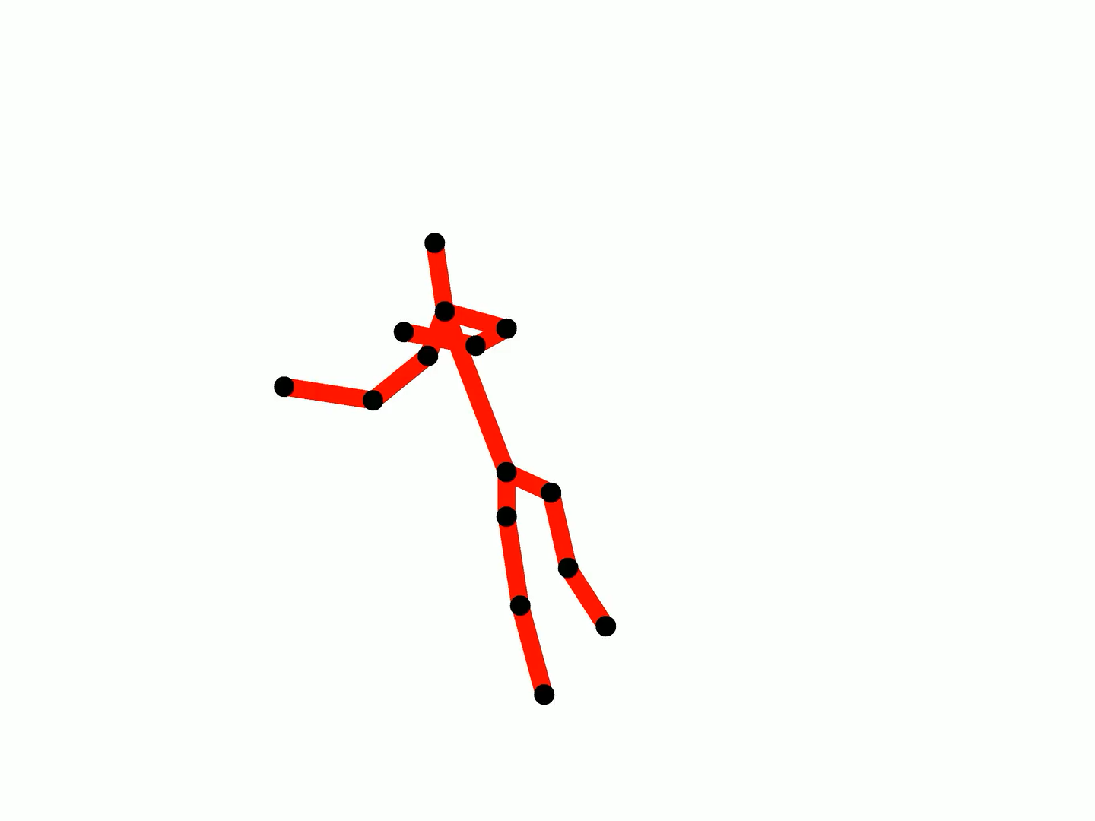

Slide 29
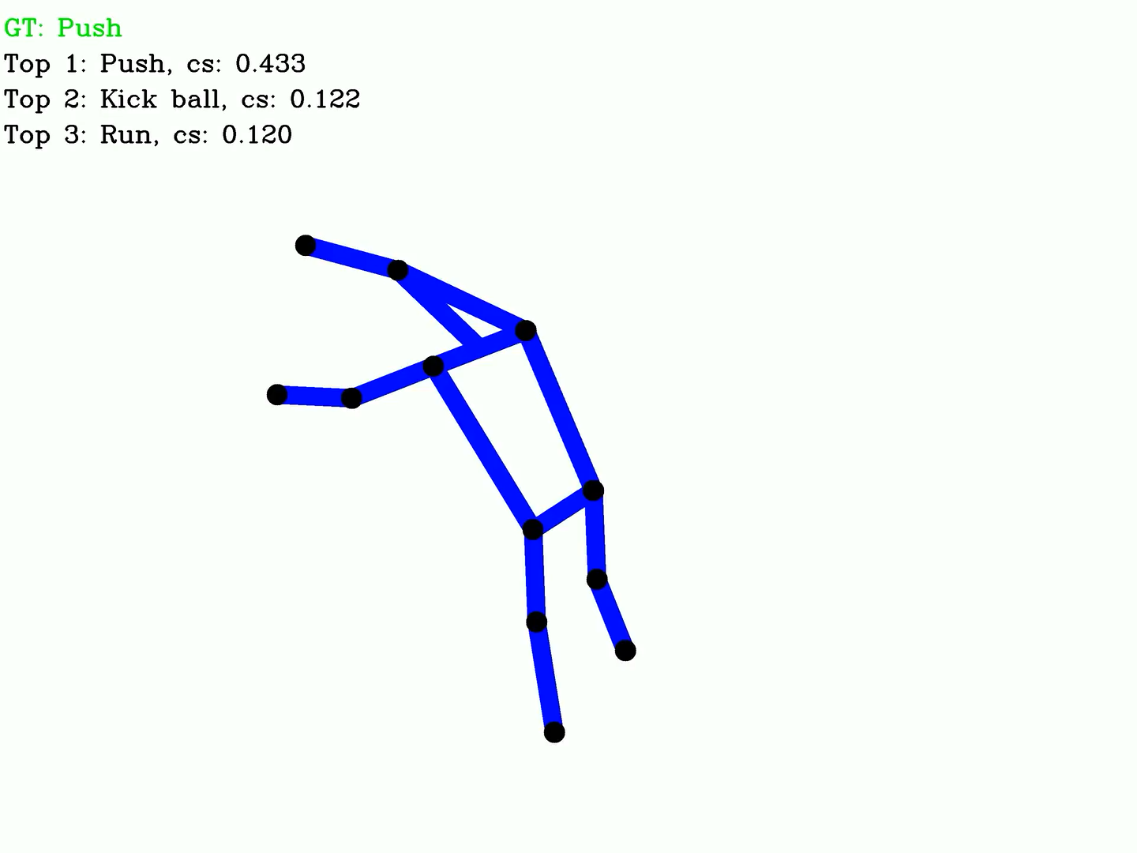
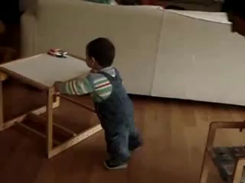
PUSH

Slide 30
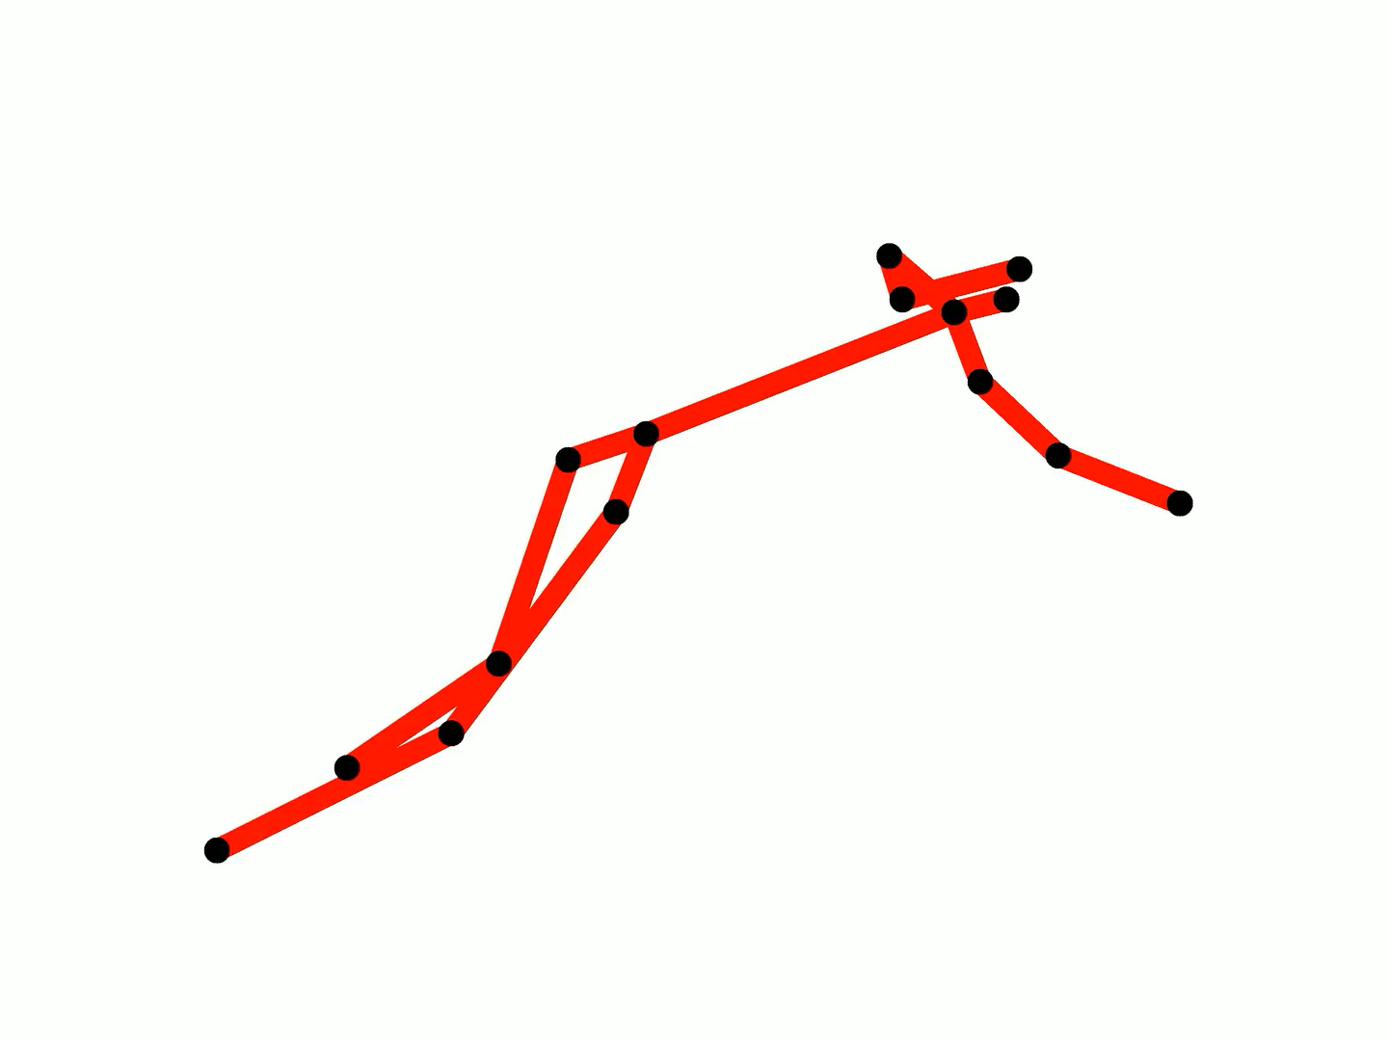

Slide 31
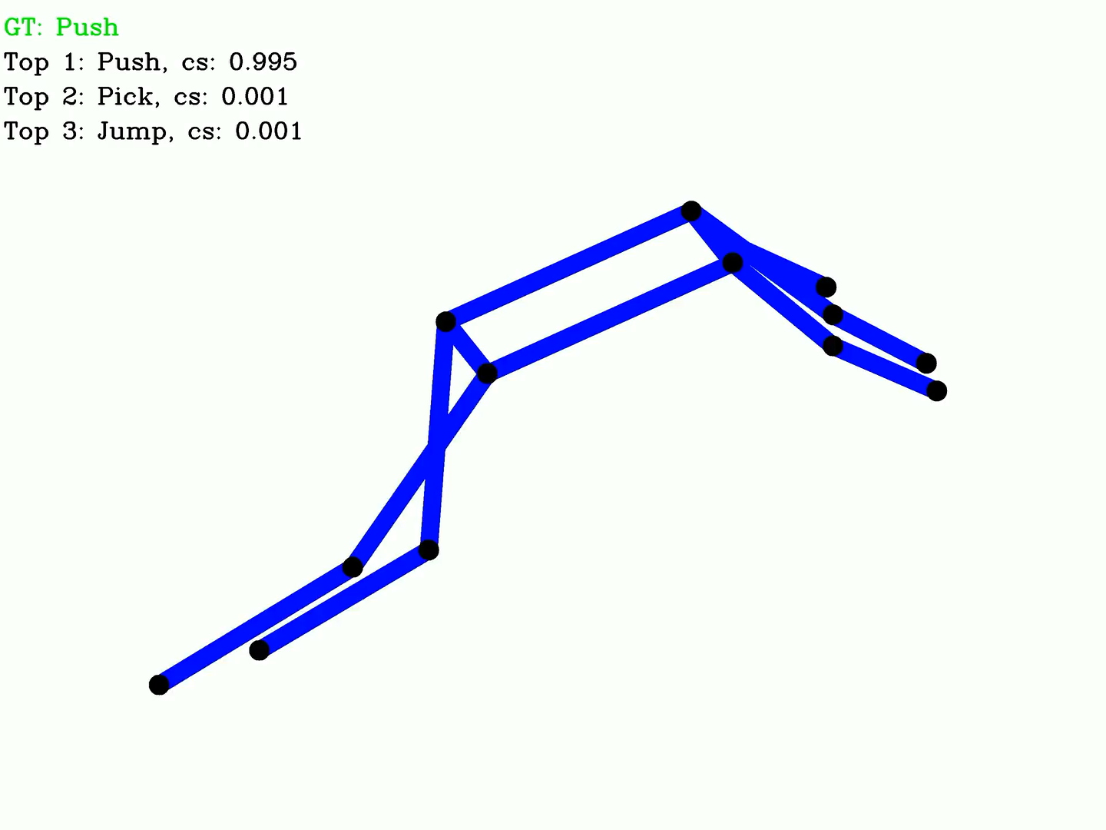
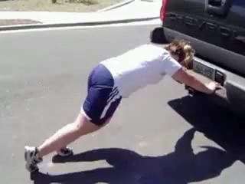
PUSH

Slide 32
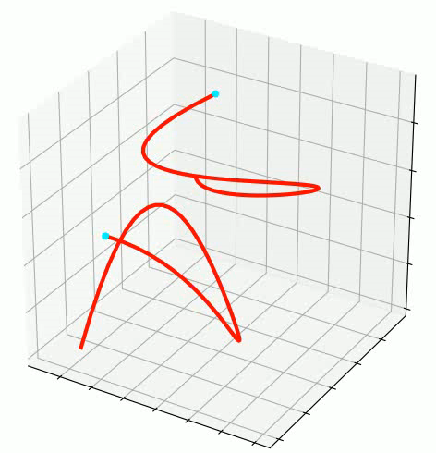
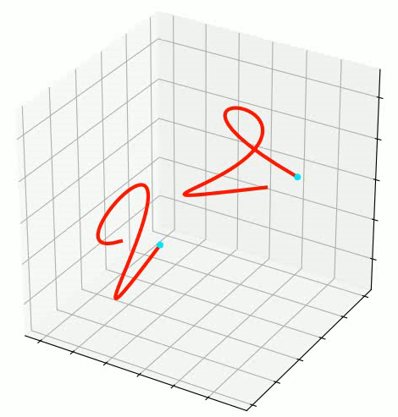

Path recovery examples

Slide 33
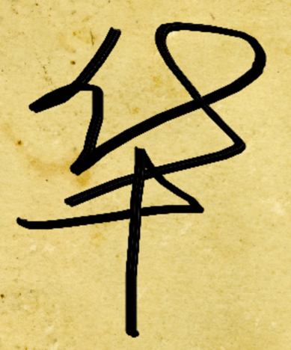
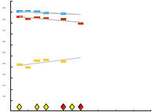

Leveraging the mathematics
Finger drawn characters
Chinese handwriting
Action Recognition
Alzheimer’s Disease
Complex social data
CyberSecurity
Agricultural Data
…
Moving matchstick man
Brain Weights
Evolving mood

Slide 34
Thank you

