Slide 1
Lean Construction: A Contradiction in Terms?
Date: Thursday 12 November 2020, 4.00PM - 5.30PM Location: Online

Slide 2
World Quality Day
The concept of World Quality Day was first introduced by the United Nations in 1990 to increase awareness of the important role that quality plays in securing nations prosperity.
World Quality Day provides an opportunity for organizations to mark their achievements and show how good quality approaches can make a substantial impact on business.

Slide 3
Lean Construction: A Contradiction in Terms?
The Construction Industries have come a long way
But the opportunities for Lean in Construction are considerably more than many sectors
tony@servicesltd.co.uk

Slide 4
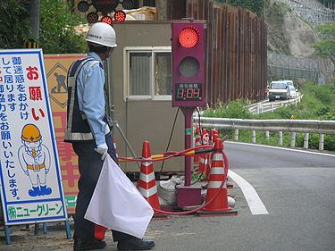
My recollections of Japan 30 years ago.. (the pictures are more current)

Slide 5
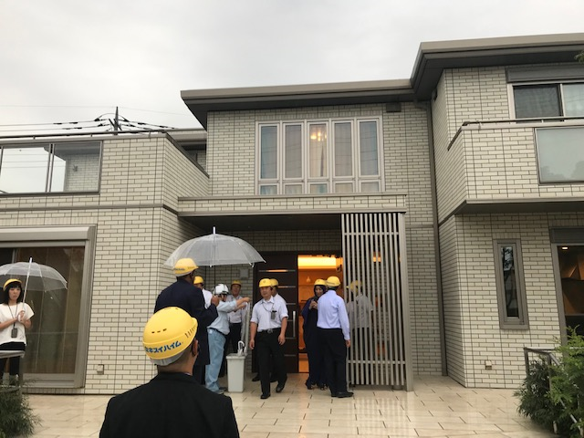
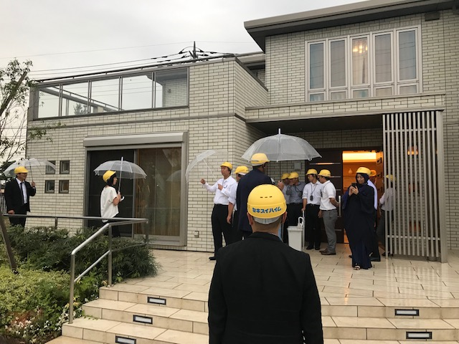
More recently ..

Slide 6
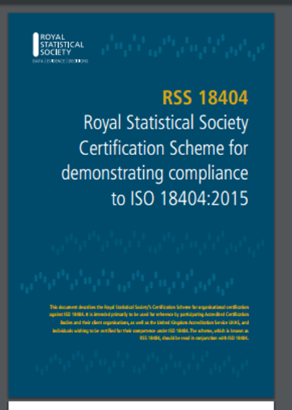
The need for Better Practice in Lean & Six Sigma and the RSS Scheme for ISO18404
Tony Bendell
Chair BSI TC MS6 & A RSS Scheme Lead
tony@servicesltd.co.uk

Slide 7
The need for Better Practice in Lean & Six Sigma and the RSS Scheme for ISO18404
Lean and Six Sigma methods have much to contribute to efficiency and quality across all sectors including manufacturing, service and construction but practice has been largely unregulated and of varied quality.
Implementation programs have often floundered and lost their way, and in some cases the competence of so-called professionals has been questionable.
For this reason, the ISO 18404 standard was developed, and the RSS took on the mantel of scheme owner, working to improve the analytical approach to process, product and service improvement globally.
This talk reports progress on this to date.
tony@servicesltd.co.uk

Slide 8
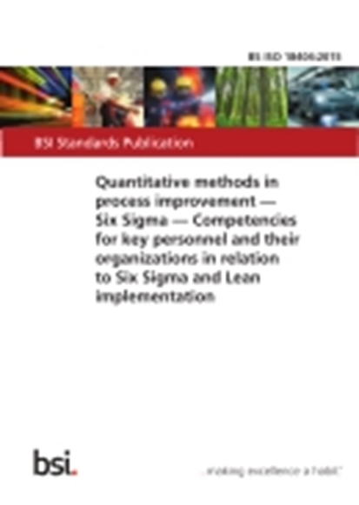
What Does ISO18404 Cover?
“If you advertise for a Six Sigma Black Belt and a candidate appears purporting to be one, how do you know? If an organisation says it is deploying Six Sigma or perhaps Lean, how can you be sure? A fundamental purpose of this standard is to assist in the answer of such questions.
Much debate has been had on the nature of Six Sigma and Lean, their commonality and their differences. ……………….
This standard, therefore, sets out the separate competency requirements for Six Sigma and Lean implementation; it also sets out a combined competency framework for Lean & Six Sigma. In so doing it focuses on the competencies (skills and abilities) to deliver benefits to an organisation rather than defining the specific educational level required for each role.
Candidates will be expected to demonstrate that they have an adequate level of competence, an amalgamation of education, training, skills and experience necessary to fulfil their roles.”
ISO18404: 2015
tony@servicesltd.co.uk
Notes:
In its Introduction, the ISO18404 standard identifies the reason for its creation as the need to be sure about competencies of people and organisations claiming Lean and/or Six Sigma expertise.

Slide 9
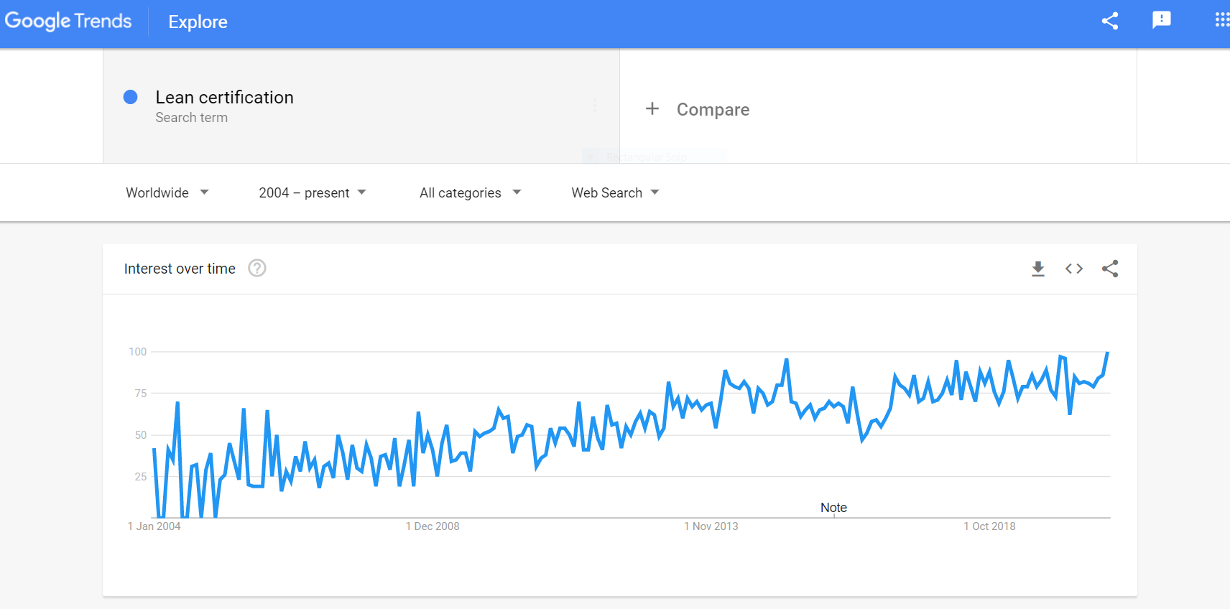
Why Was ISO18404 Created?
Six Sigma Certification
Lean Certification
tony@servicesltd.co.uk
Notes:
The level of interest in Six Sigma and Lean certification is still rising, as can be seen here from Google Trends.

Slide 10
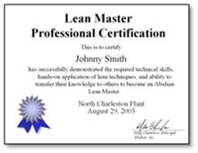
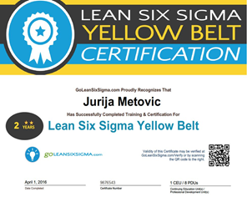
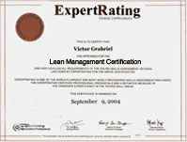
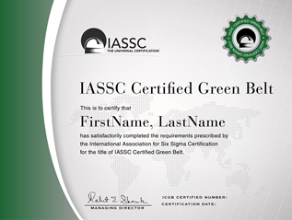
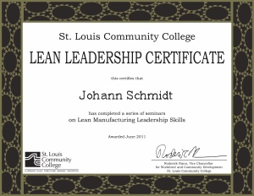
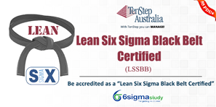
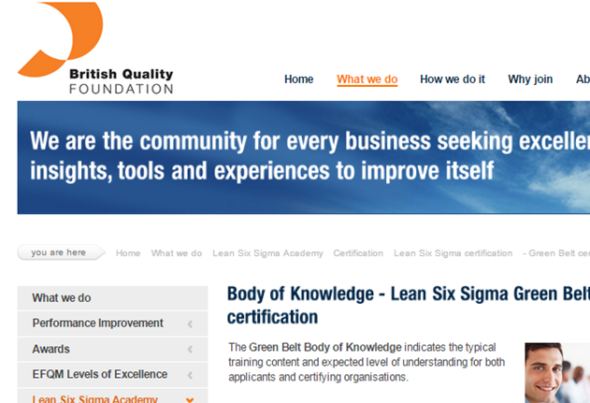
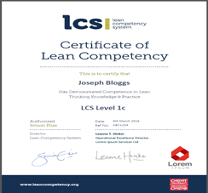
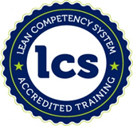
The New ISO18404 Standard- WHY?
Lean & Six Sigma big & lucrative process improvement, training and recognition market.
Unregulated and considerable abuse.
Certification of practitioners from many providers
No real internationally recognised standards
‘Accreditation’ offered by various bodies that in some cases also certified.
Need for organisational management systems for Lean & Six Sigma
tony@servicesltd.co.uk
Notes:
Your interest in taking this course, reflects the widespread interest in Lean and Six Sigma and the fact that today Lean and Six Sigma have become a big and lucrative process improvement, training and recognition market, that until the development of ISO18404 had been largely unregulated and subject to some abuse.
Whilst there were various claims by providers, until ISO18404 was developed there were no universally recognised standards in these fields, and so called ‘accreditation’ of courses, individuals and organisations was offered by various bodies that also offered the courses and certification that in some cases they were themselves accrediting.
.

Slide 11
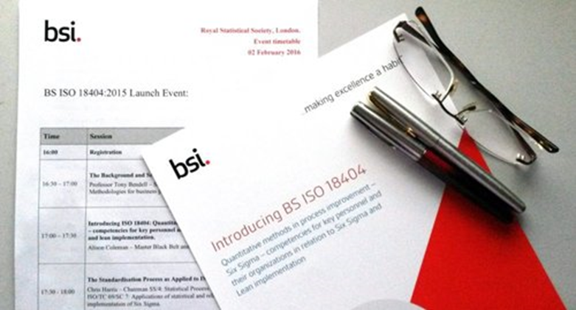
Pilot Scheme Accreditation Arrangements
The ISO18404:2015 international standard was published in December 2015.
In August 2016, UKAS announced a development project for accredited certification under the Royal Statistical Society’s sector scheme for this standard, and sought expressions of interest from interested ISO/IEC 17021 accredited certification bodies.
Harmonised European Accreditation is under consideration & some discussion has taken place internationally in relation to accredited certification under ISO18404.
This accreditation is of the certification bodies that audit organisations against ISO18404, to ensure that they all interpret the standard for certification in a similar way.
tony@servicesltd.co.uk
Notes:
At the time this course is being prepared in October 2015, the ISO8404 standard is in the process of being prepared for publication, so that certification bodies will then be able to certify individuals and inspect organisations against it. At this time, there is also an intention by the United Kingdom Accreditation Service, UKAS, to bring forward a pilot accreditation project under a sector scheme for this standard, so that the standard can go forward for Harmonised European Accreditation, to ensure that identical accreditation rules would be simultaneously established across Europe. It is anticipated that other national accreditation bodies will follow this lead. This accreditation is of the certification bodies that certify individuals and inspect organisations against ISO18404, to ensure that they all interpret the standard for certification in a similar way, and the UK based Royal Statistical Society is acting as the scheme owner. The pilot is expected to last about twelve months.

Slide 12
Organisations Applying for Certification
Organisations applying for certification under the ISO18404 standard as Six Sigma, Lean or Lean & Six Sigma organisations – need to apply to an accredited certification body in the pilot scheme, as these will be the first to be accredited for ISO18404.
BSI is currently leading in this area.
The certification body will ask the applicant to provide evidence that they meet the requirements, according to its own approved specification. In all cases this will include evidence of certification of key personnel by the Royal Statistical Society.
tony@servicesltd.co.uk
Notes:
Organisations applying for certification under the ISO18404 standard as Six Sigma, Lean or Lean & Six Sigma organisations – need to apply to an accredited certification bodies, or initially one of the pilot group of certification bodies in the pilot scheme, as these will be the first to be accredited for ISO18404. The choice of which particular certification body to apply to is up to the applicant. A certification body will ask the applicant to provide evidence that they meet the required competencies, according to its own specification. These requirements specified by the certification bodies are likely to be different between certification bodies, but in each case have been judged in the accreditation process to provide sufficient evidence of competency.

Slide 13
Individuals Applying for Certification
Contact Stuart McKendrick at RSS (or overseas partner or approved training provider)
Submit a portfolio of evidence against the competency requirements defined in ISO 8404 for:
Lean Practitioner, Leader or Expert
Six Sigma Green, Black or Master Black Belt
Lean & Six Sigma Green, Black or Master Black Belt
Attend a (Virtual) Assessment Centre
Presentation, Interview, Test
tony@servicesltd.co.uk

Slide 14
Progress to Date
Organisational Certifications
Personnel Certifications
Lead Auditor Training
International Partner, QCC Abu Dhabi
tony@servicesltd.co.uk

