Slide 1
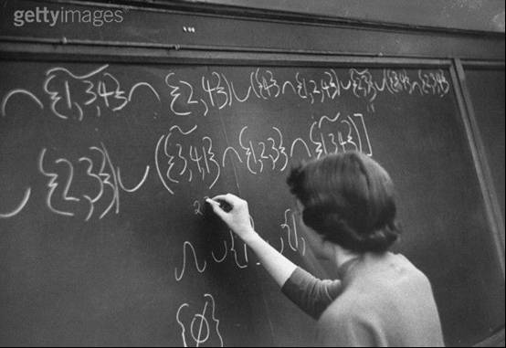
HOW TO WRITE NUMBERS
Alan Jackson
Royal Statistical Society

Slide 2
How to Write Numbers
Part II: System for summarising percentages

Slide 3
How to Write Numbers
Three parts:
grammar and the correct use of words,
system for summarising percentages,
the use of words or figures when writing numbers.

Slide 4
How to Write Numbers
This part is on:
grammar and the correct use of words,
system for summarising percentages,
the use of words or figures when writing numbers.

Slide 5
Summarising Percentages

Slide 6
Summarising Percentages
summarising percentages
sometimes a precise percentage is needed, like 65.9 per cent
sometimes “2 out of 3” is accurate enough and is generally easier to read and recall

Slide 7
Summarising Percentages
The next slide gives a series of precise percentages.
The slide following it summarises the same information, which makes it a bit easier to read.

Slide 8
Summarising Percentages
Before the number of cannons were limited, 19.8 per cent of billiard players were regularly making century breaks, but after the rules changed this fell to 4.9 per cent. Nearly 68.3 per cent of players own their own cue and 48.6 per cent of them play in a local league.

Slide 9
Summarising Percentages
Before the number of cannons were limited, 1 in 5 billiard players were regularly making century breaks, but after the rules changed this fell to 1 in 20. Nearly two-thirds of players own their own cue and half of them play in a local league.

Slide 10
Summarising Percentages
summarising percentages
three kinds of summary have been used
1 in N
because it’s easy enough to compare 1 in 4 with 1 in 9
N in 10
because it’s easy enough to compare 3 in 10 with 7 in 10
N-1 in N
because it’s not too difficult to compare 2 out of 3 with 19 out of 20

Slide 11
Summarising Percentages
summarising percentages
mixing other formats could make the proportions hard to compare
which is bigger 4 in 7 or 5 in 9 ?
what about 3 in 5 or 7 in 12 ?

Slide 12
Summarising Percentages
summarising percentages
Incidentally, the exception is a set of two or more summaries, together in a group (which are not compared with another group), which are of the form x in N, y in N, z in N, …
For example;
1 in 7 2 in 7 4 in 7
2 in 12 3 in 12 8 in 12 9 in 12
1 in 6 1 in 4 2 in 3 3 in 4
2 in 12 3 in 12 8 in 12 9 in 12

Slide 13
Summarising Percentages
The attached PDF document gives a table for summarising percentages: this is part of it.
percentage |  | summary
1.0% |  | 1 in 100
1.1% |  | 1 in 90
 | ...
68.4% |  | two-thirds
71.7% |  | 7 out of 10
 | ...

Slide 14
Summarising Percentages
summarising percentages
to find a percentage summary
look for the smallest percentage (in the percentage column)
which is greater than or equal to the percentage you want to summarise
use the summary next to it

Slide 15
Summarising Percentages
summarising percentages
to find a summary of 18.9%
 | …
15.3% |  | 1 in 7
18.1% |  | 1 in 6
19.2% |  | nearly 1 in 5 or a fifth
21.7% | … | 1 in 5 or a fifth
18.9%
18.9% is

