Slide 1
Susceptibility to COVID-19 misinformation: inoculation gaming as a potential way to reduce the effect of low numeracy skills and analytical thinking Jon Roozenbeek Department of Psychology

Slide 2
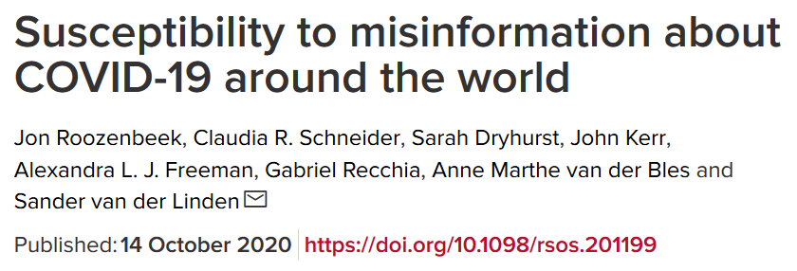
Susceptibility to COVID-19 misinformation

Slide 3
The study
5 countries (UK (2x), Ireland, USA, Spain, Mexico
6 national samples
Plan: to put all (or most) known predictors of susceptibility to misinformation (about COVID-19 and in general) into the same model
Also: see whether susceptibility to COVID-19 misinformation is associated with self-reported willingness to comply with health guidance measures + vaccination intentions

Slide 4
Misinformation about COVID-19
6 statements about COVID-19 that are clearly false
E.g. “The new 5G network may be making us more susceptible to the virus”
Two factual statements, e.g. “People with diabetes are at high risk of complications from coronavirus infection”
One ambiguous statement (about ibuprofen)
“On a 1-7 scale, how reliable do you find the following statement?”
Collapsed as a single index of “susceptibility to COVID-19 misinformation”

Slide 5
Model input
Standard demographic variables: age, gender, education, political affiliation, self-perceived minority status (any minority)
Known predictors of increased/reduced susceptibility to misinformation: numeracy skills, trust in scientists, trust in government, trust in journalists
Covid-specific predictors: risk perception about COVID-19, trust in politicians’ COVID approach, trust in the WHO’s COVID approach, seeking out information about COVID on social media, and seeking out information about COVID from the WHO.
OLS multiple linear regression with “susceptibility to COVID misinformation” as DV

Slide 6
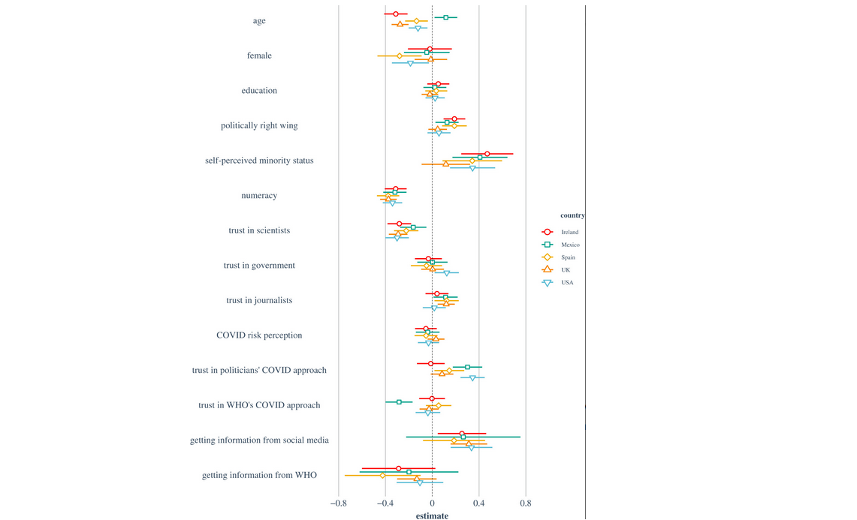

Slide 7
COVID-19 misinformation & health behaviour
“Would you get vaccinated against COVID-19?” (yes/no)
Common demographic variables: age, gender, education, political affiliation, minority status
Also: numeracy skills & trust in scientists
And: susceptibility to misinformation
Logistic regression with vaccine intentions as DV.

Slide 8
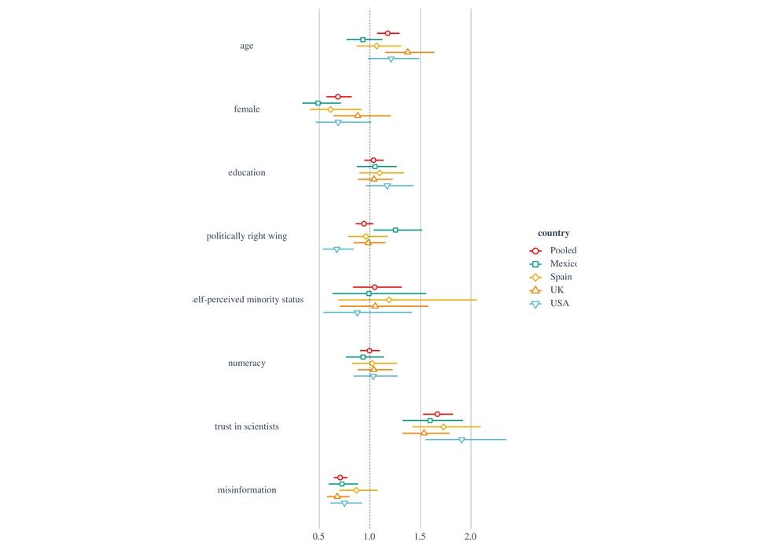

Slide 9
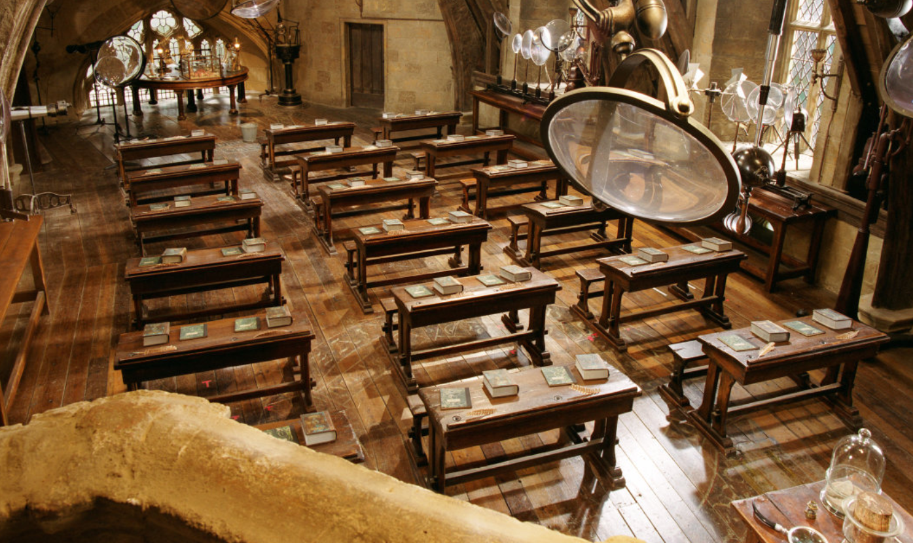
Defence Against the Dark Arts
"Your defences must therefore be as flexible and inventive as the arts you seek to undo"
—Professor Snape

Slide 10
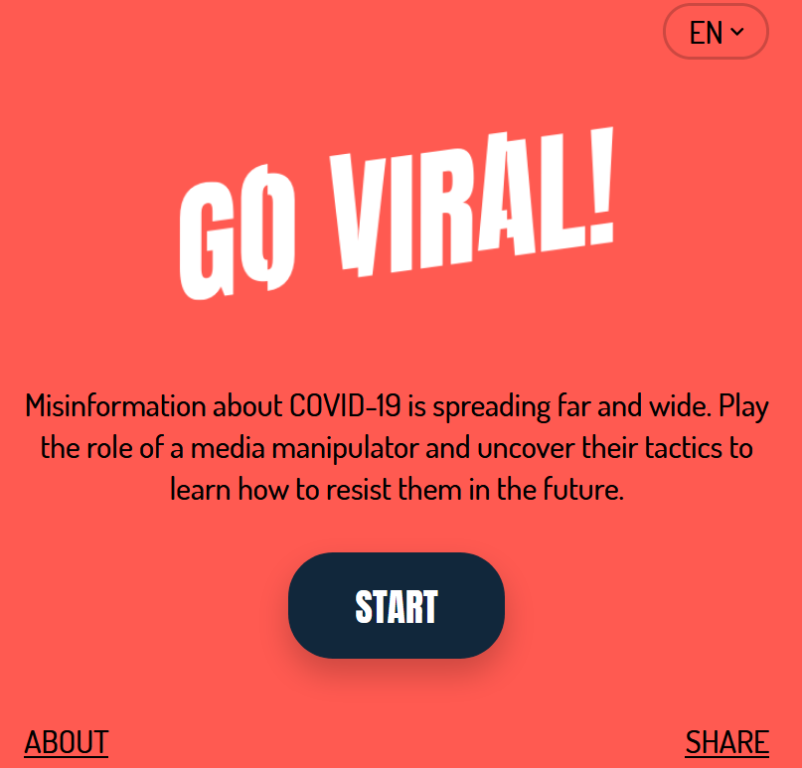
Go Viral! – www.goviralgame.com

Slide 11
Pre-registered multi-country RCT (N = 1,775)
3 countries: UK, Germany, France
3 conditions: Go Viral, UNESCO COVID infographics, control (Tetris)
Does playing Go Viral/reading infographics improve people’s ability to spot manipulative content?
Does playing Go Viral/reading infographics improve people’s confidence in their ability to do so?
Does playing the game/reading the infographics reduce people’s self-reported willingness to share misinformation about COVID with others?

Slide 12
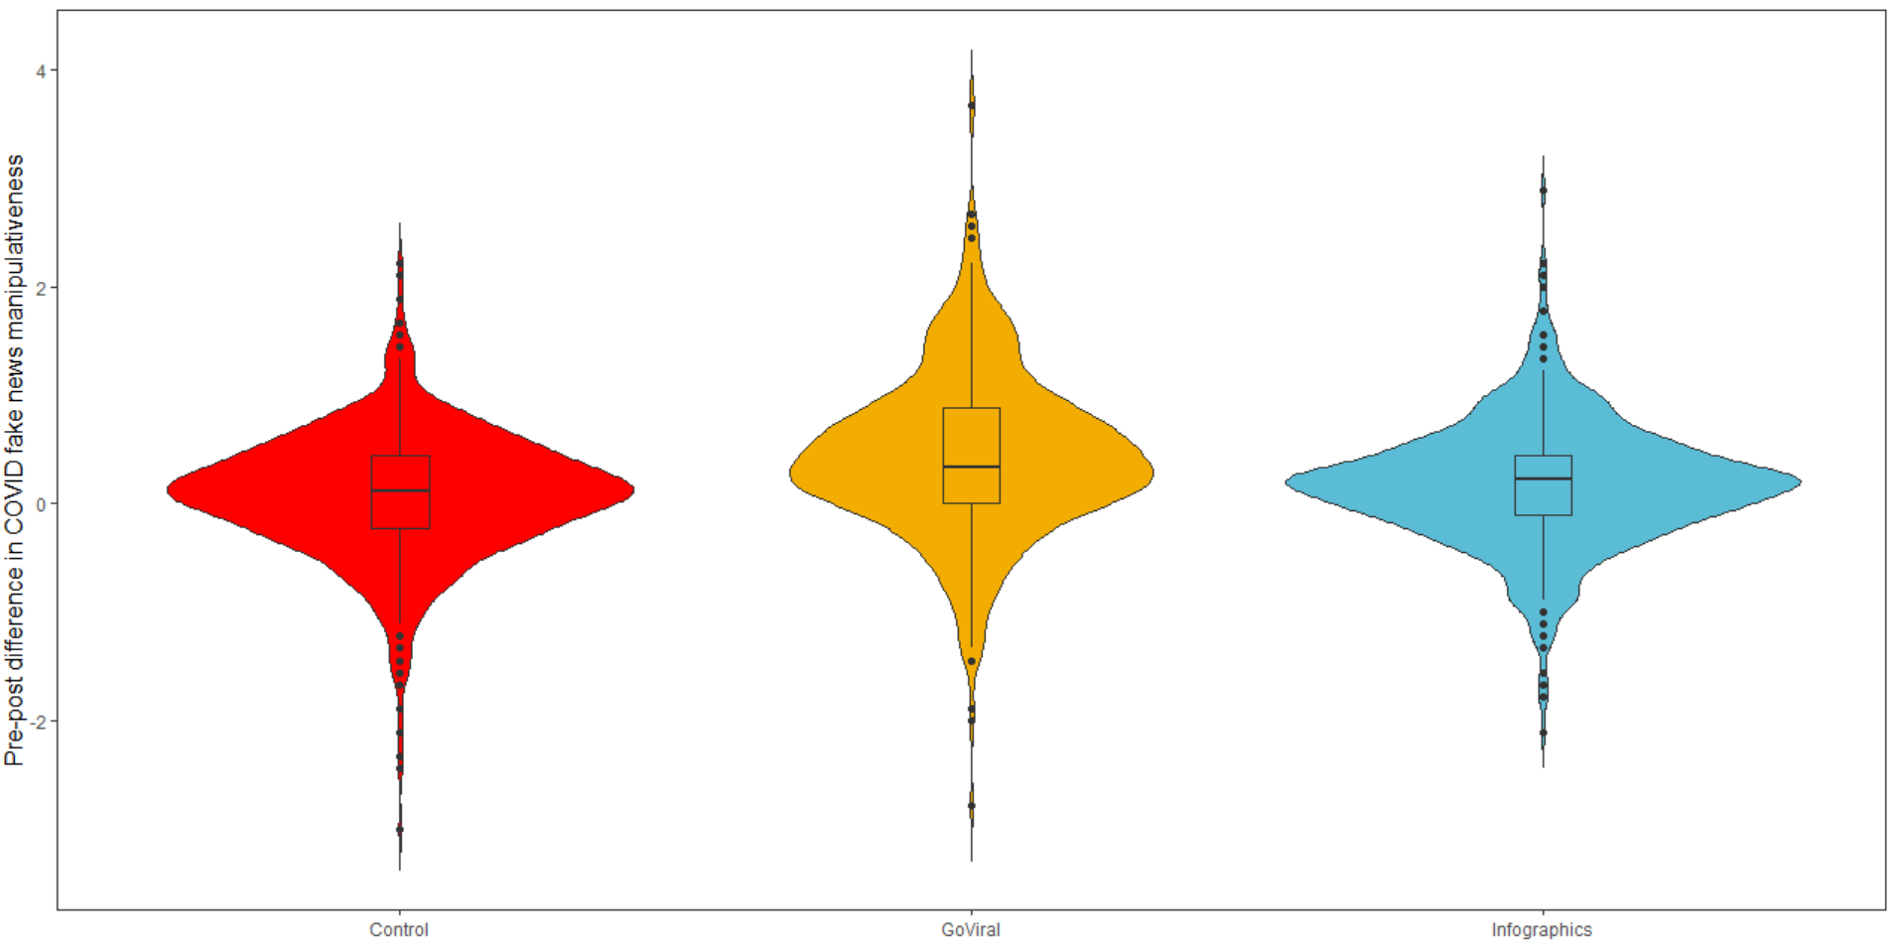
Results (sneak peek)

Slide 13
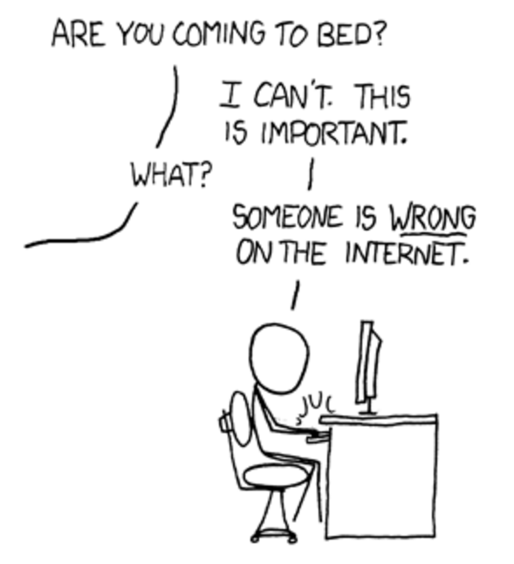
Thank you!
jjr51@cam.ac.uk

