Slide 1
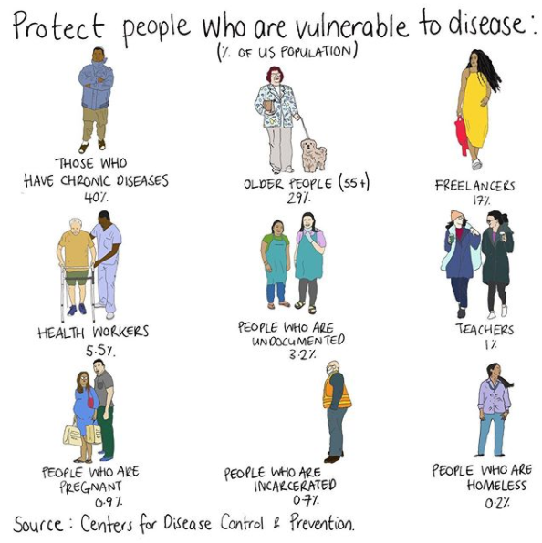
Humanising COVID-19 data through data comics and graphic medicine
Anna Feigenbaum
Associate Professor in Communication & Digital Media
Bournemouth University
@drfigtree
Mona Chalabi (instagram)

Slide 2
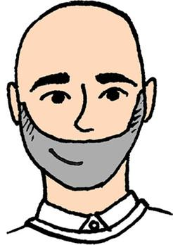
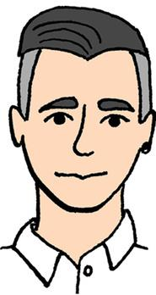
Anna Feigenbaum
Aria Alamalhodaei
Alexandra Alberda
Minute Works designers
Dom Latham & Jimmy Edmondson
Routledge 2020
*Research Assistants: Ozlem Demirkol & Dan Weissmann

Slide 3
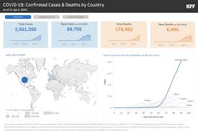
DE-HUMANISING ELEMENTS OF DATA STORYTELLING
By turning human lives and narratives into numbers, data visualisations and infographics often:
Take on an authorial perspective or ‘gods-eye view’
Sanitise experience and emotion
Reduce complexity into simple demographics
Notes:
We are talking about data storytelling in visualisations and infographics that are about the pandemic and public health. Just to be clear this critique is of the end product images and the stories they convey, not about public health workers, policies or planning.

Slide 4
CDC coronavirus - public facing infographic
John Hopkins university COVID-19 open data dashboard

Slide 5
“WE ARE READY TO QUESTION THE IMPERSONALITY OF A MERELY TECHNICAL APPROACH TO DATA, AND TO BEGIN DESIGNING WAYS TO CONNECT NUMBERS TO WHAT THEY REALLY STAND FOR: KNOWLEDGE, BEHAVIOURS, PEOPLE.”
Georgia Lupi, 2017

Slide 6
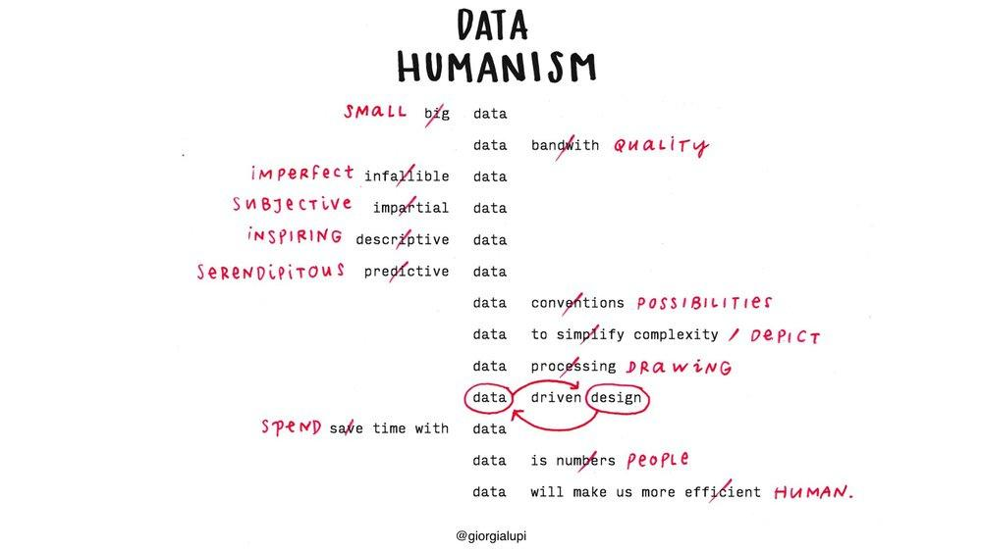
Georgia Lupi, Data Humanism

Slide 7
Tell data stories from the edges of chaos

Slide 8
Alexandra Alberda
Arthur Frank's restitution narrative
illustrated by Alexandra Alberda
Advil (ibuprofen) advertisement example of a restitution narrative

Slide 9
Arthur Frank's quest narrative
illustrated by Alexandra Alberda
Slimming World (weight loss) magazine example of a quest narrative

Slide 10
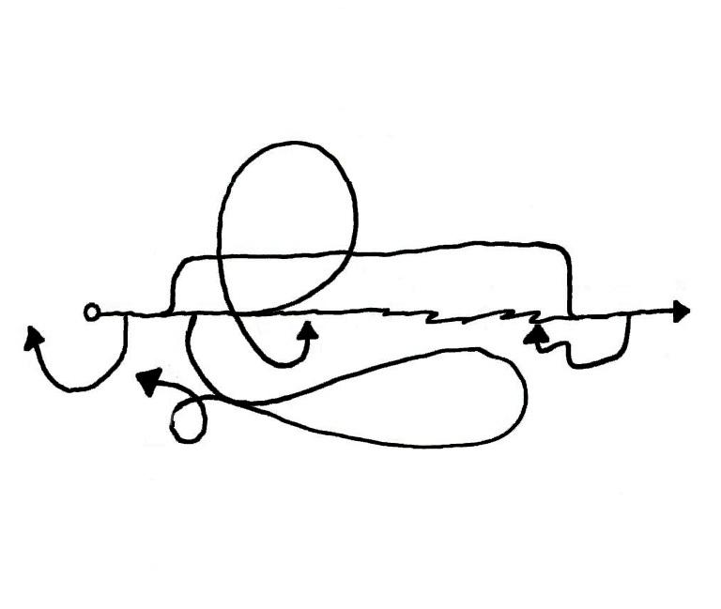
Arthur Frank's chaos narrative
illustrated by Alexandra Alberda

Slide 11
Troubles that go down to a ‘bottomless depth’
A lack of control and a feeling of being swept away
Stories that relate a spiral of suffering characterised by “and then, and then, and then” narrative progressions
They are hard for listeners to hear because they are threatening and can provoke anxiety and feelings of helplessness
They are emotionally battering
Arthur Frank 1995, 2013

Slide 12
THE ILL PERSON’S LOSS OF CONTROL IS AMPLIFIED BY THE MEDICAL ESTABLISHMENT’S INABILITY TO CONTROL THE DISEASE
Feigenbaum, KCL Keynote Paper, 27 November 2021

Slide 13
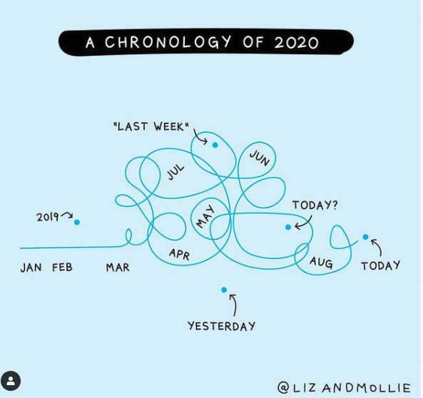
Art and IG by Liz Fosslien, No Hard Feelings (book) by Liz and Mollie (instagram)

Slide 14
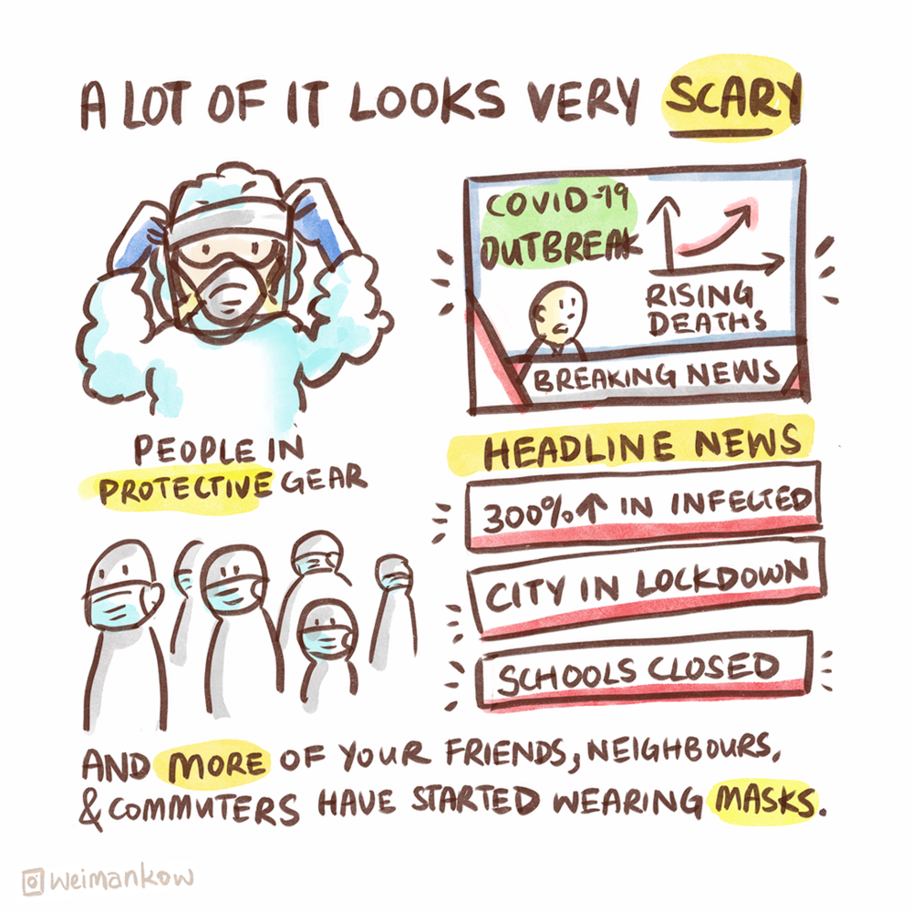
BENEFITS OF GRAPHIC MEDICINE
Approachable
Prevalent in popular culture
Created and read in many cultures
Accessible
Medium used in literacy training
Iconography represents local/regional/national identities
Effective visuals can get closer to meaning than text
Relatable
Tells the human-side of a health issue
Builds communities
Notes:
Approachable
•Prevalent in popular culture
•Cross-cultural medium
Accessible
•Easy to understand format
•Iconography represents local/regional/national identities
•Effective visuals can get closer to meaning than text
Relatable
•Tells the human-side of a health issue
•Builds communities

Slide 15
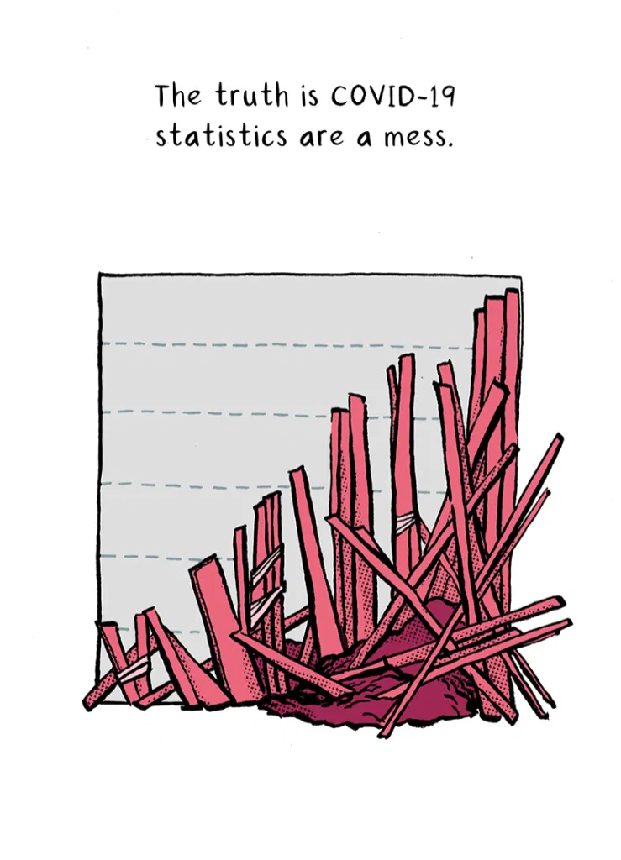
BENEFITS OF DATA COMICS
By embedding data and messages into a story or narrative:
They (can) disrupt authorial voices
They (can) refuse sanitization
They (can) present complex personhood and concepts
Katy Doughty, 2020, The Nib
Notes:
https://thenib.com/the-true-toll-of-covid-19/
Katy Doughty works in hospital administration and was responsible for updating an online Corona virus guide.

Slide 16
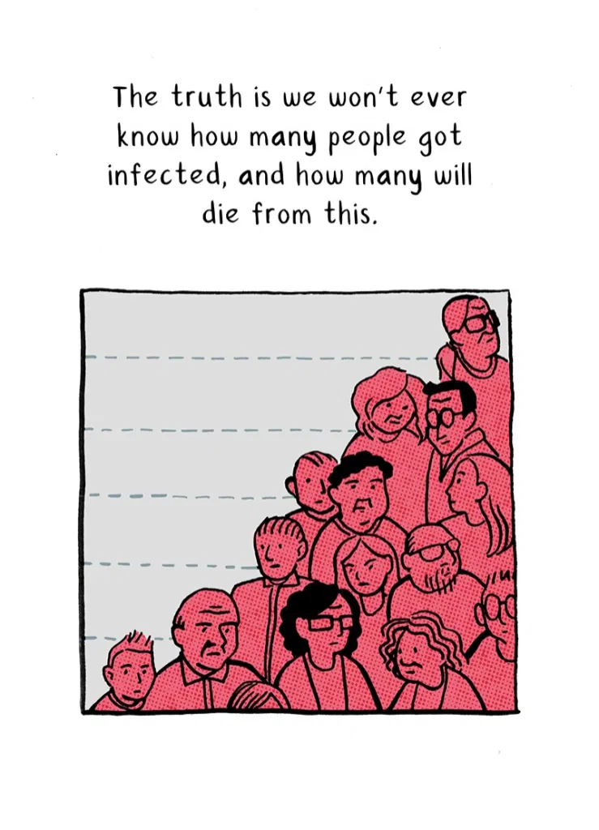
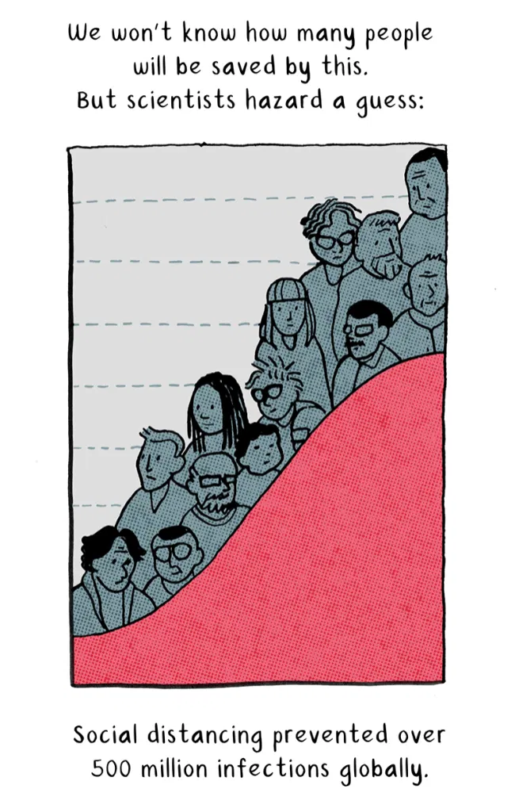
BENEFITS OF DATA COMICS
Panels from Katy Doughty, 2020, The Nib

Slide 17
THREE WAYS TO HUMANISE STATISTICAL CHAOS

Slide 18
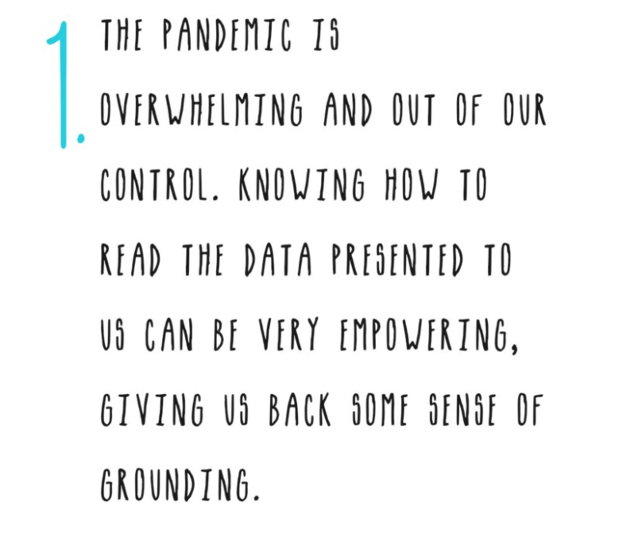
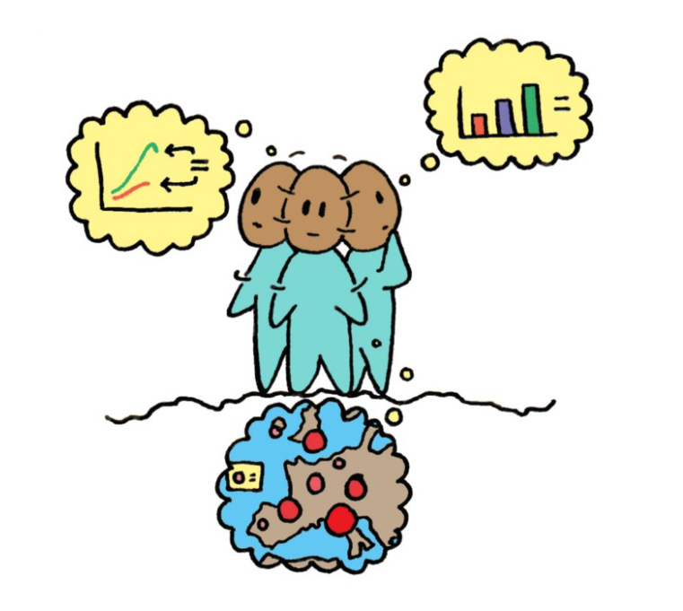
DATA LITERACY
grounding through empowerment
panels from our web-comic COVID-19 Data Visualisation Literacy is for Everyone
https://medium.com/nightingale/covid-19-data-literacy-is-for-everyone
Notes:
Katy Doughty works in hospital administration and was responsible for updating an online Corona virus guide.
_coronadiary
I teamed up with @risingartsagency responding to the question Covid 19 who is left out of the conversation ?
I asked followers for feedback and there was a lot! I picked 9 answers then spoke either directly to people who identified under these categories or alternatively found online quotes from those in response to the pandemic.

Slide 19
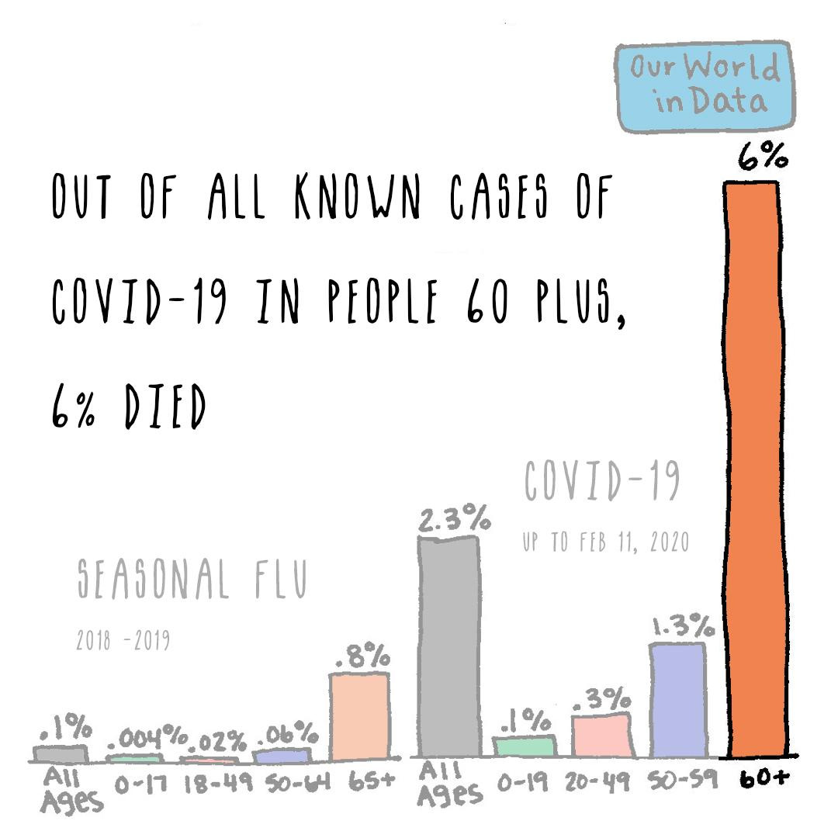
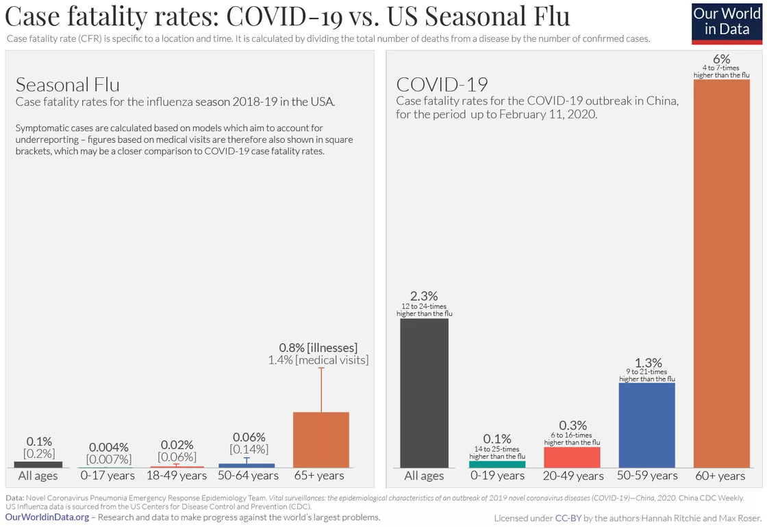
DATA LITERACY
grounding through empowerment
panels from our web-comic COVID-19 Data Visualisation Literacy is for Everyone
https://medium.com/nightingale/covid-19-data-literacy-is-for-everyone
Notes:
Katy Doughty works in hospital administration and was responsible for updating an online Corona virus guide.
_coronadiary
I teamed up with @risingartsagency responding to the question Covid 19 who is left out of the conversation ?
I asked followers for feedback and there was a lot! I picked 9 answers then spoke either directly to people who identified under these categories or alternatively found online quotes from those in response to the pandemic.

Slide 20
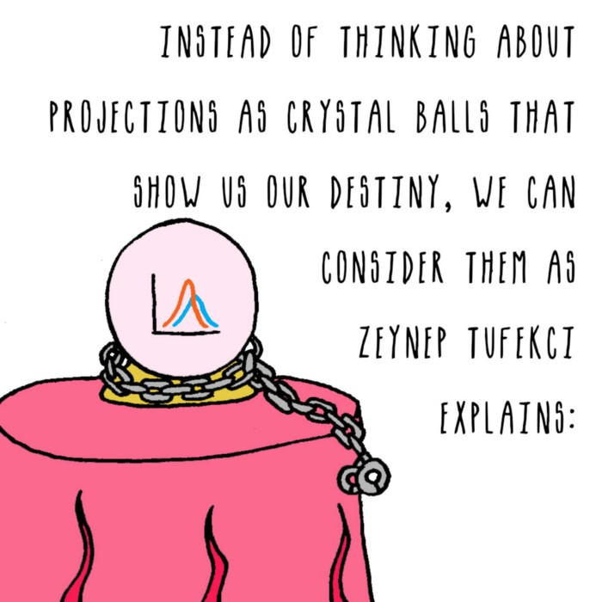
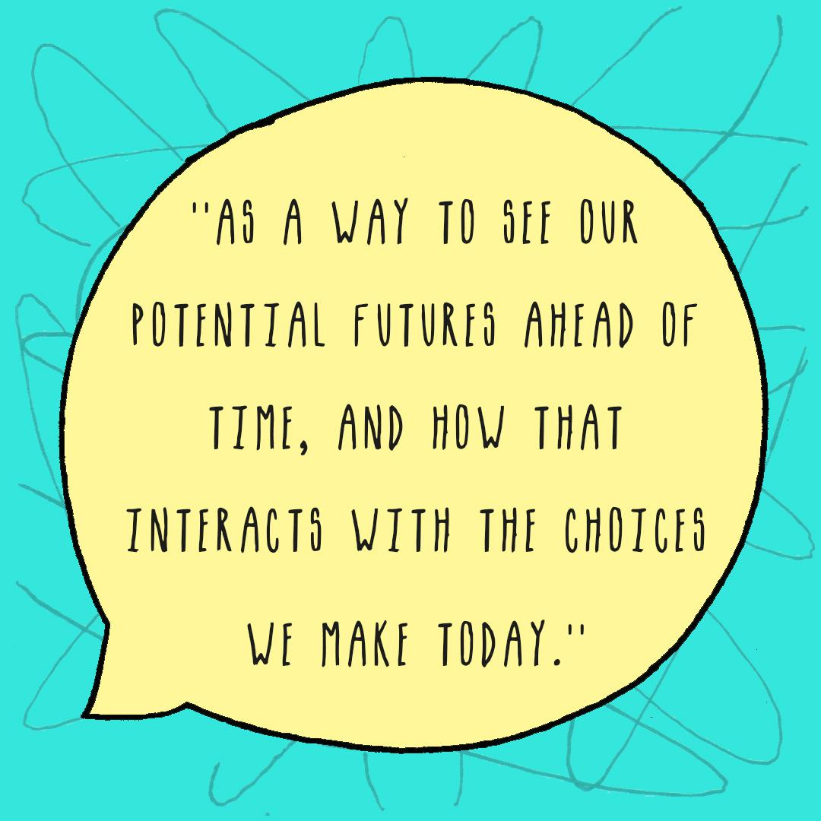
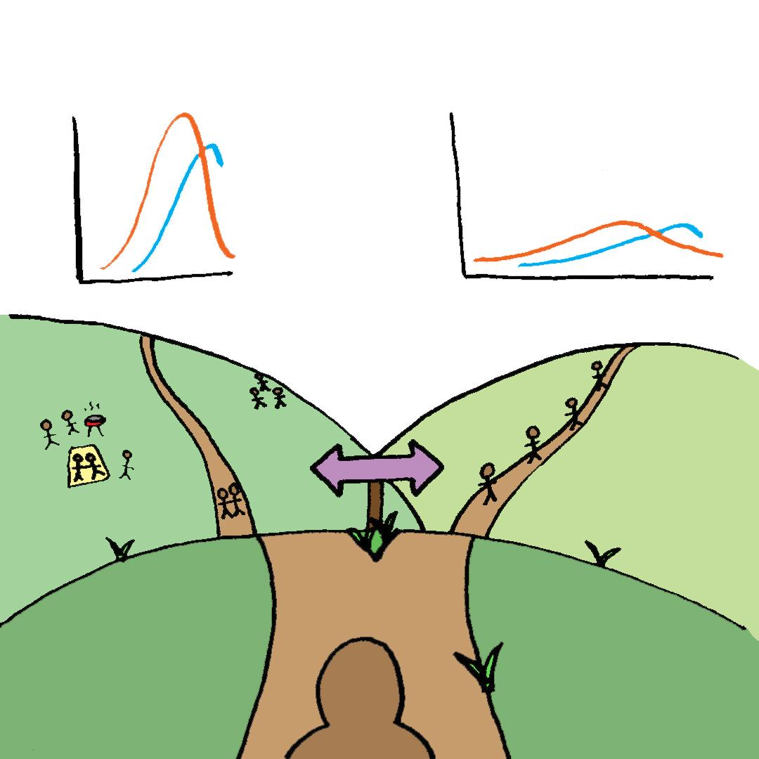
DATA LITERACY
grounding through empowerment
panels from our web-comic COVID-19 Data Visualisation Literacy is for Everyone
https://medium.com/nightingale/covid-19-data-literacy-is-for-everyone
Notes:
Katy Doughty works in hospital administration and was responsible for updating an online Corona virus guide.
_coronadiary
I teamed up with @risingartsagency responding to the question Covid 19 who is left out of the conversation ?
I asked followers for feedback and there was a lot! I picked 9 answers then spoke either directly to people who identified under these categories or alternatively found online quotes from those in response to the pandemic.

Slide 21
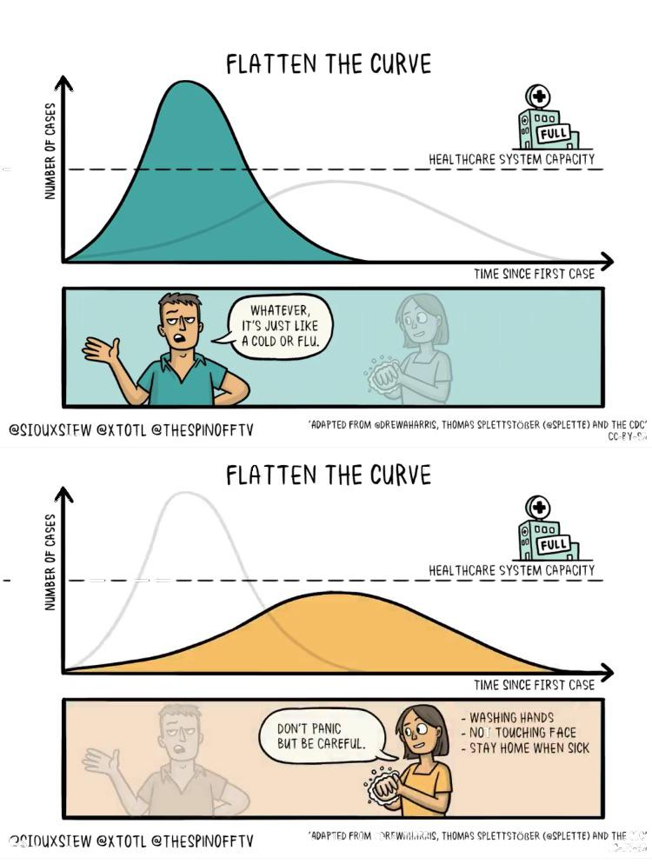
DATA LITERACY
grounding through empowerment
“Animated illustrations by cartoonist Toby Morris and microbiologist Siouxsie Wiles explaining the importance of social distancing during the coronavirus outbreak have gone viral after they were published by a website in New Zealand.” https://www.dezeen.com/2020/03/22/coronavirus-animations-toby-morris-siouxsie-wiles-design-graphics/
Notes:
_coronadiary
I teamed up with @risingartsagency responding to the question Covid 19 who is left out of the conversation ?
I asked followers for feedback and there was a lot! I picked 9 answers then spoke either directly to people who identified under these categories or alternatively found online quotes from those in response to the pandemic.

Slide 22
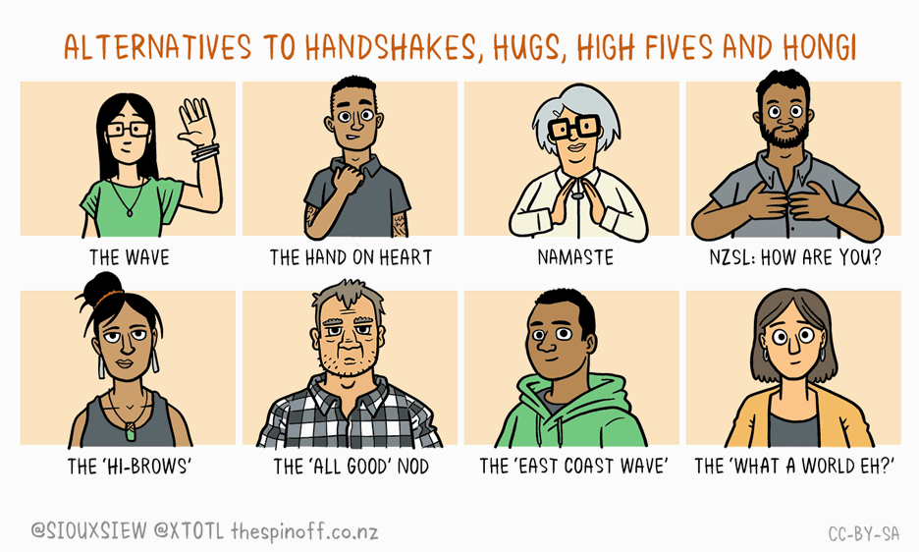
DATA LITERACY
grounding through empowerment
“Animated illustrations by cartoonist Toby Morris and microbiologist Siouxsie Wiles explaining the importance of social distancing during the coronavirus outbreak have gone viral after they were published by a website in New Zealand.” https://www.dezeen.com/2020/03/22/coronavirus-animations-toby-morris-siouxsie-wiles-design-graphics/
Notes:
_coronadiary
I teamed up with @risingartsagency responding to the question Covid 19 who is left out of the conversation ?
I asked followers for feedback and there was a lot! I picked 9 answers then spoke either directly to people who identified under these categories or alternatively found online quotes from those in response to the pandemic.

Slide 23
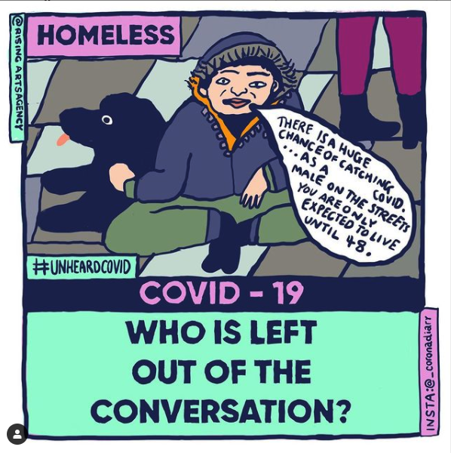
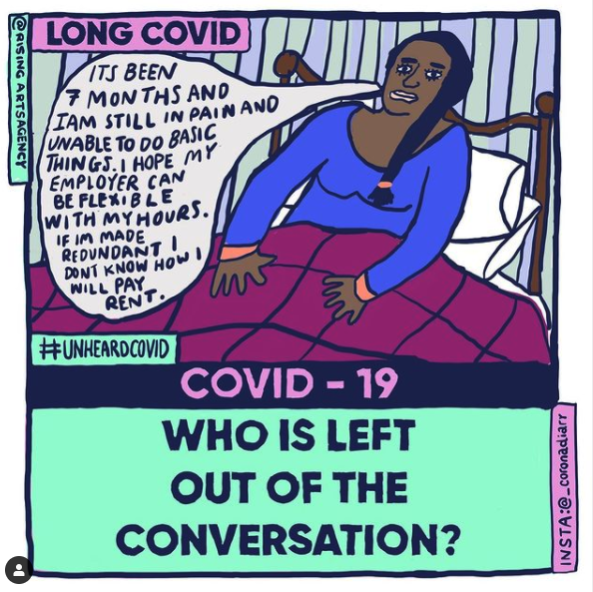
EMPATHY
humanising what is counted and uncounted
Monique Jackson, @_coronadiary collaboration with @risingartsagency #UNHEARDCOVID, 2020
Notes:
Katy Doughty works in hospital administration and was responsible for updating an online Corona virus guide.
_coronadiary
I teamed up with @risingartsagency responding to the question Covid 19 who is left out of the conversation ?
I asked followers for feedback and there was a lot! I picked 9 answers then spoke either directly to people who identified under these categories or alternatively found online quotes from those in response to the pandemic.

Slide 24
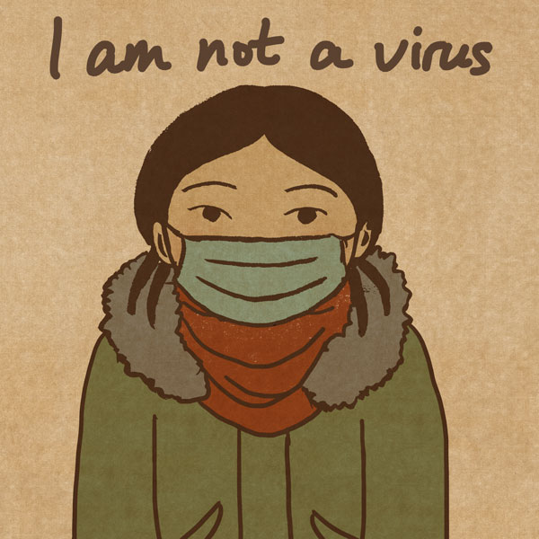
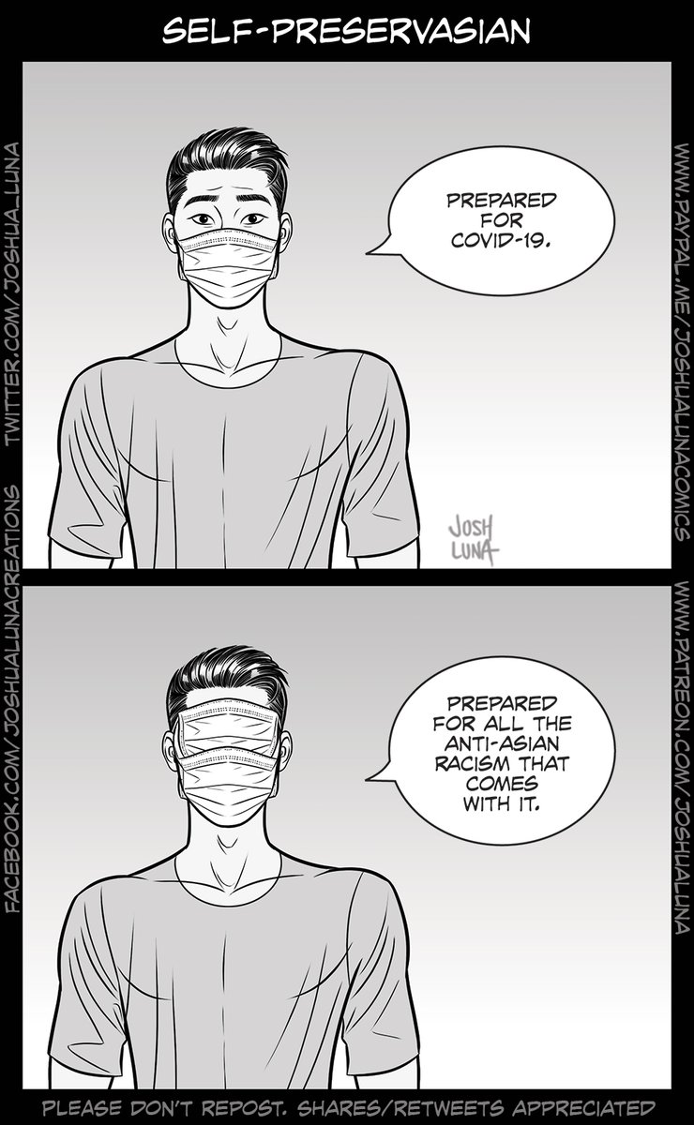
EMPATHY
humanising what is counted and uncounted
“The title of [Sjoblom’s] series stemmed from a hashtag, #IAmNotAVirus, that was started by French Asians in response to racist incidents on public transportation and through social media. The movement has also inspired other illustrators on Instagram to create art in response.”
https://www.pbs.org/newshour/arts/i-am-not-a-virus-how-this-artist-is-illustrating-coronavirus-fueled-racism
Wool-Rim Sjöblom
Joshua Luna
Notes:
_coronadiary
I teamed up with @risingartsagency responding to the question Covid 19 who is left out of the conversation ?
I asked followers for feedback and there was a lot! I picked 9 answers then spoke either directly to people who identified under these categories or alternatively found online quotes from those in response to the pandemic.

Slide 25
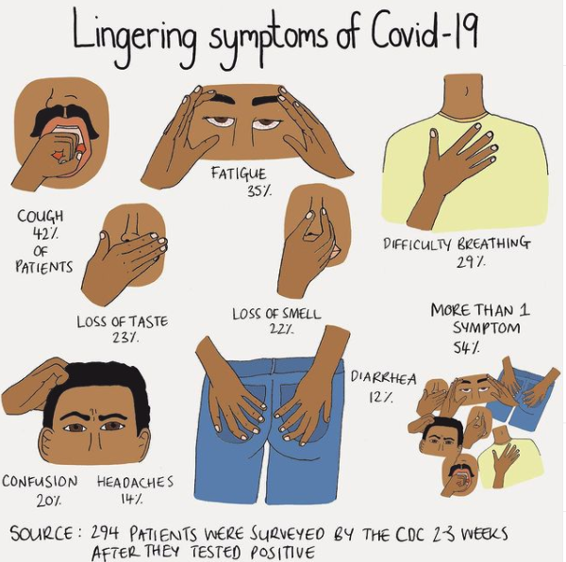
EMPATHY
humanising what is counted and uncounted
Mona Chalabi was recently made an honourary fellow of the British Science Association for her work communicating data on COVID-19 https://www.instagram.com/monachalabi/
Notes:
_coronadiary
I teamed up with @risingartsagency responding to the question Covid 19 who is left out of the conversation ?
I asked followers for feedback and there was a lot! I picked 9 answers then spoke either directly to people who identified under these categories or alternatively found online quotes from those in response to the pandemic.

Slide 26
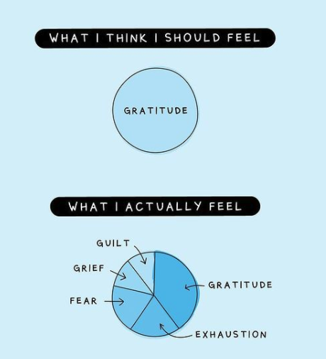
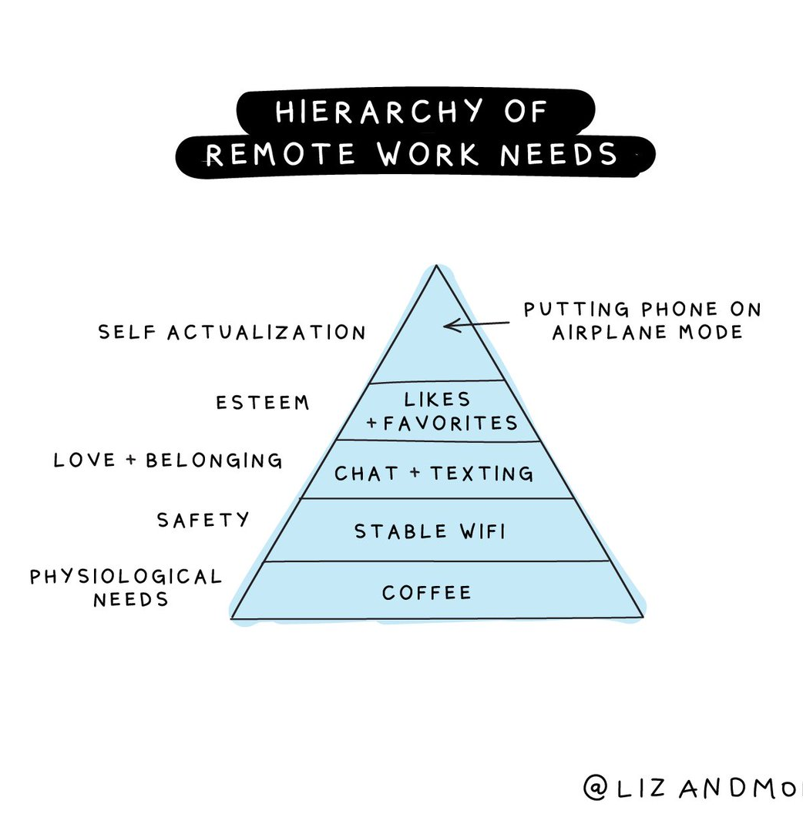
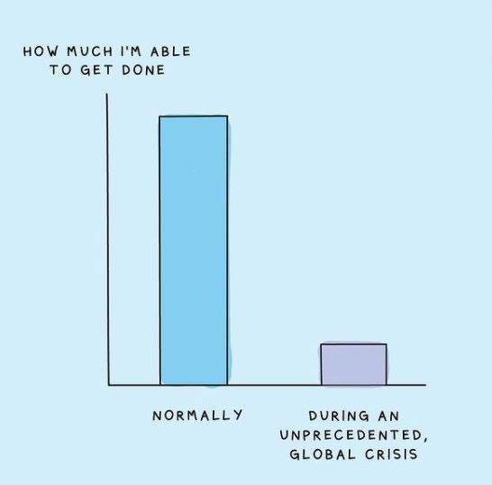
AGENCY
can’t control the big things, can control what’s in front of us
“Liz Fosslien is head of content at Humu, a company that nudges people toward better work habits. Mollie West Duffy is an organizational development expert and consultant. They are the authors of the book No Hard Feelings: The Secret Power of Embracing Emotions at Work.” https://sloanreview.mit.edu/article/managing-stress-and-emotions-when-working-remotely/
Notes:
https://firstround.com/review/weathering-the-emotional-storms-of-a-crisis-a-tactical-guide-for-individual-contributors-and-managers/
_coronadiary
I teamed up with @risingartsagency responding to the question Covid 19 who is left out of the conversation ?
I asked followers for feedback and there was a lot! I picked 9 answers then spoke either directly to people who identified under these categories or alternatively found online quotes from those in response to the pandemic.

Slide 27
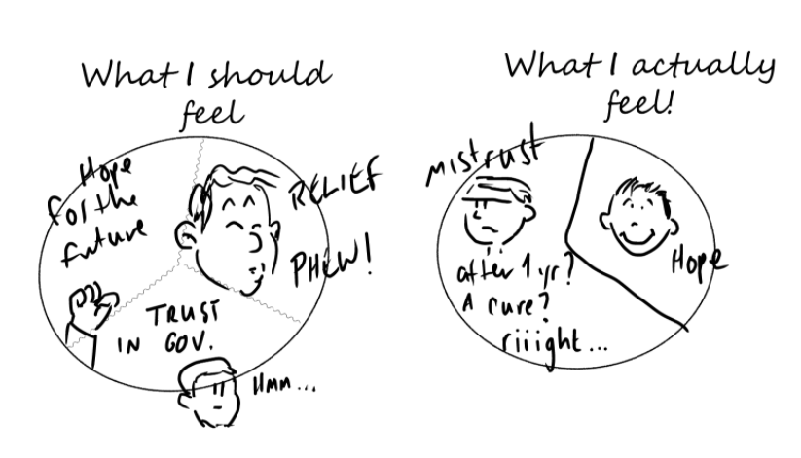
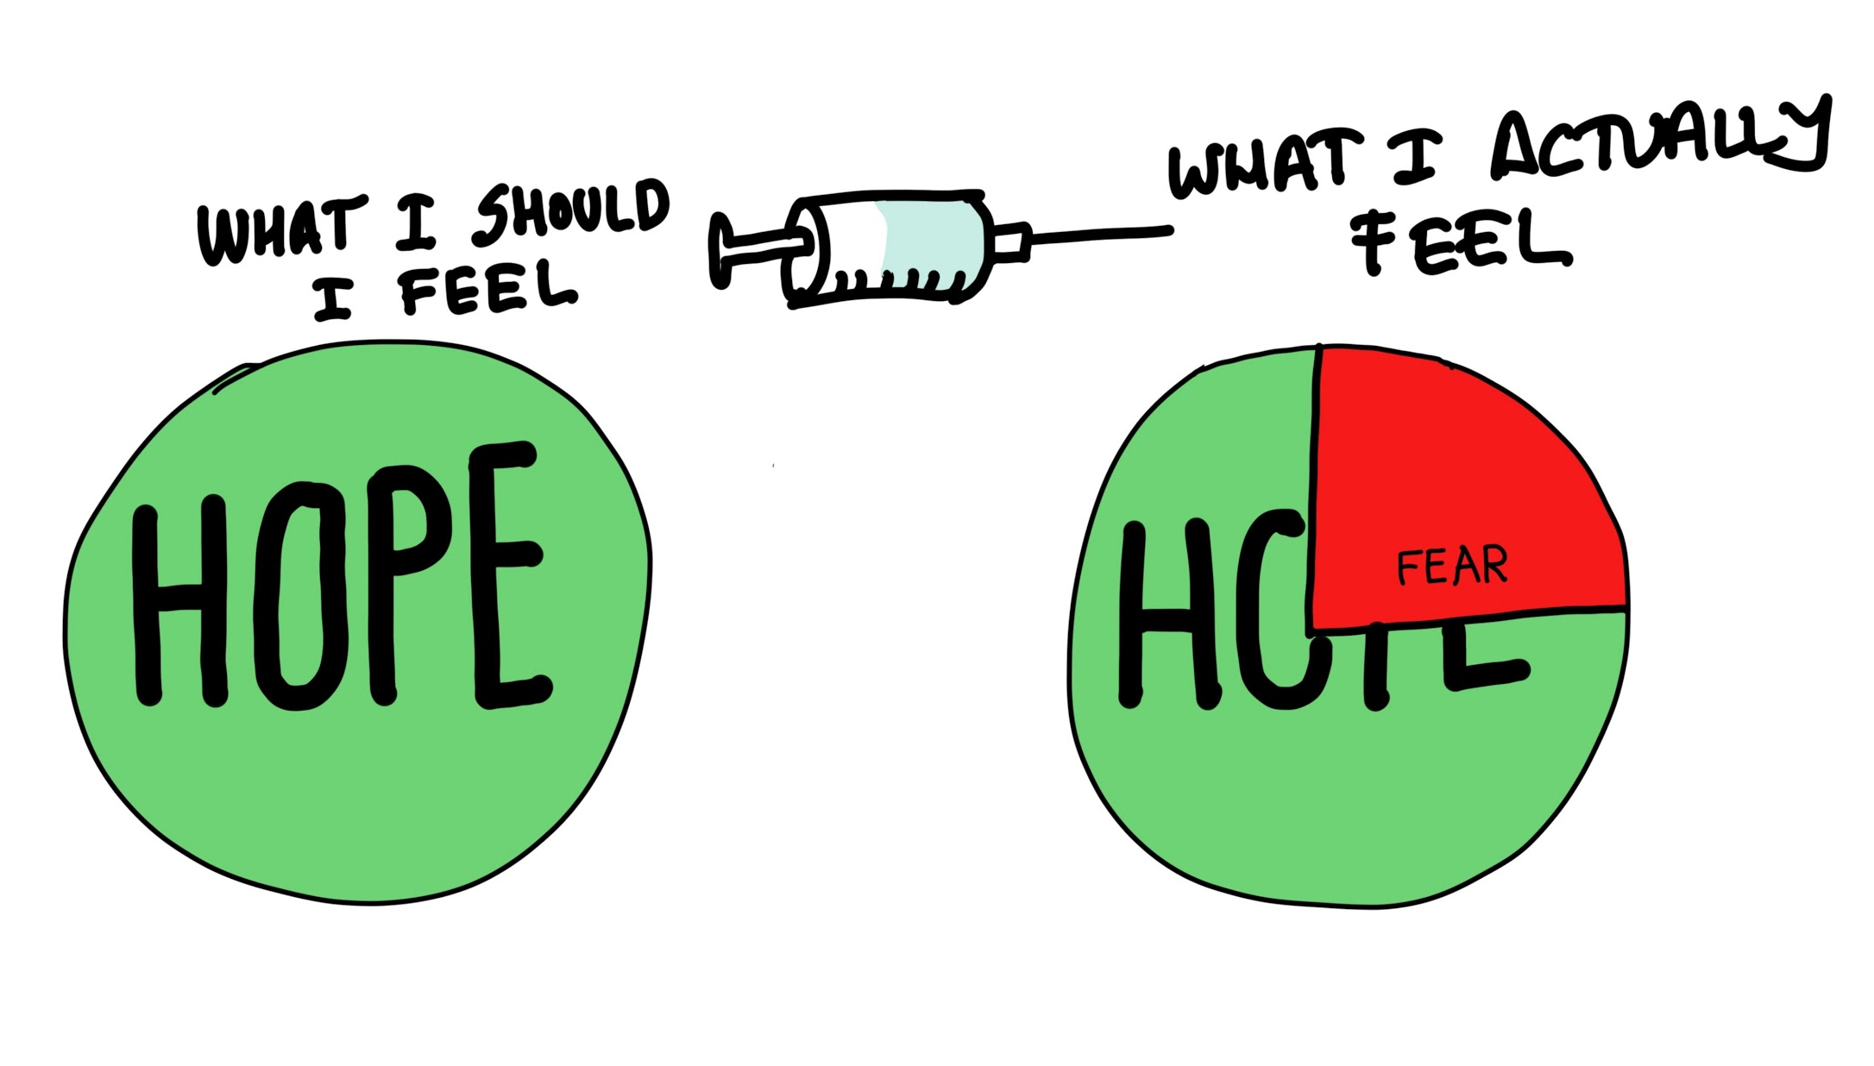
AGENCY
can’t control the big things, can control what’s in front of us
Participant comics created in response to the prompt question ‘What do you think you should feel about the COVID-19 vaccines? What do you actually feel?” This prompt used Liz and Mollie’s comics as a way of exploring how we represent the ‘data’ of our own internal experience and emotions. This activity was part of the BU ESRC Festival of Social Sciences, 2020
Notes:
_coronadiary
I teamed up with @risingartsagency responding to the question Covid 19 who is left out of the conversation ?
I asked followers for feedback and there was a lot! I picked 9 answers then spoke either directly to people who identified under these categories or alternatively found online quotes from those in response to the pandemic.

Slide 28
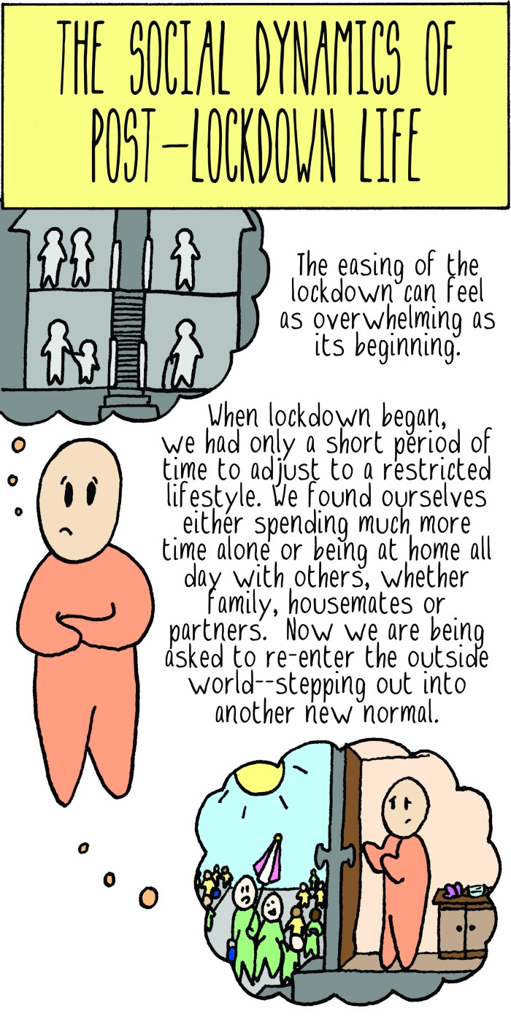
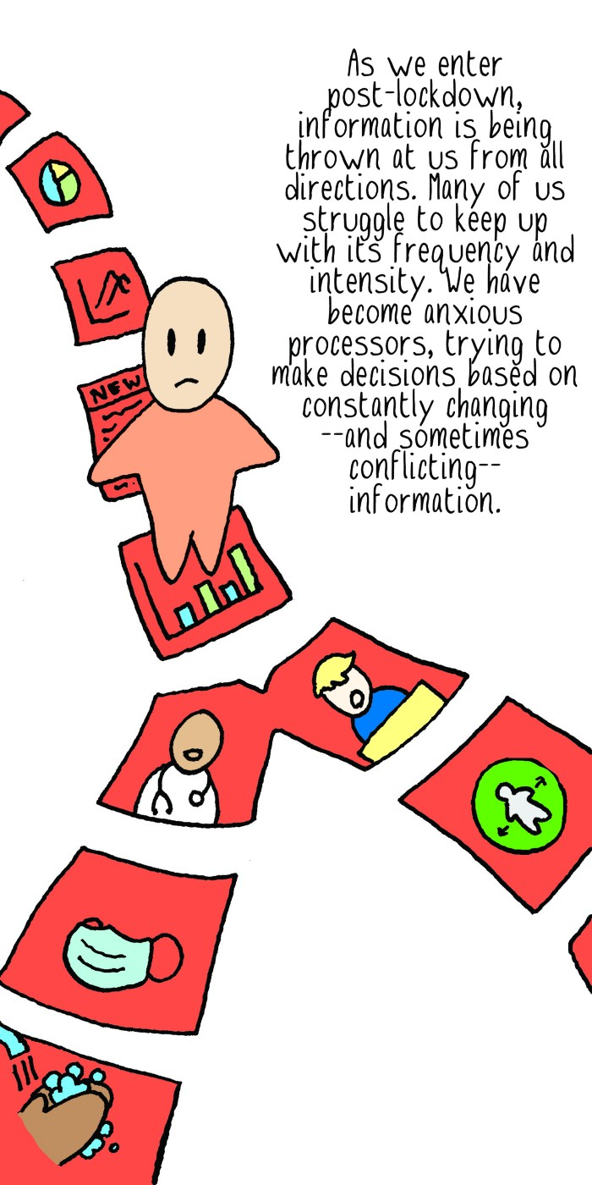
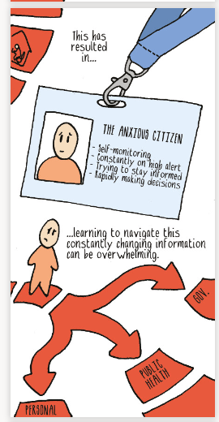
AGENCY
can’t control the big things, can control what’s in front of us
Notes:
_coronadiary
I teamed up with @risingartsagency responding to the question Covid 19 who is left out of the conversation ?
I asked followers for feedback and there was a lot! I picked 9 answers then spoke either directly to people who identified under these categories or alternatively found online quotes from those in response to the pandemic.

Slide 29
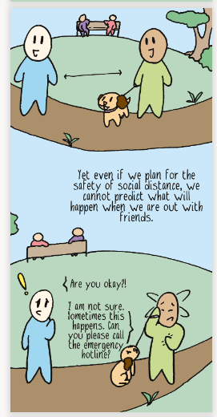
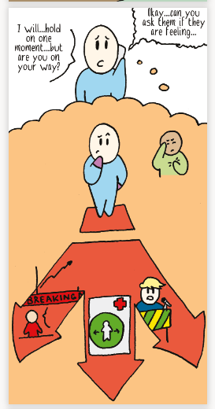
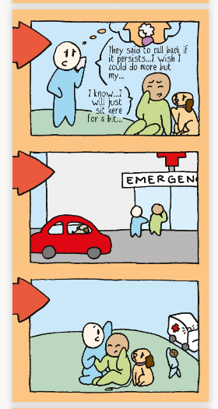
AGENCY
can’t control the big things, can control what’s in front of us
Notes:
_coronadiary
I teamed up with @risingartsagency responding to the question Covid 19 who is left out of the conversation ?
I asked followers for feedback and there was a lot! I picked 9 answers then spoke either directly to people who identified under these categories or alternatively found online quotes from those in response to the pandemic.

Slide 30
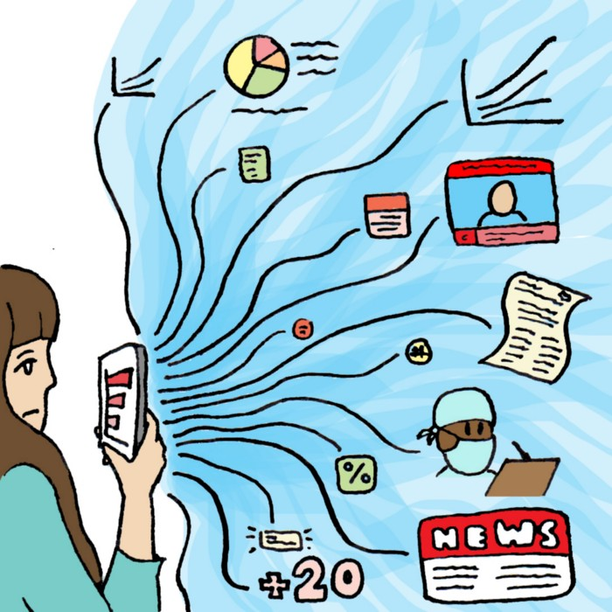
UKRI/AHRC research project
Data Storytelling in COVID-19 web-comics
Want to work with us?
We’re hiring a postdoc
Thank you for listening.
Dr. Anna Feigenbaum
email: afeigenbaum@bournemouth.ac.uk
twitter: @drfigtree
Order from Routledge
20% discount code = FLR40

