Slide 1
How The Economist has collected and analysed covid-19 data

Slide 2
Introduction The Economist’s data team

Slide 3
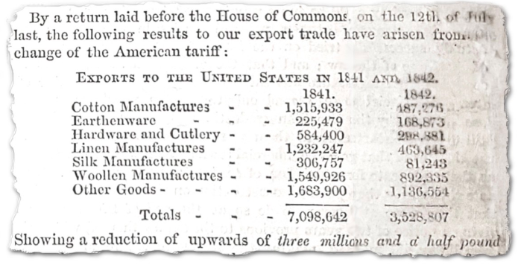
The Economist has crunched numbers since its first edition in 1843

Slide 4
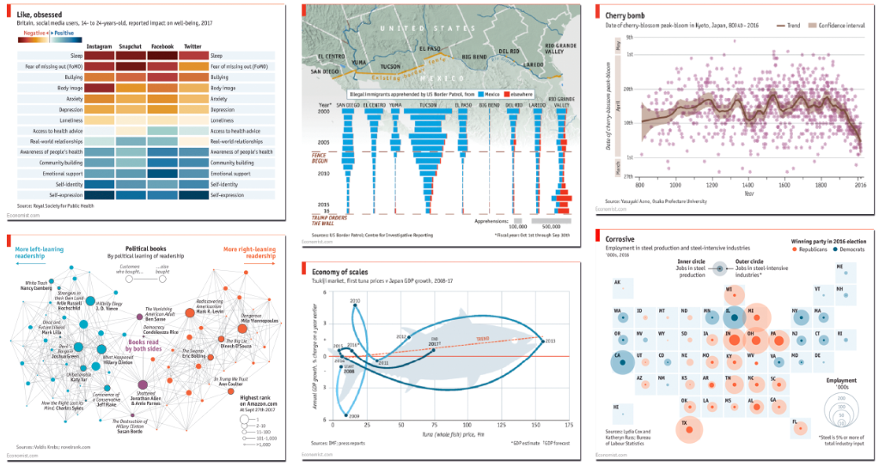
Today, we have a team dedicated to data-driven storytelling

Slide 5
And we have worked together to answer tricky questions about covid-19

Slide 6
Part 1: Mobility during covid-19 How did people change their behaviour?

Slide 7
How to measure human behaviour in real time?
Liverpool Street Station, 8pm on Friday April 10th 2020

Slide 8
How train stations "usually" look

Slide 9
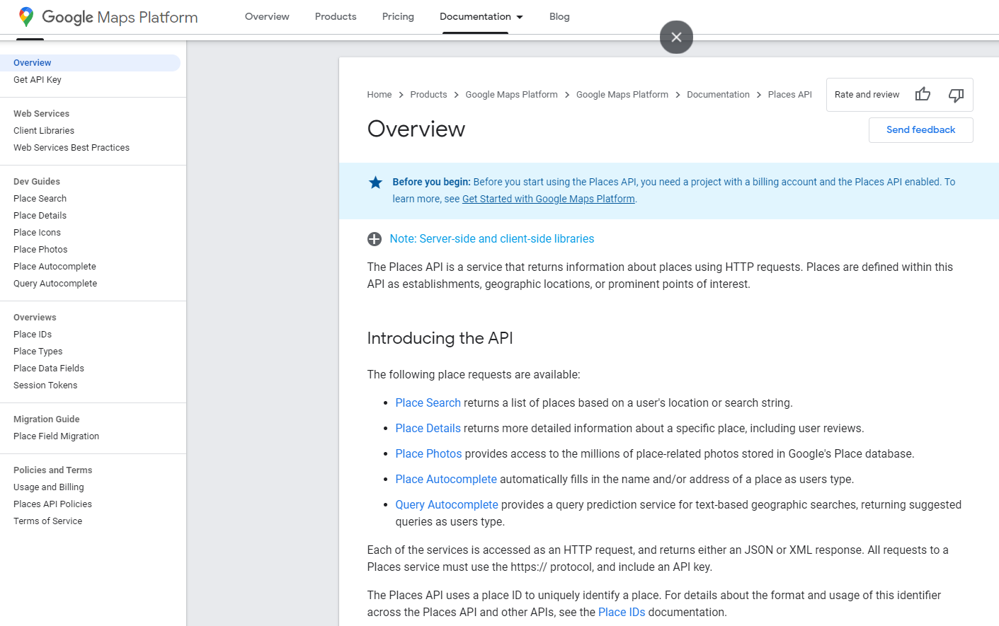
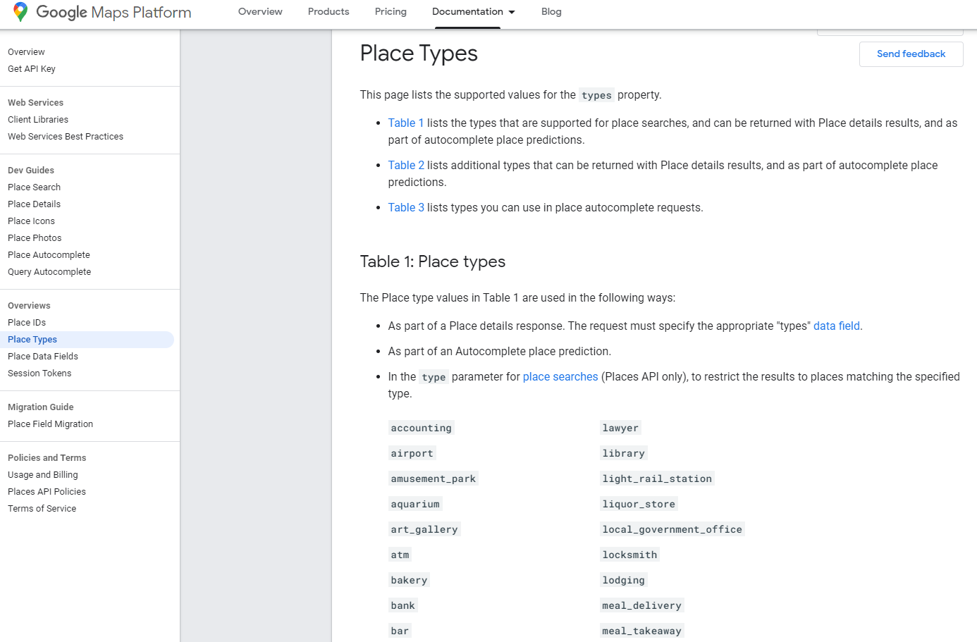
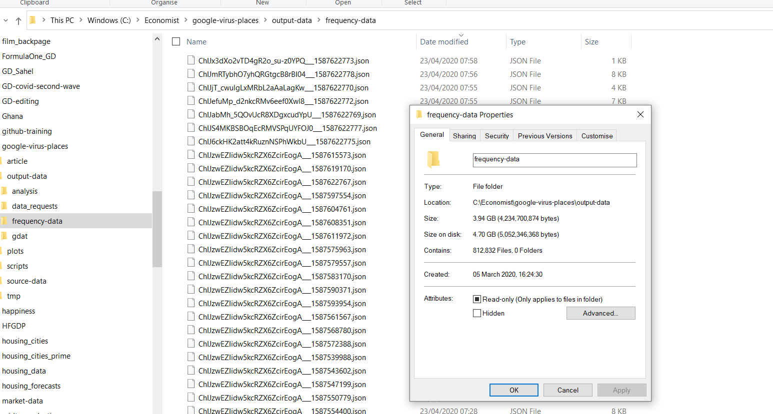
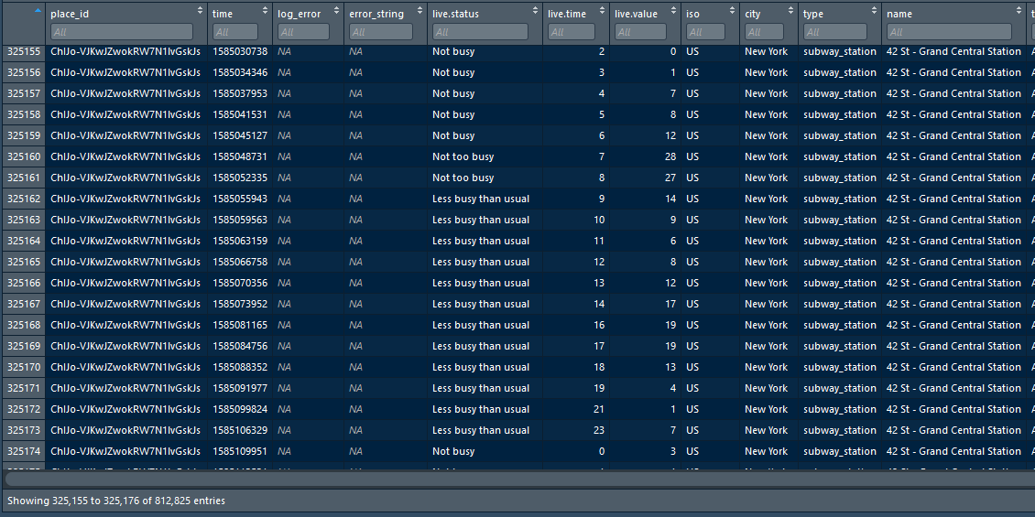
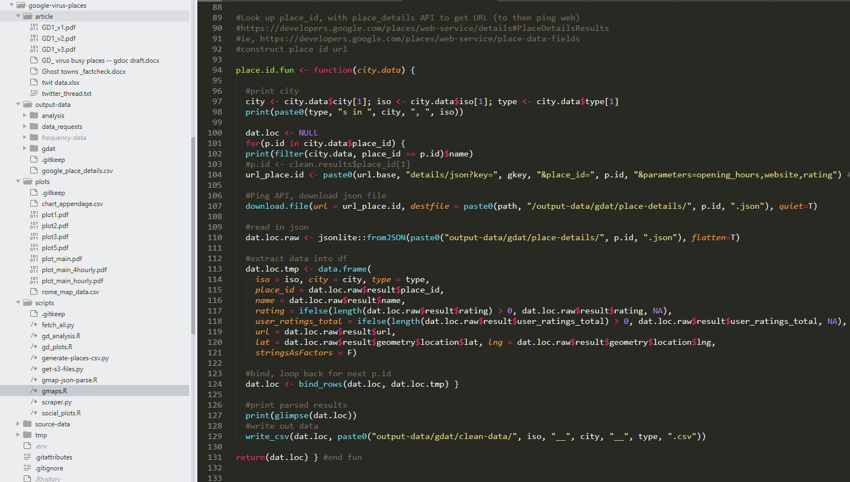
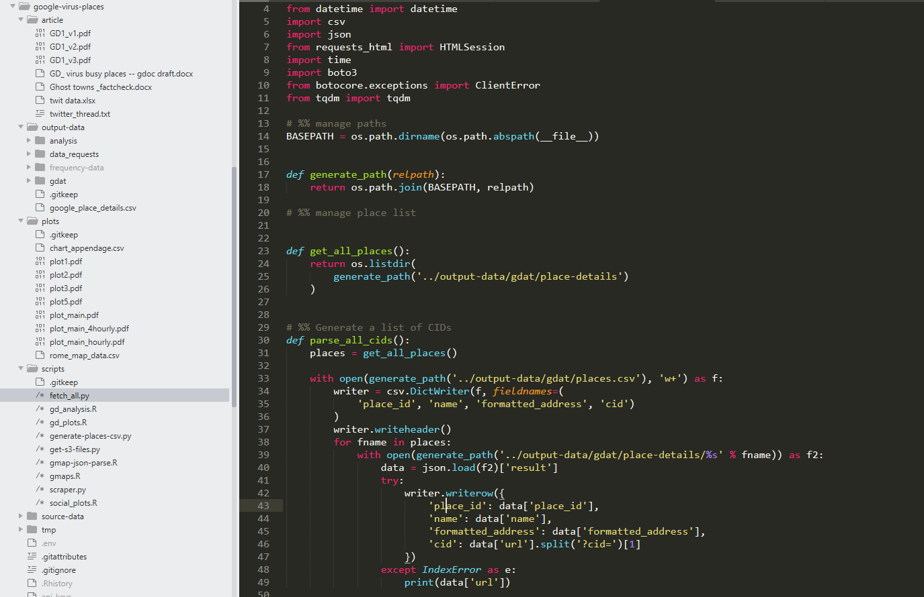
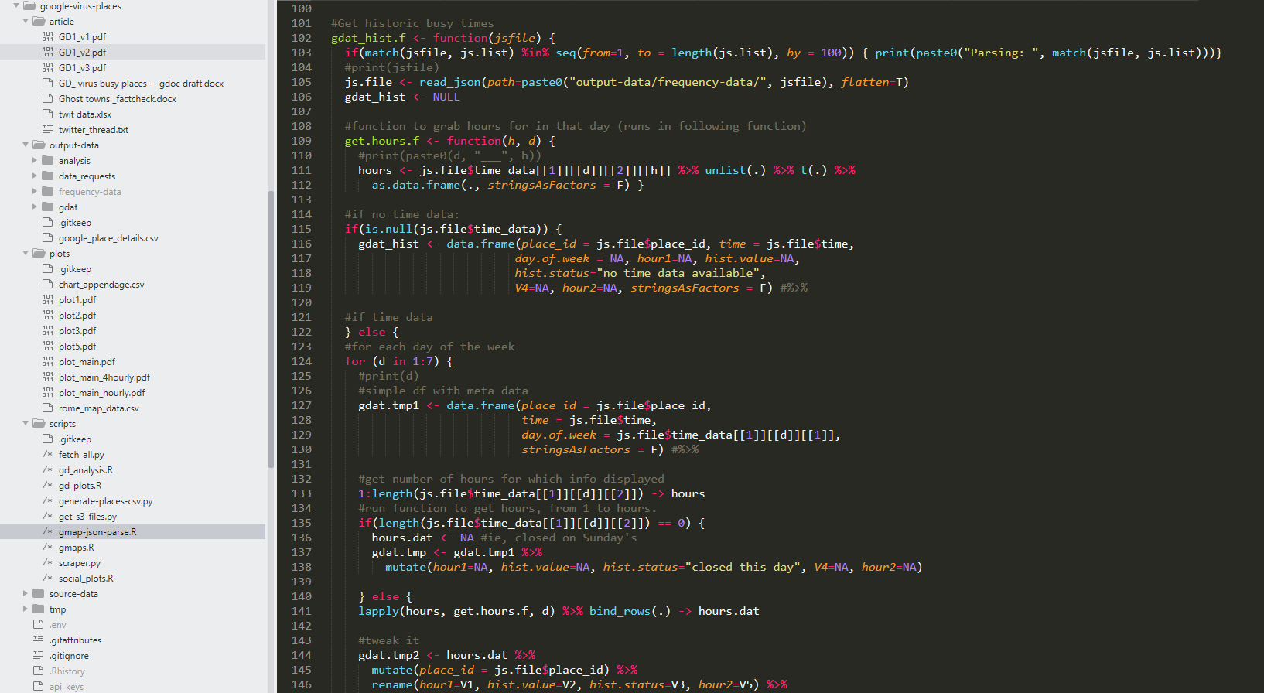
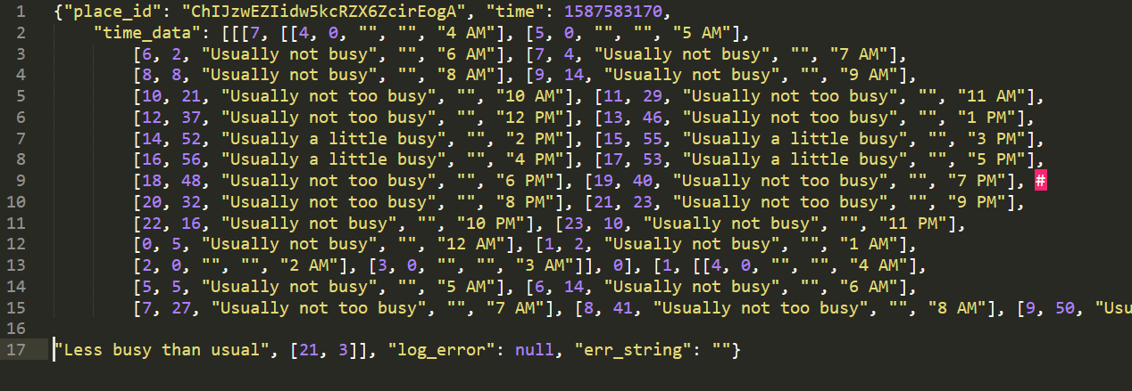
Get me the data!

Slide 10
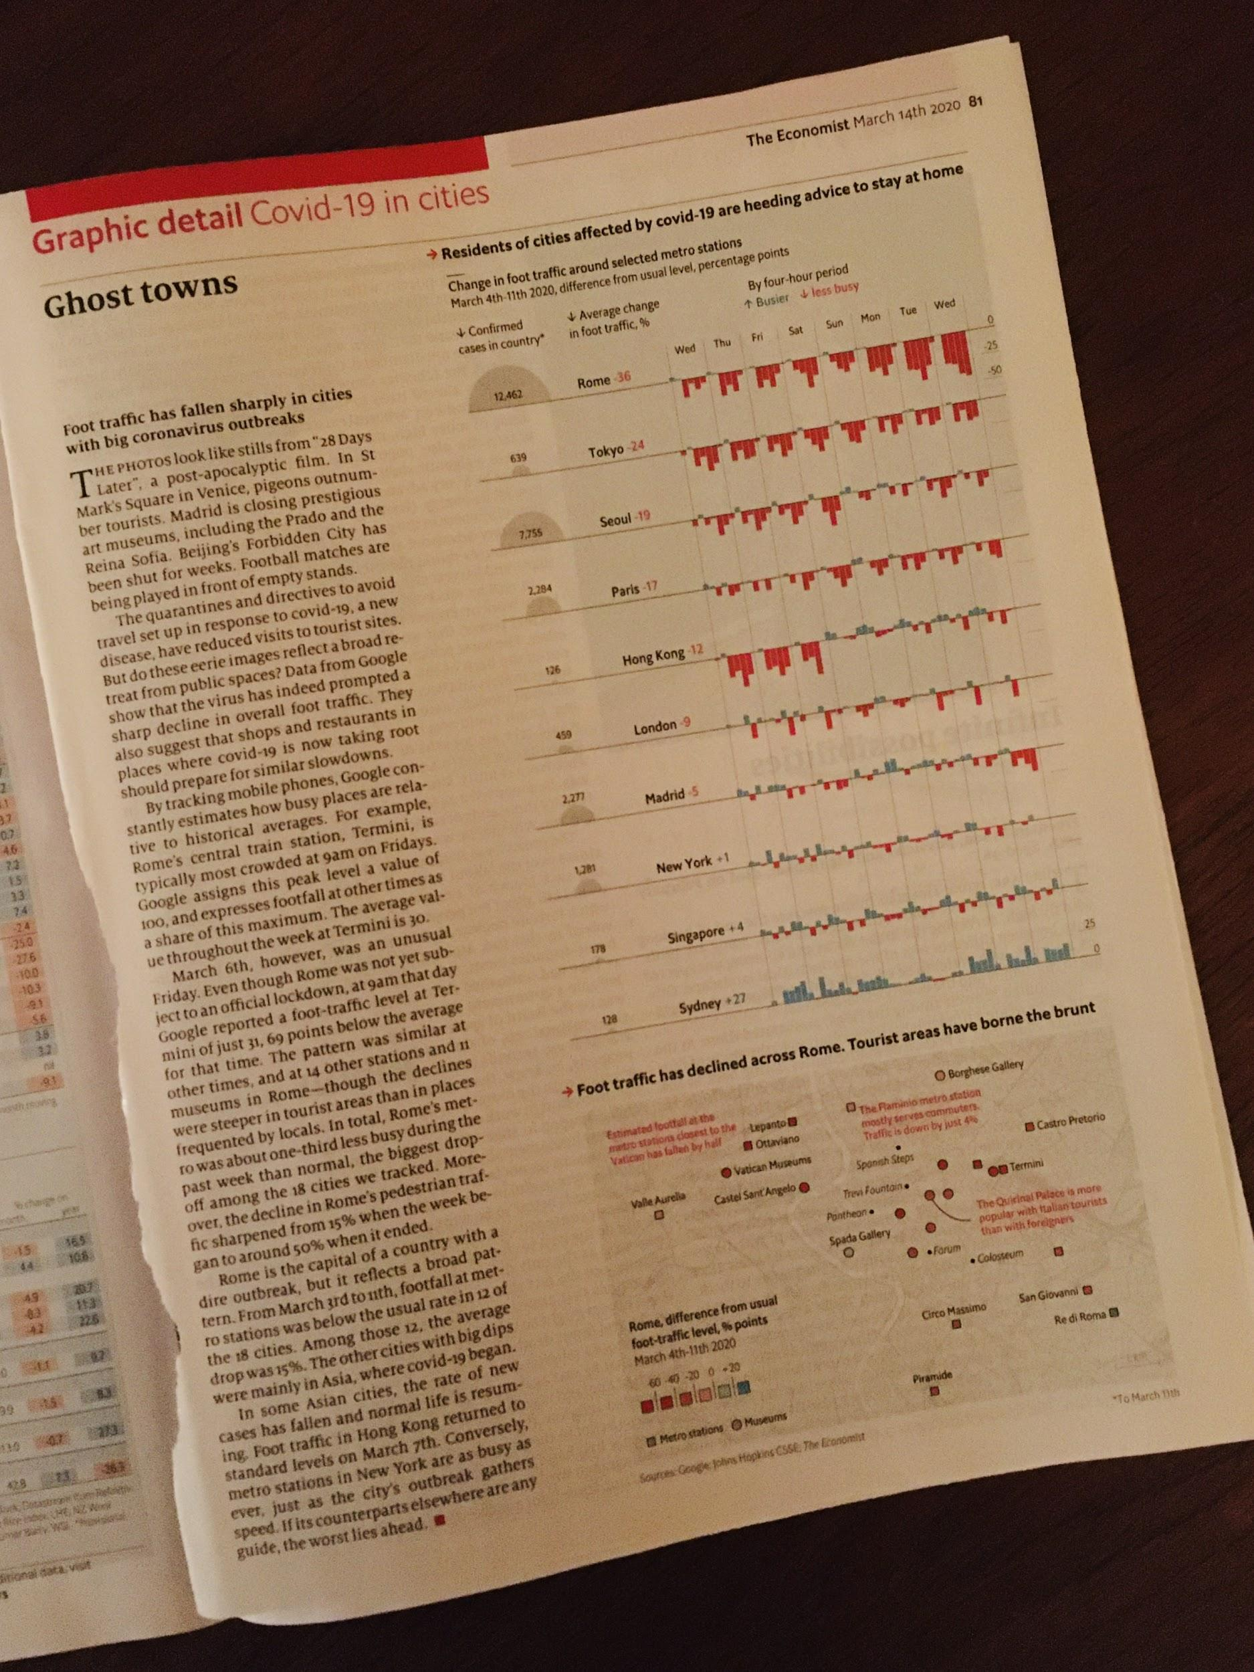
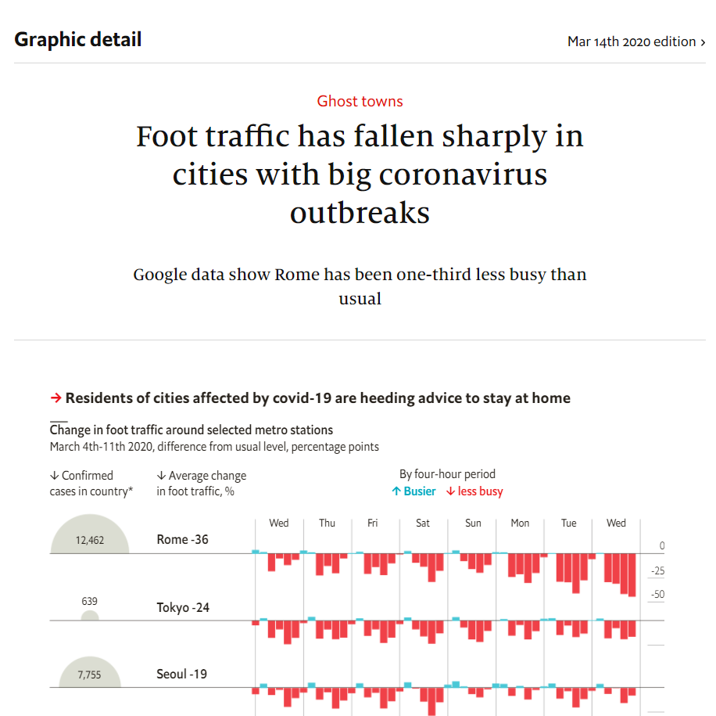
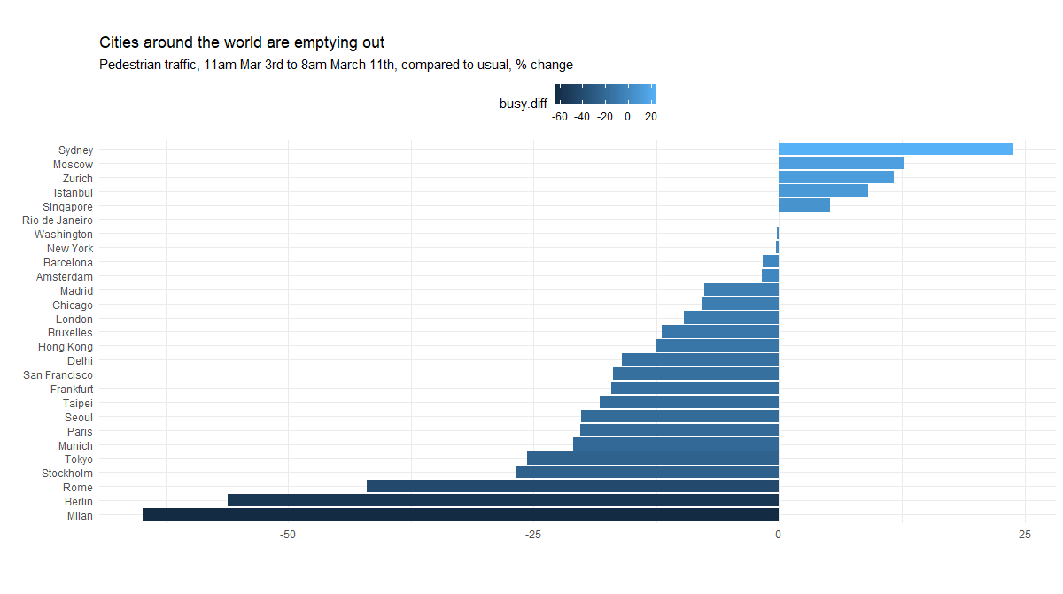
What's the story?

Slide 11
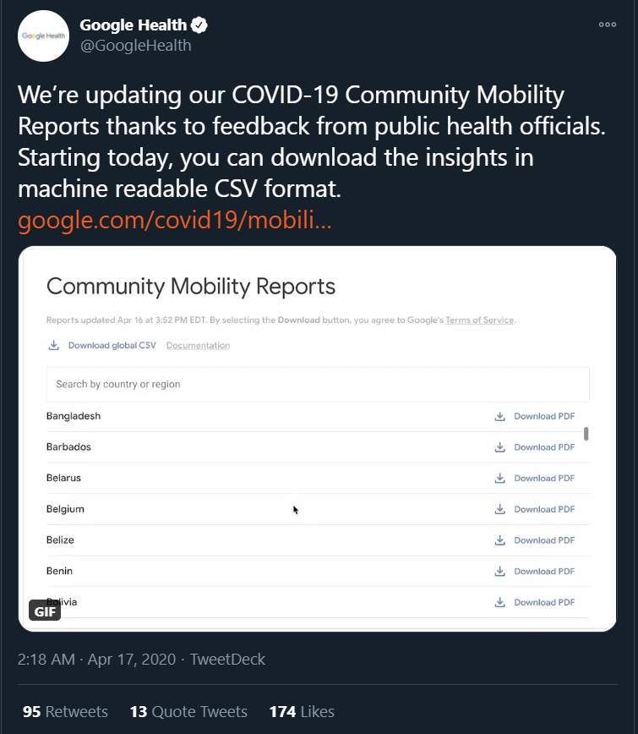
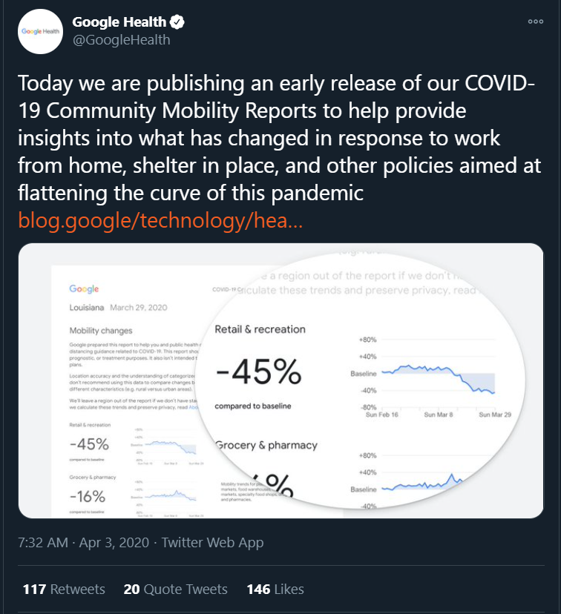
Google's response

Slide 12
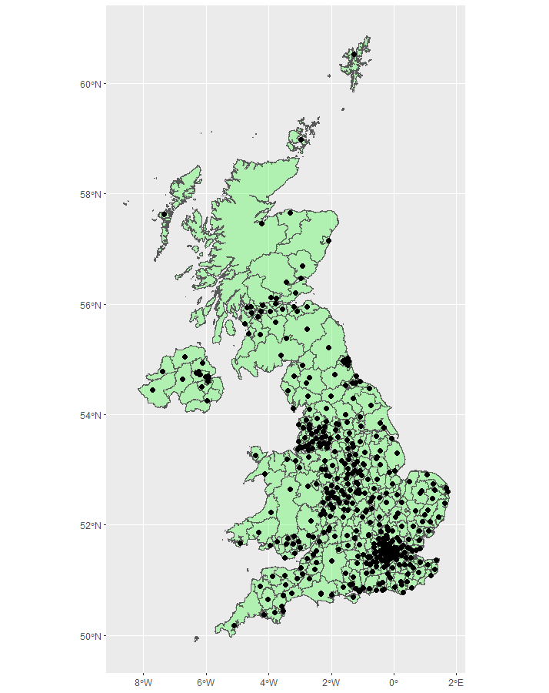
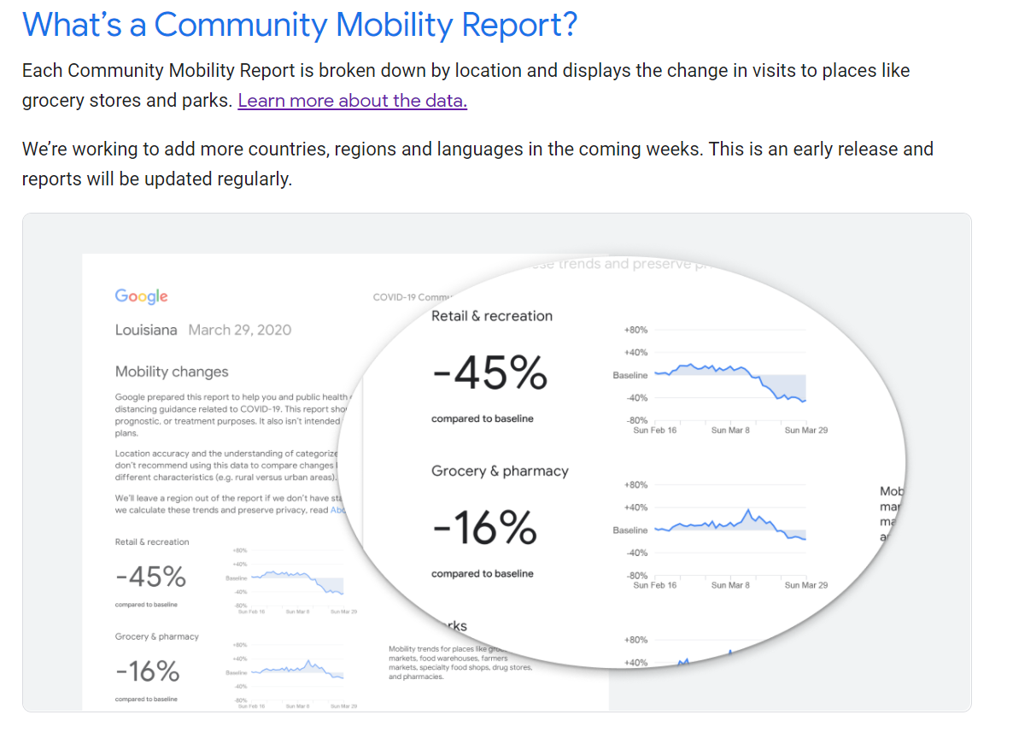
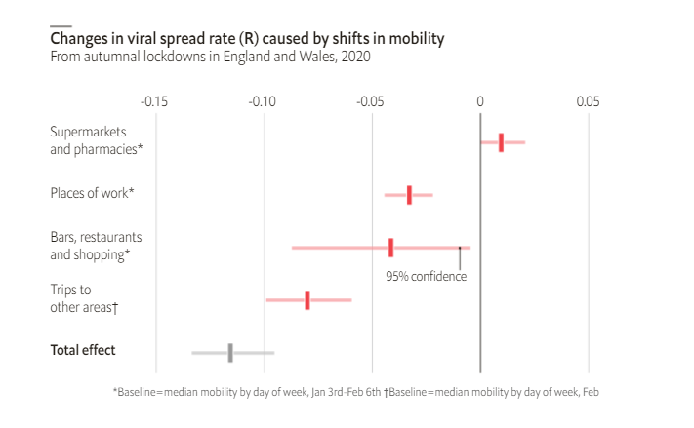
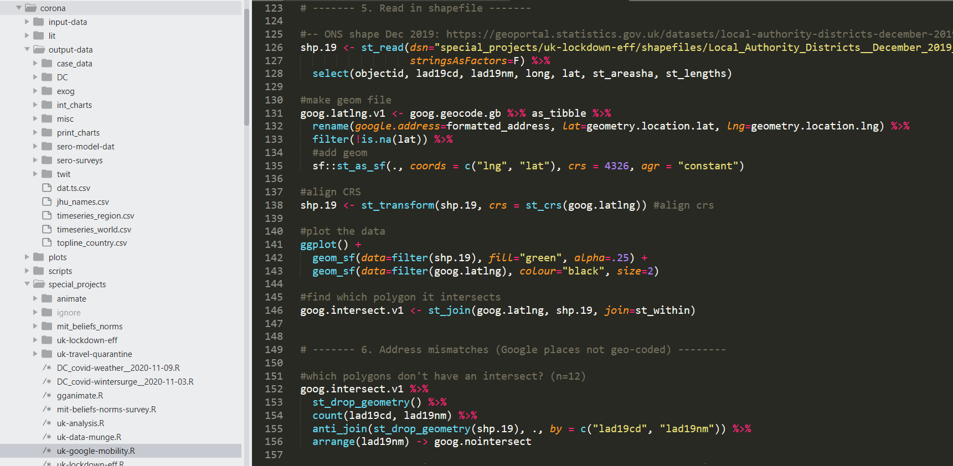
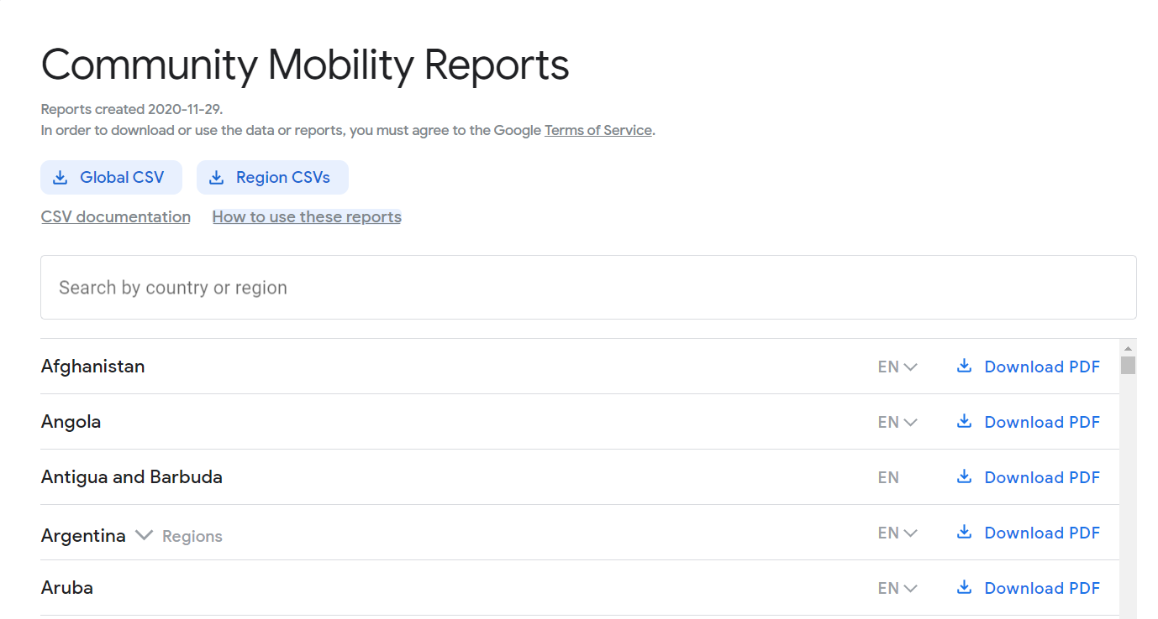
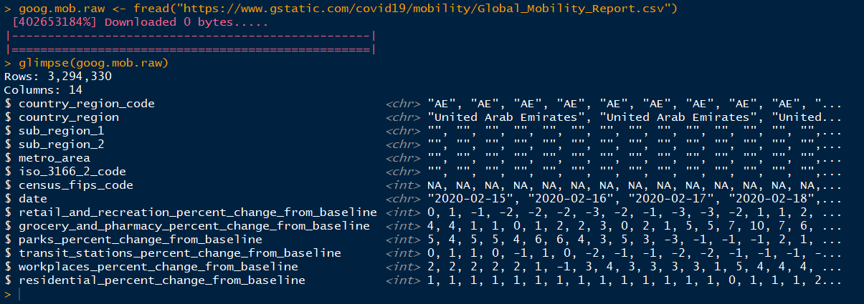
Using the data

Slide 13
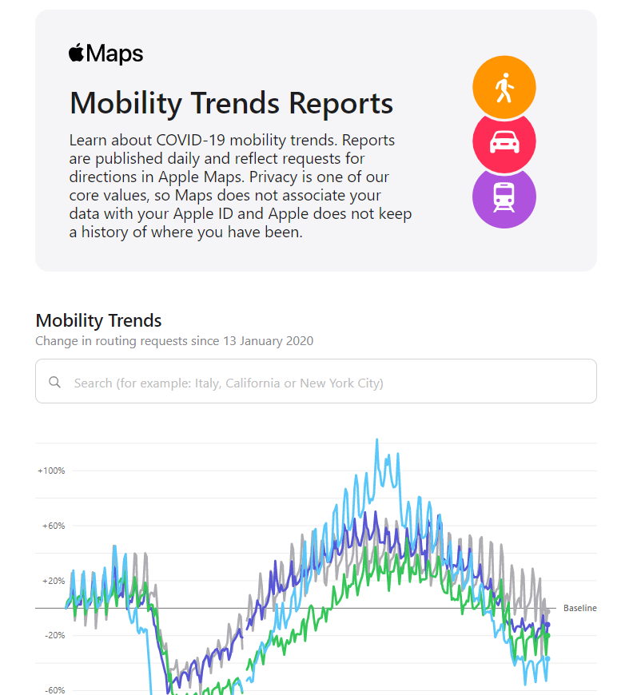
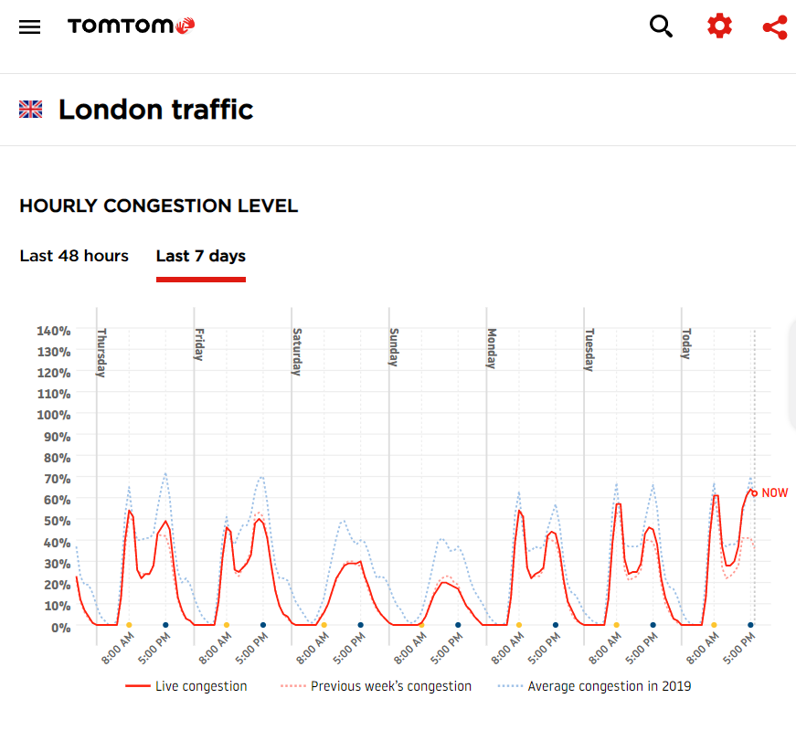
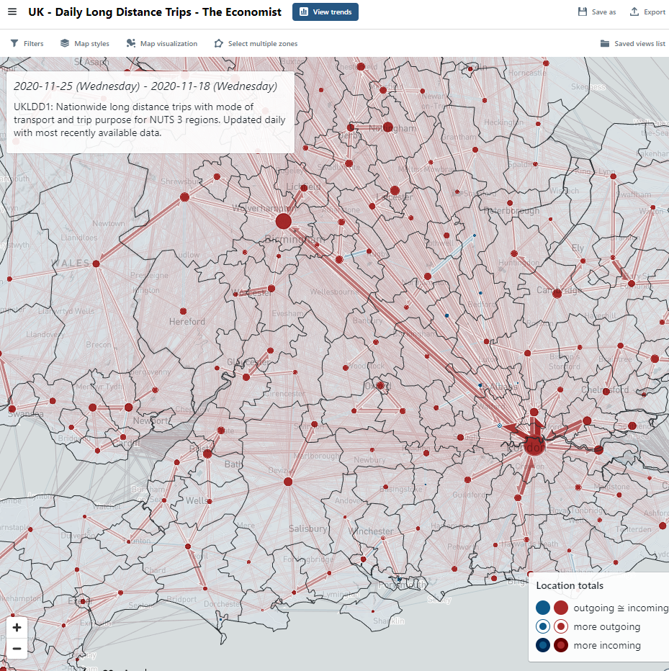
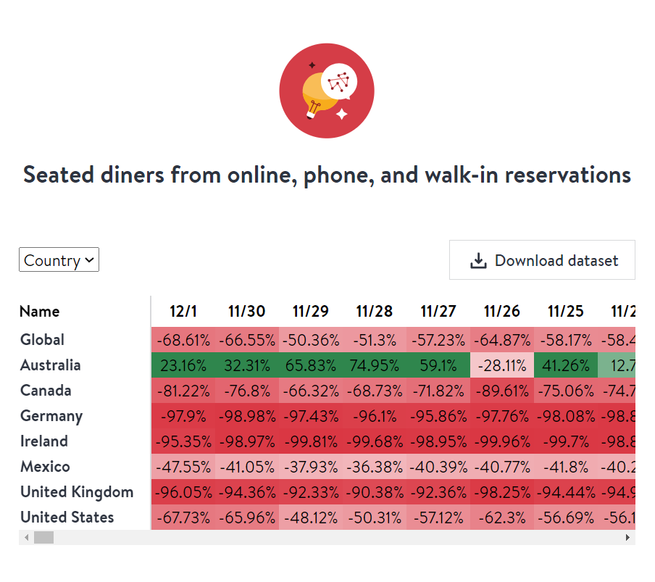
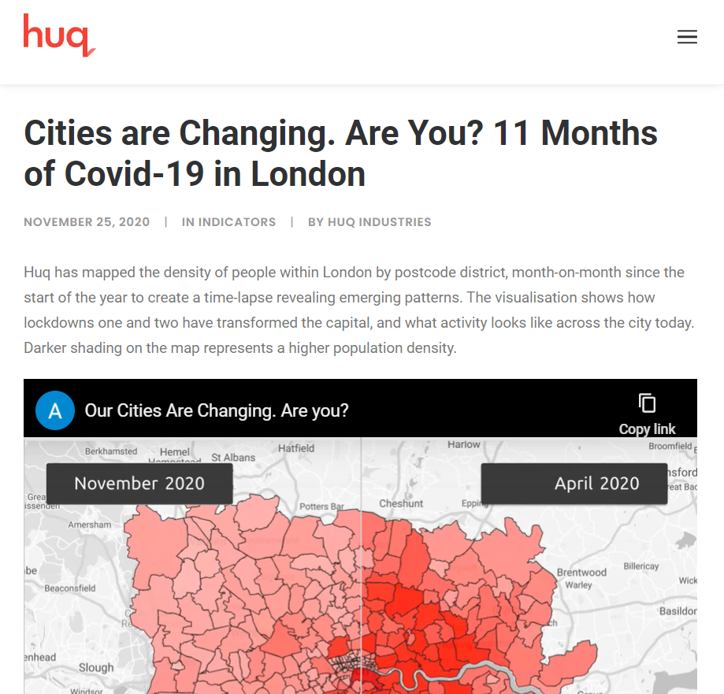
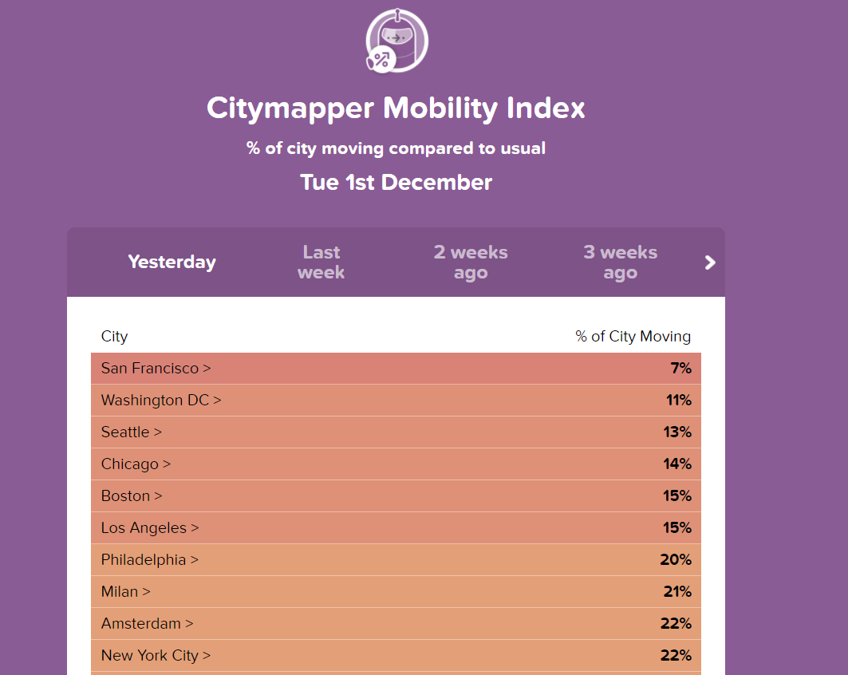
Mobility everywhere

Slide 14
Part 2: Excess mortality How many people died due to the pandemic?

Slide 15
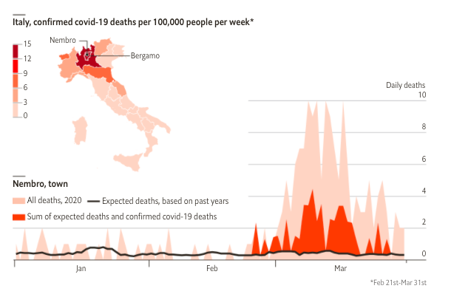
Why did we start counting excess deaths?
MARCH 2020
We received data from Nembro, in Italy, which showed that the death toll from covid-19 was probably much higher than the official figure.

Slide 16
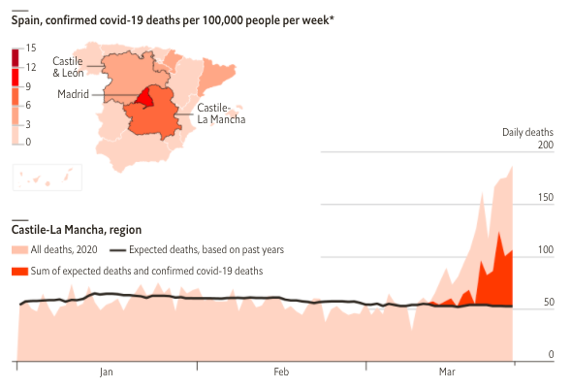
Why did we start counting excess deaths?
MARCH 2020
In Spain, El País also published data that showed a similar discrepancy in Castile-La Mancha, Castile & León and Madrid.

Slide 17
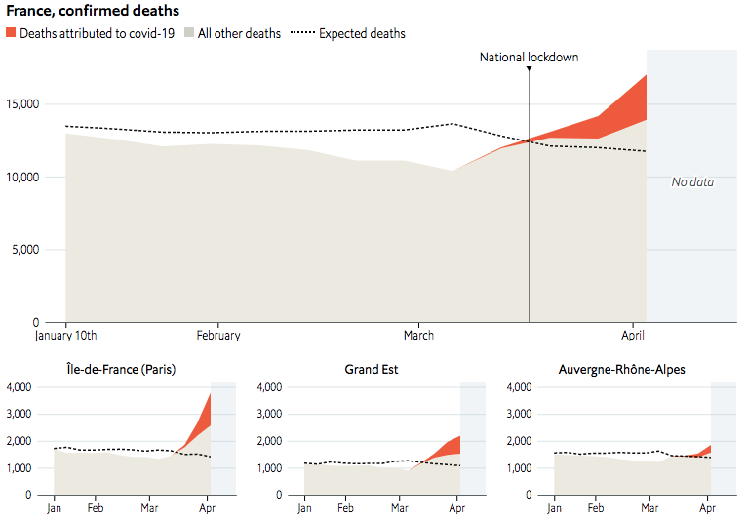
Building an excess mortality tracker
APRIL 2020
We decided to build an interactive tracking page, which illustrated the number of excess deaths in a handful of countries and regions.

Slide 18
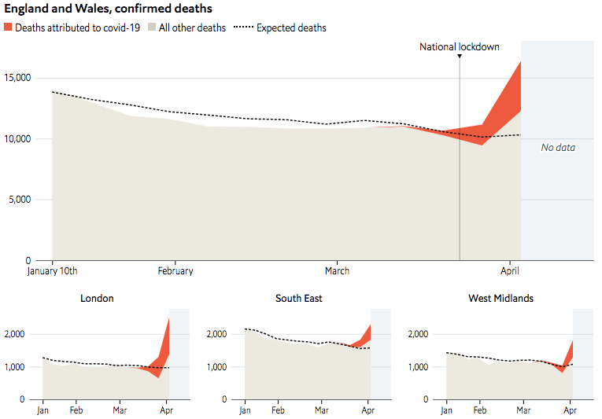
Building an excess mortality tracker
APRIL 2020
At first, our tracking page included only Western countries, and relied mainly on official sources (such as the ONS).

Slide 19
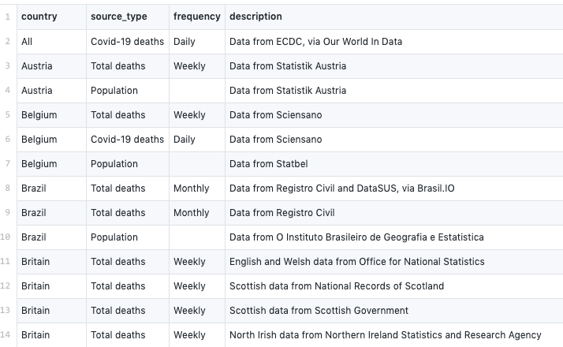
Collecting and cleaning data
APRIL 2020
As data became available in more countries, including from non-official sources (such as figures on burials), we started to collect and clean it using several R scripts.

Slide 20
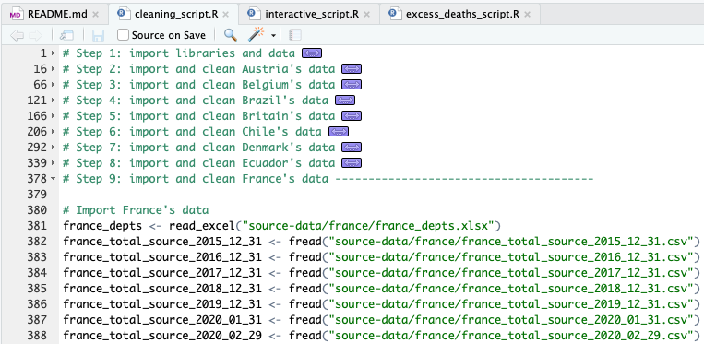
Collecting and cleaning data
APRIL 2020
The code for each country is quite detailed, and often binds together several data files.

Slide 21
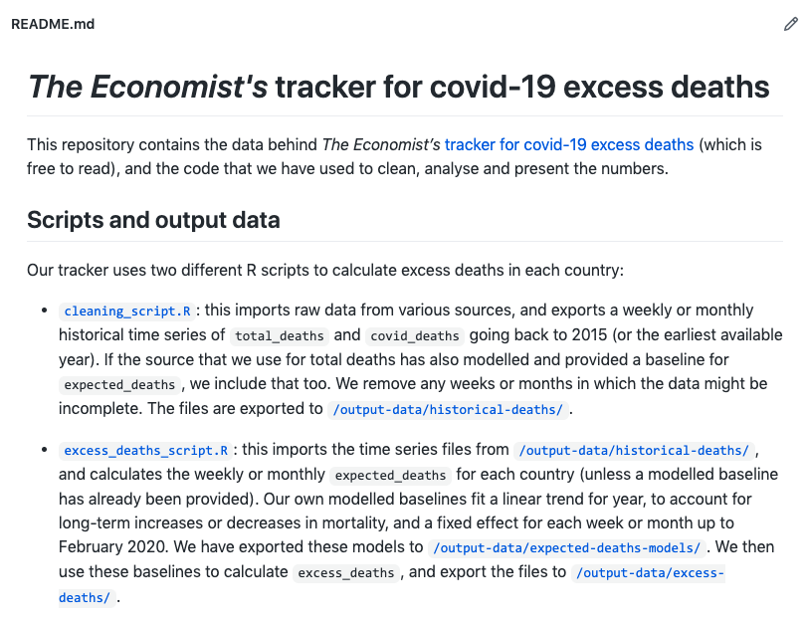
Publishing the code and data on GitHub
MAY 2020
We wanted to share the data and code with researchers, so in May we published all of it on GitHub.

Slide 22
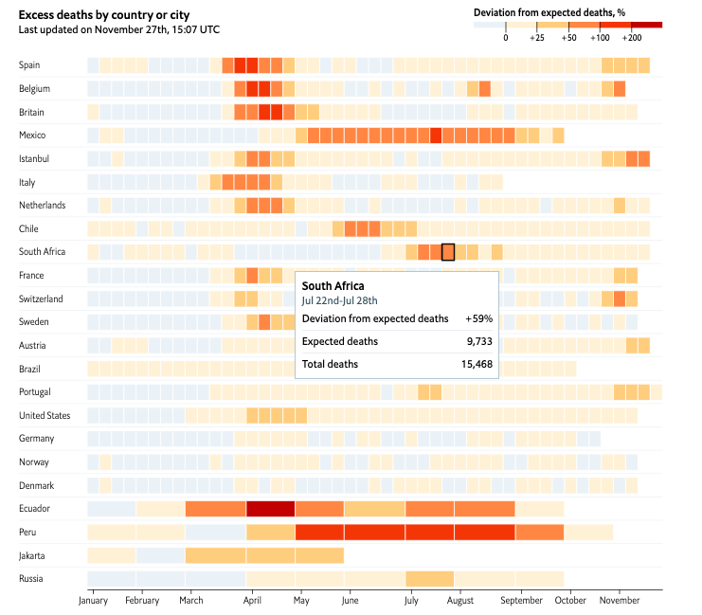
Updating the infographics
JULY 2020
In July we redesigned the tracking page, to include more interactive designs (such as this heatmap).

Slide 23
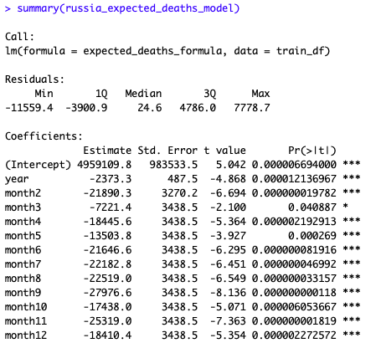
Training models for expected deaths
SEPTEMBER 2020
In September we changed the way that we calculate expected deaths, using regression models with yearly time trends and fixed effects for weeks and months.

Slide 24
Part 3: Seroprevalence modelling How many people were infected by covid-19?

Slide 25
Testing, testing
Infection
2. Diagnosis
3. Official statistics
Least probable to be recorded in:
Poor countries
Low-testing countries
Early outbreaks

Slide 26
Wider problem:
“Biased” data
Errors are not random
Raw data is misleading
Augmentation is necessary

Slide 27
Example: Covid-19 cases vs average incomes, April

Slide 28
Example: Covid-19 cases vs average incomes, April

Slide 29
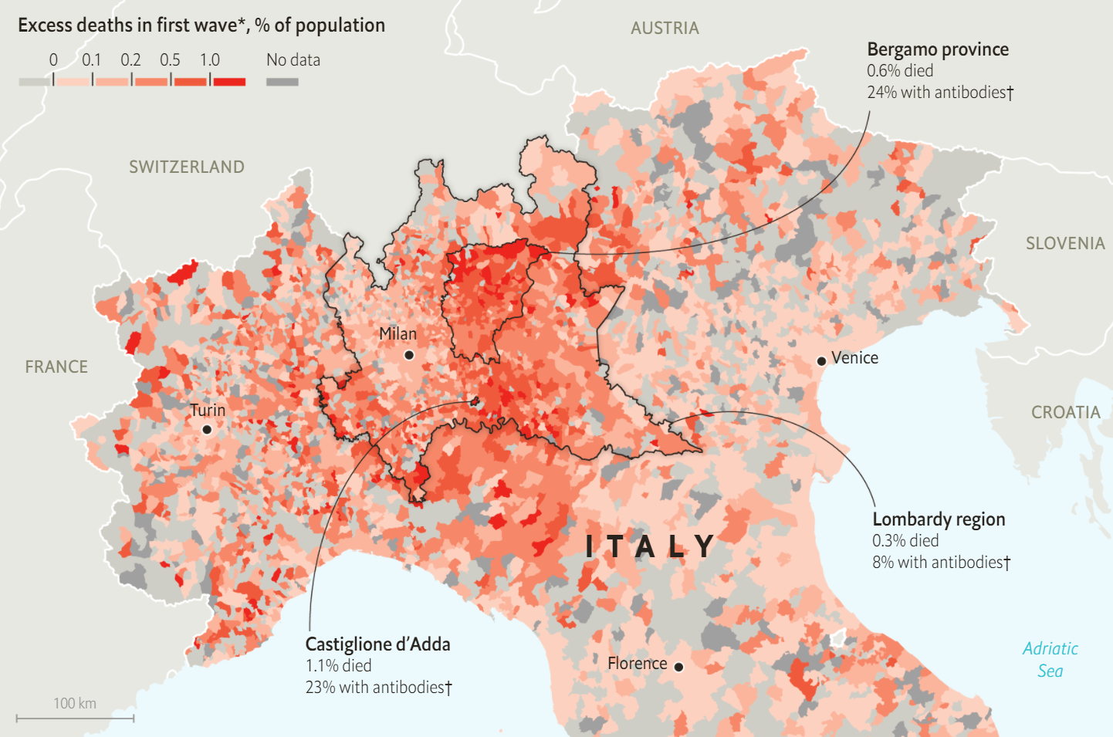
True % infected = Serosurveys
Tests random sample of population for covid-19 antibodies
= Estimate of % previously infected
Cons: rare and only cross-sections

Slide 30
Solution to flawed case counts:
1
2
3
Collect serosurveys
Connect to other variables (deaths, cases, testing capacity)
Estimate infections where unknown

Slide 31
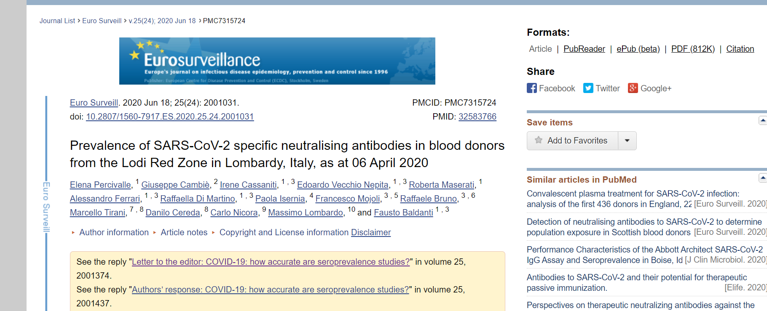
1. Collecting serosurveys
Academic journals/preprints and government websites
279 estimates from 19 countries
~ 6000 cells of data

Slide 32
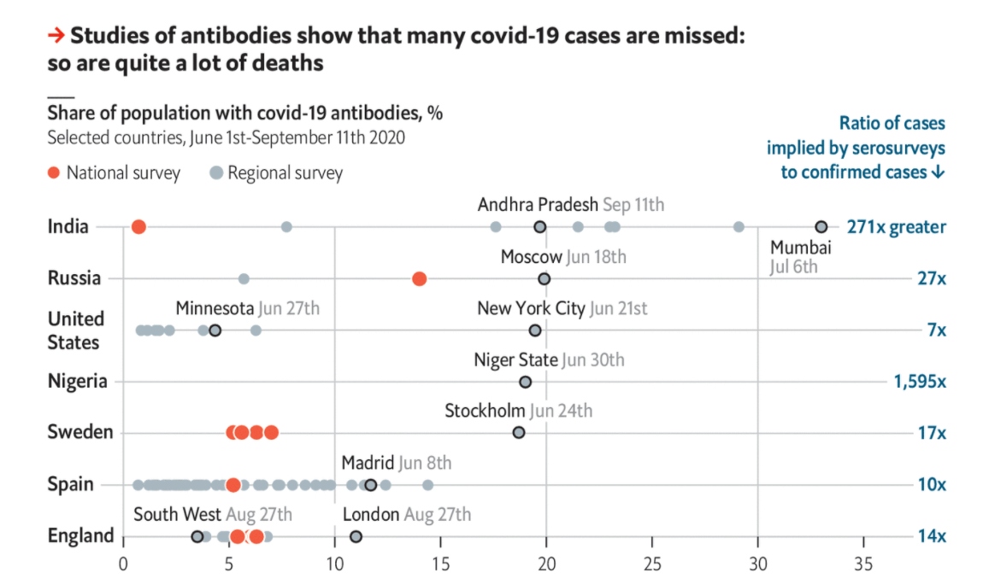
2. Connecting to other data
Link to official data (national or subnational)
Covid-19 deaths
Covid-19 cases
Testing capacity (proxied by GDP per capita)

Slide 33
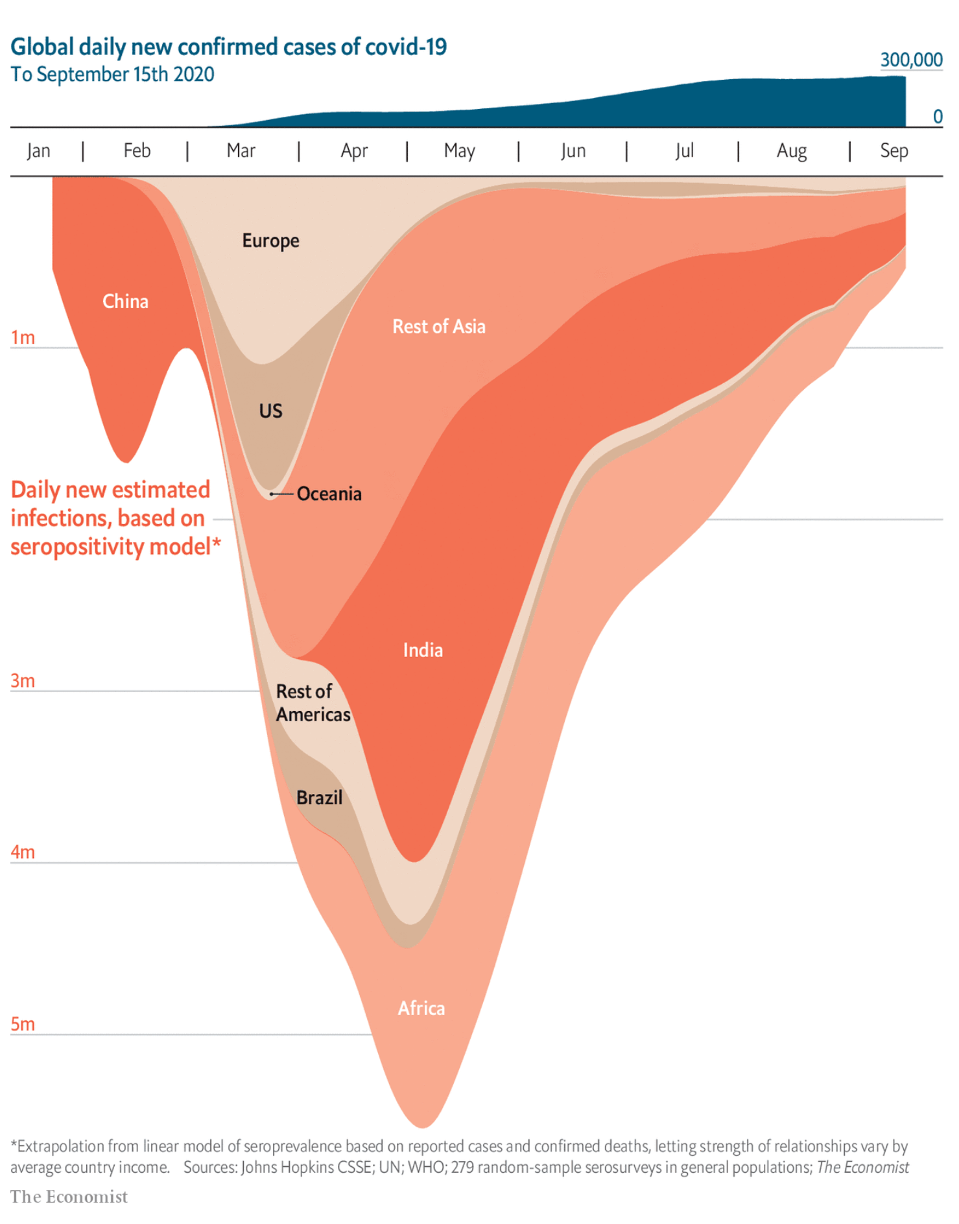
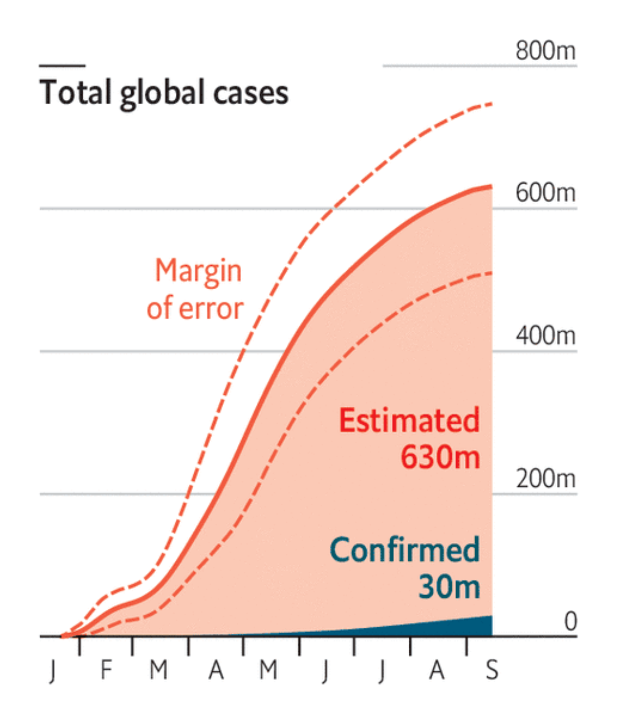
3. Estimate % infected

Slide 34
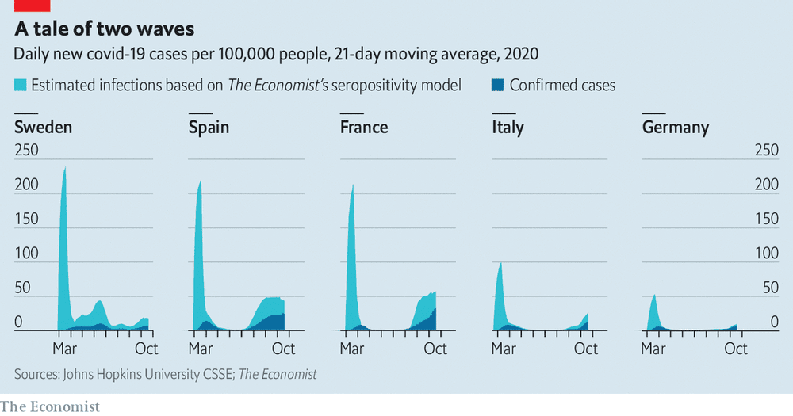
The first wave vs the second

Slide 35
Conclusions What lessons have we learned, and what could we have done better?

Slide 36
Lessons
1.
2.
Collection is crucial: data sets must be gathered from lots of sources.
Transparency helps: putting data / code on GitHub helps our work reach more people.
3.
4.
Definitions matter: we have to spell out exactly what we are measuring and why.
Communicating uncertainty: it is important to show the limitations of our work.

Slide 37
Things we could do better
1.
2.
Collaboration: can organisations work together to reduce duplication of labour?
Standardisation: can we agree consistent definitions across organisations?
3.
Peer review: could we get more comments from experts about our work?

