Slide 1
Breaking tomorrow’s news today at the Evening Standard: How to get it right (or wrong) when writing COVID news
Ross Lydall
Health Editor
Evening Standard

Slide 2
What happens when ONS statistics are published - 30 minutes before your final deadline?
How do you make the right call when deciding which announcement merits the front page?
Which statistics should be ignored?
Which statistics matter?
Which statistics have the potential to mislead?

Slide 3
Life as a reporter before and during COVID
Covering the patch
Covering the patch in a mask

Slide 4
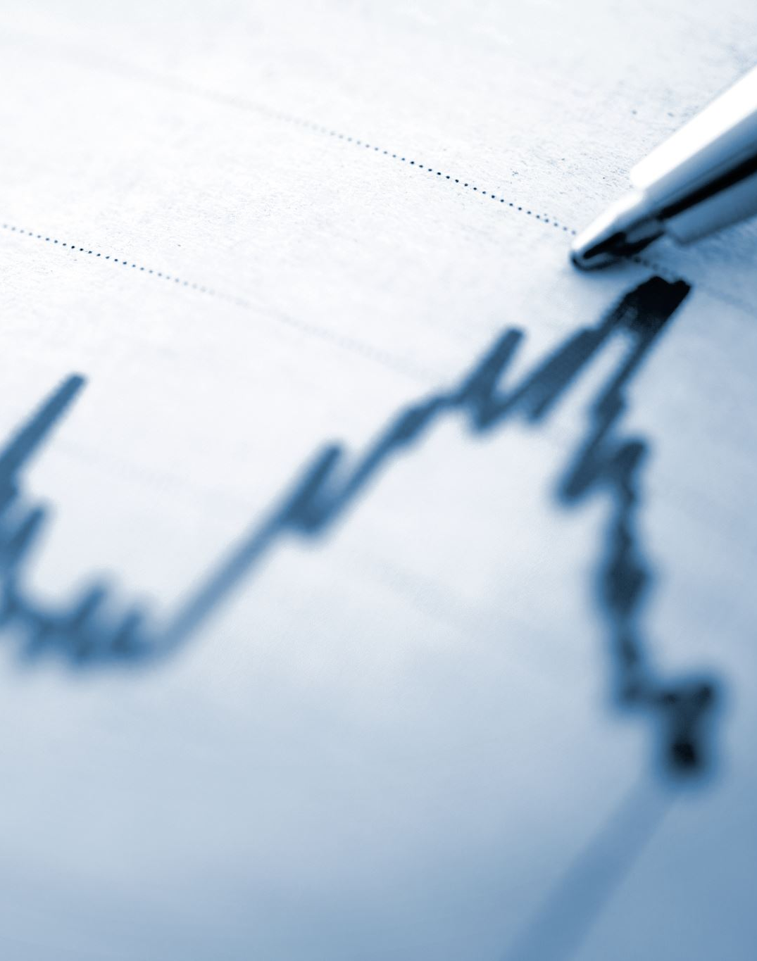
The challenges faced by the Evening Standard during the pandemic
Reporting exclusive stories at speed
Gathering relevant and new content
Accurately reporting on the most complex story of our careers
Having only minutes to work out what the data means

Slide 5
Typical day
6.30am: Check emails, BBC News website, Today programme.
7am: Start filing breaking stories
7.30am: email “paper” news editor with newslist. Check diary and PA schedule
8am: Check what colleagues are working on
8.30am: Receive instructions from news editor
10am: DEADLINE
11am: Paper goes “off stone”

Slide 7
Before and after COVID
Pre-pandemic: 900,000 copies a day in two editions, distributed free across Greater London
October 2009: ES becomes free paper.
2002: 450,000 copies sold daily, 40p a copy. Five editions a day.
March 2020: 500,000 print run includes copies direct to readers’ homes
August 2020: ES goes “web first”, building traffic to 2m visits a day
x

Slide 8
Web first
What has the “web first” strategy meant for reporters?
For some senior reporters it remains “paper first”
Encouraged to write the bigger stories for web when possible when “off edition”
Find stories for next day while being ready to spring into action at moment’s notice

Slide 9
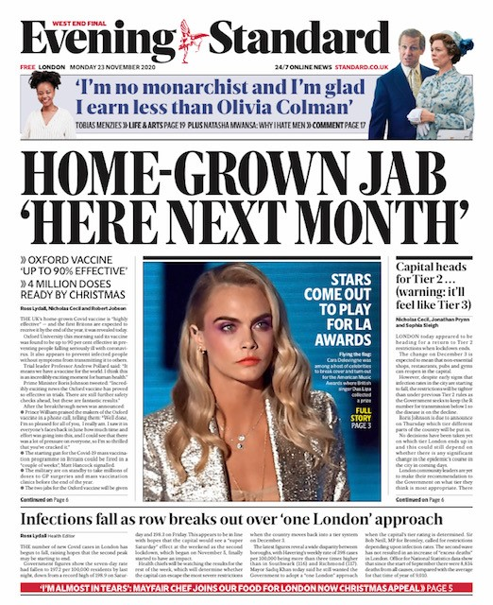

Slide 10
Daily data drop
ONS (Tuesday 0930 mortality stats, Friday midday surveillance report)
DHSC (Test and Trace, 11am Thursday)
PHE (weekly surveillance report, 2-4pm Thursday)
NHS England (daily hospital death toll, 2pm)
Govt dashboard (4pm)
Govt Office for Science: (R number, 1pm Friday)

Slide 11
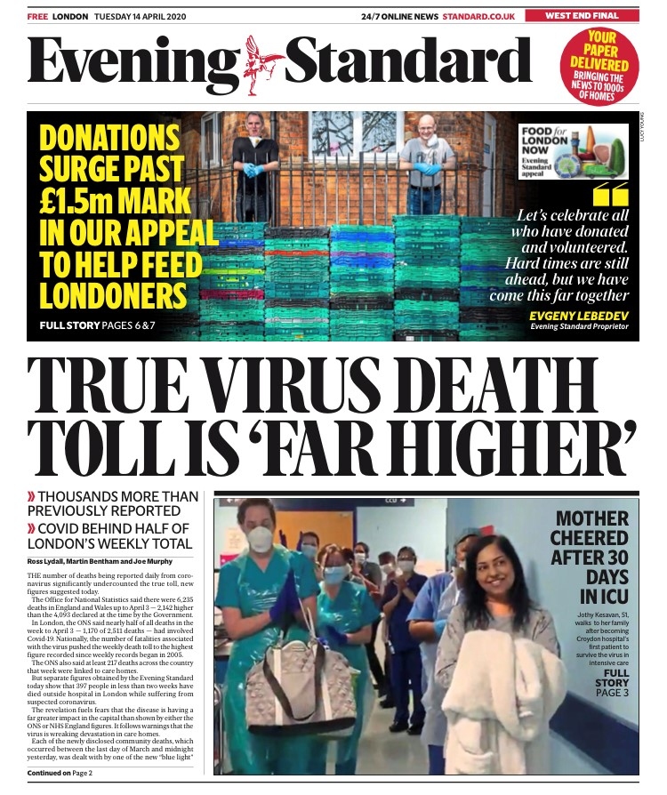

Slide 13
What have we learned?
Only Tuesday ONS statistics work for the paper – and with diminishing results
Test and Trace remained a fascination for many weeks
Dashboard can be hugely misleading, but also key metric for London
Data for ventilated beds but not ICUs
No data on long stay patients
NHS staff data is dated
No “real” case numbers, only rates (indebted to PA)
How many survived?
R number, SAGE minutes: weekend has already begun
R

Slide 14
How have we learned?
By working out the data lag
By understanding interaction between cases, hospitalisations and deaths
By reading expert commentary (thanks SMC, The Times, occasionally Twitter)
By speaking with experts, particularly in hospitals
By reviewing what we reported in previous weeks to add context
R

Slide 15
In summary: How to get it right on time
Prepare ahead
Know where to look
File in takes
Double-check before pressing send
Review how other media reports same data
I agree with Nick (Robinson)

Slide 17
Next steps
Delivering what the Editor wants
Delivering what readers want (analytics)
Remain open to as many opinions as possible
r

Slide 18
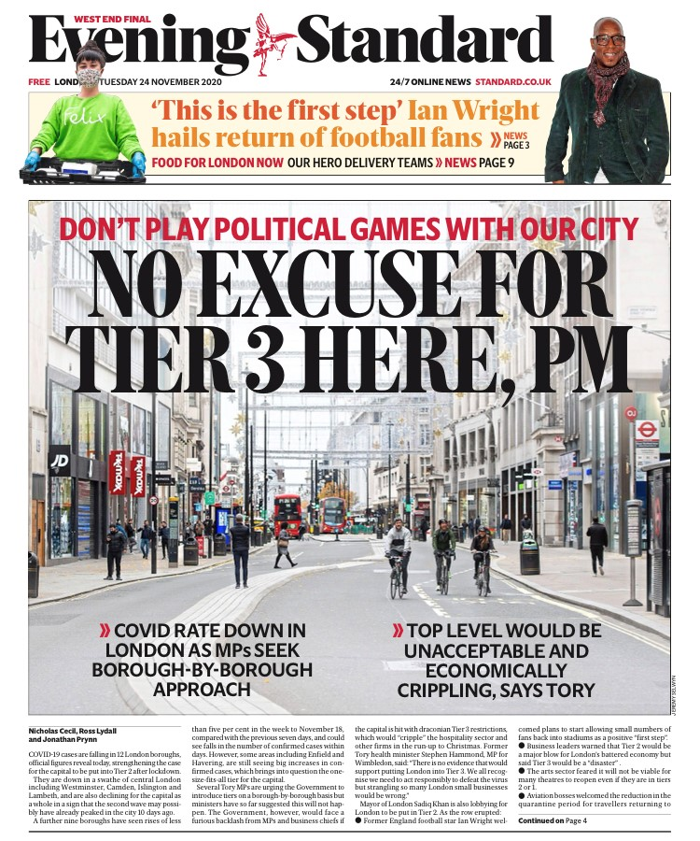

Slide 19
Added challenges
City Hall
Cycle lanes
The Crystal
Crime and chaos
Ross.Lydall@standard.co.uk

Slide 20
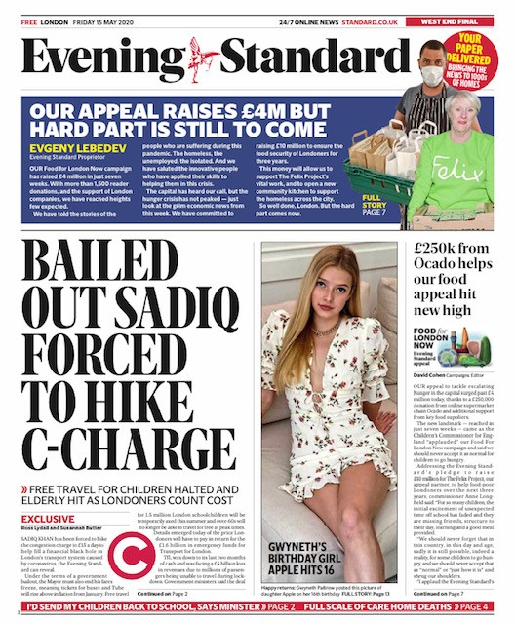

Slide 22
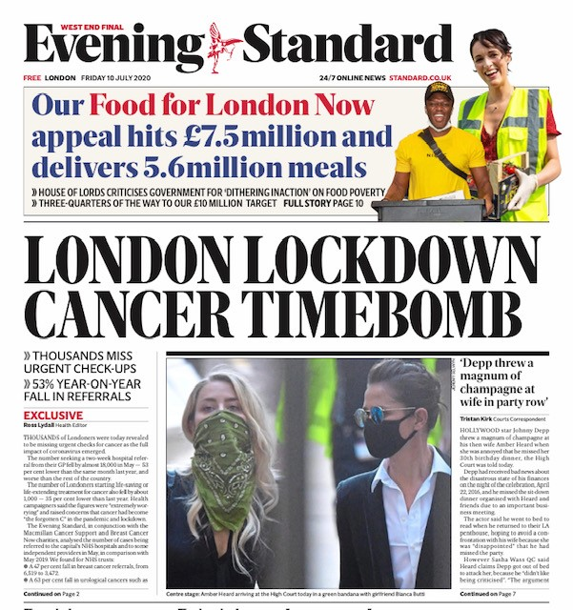

Slide 23
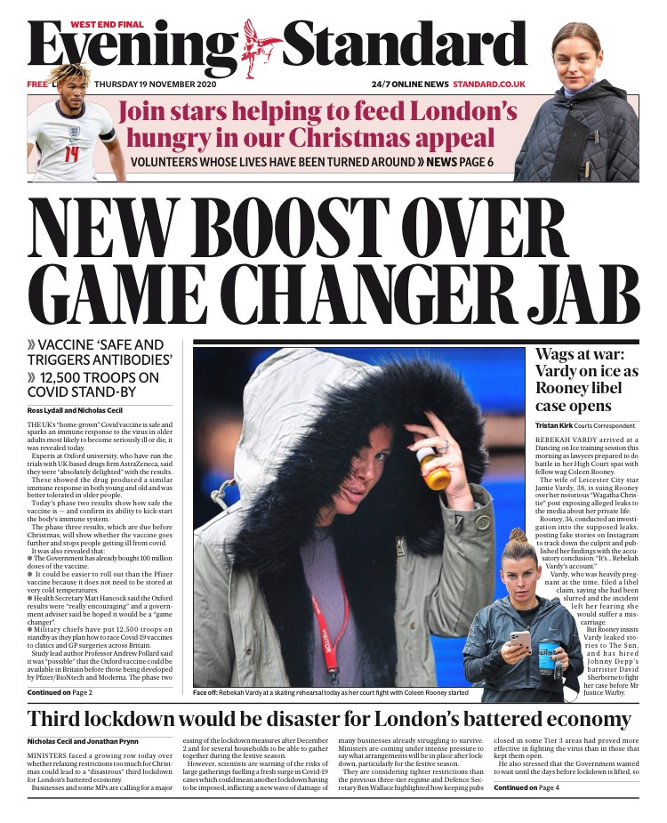

Slide 24
And finally
Sleep well, stay healthy, avoid alcohol
Pray your child’s classroom bubble doesn’t get covid
Journalism is a contact sport
Prepare for a battle: Level 4 restrictions have only made relations with NHS press offices worse.
Thank you for listening
Ross.Lydall@standard.co.uk

