Slide 1
Fiona Lethbridge
Senior Press Officer

Slide 2
There is plenty to celebrate – efforts of scientists, statisticians and journalists

Slide 4
How do we make sure journalists continue to have access to the best science when things are increasingly politicised, and how can we make sure the best scientists keep engaging and don’t pull back from the fray?

Slide 5
Keep helping the science journalists

Slide 6
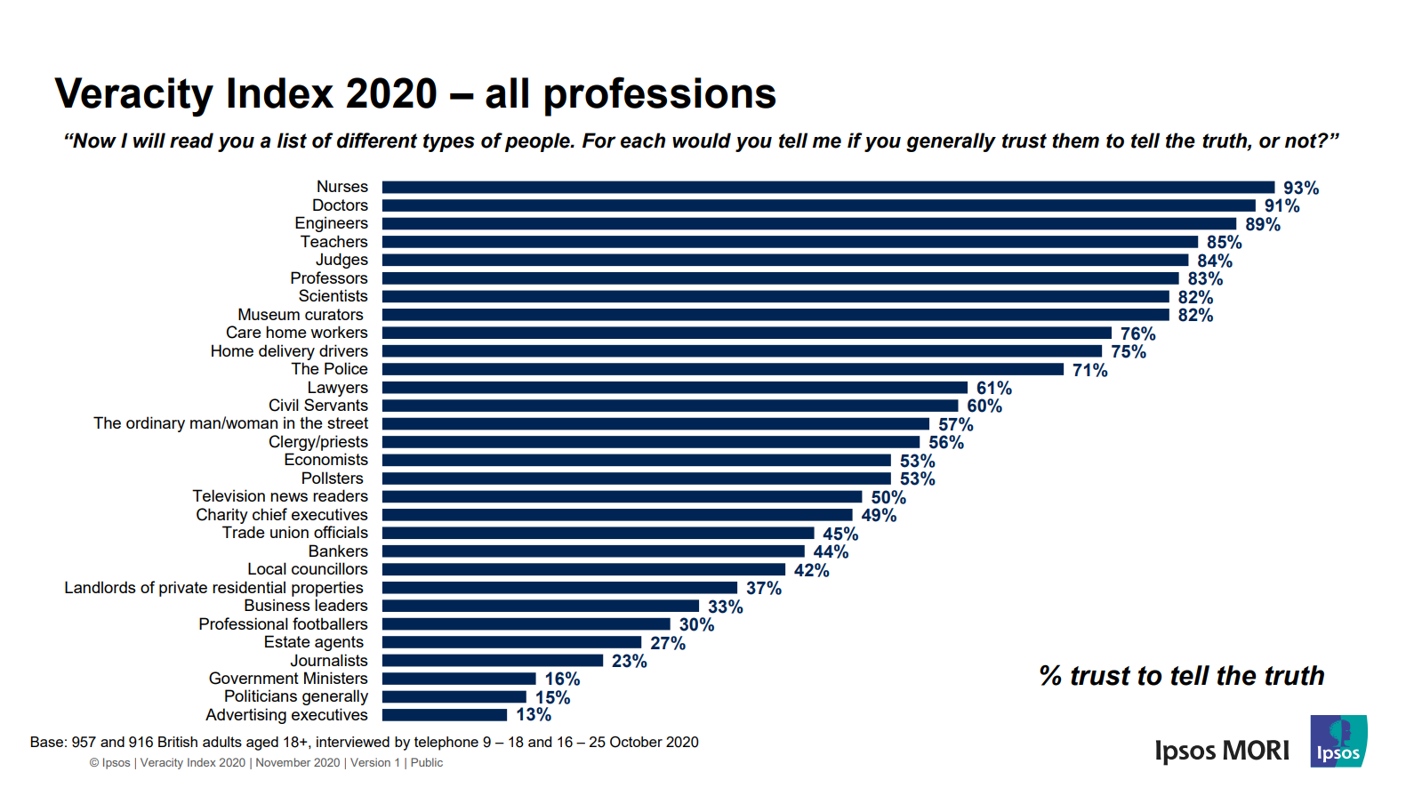

Slide 7
Keep being sciency:
stick to the evidence; talk about data
change your mind when the evidence changes
be open about uncertainty
“I don’t know” is a mark of expertise not ignorance
don’t ‘take sides’ from an ideological perspective
stay in your lane

Slide 8
lethbridge@sciencemediacentre.org
www.sciencemediacentre.org

