Slide 1
Will the new coronavirus lead to new ways of reporting on statistics?
Kevin McConway Emeritus Professor of Applied Statistics The Open University
Conference on Coronavirus, Statistical Chaos and the News
4 December, 2020

Slide 2
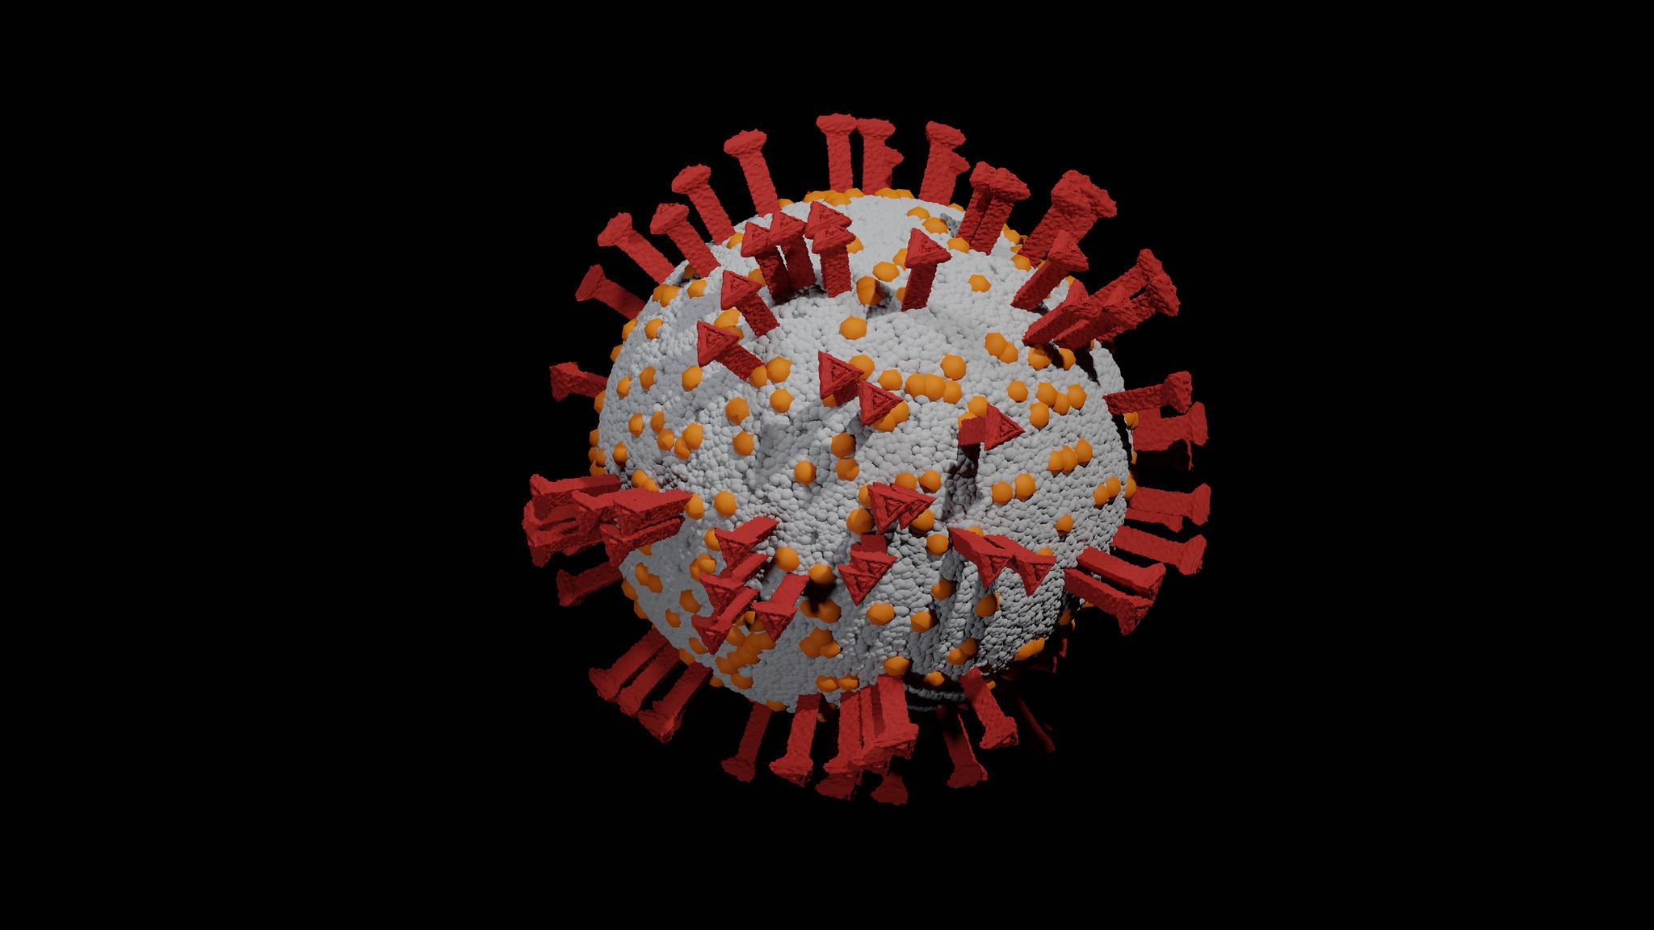
…but first: A coronavirus example…
Or,
Two UK statisticians sucked into German Twitter storm shock horror!
‹#›

Slide 3
An analysis of SARS-CoV-2 viral load by patient age
Terry C. Jones^{1,2}, Barbara Mühlemann^{1,3}, Talitha Veith^{1,3} , Marta Zuchowski⁴, Jörg Hofmann⁴,
Angela Stein⁴, Anke Edelmann⁴, Victor Max Corman^{1,3}, Christian Drosten^{1,3}
Affiliations:
1: Institute of Virology, Charité-Universitätsmedizin Berlin, corporate member of Freie
Universität Berlin, Humboldt-Universität zu Berlin, and Berlin Institute of Health, 10117 Berlin,
Germany
2: Center for Pathogen Evolution, Department of Zoology, University of Cambridge, Downing
St., Cambridge, CB2 3EJ, U.K.
3: German Centre for Infection Research (DZIF), partner site Charité, 10117 Berlin, Germany
4: Labor Berlin - Charité Vivantes GmbH, Sylter Straße 2, 13353 Berlin, Germany
https://zoonosen.charite.de/fileadmin/user_upload/microsites/m_cc05/virologie-ccm/dateien_upload/Weitere_Dateien/analysis-of-SARS-CoV-2-viral-load-by-patient-age.pdf
Abstract
Data on viral load, as estimated by real-time RT-PCR threshold cycle values from 3,712
COVID-19 patients were analysed to examine the relationship between patient age and
SARS-CoV-2 viral load. Analysis of variance of viral loads in patients of different age categories
found no significant difference between any pair of age categories including children. In
particular, these data indicate that viral loads in the very young do not differ significantly from
those of adults. Based on these results, we have to caution against an unlimited re-opening of
schools and kindergartens in the present situation. Children may be as infectious as adults.
‹#›

Slide 4
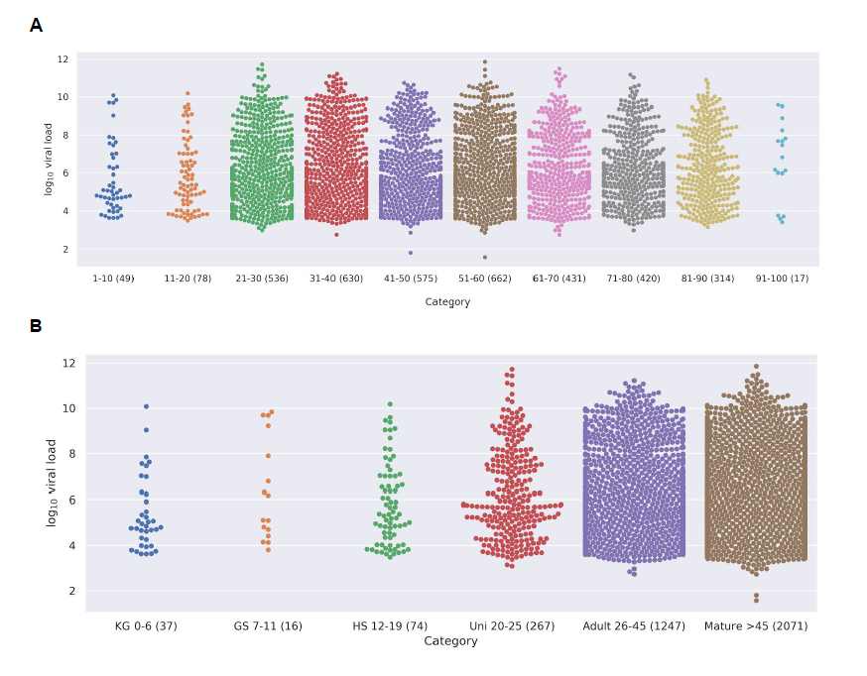
‹#›

Slide 5
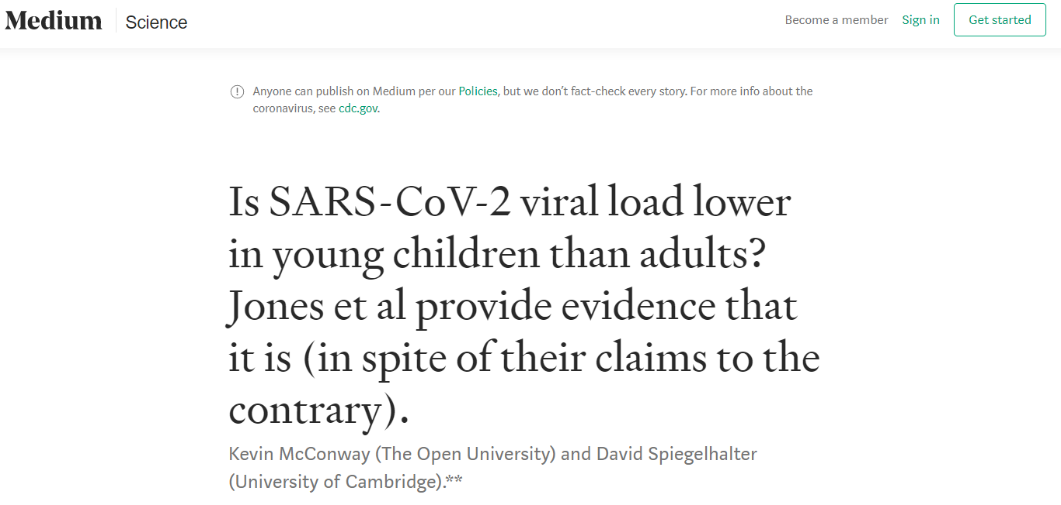
https://medium.com/@d_spiegel/is-sars-cov-2-viral-load-lower-in-young-children-than-adults-8b4116d28353
Published 25 May 2020
‹#›

Slide 6
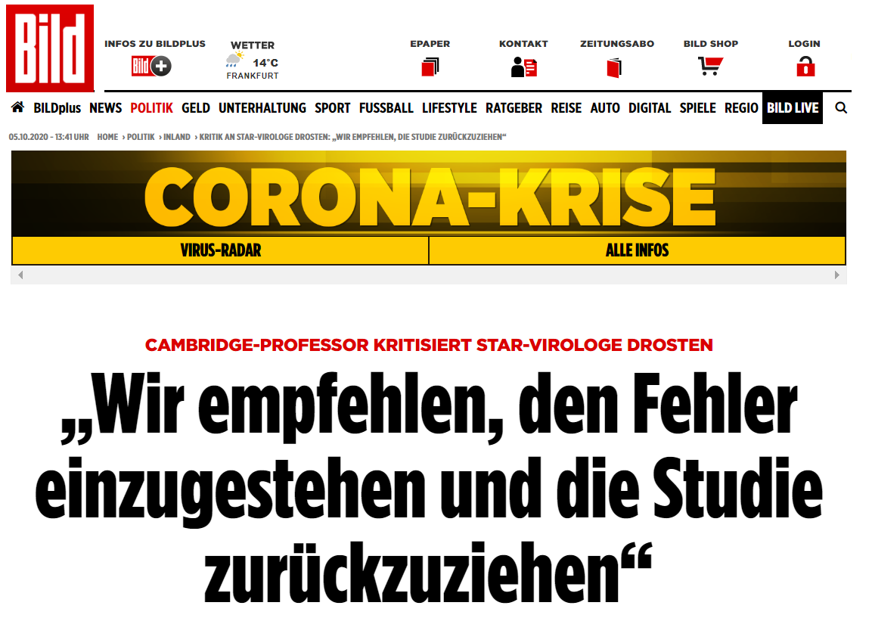
https://www.bild.de/politik/inland/politik-inland/kritik-an-star-virologe-drosten-wir-empfehlen-die-studie-zurueckzuziehen-70884902.bild.html , first published 27.05.2020
‹#›

Slide 7
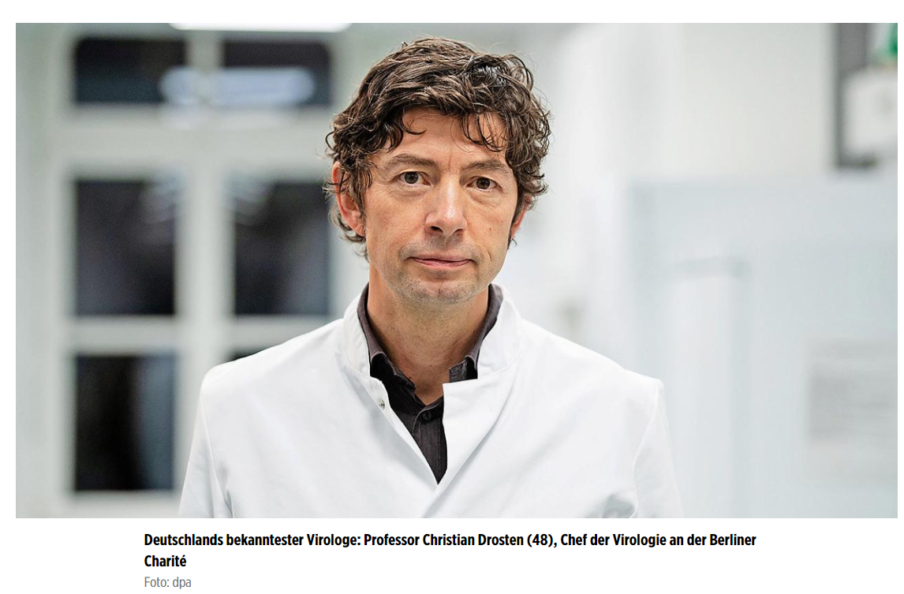
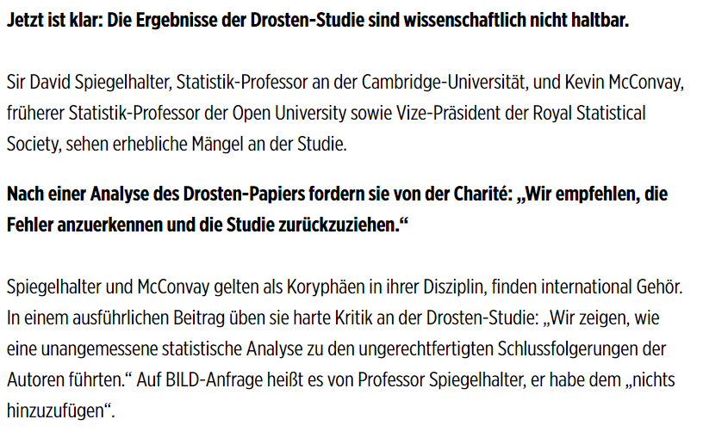
‹#›

Slide 8
https://www.bild.de/politik/inland/politik-inland/fragwuerdige-methoden-drosten-studie-ueber-ansteckende-kinder-grob-falsch-70862170.bild.html, first published 25.05.2020

Slide 9
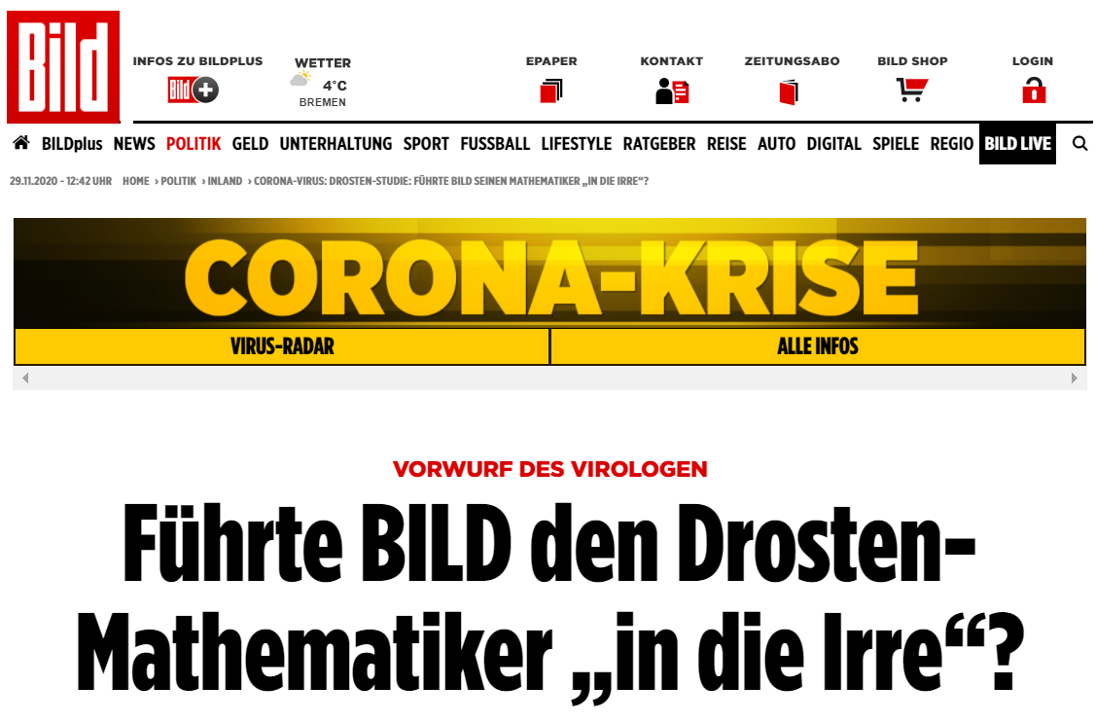
https://www.bild.de/politik/inland/politik-inland/corona-virus-drosten-studie-fuehrte-bild-seinen-mathematiker-in-die-irre-70887122.bild.html, first published 26.05.02

Slide 10
What, if anything, does this teach us?
Imagine the preprint had come out in another year, about some infection that wasn’t infecting tens of thousands and locking countries down.
We quite likely wouldn’t even have seen it, and if we had…
…we’d have done what one is supposed to do with a preprint – comment to the authors, maybe in public on a preprint archive.
We wouldn’t have involved ourselves in this public way if the politics hadn’t already been put in there by the original authors and continued by others.
Christian Drosten has a strong public profile in Germany. There’s polarisation of the debate there just as here.
How far should we have checked on the situation in Germany before getting involved?
Blastland et al., Nature, ‘Five rules for evidence communication’, https://doi.org/10.1038/d41586-020-03189-1
Strive to inform, not persuade
Did we strive hard enough?

Slide 11
What hasn’t changed
‹#›

Slide 12
What hasn’t changed
Ubiquitous statistics (well, numbers)

Slide 13
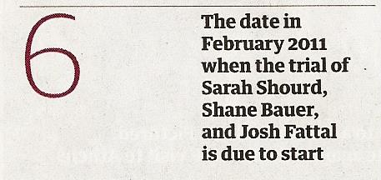
What statistics were there in the traditional media pre-Covid?
There are numbers everywhere!
Business, sport…
…but also politics, economics,…
…science (mostly health, environment)…
…infographics…
…silly stories based on dubious surveys, fillers, just about everywhere.
Why?
Because they are the basis of the story, but also…
…for rhetorical purposes or to increase credibility and trustworthiness…
…or just to make the page or webpage look better.
(More in McConway K (2019) ‘Towards a Fruitful Relationship Between Statistics and the Media: One Statistician’s View’, in Nguyen, An (ed.) News, Numbers and Public Opinion in a Data-Driven World, London: Bloomsbury; or McConway K (2016) ‘Statistics in the media: A statistician’s view’, Journalism, 17, 49–65, DOI: 10.1177/1464884915593243)
Guardian, 22 November 2010
‹#›

Slide 14
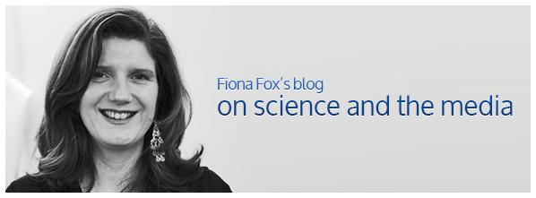
What has and hasn’t changed
Ubiquitous statistics (well, numbers)…
…but numbers have been ubiquitous for decades (or for ever, really)
I suspect what’s changed isn’t so much the column inches of coverage as
news value
perceived importance of the numbers
the type of journalists involved (beat, background, data skills)
Fiona Fox, Chief Executive of the (UK) Science Media Centre blogged about the involvement of political correspondents:
“But many of the big decisions still rest on our progress in understanding the virus and frankly none of us yet fully understand it. […] Doubtless politicians are spinning and hiding plenty as they always have. But somehow the ‘why is this lying bastard lying to me’ approach feels a little off beam.” https://www.sciencemediacentre.org/does-covid-19-need-a-different-kind-of-journalism/, 4 May 2020

Slide 15
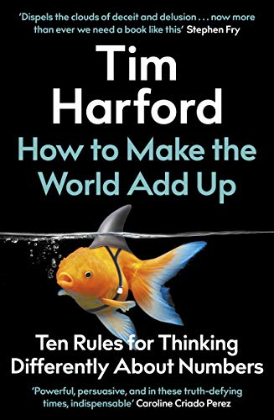
Why so many numbers?
The unreasonable persuasiveness of numbers.
Numbers as devices of rhetoric.
Interesting recent paper by Brendan Lawson and Matthew Lovatt: Towards a rhetorical understanding of statistics in politics: Quantifying the National Health Service ‘Winter Crisis’. European Journal of Communication, 2020, https://doi.org/10.1177/0267323120966842
Numbers for shutting down argument.
Numbers can increase the credibility of a story. (Koetsenruijter 2008, 2011, 2018)
Tim Harford’s new book How to Make the World Add Up: Ten Rules for Thinking Differently about Numbers (Bridge Street Press, 2020)
Rule 1: Search your feelings

Slide 16
What hasn’t changed
Ubiquitous statistics (well, numbers)
Poor communication of uncertainty

Slide 17
Why communicate uncertainty
‹#›

Slide 18
BMJ Evidence-based Medicine, Oct 2010 (online)
http://dx.doi.org/10.1136/bmjebm-2020-111541

Slide 19
Their conclusion
Two key messages sent to patients, instructing significant undertakings, by government in the context of COVID-19 did not contain any reference to their uncertainties. Yet the advice given was not based on highly certain evidence […].
Evidence based policy means that policy and public advice should change as better evidence emerges. If apparently inexplicable changes to advice follows, these risk incurring a loss of trust, and the public referring to less reliable sources instead. […]
Further, medical ethics requires honesty and openness about the extent and limitations of current knowledge.
We recommend that future public communications about risks in the context of COVID-19 carefully includes uncertainties and caveats. We also recommend that admissions of uncertainty in such communications is regarded as a strength of communication and desirable by policymakers.

Slide 20
…and there’s more…
BMJ editorial, 19 October 2020, ‘Covid-19’s known unknowns’, by George Davey Smith, Michael Blastland and Marcus Munafò, https://doi.org/10.1136/bmj.m3979
Subtitle “The more certain someone is about covid-19, the less you should trust them”.
UnHerd, 26 October 2020, ‘How the experts messed up on Covid’, by Stuart Ritchie and Michael Story, https://unherd.com/2020/10/how-the-experts-messed-up-on-covid/

Slide 21
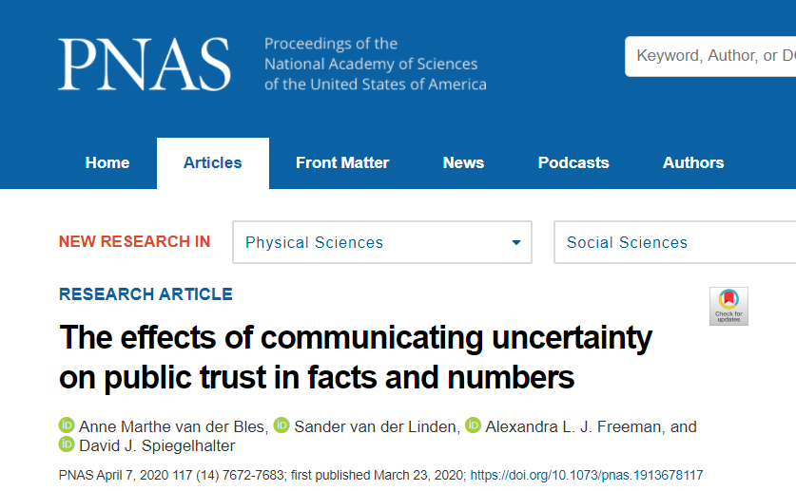
https://doi.org/10.1073/pnas.1913678117
Winton Centre for Risk and Evidence Communication, https://wintoncentre.maths.cam.ac.uk/

Slide 22
Significance
Does openly communicating uncertainty around facts and numbers necessarily undermine audiences’ trust in the facts, or the communicators? Despite concerns among scientists, experts, and journalists, this has not been studied extensively.
In four experiments and one field experiment on the BBC News website, words and numerical ranges were used to communicate uncertainty in news article-like texts. […] Communicating uncertainty numerically only exerted a minor effect on trust.
Knowing this should allow academics and science communicators to be more transparent about the limits of human knowledge.
Abstract
[…] Results show that whereas people do perceive greater uncertainty when it is communicated, we observed only a small decrease in trust in numbers and trustworthiness of the source […]

Slide 23
Why it can be hard to communicate uncertainty (even for statisticians)
‹#›

Slide 24
It’s complicated!
There are different kinds of uncertainty
Imagine you’re Boris Johnson deciding on tiering system – or you’re writing about the decision.
How many people are infected now in different parts of Kent? In principle you could test everyone and know this.
Epistemic uncertainty
What will happen in the future if Kent is put in Tier 3? That depends on uncertain events in the future – how much people mix, how well the rules are followed, how the local MPs react, etc. etc.
Aleatory uncertainty

Slide 25
What hasn’t changed
Ubiquitous statistics (well, numbers)
Poor communication of uncertainty
Part of journalists’ role is to keep bad science out of the news
Part of scientists’/statisticians’ role too

Slide 26
What has changed
‹#›

Slide 27
What’s changed for statistics and science reporting
Ubiquitous important statistics!
Number Theatre, and its close relative Chart Cinema
Preprints, preprints everywhere
‘Following the science’ – but there’s no such thing as THE science
Hindsight bias, particularly as a tool for political correspondents!

Slide 28
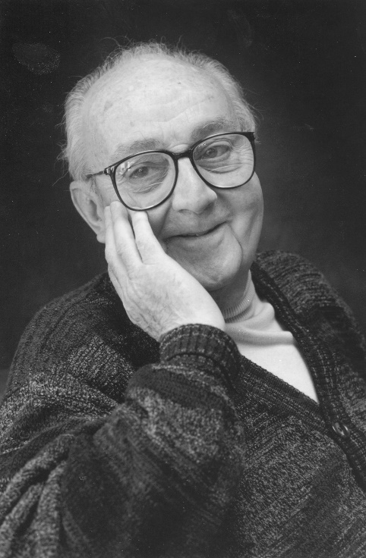
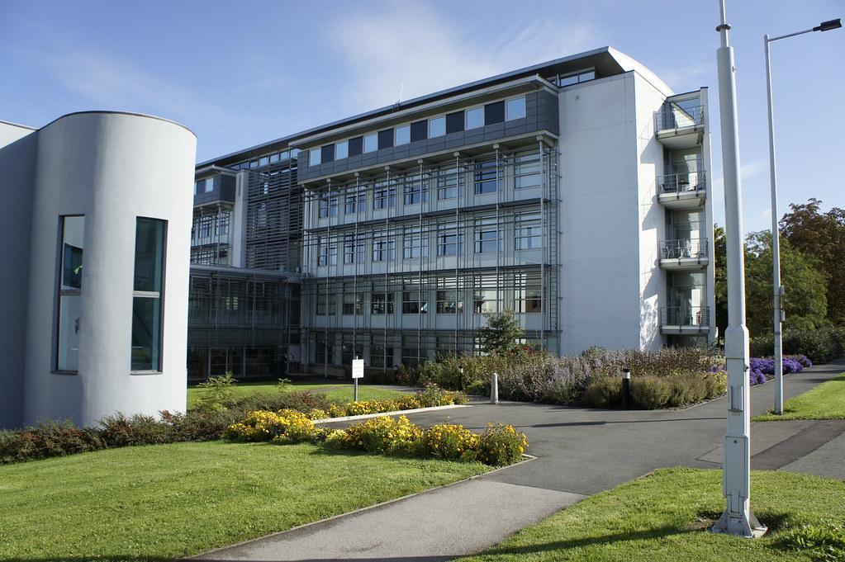
What’s changed for statistics and science reporting
People at every level not understanding modelling (not even some of the people doing it…) – with consequent bad communication.
All models are wrong but some are useful (George Box, statistician, 1919-2013)
A map is not the territory (Alfred Korzybski, engineer/philosopher, 1879-1950)
Are we mapping some existing landscape, or a not-yet-knowable future place?
GeorgeEPBox.jpg by DavidMCEddy at en.Wikipedia is licensed under CC BY-SA 3.0

Slide 29
COVID pandemic examples
Same old issues, new contexts

Slide 30
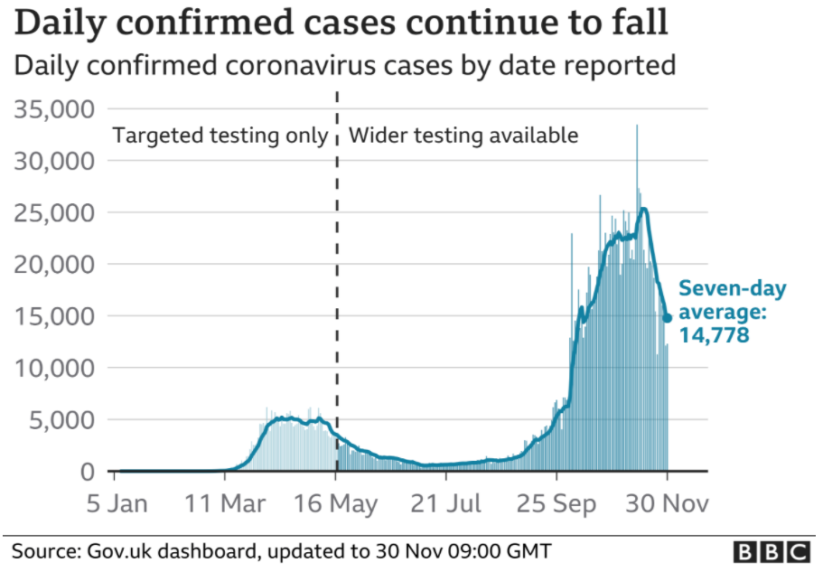
Not comparing like with like
Daily counts of new infections
Counts of new ‘confirmed cases’ daily, on daily briefings and (now) coronavirus.data.gov.uk
Misleading because they depend so much on testing – how many tests, which people, speed of reporting.
Media outlets vary in clarity on this.
www.theguardian.com, 1 December 2020
www.bbc.co.uk/news, 1 December 2020

Slide 31
False positives and false negatives
PCR swab test bafflement
People’s intuitions about errors in diagnostic/identification/screening test results are notoriously awful.
Misleading media coverage in the past of health screening (mammography, PSA prostate cancer screening), live facial recognition cameras, etc.
PCR swab tests can produce false positives and false negatives – lots of erroneous statements
Several science journalists spotted this, and reported the position correctly. Thank you!

Slide 32
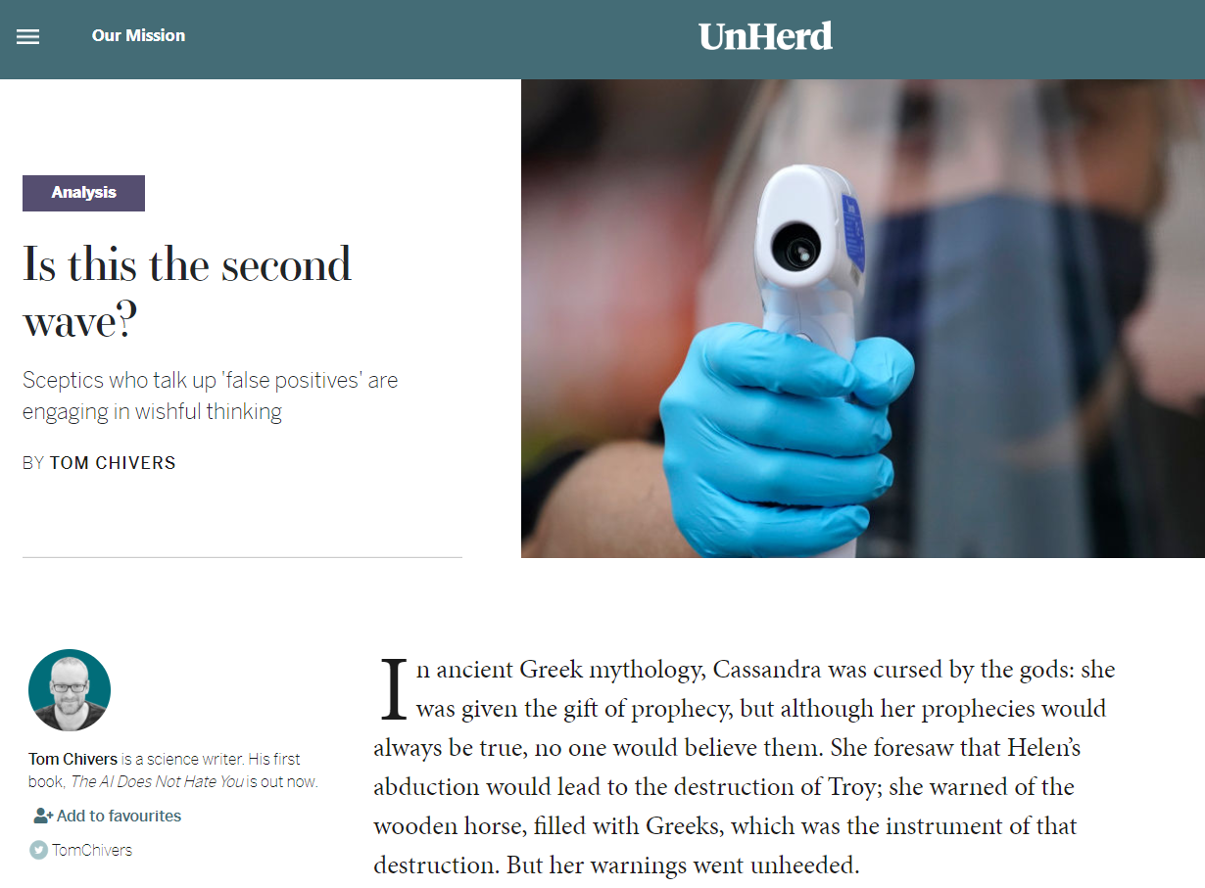
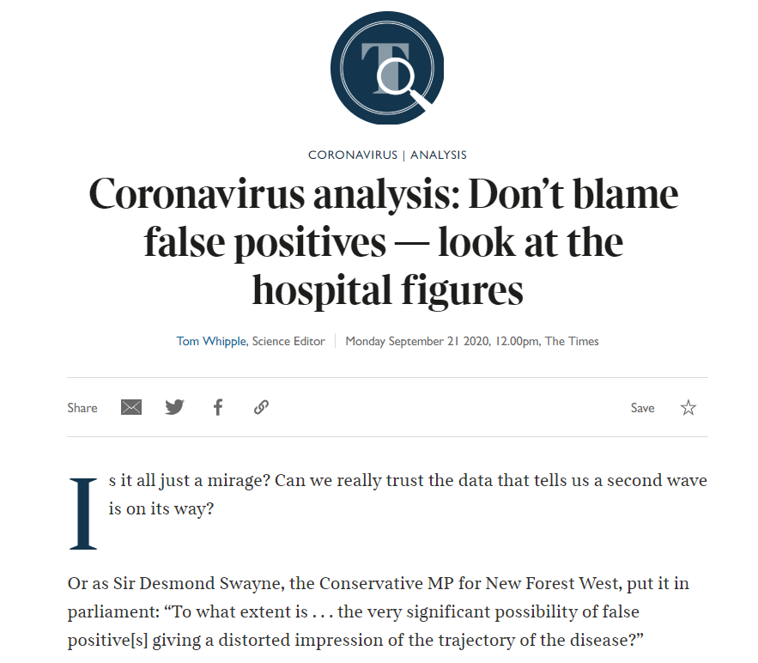
https://unherd.com/2020/09/do-we-need-a-second-lockdown/
https://www.thetimes.co.uk/edition/news/coronavirus-analysis-dont-blame-false-positives-look-at-the-hospital-figures-3xf7wj0fv

Slide 33
Correlation is not causation
What’s making case numbers change?
https://www.dailymail.co.uk/news/article-8785775/Coronavirus-cases-spiralled-days-August-Bank-Holiday.html
MailOnline analysis has revealed a slight coronavirus spike following Black Lives Matter protests on June 13 and 14, and a sudden surge in cases after the August Bank Holiday

Slide 34
Advice for statisticians on working with journalists

Slide 35
Two cultures?
Statisticians think journalists…
are illiterate
are pedantic
make the story so boring that it doesn’t get across
concentrate so much on the ifs and buts that the overall message disappears
won’t listen

Slide 36
Working with journalists
Recognise that journalists are different
Timescales:
Shorter than most statisticians are used to
Journalists won’t wait because they can’t
Agenda and “news value”
The pressure to be personal
Journalists have strengths that (most) statisticians don’t:
Knowing their audience
Getting things across in a short space
Generally, telling stories

Slide 37
Working with statisticians
Recognise that statisticians are different
Uncertainty:
We know about it and don’t often ignore it
(But we don’t all know enough about communicating it)
Informing rather than persuading
We’re used to explaining awkward technical things to non-specialists (like you…)
We’re trained nit-pickers – there might be a story in what we tell you on that
We can explain why a press release really isn’t worth covering

Slide 38
Thanks!
Feedback to:
kevin.mcconway@open.ac.uk Twitter: @kjm2
‹#›

