Slide 1
Coronavirus, Statistical Chaos and the News Preliminary Reflections from Journalists and Scholars 4 December, 2020

Slide 2
Welcome from the host institution
Dr Einar Thorsen
Professor of Journalism & Communication
Executive Dean, Faculty of Media & Communication, Bournemouth University

Slide 3
“House-keeping” things
A personal thank to Carole Haynes, former Policy Manager at the RSS for working enthusiastically on this conference during April-October
This conference is recorded and will be posted on BU, RSS and ABSW websites
Please use the Q&A window to ask questions or make comments.
Please tweet from the event, using the following hashtags if possible:
#StatsintheMedia
#sciencejournalism
If you need any help, please email Khanh Hoang at khoang@bournemouth.ac.uk

Slide 4
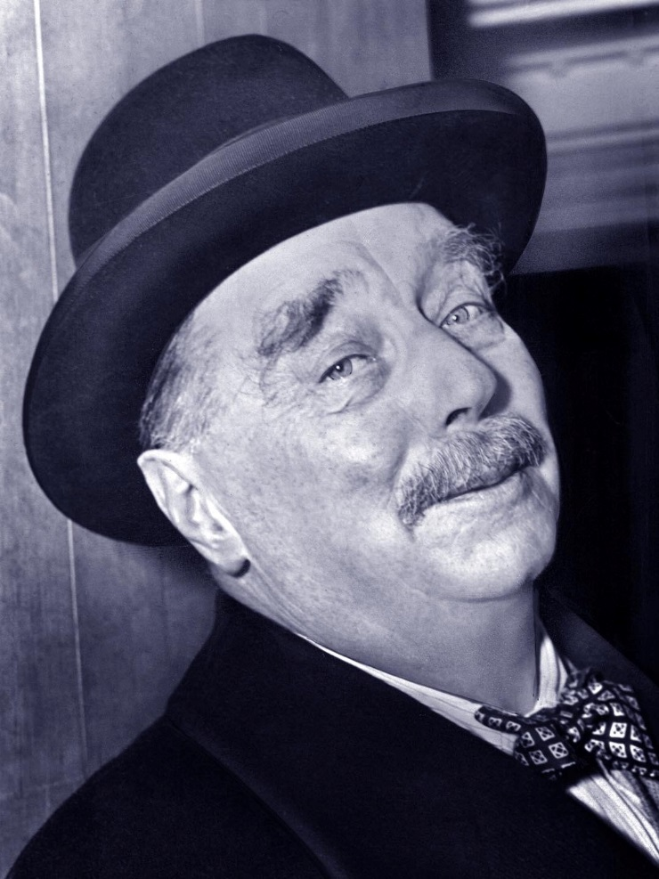
117 years ago…
The time may not be very remote when (…) for complete initiation as an efficient citizen (…), it is as necessary to be able to compute, to think in averages and maxima and minima, as it is now to be able to read and write.
H. G. Wells, Mankind in the Making, 1903, p. 189

Slide 5
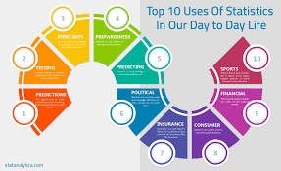
That time has long come
Statistics as part of the fabric of our life
to be more so in an increasingly datafied world
People badly need to understand numbers in context to be informed and self-governed citizens
to respond properly to a measured world
to resist tendency to put unconditional faith in numbers
to be less vulnerable to vested manipulation of their hopes and fears

Slide 6
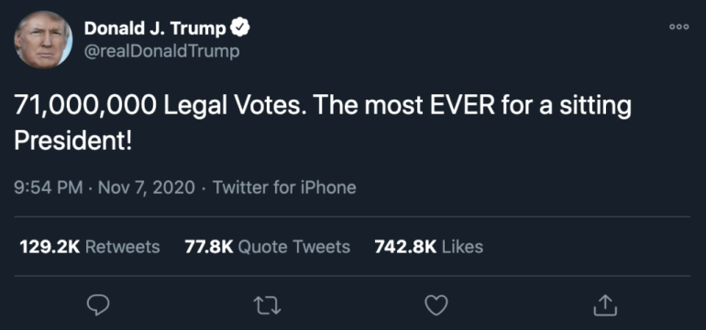
At the same time…
Lies, damn lies and “statistical bullshit” in the post-truth era (Harford, 2016)
"The casual slinging around of numbers not because they are true or false, but to sell a message”
Primarily to catch attention and/or stir emotion
Potentially viral on social media

Slide 7
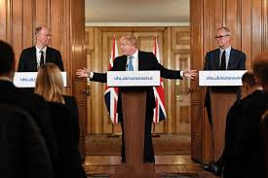
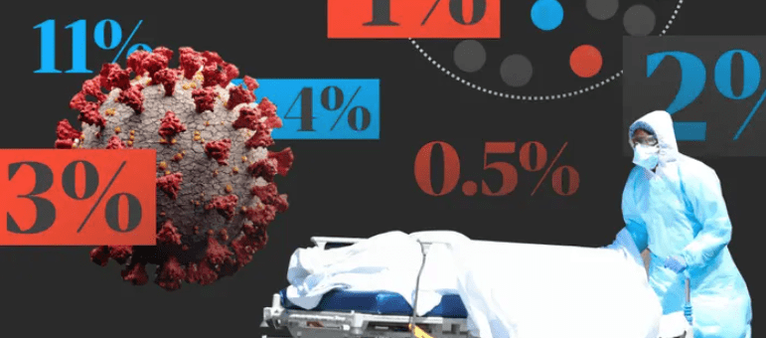
Covid-19: the new culminating point?
Notes:
Spiegelhalter has called the communication of statistics during the pandemic ‘embarrassing’ and a ‘missed opportunity’. Speaking on the BBC’s Andrew Marr show, he said the British public were largely supportive of the government’s measures to tackle the virus and were hungry for information but instead they were being fed ‘number theatre’. He added: “I wish the data was being presented by people who really understand its strengths and limitations and could treat the audience with some respect.”

Slide 8
Today’s agenda
1. What are the major challenges to news reporting of the constantly changing flow of Covid-19 data and statistics?
2. To what extent does news reporting of Covid-19 data and statistics change hearts, alter minds and/or mobilise people into proper pandemic actions?
3. What methods, techniques and platforms do journalists use to obtain, unpack, portray and deliver Covid-19 data and statistics to help people make sense of the pandemic?
4. How well have journalists performed in questioning, scrutinising and communicating Covid-19 data and statistics to debunk statistical “lies and damn lies”?
5. How effectively have scientists and statisticians collaborated with journalists in conveying them to the public – and vice versa?

Slide 9
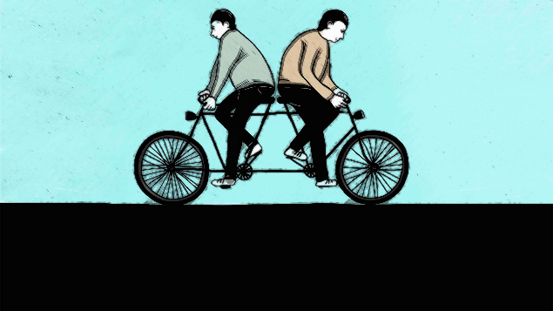
Starting point
Science and journalism are NOT two worlds apart
Both seek the truth through rigorous verification
Both have high stakes in public communication of data and statistics
A partnership built on mutual understanding is urgently needed

Slide 10
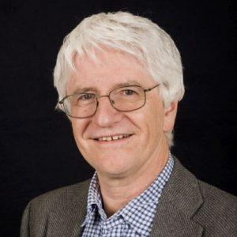
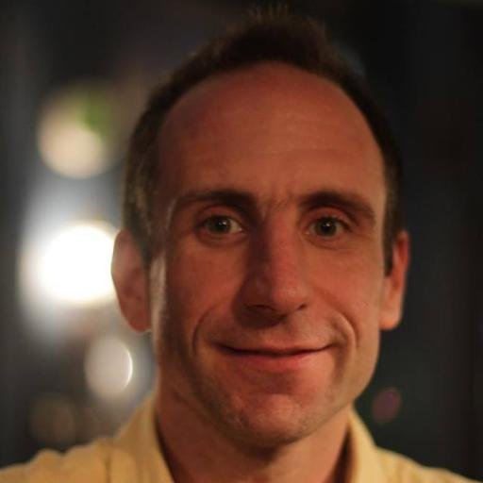
CORONAVIRUS, STATISTICAL CHAOS AND THE NEWS 04/12/2020
SESSION 1 (KEYNOTE)
Will the new coronavirus lead to new ways of reporting on statistics?
Kevin McConway
Emeritus Professor of Applied Statistics, Open University & former Vice-President for Academic Affairs, Royal Statistical Society
Andy Extance
Chair, Association of British Science Writers

Slide 11
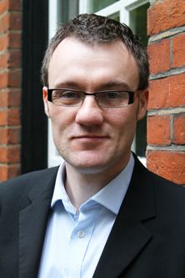
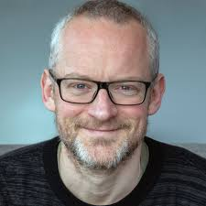
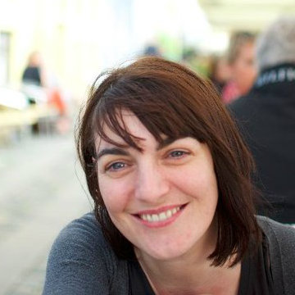
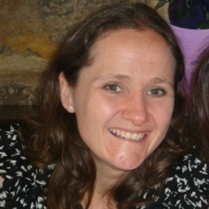
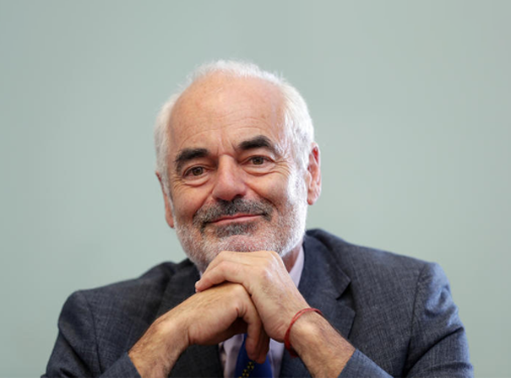
CORONAVIRUS, STATISTICAL CHAOS AND THE NEWS 04/12/2020
SESSION 2 (PANEL DISCUSSION)
REPORTING FROM A “STATISTICAL CHAOS”: CHALLENGES OF COMMUNICATING COVID-19 RISKS
Stuart Allan, Professor & Head, School of Journalism, Media and Culture, Cardiff University
Paul Bradshaw, Pioneer Data Journalist & Scholar, BBC Shared Data Unit and Birmingham City University
Tom Chivers, RSS Award-Winning Science Writer
Pamela Duncan, Data Journalist, Guardian News & Media
Jane Kirby, Health Editor, PA Media
David Spiegelhalter, Chair, Winton Centre for Risk and Evidence Communication, Cambridge University & Co-chair, RSS Covid-19 Taskforce

Slide 12
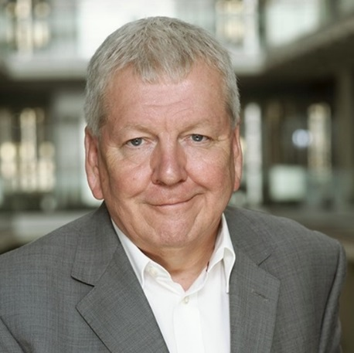
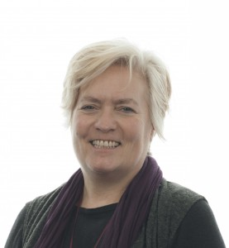
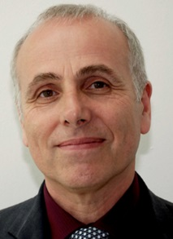
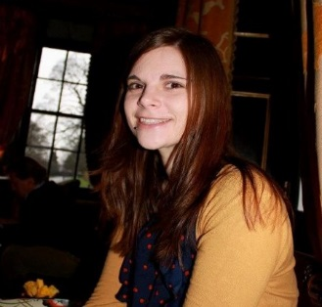
CORONAVIRUS, STATISTICAL CHAOS AND THE NEWS 04/12/2020
SESSION 3
PANDEMIC JOURNALISM: TIGHTROPE WALKING BETWEEN SCIENCE AND POLITICS?
Weaponising Statistics
Timandra Harkness, Science Presenter and Writer & RSS Fellow
Lawrence McGinty
Chair, Medical Journalists’ Association & former Science and Medical Editor, ITV
Political opinion vs. expert opinion: do we need to always make clear the difference to audiences?
Ann Hemingway, Professor of Public Health and Wellbeing, Bournemouth University
Philip Schlesinger FRSE, FAcSS, FRSA
Professor in Cultural Theory, University of Glasgow
Bringing scientists and journalists together in an unprecedented crisis: The Science Media Centre’s experience
Fiona Lethbridge, Senior Press Officer, Science Media Centre

Slide 13
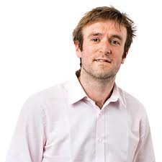
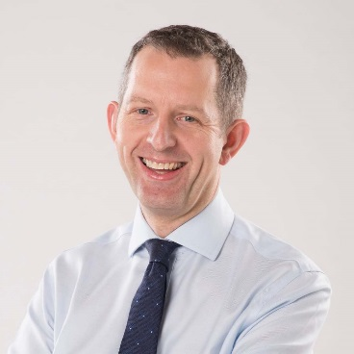
CORONAVIRUS, STATISTICAL CHAOS AND THE NEWS 04/12/2020
SESSION 4
RESPONSES TO CHALLENGES: INNOVATIONS & LIMITATIONS (PART 1)
Numbers in the newsroom: how COVID-19 statistics have led the news at The Times and how we have coped
Tom Whipple, Science Editor, The Times
Brendan Lawson PhD Candidate, University of Leeds
Covid-19 reporting at PA Media: What have we learned so far??
Jane Kirby, Health Editor, PA Media
Paul Bradshaw
Pioneer Data Journalist & Scholar, BBC Shared Data Unit & Birmingham City University
Tomorrow’s news today at the Evening Standard: How to get it right (or wrong) when trying to break COVID news
Ross Lydall, Health Editor & City Hall Editor, Evening Standard

Slide 14
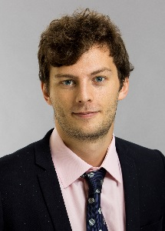
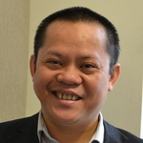
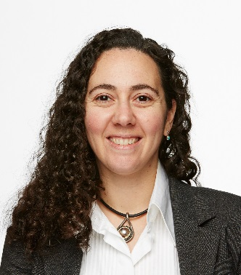
CORONAVIRUS, STATISTICAL CHAOS AND THE NEWS 04/12/2020
SESSION 4
RESPONSES TO CHALLENGES: INNOVATIONS & LIMITATIONS (PART 2)
How The Economist has collected and analysed Covid-19 data
James Tozer, Data Journalist, The Economist
James Fransham, Data Correspondent, The Economist
Sondre Solstad, Senior Data Journalist, The Economist
An Nguyen Associate Professor of Journalism, Bournemouth University
Reach PLC’s localised response to Covid-19 data
Claire Miller, Head of Data Journalism, Reach PLC
Helen Kennedy Professor of Digital Society, Sheffield University
Humanising COVID-19 data through data comics and graphic medicine
Anna Feigenbaum, Associate Professor of Communication and Digital Media, Bournemouth University

Slide 15
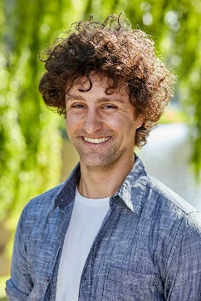
CORONAVIRUS, STATISTICAL CHAOS AND THE NEWS 04/12/2020
SESSION 6
COVID-19 DATA AND NEWS AUDIENCES
Communicating data visually?
Helen Kennedy, Professor of Digital Society, Sheffield University
Andy Extance
Chair, Association of British Science Writers
Andy Extance
Chair, Association of British SWriters
Citizen science’s synergies for improving science reporting during the Covid-19 pandemic
Stuart Allan, Professor & Head, School of Journalism, Media and Culture, Cardiff University
Lawrence McGinty
Chair, Medical Journalists’ Association & former Science and Medical Editor, ITV
Susceptibility to COVID-19 misinformation: inoculation gaming as a potential way to reduce the effect of low numeracy skills and analytical thinking
Jon Roozenbeek, Postdoctoral Research By-Fellow in Psychology, Cambridge University

Slide 16
Coronavirus, Statistical Chaos and the News Preliminary Reflections from Journalists and Scholars 4 December, 2020

