Slide 1
Master Protocols and Platform Trials in Type 1 Diabetes
16.1.2020
Prof. Adrian Mander
Centre for Trials Research, Cardiff University
Intelligent Clinical Trials in INNODIA

Slide 2
Outline
Introduce INNODIA network
Introduce the FDA guidelines on Master Protocols
Show how Master Protocols have been used
Where are we with the INNODIA master protocol

Slide 3
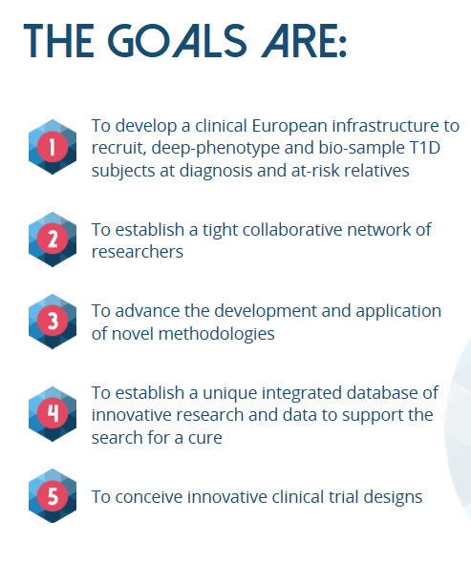
Consortium
https://innodia.eu
Academic Lead: C Mathieu (Leuven), EFPIA lead: AM Schulte (Sanofi)

Slide 4
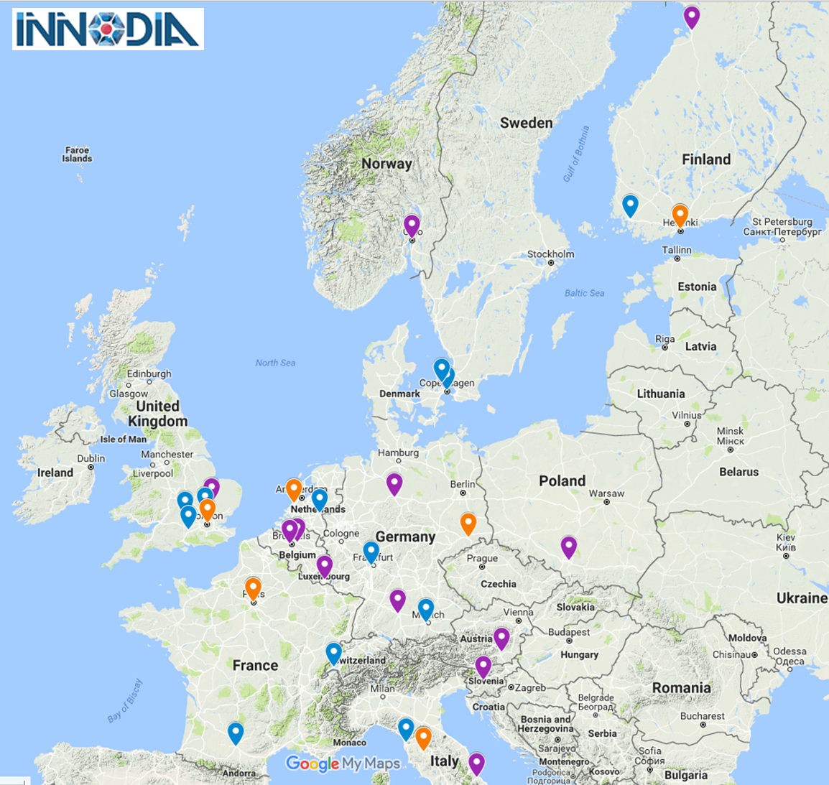
Consortium
Clinical sites
Immune Hubs
Other partners

Slide 5
Accredited Clinical Network
15 clinical sites across 10 countries responsible for the care of over 15 thousand people with Type 1 Diabetes
All sites have been accredited by INNODIA for their capability and expertise in conducting studies and clinical trials in T1D
Compliance with INNODIA sample and data collection (INNODIA protocol and SOPs)
Accreditation included handbook, questionnaire and site visit

Slide 6
Standardisation – sample collection
Identical study procedures across all clinical centres
Common study manual and SOPs for collection, preparation, storage and shipment of samples
Including standardisation of MMTT and liquid meal used
Centralised analysis/storage of clinically relevant samples
Centralised analysis of auto-antibodies, C-peptide (plasma and DBS)
Centralised storage of samples for future ‘omics’
Centralised “omics” processing of samples
DBS = dried blood spot, MMTT = mixed meal tolerance test

Slide 7
Master Protocol - Published information
FDA published draft guideline for Master Protocols
https://www.fda.gov/downloads/Drugs/GuidanceComplianceRegulatoryInformation/Guidances/UCM621817.pdf
Recommendations for the design and conduct of trials in cancer to
simultaneously investigate more than one investigational drug, and/or
investigate more than one cancer type within the same trial structure
References
Janet Woodcock and Lisa M LaVange (2017) "Master protocols to study multiple therapies, multiple diseases, or both" NEJM
MW Redman and CJ Allegra (2015) "The Master protocol concept” Semin. Oncol.
A Hirakawaa et al. (2018) “Master protocol trials in oncology: Review and new trial designs" Cont.Clin.Trials Comms.

Slide 8
Background
Operational Efficiency
Expediting late-stage drug development through
Developing trials designs that test multiple drugs and/or multiple cancer subpopulations in parallel under a single protocol (master protocol)
Master protocol is often used to describe the design of trials such as
Umbrella, basket or platform trials
Example include Lung-MAP, NCI-MATCH trial and I-Spy2 trials
Given a single infrastructure these trials need to be well designed and conducted to ensure patient safety and to obtain quality data.

Slide 9
Precision Medicine
Targeting treatments to subgroups of a population

Slide 10
What is a platform trial?
A “single” trial to evaluate multiple treatments within the same protocol
A platform trial will contain many sub-trials
INNODIA : MELD-ATG, VerapT1D, Novartis (Iscalimab)
An intention to investigate treatment combinations
Quantify treatment effects within subgroups
We already consider age as a subgroup
Biomarker trials should be the future
Recommended to have a common control
Can be a perpetual trial (no end)

Slide 11
Common control issues
only compare treatments to concurrent controls (matched in time)
consider sub-trials as independent trials and do not adjust for multiplicity
comparisons between sub-trials such as “which of these treatments is the most efficacious?”
control for overall false positives

Slide 12
Saville and Berry "Efficiencies of platform clinical trials: A vision of the future”. 2016 Clinical Trials

Slide 13
Biomarker platform trial

Slide 14
I-Spy2 : Breast Cancer platform trial

Slide 15
FDA recommendations on MP
Recommends that the sponsor establish the recommended phase 2 dose
an initial dose-finding phase is allowed in each sub-trial
An MP can be
exploratory studies
support a marketing application
structured to evaluate, in parallel multiple drugs compared to their respective controls or a single control
The design can be fixed or adaptive with the intent to modify or terminate sub-trials

Slide 16
Key Areas
Consortium building/Partnership alliances
Regulatory strategy
Recruitment
Data management
Safety management
Drug Acquisition and Management
Trial Oversight (financial, contractual, IT, etc..)
Training/Education

Slide 17
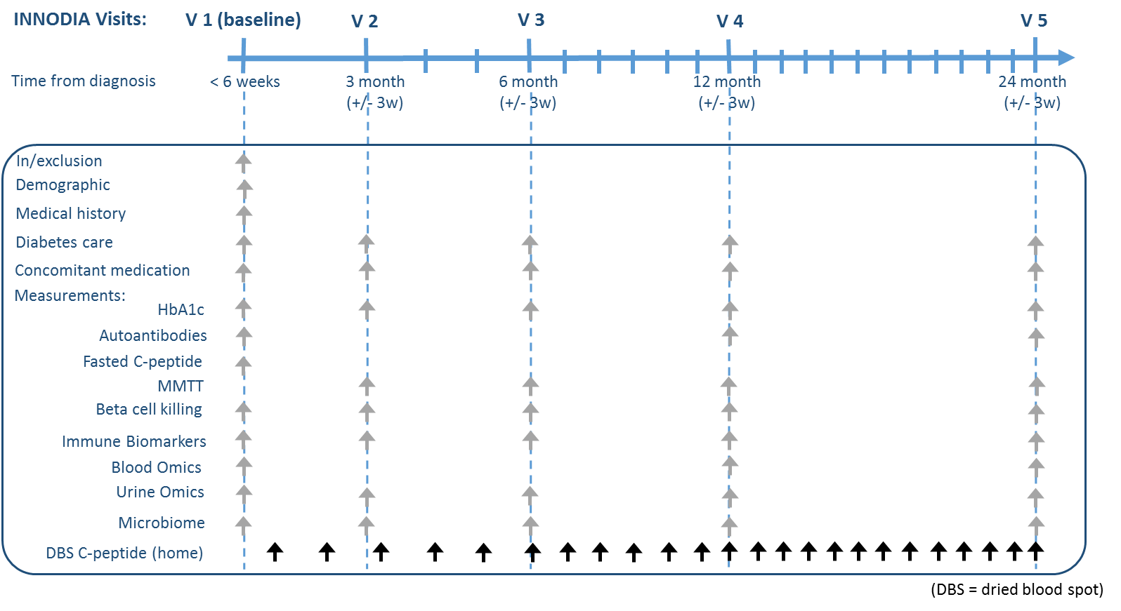
INNODIA Platform

Slide 18
Each trial can add additional measurements
* the MELD-ATG trial will be performed on top of the INNODIA Master protocol
2w
4w
CT V0
CT V4
(3 month)
CT V5
(6 month)
CT V6
(9 month)
CT V7
(12 month)
CT V-1
Randomisation
*
MMTT
*
*
MELD-ATG* additional measures
Toxicology
*
*
*
*
*
Blood Immune Biomarkers
Blood Omics
In/exclusion
Demographic
Medical history
Diabetes care
Concomitant medication
Measurements:
HbA1c
Autoantibodies
Fasted C-peptide
MMTT
Beta cell killing
Immune Biomarkers
Blood Omics
Urine Omics
Microbiome
DBS C-peptide (home)
…………………..Monthly until end of study……………………….
Time from diagnosis
< 6 weeks
3 month
(+/- 3w)
6 month
(+/- 3w)
12 month
(+/- 3w)
24 month
(+/- 3w)

Slide 19
Cross Trial Comparisons
The primary intention is that each sub-trial will be considered statistically independent
Cross-trial comparisons will need to consider multiplicity
When sub-trials included a shared control then cross-trial comparisons will be possible
direct comparisons are used using concurrent controls
indirect comparisons are used via models
When sub-trials do not include shared control data then the natural history data in conjunction with placebo data may enable such comparisons
care will need to be taken to understand any population differences

Slide 20
Population selection and external controls
Sub-trials could use the data from the natural history data
Bayesian methods can be used to measure how close placebo data are to the natural history data
When agreement, information can be borrowed to improve power of results
Methods such as power prior, commensurate prior and hierarchical borrowing
Ideally the sub-trial population is a random sample of the natural history data and this can be used in inference
However, it is recognised that the natural history population will be predominantly people not joining a trial

Slide 21
Novel Trial designs
Two of the sub-trials are planned to be adaptive trials
Verapamil (two-arm parallel group trial) [Adults]
Using a mixed effects model of the repeatedly measured outcome, AUC C-peptide to stop for futility when 45/120 participants have been recruited.
MELD-ATG (dose ranging trial) [12yrs+]
8 cohorts of participants, each cohort randomised (balanced) to the highest dose, placebo and intermediate dose(s)
Interim analyses predict (Bayesian model) which intermediate dose(s) should be used

Slide 22
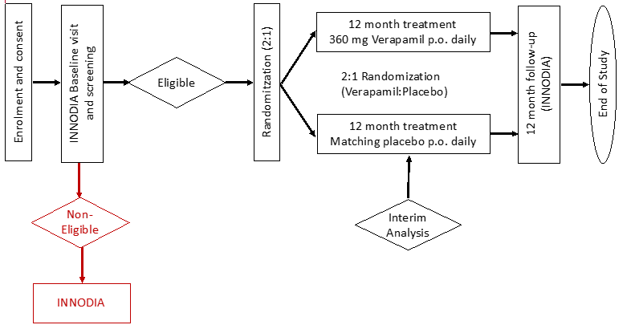
VER-A-T1D
Sample size
Participants will be allocated to treatment or placebo in a 2:1 ratio (Verapamil SR : Placebo).
120 subjects will be needed (40 participants in the control arm and 80 in the experimental arm) to achieve 88% power at 5% significance level to detect a change of 0.18 nmol/L/min.

Slide 23
Verapamil Study
Study Design
AUC C-peptide is measured at baseline, 3, 6, 9 and 12 months.
Primary is 12 months
An interim is planned at 10 months
Recruitment is predicted to be around 5 per month
Assuming a uniform recruitment pattern
At interim, should have
5 people with baseline, 15 people with up to 3 months, 15 people with up to 6 months data, 5 people with up to 9 months

Slide 24
Verapamil Study
Design details (by simulation)
Fitting a mixed effects model with time as discrete, person as a random intercept (assuming MAR), estimate the treatment effect at 6 months
If the Z–statistic is <-0.5 then stop for futility o.w. continue to recruit 120 people
Gives a 30% chance of stopping if H₀ is true
Power of 87.9% for a change in ln(AUC+1) of 0.18 units.
An expected (under the null) SS of 97
Power reduction for doing an interim analysis is 4% with the potential gain of 23 fewer people
Assuming an AR(1) autocorrelation residual error structure and that the treatment effect is linear over time

Slide 25
Additional trigger point
Combination arms
The intention of platform trials is to investigate combination treatment arms
We are currently investigating how to add in several Verapamil + ? arms after the interim analysis
Which Z-score would encourage further Verapamil study?
What is the best way of joining combination arms into the current master protocol sharing the single Verapamil arm (independent or dependent trials)

Slide 26
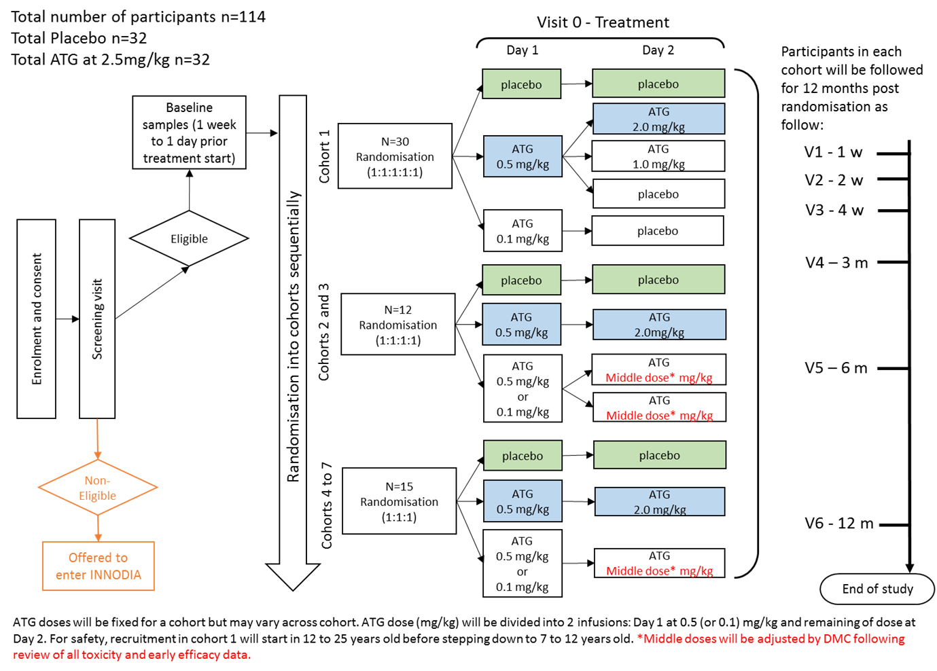
MELD-ATG
N=
6
6
6
6
6
6
6
6
6
20
20
20

Slide 27
MELD ATG trial
Analysis
AUC C-peptide is measured at baseline, 3, 6, 9 and 12 months
There is a set of doses for ATG
0.1, 0.5, 0.75, 1, 1.25, 1.5, 1.75, 2, 2.25 and 2.5 mg/kg
Each interim analysis will use all available data
The analysis is a Bayesian repeated measures model,
Categorical time, dose factors but a linear time by dose interaction.
ID is a random effect (i.e. intercept)
Priors estimated from historical data on the autocorrelation and variance components.
Additionally we have CD8/CD4 ratio of biomarkers (measured within weeks of first dose)
If no effect “visually” then that dose

Slide 28
MELD ATG trial
Interim analysis
A Bayesian prediction is made for the end of the study conditional on the observed data.
All future people who won’t be given placebo or 2.5mg/kg are allocated one of the doses in the set of doses.
Their outcomes are predicted.
The predictive probability that each dose of the set will differ in means from the placebo group is calculated.
The lowest dose that gives the predicted probability > 0.9 is selected for the next cohort (when two doses are selected the dose will be the average between the lowest dose and 2.5mg/kg is selected)
This dose can be 2.5mg/kg

Slide 29
Additional information
Dried Blood Spot C-peptide (DBS C-peptide)
There is the potential to model more frequently measured DBS C-peptide jointly with the Mixed Meal Tolerance Test C-peptide
This would allow more accurate predictions and help with the assumptions of the primary missing outcome data.

Slide 30
Status and achievements (last 6 months)
Master protocol EMA Scientfic Advice
Discussion with SAWP Scientfic officer (Dr.T Vetter) throughout 2019
Final application to SAWP committee sent on August 22 for CHMPH Qualification opinion
Response received October 7 with list of questions
Written response sent to EMA SAWP sent (November 15)
Slide deck for F2F meeting to be submitted by November 20
Scientific Advice F2F meeting scheduled for November 27 in Amsterdam
Studies due to start mid 2020

Slide 31
Conclusions
MPs are difficult to write and are complex BUT they lead to operational efficiencies
MPs contain standardization, common quality control, a single database across multiple studies
Shared controls and the natural history data should lead to statistical efficiencies and a better understanding of results between trials

