Slide 1
RSS GradStat mentoring scheme – mentor reflections
Dr Paul D Baxter
Associate Professor in Biostatistics, University of Leeds
Vice President for Professional Affairs, Royal Statistical Society

Slide 2
My career
BSc (1st class honours) Mathematics with Economics
Univ. Essex, 1997-2000
PhD Statistics “Extraction of fade slope profiles from radiocommunications data using wavelets”
Univ. Essex, 2000-2004
Lecturer in Statistics
Univ. Leeds, Department of Statistics, 2003-2009
Senior Research Fellow in Biostatistics
Univ. Leeds, Division of Biostatistics, 2009-2011
Associate Professor in Biostatistics
Univ. Leeds, Division of Biostatistics, 2011-Present

Slide 3
My involvement with RSS
Joined as a fellow (Nov 2000)
Became Leeds/Bradford Local Group Secretary (Jun 2004 to May 2011)
Became Young Statisticians Section Secretary (Jul 2008 to Dec 2011)
Elected Council Member (Oct 2008 to Dec 2012)
Elected Chartered Statistician (Apr 2010)
Became Associate Editor of JRSS-C (Jan 2011 to Dec 2014)
Became Professional Development Committee Chair (Jan 2011 to Sep 2013)
Became Guy Schools Lecturer (Oct 2011 to Sep 2012)
Elected Professional Affairs Committee Member (Jan 2014 to Dec 2018)
Became Leeds/Bradford Local Group Chair (Jul 2014)
Became Vice President for Professional Affairs (Jan 2017)

Slide 4
My GradStat mentoring
1st mentee Academic (Lecturer) based in London (Jun 2010 to Jul 2012)
2nd Mentee Academic (Research Fellow) based in Midlands (May 2012 to Feb 2016)
3rd Mentee Academic (Research Associate) based in Midlands (Jun 2016 to date)
Notes:
One at a time – similar background to my own

Slide 5
Starting the relationship
The RSS checklist
Notes:
Meet face to face or teleconference

Slide 6
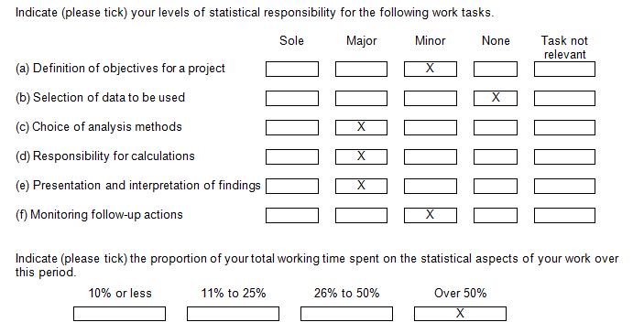
During the relationship (1)
Sharing your CStat application
Mentee shares CV

Slide 7
During the relationship (2)
Helping mentee with the
GradStat Mid Term Assessment (MTA)

Slide 8
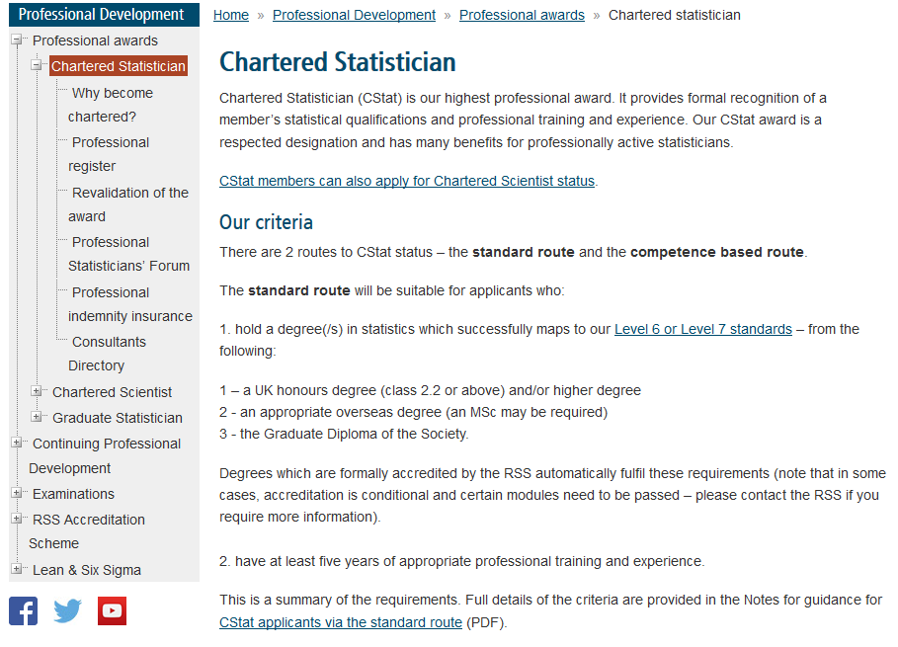
Conclusion of the relationship
Assisting mentee to submit
CStat application

Slide 9
Benefits & challenges
+ Giving back to the statistical community
+ Making a difference to an individual
+ Mentoring an important skill in many promotions criteria
- Time to prepare and hold meetings
- Maintaining a relationship without face-to-face meetings
- Being clear on remit and focus of the relationship alongside any other mentoring mentee is receiving

Slide 10
Advice
Work with mentees from a similar sector of employment
Timing and capacity – one mentee at a time?
Agree expectations at the start
Focus relationship around CStat application and MTA
Ask mentee to keep brief notes and actions from meetings
Help mentees to see the broader picture of CPD
Engagement with the profession
Signposting opportunities e.g. those offered by RSS
Recording all relevant activities

