Slide 1
Alastair McAlpine
Senior Statistician

Slide 4
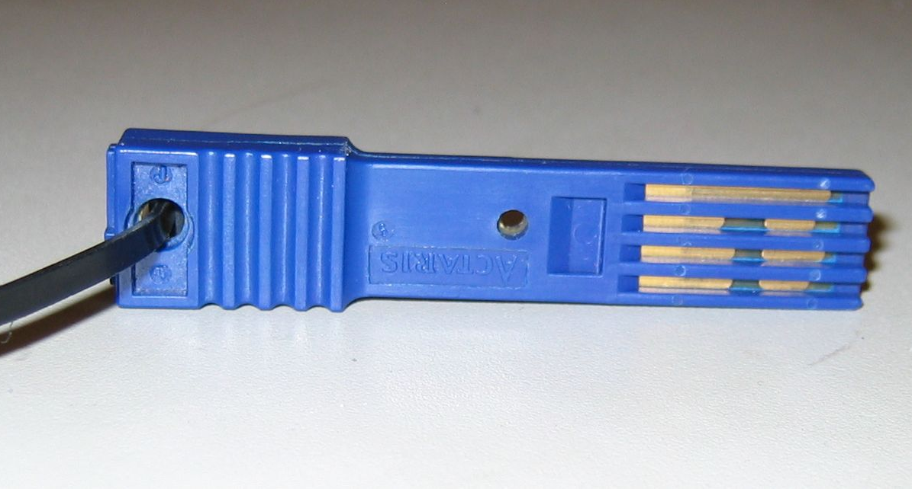

Slide 6
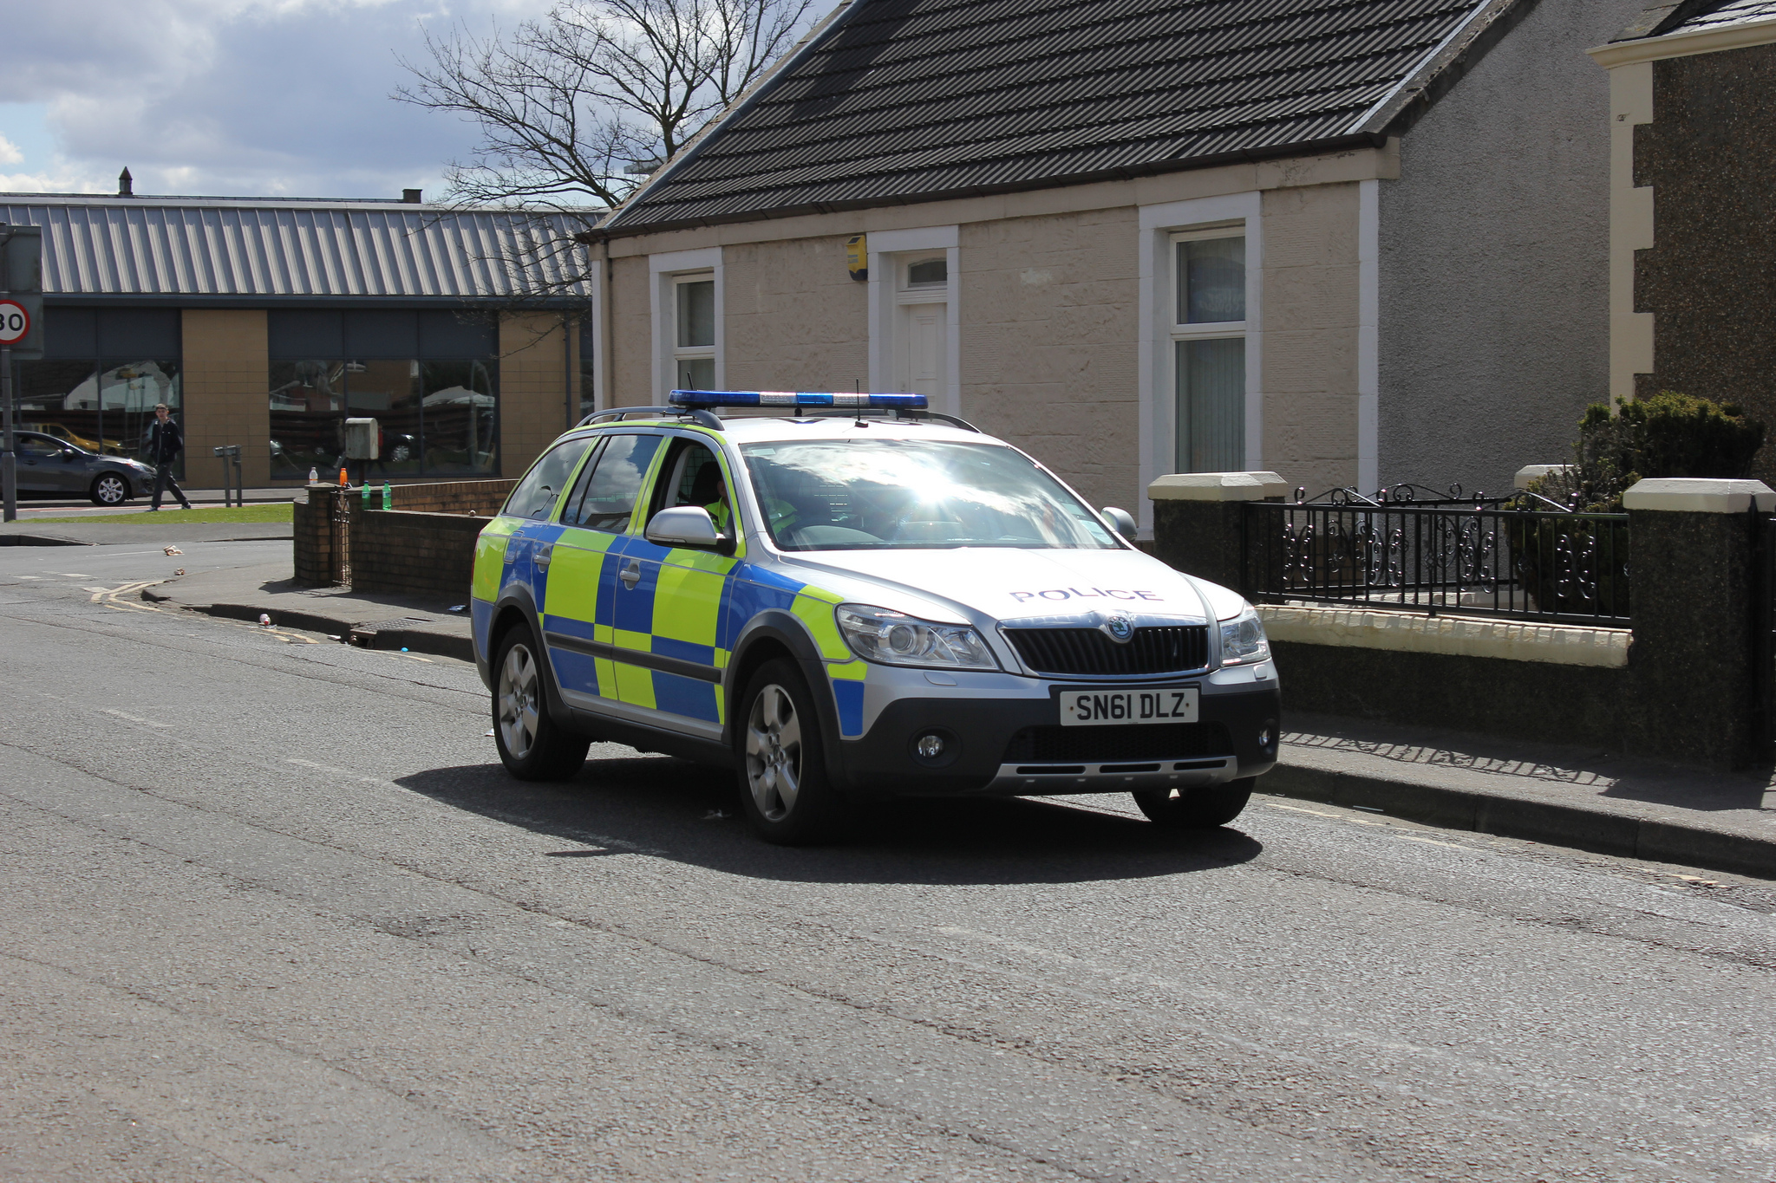

Slide 7
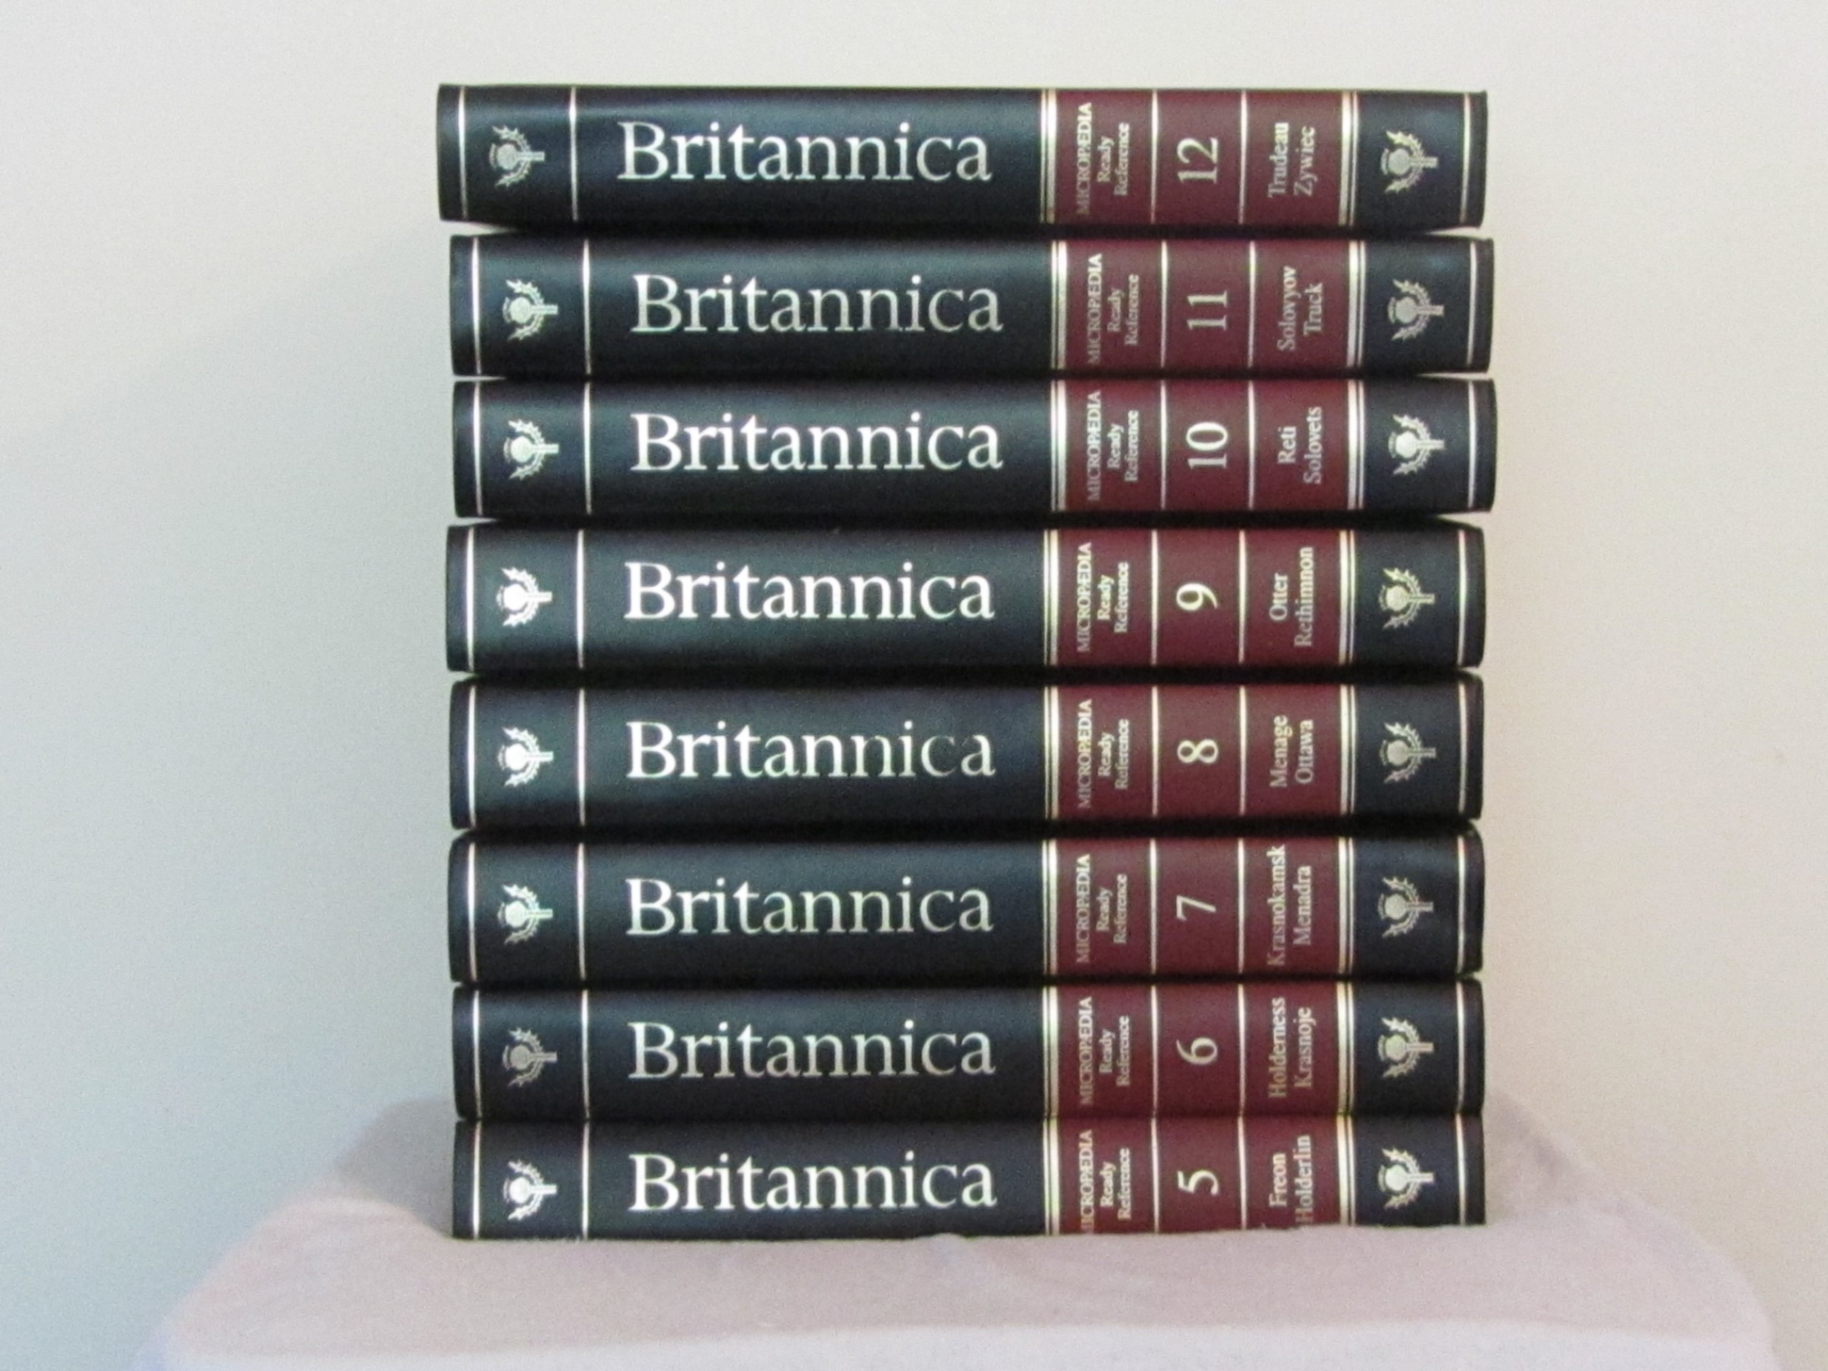

Slide 10
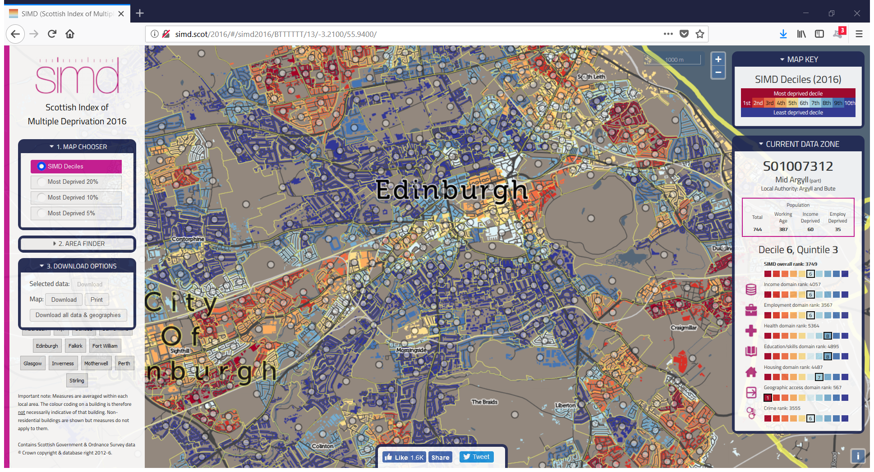

Slide 11
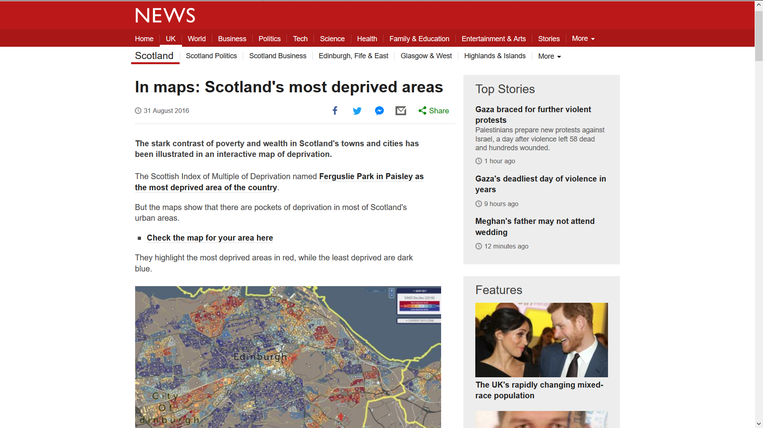

Slide 12
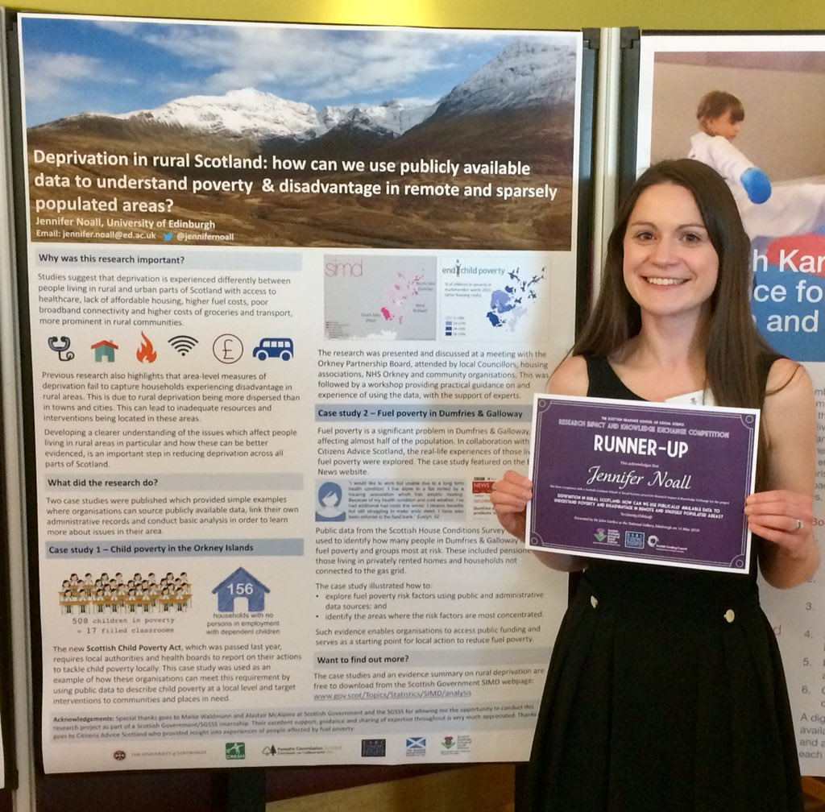

Slide 13
Alastair McAlpine
Senior Statistician
@A_statto

