Slide 1
MHCLG Online Data Dashboard
RSS Excellence in Official Statistics Awards Webinar
16th May 2018
Notes:
15 mins
Rob Green
Ministry of Housing, Communities and Local Government
Online data dashboard – 2 years – data and visualisation on MHCLG policy areas

Slide 2
Agenda
MHCLG Implementation Unit
Motivation for the MHCLG Online Data Dashboard
What is it?
OpenDataCommunities
How it was created
Key outcomes
Next steps

Slide 3






MHCLG Implementation Unit
HOUSING MARKET
EFFECTIVE LOCAL GOVERNMENT
LOCAL GROWTH
GRENFELL RESPONSE
INTEGRATED COMMUNITIES
EU
EXITING THE EU
MHCLG’s Implementation Unit exists to drive better implementation of the Secretary of State’s priorities.
Main functions:
Tracking progress – performance reporting to Ministers and central government departments
Problem solving – quick reviews and deep dives on policies and programmes
Building capability – providing tools and training in the department to increase implementation skills
Notes:
Packs
Deep dives – qual and quant, fieldwork
Dashboards / mapping

Slide 4
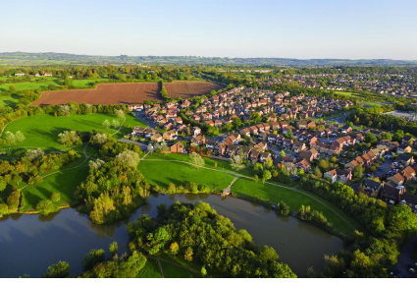
Motivation for the MHCLG Online Data Dashboard
• Building capability - tracking performance
Executive Team – easy access to data and visuals on departmental performance for all staff
Teams to use data and visuals for policy development, presentations and reports
Single Departmental Plan Objectives (2017)
  1.Fix the broken housing market
  2.Grow local economies
  3.Build integrated communities
  4.Support effective local government
  5.Ensure an effective response to the Grenfell Tower fire
  6.Support local government, local economies and the housing sector to get ready for EU Exit, so that the department can continue to deliver its policies

Slide 5
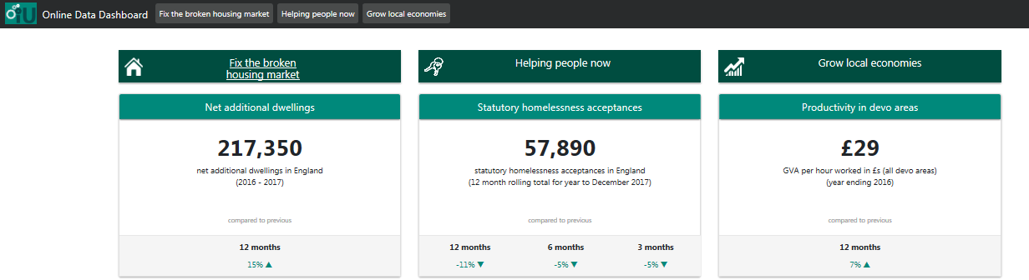
What is it?
https://iu.opendatacommunities.org/
show’s the latest performance data and visualisations on a range of MHCLG policy areas.
options to download data and snip charts for use in presentations, briefings and reports
automatic data updates from OpenDataCommunities, the departments open data platform which we aim to keep up to date within 24 hours of publication
access via your desktop, laptop, tablet or mobile phone
from the front page you can see the latest statistics on key policy areas and then drill down to charts and further data.

Slide 6
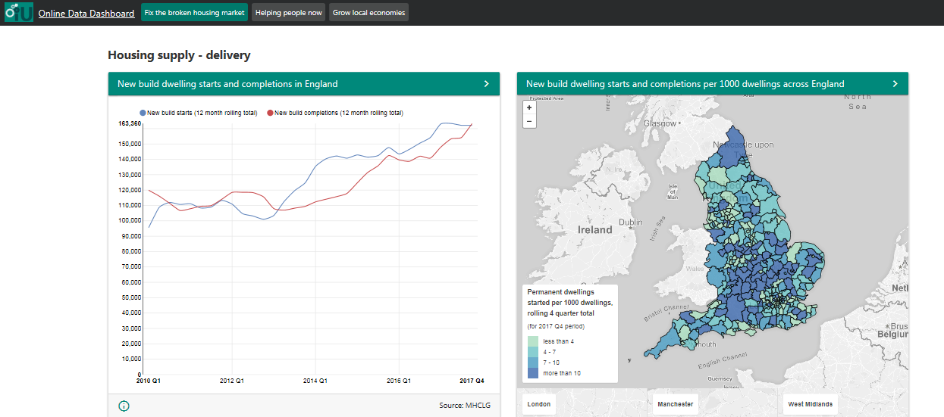
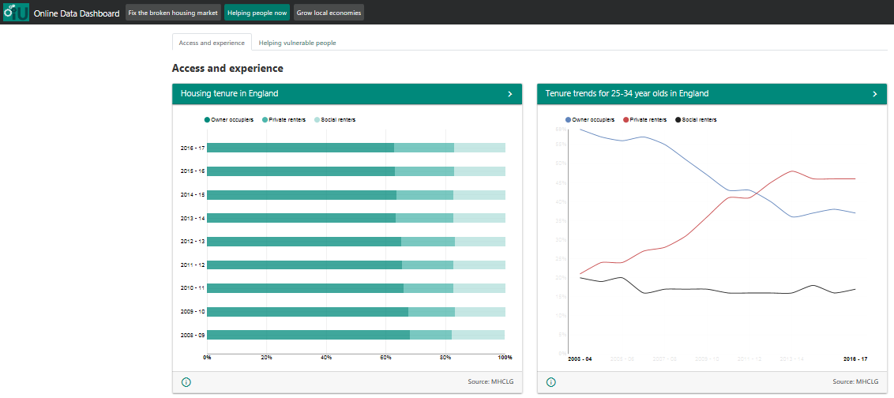
What is it?

Slide 7

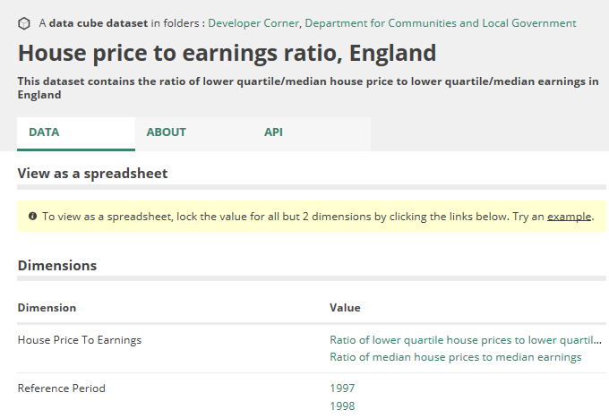
OpenDataCommunities
The departments linked data platform
Open access to local data
A selection of official statistics and data outputs on themes related to MHCLG’s objectives
  Housing supply,
  home ownership,
  devolution of power to support local growth
  building strong communities.
  OpenDataCommunities

Slide 8



How it was created
Developed by Swirrl
Data Analysis and Statistics team / OpenDataCommunities
Single Departmental Plan objectives / measures
Analysts / statisticians on indicators and presentation

Slide 9
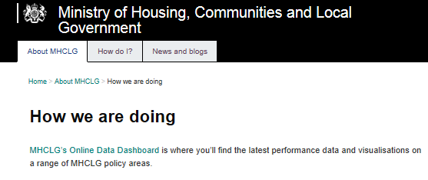

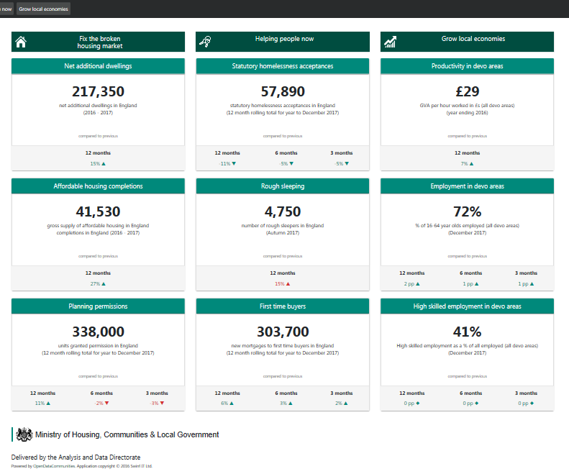
Key outcomes
tool available for use in department
easier to use evidence and data in policy making

Slide 10
Next steps
keeping it up to date
will monitor use / feedback to inform development
adding in further SDP strategic objectives
adding functionality
going public?
HOUSING MARKET
EFFECTIVE LOCAL GOVERNMENT
LOCAL GROWTH
GRENFELL RESPONSE
INTEGRATED COMMUNITIES
EU
EXITING THE EU

Slide 11
Questions / comments?
rob.green@communities.gsi.gov.uk

