Slide 1
Statistics for Public Policy
John Pullinger
National Statistician
27 January 2016
Slide 1

Slide 2
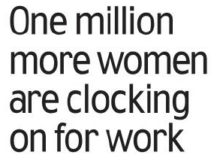
Slide 2

Slide 3
Slide 3

Slide 4
Slide 4

Slide 5
Slide 5

Slide 6
Slide 6

Slide 7
Slide 7

Slide 8
Slide 8

Slide 9
Slide 9

Slide 10
Slide 10

Slide 11
Slide 11

Slide 12
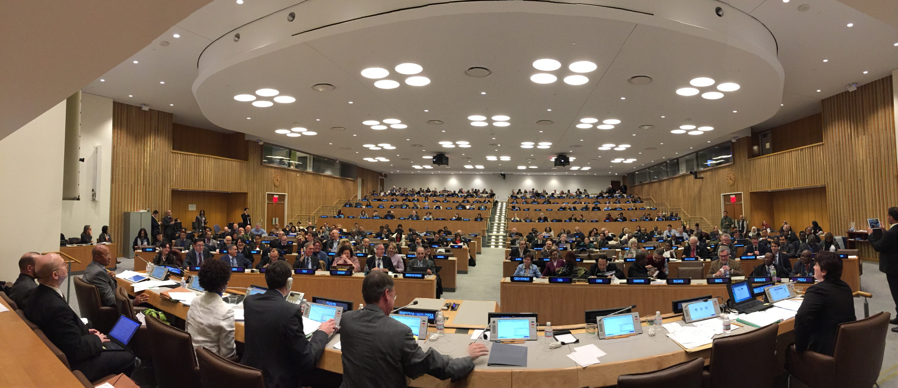
Slide 12

Slide 13
Any questions?
Slide 13

