Slide 1
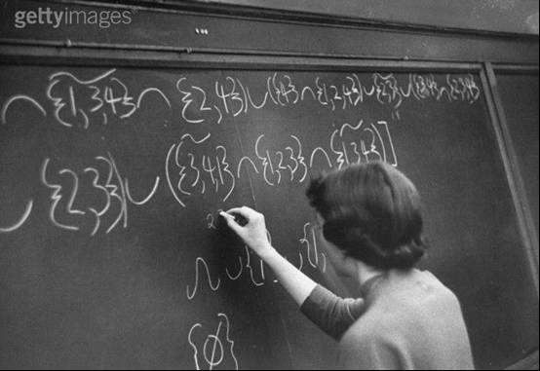
HOW TO WRITE NUMBERS
Alan Jackson
Royal Statistical Society

Slide 2
How to Write Numbers
Part 1: Grammar and the correct use of words

Slide 3
How to Write Numbers
This course on how to write numbers is in three parts:
grammar and the correct use of words,
system for summarising percentages,
the use of words or figures when writing numbers.

Slide 4
How to Write Numbers
This part is on:
grammar and the correct use of words,
system for summarising percentages,
the use of words or figures when writing numbers.

Slide 5
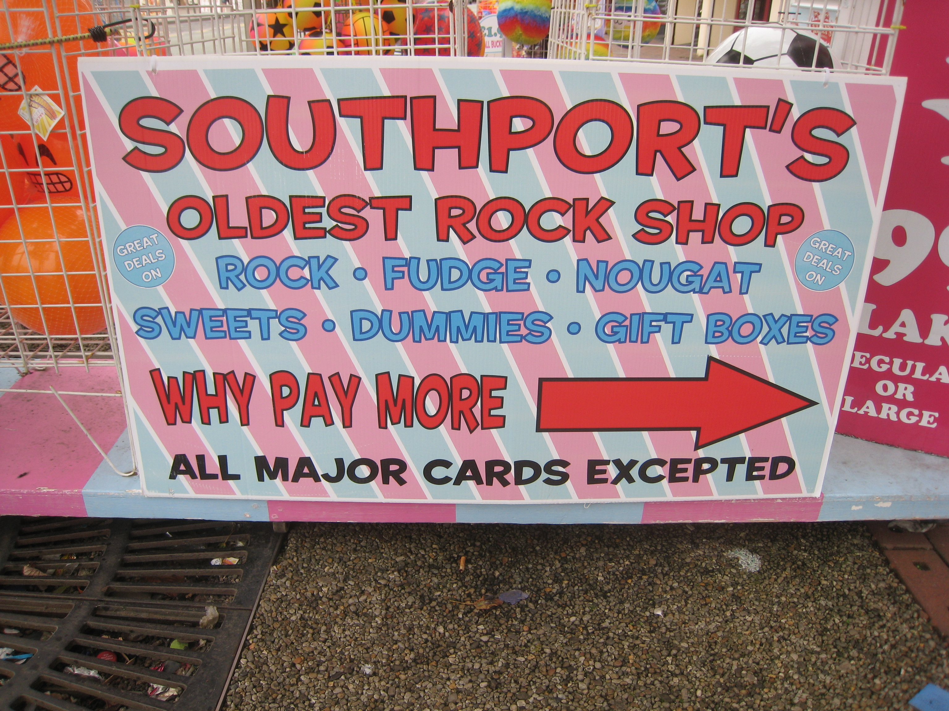
Grammar and the Correct Use of Words

Slide 6
Grammar and the Correct Use of Words
You will be shown short passages which contain deliberate mistakes. Your aim is to identify them. There is at least one in each passage (usually more).
But they are deliberate mistakes unlike …
David Bentley

Slide 7
Grammar and the Correct Use of Words
Read the passage on the grey slide and try to spot the mistakes.
The next slides will show the mistakes highlighted in red (or orange if it is a bit sloppy rather than being wrong).
The next blue slides explain the mistakes.
All the passages are about the game of billiards. You don’t need to know anything about billiards other than it is the game that preceded snooker and it is played with two white balls and one red ball (and you don’t really need to know that).

Slide 8
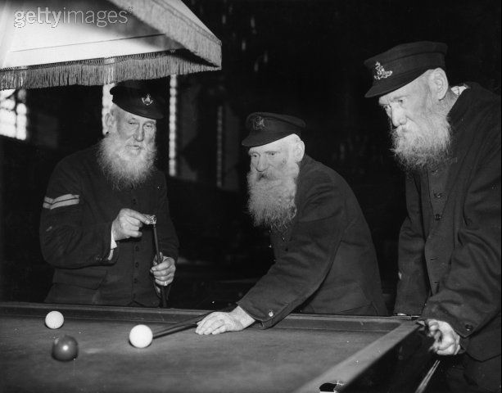
Billiards

Slide 9
Grammar and the Correct Use of Words
Less people know the rules of billiards compared to fifty years ago, and none of the current professionals is making breaks as large as the earlier players.
What’s wrong here?

Slide 10
Grammar and the Correct Use of Words
Less people know the rules of billiards compared to fifty years ago, and none of the current professionals is making breaks as large as the earlier players.

Slide 11
Grammar and the Correct Use of Words
Less people know the rules of billiards compared to fifty years ago, and none of the current professionals is making breaks as large as the earlier players.

Slide 12
Grammar and the Correct Use of Words
Less people know the rules of billiards compared to fifty years ago, and none of the current professionals is making breaks as large as the earlier players.

Slide 13
Grammar and the Correct Use of Words
fewer and less
fewer is used for things you can count: fewer songs, fewer trees
less is used for things you can’t count: less music, less timber
a general rule is to use fewer with plural nouns: fewer banknotes
and less with singular nouns: less money

Slide 14
Grammar and the Correct Use of Words
fewer and less
Less people know the rules of billiards …
Fewer

Slide 15
Grammar and the Correct Use of Words
fewer and less
the exception is
that some continuous measurements look like plurals; for example, 200 miles
usually thought of as a total distance and not 200 individual miles
so Cardiff is less than 200 miles from London
the journey usually takes less than three hours

Slide 16
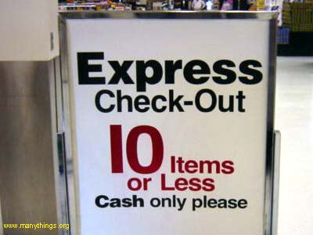
Grammar and the Correct Use of Words
fewer and less
fewer

Slide 17
Grammar and the Correct Use of Words
compare to or compare with
compare to is used to liken things: compare with to consider their differences.
“Joe Davis can be compared to Walter Lindrum.” means that the two billiard players are thought to be similar.
“Joe Davis was compared with Walter Lindrum.” means that the relative merits of each player were assessed:
they may or may not have turned out to be similar.

Slide 18
Grammar and the Correct Use of Words
compare to or compare with
Fewer people know the rules of billiards
compared to fifty years ago …
with fifty years ago …

Slide 19
Grammar and the Correct Use of Words
compare with and compare to
compare to often appears in figurative senses
as in: “Shall I compare thee to a summer’s day?”
but in statistical reports and other official writing, compare with is nearly always the one you want.

Slide 20
Grammar and the Correct Use of Words
none
none can be either singular or plural
the choice is based on the surrounding words but there is no simple rule
however, the use of singular or plural should be consistent in the same sentence
“none of the billiard players described themselves as a professional” is wrong
it should be: “none of the billiard players described themselves as professionals”

Slide 21
Grammar and the Correct Use of Words
none
… and none of the current professionals is making breaks as large as …
are

Slide 22
Grammar and the Correct Use of Words
Billiards was most popular in the 1920’s when eight percent of 30 year olds could play the game, and two fifths of them claimed to have made a break of 50 or more.
What’s wrong here?

Slide 23
Grammar and the Correct Use of Words
Billiards was most popular in the 1920’s when eight percent of 30 year olds could play the game, and two fifths of them claimed to have made a break of 50 or more.

Slide 24
Grammar and the Correct Use of Words
Billiards was most popular in the 1920’s when eight percent of 30 year olds could play the game, and two fifths of them claimed to have made a break of 50 or more.

Slide 25
Grammar and the Correct Use of Words
Billiards was most popular in the 1920’s when eight percent of 30 year olds could play the game, and two fifths of them claimed to have made a break of 50 or more.

Slide 26
Grammar and the Correct Use of Words
Billiards was most popular in the 1920’s when eight percent of 30 year olds could play the game, and two fifths of them claimed to have made a break of 50 or more.

Slide 27
Grammar and the Correct Use of Words
years
no apostrophe is needed when making years plural
so the 1960s not the 1960’s
and the ’60s not the ’60’s
the apostrophe in the ’60s is needed because it stands for the missing 19

Slide 28
Grammar and the Correct Use of Words
years
Billiards was most popular in the 1920’s …
1920s

Slide 29
Grammar and the Correct Use of Words
per cent and percentage
5% is written as five per cent not five percent (except in America)
the noun is percentage as in a percentage increase

Slide 30
Grammar and the Correct Use of Words
per cent and percentage
… when eight percent of 30 …
per cent

Slide 31
Grammar and the Correct Use of Words
year – old
expressions like 70 - year - olds need hyphens
so that the reader does not have to guess what they mean
the expression five - year - old children
is not the same as five year - old children
and the reader is left to guess what five year old children means

Slide 32
Grammar and the Correct Use of Words
year – old
… of 30 year olds could play the …
… of 30 - year -olds

Slide 33
Grammar and the Correct Use of Words
fractions
put in a hyphen when writing fractions if the numerator (the number on top) is more than one
so one third
but two - thirds
and three - quarters and five -eighths …

Slide 34
Grammar and the Correct Use of Words
fractions
… and two fifths of them claimed to …
… and two - fifths

Slide 35
Grammar and the Correct Use of Words
In the 1950 English Championship there was one or more century breaks in every match which means that there were very approximately 300 century breaks. In 22 per cent of games a break of 200 or more was made: an increase of 10 per cent on the previous year.
What’s wrong here?

Slide 36
Grammar and the Correct Use of Words
In the 1950 English Championship there was one or more century breaks in every match which means that there were very approximately 300 century breaks. In 22 per cent of games a break of 200 or more was made: an increase of 10 per cent on the previous year.

Slide 37
Grammar and the Correct Use of Words
In the 1950 English Championship there was one or more century breaks in every match which means that there were very approximately 300 century breaks. In 22 per cent of games a break of 200 or more was made: an increase of 10 per cent on the previous year.

Slide 38
Grammar and the Correct Use of Words
In the 1950 English Championship there was one or more century breaks in every match which means that there were very approximately 300 century breaks. In 22 per cent of games a break of 200 or more was made: an increase of 10 per cent on the previous year.

Slide 39
Grammar and the Correct Use of Words
one or more
one or more is always plural

Slide 40
Grammar and the Correct Use of Words
one or more
… there was one or more century breaks …
were

Slide 41
Grammar and the Correct Use of Words
approximately
approximately means “near to”
so very approximately means “very near to”
the mathematical sense of the word implies some specified degree of accuracy
the general meaning of the word is changing so it is better to use words like: about, nearly, around, almost

Slide 42
Grammar and the Correct Use of Words
per cent and percentage
… there were very approximately 300 century breaks.
… there were about

Slide 43
Grammar and the Correct Use of Words
per cent and percentage point
there is an important difference between per cent and percentage point
talking about percentage changes in percentages can lead to confusion
if something goes up from 20 per cent to 30 per cent
then this is a 50 per cent increase
but this could suggest that the new percentage is 70 per cent
better to say that 20 per cent has gone up by 10 percentage points

Slide 44
Grammar and the Correct Use of Words
per cent and percentage point
… an increase of 10 per cent on the previous year.
2 percentage points

Slide 45
Grammar and the Correct Use of Words
At the start of the 20th century there were a total of 162 professional billiard players in Britain. About half of them were between 30 - 40 years old. The number who had made a break of 500 or more is estimated at about 30.
What’s wrong here?

Slide 46
Grammar and the Correct Use of Words
At the start of the 20th century there were a total of 162 professional billiard players in Britain. About half of them were between 30 - 40 years old. The number who had made a break of 500 or more is estimated at about 30.

Slide 47
Grammar and the Correct Use of Words
At the start of the 20th century there were a total of 162 professional billiard players in Britain. About half of them were between 30 - 40 years old. The number who had made a break of 500 or more is estimated at about 30.

Slide 48
Grammar and the Correct Use of Words
At the start of the 20th century there were a total of 162 professional billiard players in Britain. About half of them were between 30 -40 years old. The number who had made a break of 500 or more is estimated at about 30.

Slide 49
Grammar and the Correct Use of Words
total
the expression a total of is usually just padding and can be left out

Slide 50
Grammar and the Correct Use of Words
total
… there were a total of 162 professional billiard players …
162

Slide 51
Grammar and the Correct Use of Words
the dash
X-Y can mean from X to Y or
between X and Y
so you can write: “players who are 30 - 40 years old”
but not “… who are from 30 - 40 years old”
or “… who are between 30 -40 years old”
the words from and between are already taken care of by the punctuation

Slide 52
Grammar and the Correct Use of Words
the dash
… half of them were between 30 – 40 years old.
30 - 40 years old.

Slide 53
Grammar and the Correct Use of Words
the dash
Care should be taken with the surrounding prepositions and conjunctions.
… half of them were from 30 to 40 years old. ✓
… half of them were between 30 and 40 years old. ✓
… half of them were between 30 to 40 years old. ✗
… half of them were from 30 and 40 years old. ✗

Slide 54
Grammar and the Correct Use of Words
estimated at about
because the word estimated carries the idea of an approximation
it doesn’t need to be followed by words like “about”
leave them out

Slide 55
Grammar and the Correct Use of Words
estimated at about
The number … is estimated at about 30.
30.

Slide 56
Grammar and the Correct Use of Words
Before the number of cannons were limited, 1 in 5 billiard players were regularly making breaks of a 100 or more, but after the rules changed only a fraction of players made century breaks.
What’s wrong here?

Slide 57
Grammar and the Correct Use of Words
Before the number of cannons were limited, 1 in 5 billiard players were regularly making breaks of a 100 or more, but after the rules changed only a fraction of players made century breaks.

Slide 58
Grammar and the Correct Use of Words
Before the number of cannons were limited, 1 in 5 billiard players were regularly making breaks of a 100 or more, but after the rules changed only a fraction of players made century breaks.

Slide 59
Grammar and the Correct Use of Words
Before the number of cannons were limited, 1 in 5 billiard players were regularly making breaks of a 100 or more, but after the rules changed only a fraction of players made century breaks.

Slide 60
Grammar and the Correct Use of Words
Before the number of cannons were limited, 1 in 5 billiard players were regularly making breaks of a 100 or more, but after the rules changed only a fraction of players made century breaks.

Slide 61
Grammar and the Correct Use of Words
number of
the number of takes a singular verb
a number of takes a plural verb
the number of billiard tables needing a new cloth was higher than last year:
a number of them were completely unusable

Slide 62
Grammar and the Correct Use of Words
number of
Before the number of cannons were limited …
was

Slide 63
Grammar and the Correct Use of Words
one in N
expressions like one in six are always singular
one in six billiard players have made a 50 break is wrong
it should be: one in six billiard players has made a 50 break
✗
✓

Slide 64
Grammar and the Correct Use of Words
one in N
… 1 in 10 billiard players were …
was

Slide 65
Grammar and the Correct Use of Words
hundreds and thousands
the number 100 is always read as one hundred
It is wrong to say that “a player scored a 100 points”
you would be saying “a one hundred points”
it should be “a player scored 100 points”
the same rule applies to other numbers which are written as 1 followed by a number of 0s
for example: 1,000 is read as one thousand

Slide 66
Grammar and the Correct Use of Words
hundreds and thousands
… breaks of a 100 or more …
100

Slide 67
Grammar and the Correct Use of Words
fraction and percentage
strictly speaking a fraction or percentage of something does not have to be a small fraction or percentage
99% is still a percentage and is still a fraction
usually both words are thought of as being small, as in: “only a fraction remained”
even so, it would be more precise to say: “only a small fraction remained”
999
1000

Slide 68
Grammar and the Correct Use of Words
fraction and percentage
… only a fraction of players made century breaks …
… only a small fraction

Slide 69
Grammar and the Correct Use of Words
According to a survey carried out by the Billiards Association some 50 years ago of some 800 clubs, some 14,000 people played billiards biweekly, and some 47 were qualified as billiards referees.
What’s wrong here?

Slide 70
Grammar and the Correct Use of Words
According to a survey carried out by the Billiards Association some 50 years ago of some 800 clubs, some 14,000 people played billiards biweekly, and some 47 were qualified as billiards referees.

Slide 71
Grammar and the Correct Use of Words
According to a survey carried out by the Billiards Association some 50 years ago of some 800 clubs, some 14,000 people played billiards biweekly, and some 47 were qualified as billiards referees.

Slide 72
Grammar and the Correct Use of Words
some
there’s nothing wrong with using the word some to mean about, as in:
“some 14,000 people played billiards …”
the problem is that the word can give the impression that the writer is unsure of the reliability of the figures,
particularly if some is used repetitively
positive expressions (like “nearly” or “just over”) are better

Slide 73
Grammar and the Correct Use of Words
some
According to a survey … of nearly 800 clubs, an estimated 14,000 people played billiards …, and 47 were qualified as billiards referees.
According to a survey … of some 850 clubs, some 14,000 people played billiards …, and some 47 were qualified as billiards referees.

Slide 74
Grammar and the Correct Use of Words
some
usually the word some can be left out with no danger of appearing vague or reckless
large rounded numbers are nearly always thought of as estimates:
they don’t need to be qualified.

Slide 75
Grammar and the Correct Use of Words
some
According to a survey … of nearly 800 clubs, an estimated 14,000 people played billiards …, and 47 were qualified as billiards referees.
According to a survey … of 800 clubs, 14,000 people played billiards …, and 47 were qualified as billiards referees.

Slide 76
Grammar and the Correct Use of Words
biweekly
words like biweekly and bimonthly are at best confusing and at worst misleading
it’s kinder to the reader to say things like every two weeks or twice a week
you could even say every two years instead of biennial then no-one will have to try and remember what the word means

Slide 77
Grammar and the Correct Use of Words
biweekly
USELESS!

Slide 78
Grammar and the Correct Use of Words
biweekly
14,000 people played billiards biweekly,
twice a week,

Slide 79
Grammar and the Correct Use of Words
“data is” or “data are”?
strictly speaking data is a plural noun
but you wouldn’t say: “the player’s stamina were in need of improvement”
a collective noun can be singular or plural “the team was relegated” “the team were presented with medals”

Slide 80
Grammar and the Correct Use of Words
“data is” or “data are”?
in general use “data” was considered as a plural (“data are”), and in technical use (computing, statistics, …) it was treated as singular (“data is”)
precedent: cutlery and luggage are singular
bowlful of sugar
so say data is unless it sounds really odd

Slide 81
