Slide 1
A conceptual, technical and practical framework for missing data in longitudinal clinical studies:
Critical skills and important habits for statisticians
Craig Mallinckrodt
PSF Forum
June 4, 2015

Slide 2
Outline
  Background
  Influence and change
  Application in Missing data

Slide 3
Context
  I have tried to be as accurate as possible
  Some recollections are accurate, but inevitably some are convenient
  Therefore, to some degree this presentation reflects what I would have liked to have done, or what I would do if doing it again, rather than what was actually done

Slide 4
Acknowledgements
Geert Molenberghs (Universiteit Hasselt, Diepenbeek), Lei Xu (BioGen Idec, Boston), Adam Meyers (BioGen Idec, Boston, MA). Ilya Lipkovich (Quintiles, Indianapolis), Hank Wei (Eli Lilly, Indianapolis), Qun Lin (Eli Lilly, Indianapolis), and Dustin Ruff (Eli Lilly, Indianapolis).
Caroline Beunckens (Universiteit Hasselt, Diepenbeek), James Carpenter (London School of Hygiene and Tropical Medicine), Raymond Carroll (Texas A&M University, College Station), Christy Chuang-Stein (Pfizer, New York), Scott Clark (Eli Lilly, Indianapolis), Mike Detke (MedAvante, Hamilton), Ivy Jansen (Universiteit Hasselt, Diepenbeek), Chris Kaiser (Eli Lilly, Indianapolis), Mike Kenward (London School of Hygiene and Tropical Medicine), Peter Lane (Glaxosmithkline, Harlow), Andy Leon (Weill Medical College, Cornell, New York), Stacy Lindborg (BioGen Idec, Boston), Rod Little (University of Michigan, Ann Arbor), James Roger, (London School of Hygiene and Tropical Medicine); Steve Ruberg (Eli Lilly, Indianapolis), Shuyi Shen (Genentech, Ocenside), Cristina Sotto (Universiteit Hasselt, Diepenbeek), Birhanu Ayele (Universiteit Hasselt, Diepenbeek), Herbert Thijs (Universiteit Hasselt, Diepenbeek), Russ Wolfinger (SAS, Cary)

Slide 5
Motivating Example
In the first half of the 19th century about 5/1000 European women died from childbirth. Death rates in maternity hospitals were often 10x
Semmelweis discovered that the incidence of childbed fever could be drastically cut by the use of hand disinfection. But did not know why
His findings not accepted. Committed to an asylum where he died at age 47 after being beaten by the guards 14d after committed
He was right, but ineffective

Slide 6
Career Path
2-year associates degree in production ag.
Unsuccessful farming business
BS in Animal Science, MS, PhD in Animal Breeding and Genetics
4 years Dept of Statistics Colorado State Univ.
Eli Lilly 17+ years

Slide 7
3 phases of missing data work
  1998-2002: Choice of the primary analysis
  2003-2008: Categorical data, MI, Consolidation
    Pharma expert team on missing data
  2009-present: Estimands, Sensitivity, Consolidation
    Lilly Advanced Analytics Hub
    DIA Scientific Working Group

Slide 8
Outline
  Career background
  Influence and change
  Application in missing data

Slide 9
Influence Myths (Dr. Elaine Seat)
Inherently slimy
Rationality is the best way to influence
Influence & power are based on position / rank
Involving others and sharing power weakens your own position
First impressions and good manners are old fashioned

Slide 10
Outcomes of Influence Attempts
Commitment: willing and enthusiastic, needed for complex / difficult tasks
Compliance: willing but apathetic, minimal effort, works for routine tasks
Resistance: opposed to the request, actively tries to avoid doing it

Slide 11
Types of Influence / Power
Legitimate
Reward
Coercive
Connection
Information
Expert
Referent

Slide 12
Influence Tactics
Ingratiation
Consultation
Exchange
Inspiration
Personal appeal
Pressure
Logic (rational persuasion)
Legitimizing
Coalition

Slide 15
Yeah, But…
Problem: I am not an inspirational speaker / presenter. Therefore, I can not be influential
Solution: Consultation is the second most important aspect. Sharing power doesn’t make you weaker

Slide 16
Leading Disruptive/Complex Change
Vision
Skills
Incentives
Resources
Action Plan
CHANGE
Skills
Incentives
Resources
Action Plan
CONFUSION
Vision
Incentives
Resources
Action Plan
ANXIETY
Vision
Skills
Resources
Action Plan
GRADUAL CHANGE
Vision
Skills
Incentives
Action Plan
FRUSTRATION
Vision
Skills
Incentives
Resources
FALSE STARTS
Note that without adequate Communication of each of these elements, it is the same as not having the element present.
Stephen J. Ruberg

Slide 17
Outline
  Career background
  Influence and change
  Application in missing data

Slide 18
Defining Moment: Golden Nugget
Recognized missing data in clinical trials was a different manifestation of a problem I had worked on extensively in the genetic evaluation of livestock
  The data available is a selected subset
  In genetic evaluations we had learned that so long as all the info upon which the selection decision had been based was included in the analysis the available data would yield unbiased results
  A different way of expressing MAR

Slide 19
Broad Base of Internal Support
Sought out more senior statisticians at Lilly for advice and support
Sought out external Collaborators, including those with differing views
Cultivate Champions
  Others invested in success of the effort
Provide support
  Advise, consult, present
Mutual support for similar research
Change seen as positive step forward rather than as a step away from something negative

Slide 20
Making the New Way Easy
%MACRO MIXED_1 (Y, BVBEG, BVEND, CVBEG, CVEND, CLASS, MODEL, COV, Data);
proc mixed data = &Data;
class &CLASS;
model &Y = &MODEL / ddfm=kr;
repeated visit/sub=patient type = &COV;
lsmeans therapy*visit / cl diff;
run;
%MEND;
%MIXED_1 (HAMDTL17, 1, 2, 3, 8, site patient therapy visit,
therapy visit site basval therapy*visit basval*visit,
un, A);

Slide 21
External Support
Sought out external Collaborators, including those with differing views
Not just a statistical issue – make it understandable to clinicians
Mutual support for similar research
Change seen as positive step forward rather than as a step away from something negative

Slide 22
Missing Data Hub Vision
  1) Lower rates of, and reduce the bias from, missing data
  2) Improve inferences from trials with missing data
  By implementing the recommendations for prevention and treatment of missing data developed by NAS expert panel and the PhRMA missing data expert team
  20 cross-functional volunteers

Slide 23
Action Plan
  Three work streams – Champion for each
    Prevention
    Treatment
    Research
  5 work domains – Chance for each member to contribute
    Tools
    Training
    Methods development
    Consulting
    External influence

Slide 24
Influence, Power, and Tactics
  No legitimate power
  Pressure / coercion kills enthusiasm for volunteers
  Reward useful in the “Drive” sense
    Freedom to create / innovate
  Information from me and from expert panel useful, especially in providing vision
  Consultation – diverse problem to be tackled from all angles, needed diverse expertise
  Referent power important

Slide 25
Influence, Power, and Tactics
  Cultivate champions through consultation and freedom to operate / innovate – sharing power
  Not everything was done the way I wanted, but the way others did it may have been better anyway and giving the freedom to “own” their work was very motivating
  Patience was important – all volunteers. Only a few members of the group could consistently contribute at a substantive level

Slide 26
DIA Scientific Working Group
  Although the missing data hub was effective, we could be more effective if we collaborated with other companies
  Vision: Create a publically available library of programs and supporting materials for sensitivity analyses
  Lilly seeded the effort with programs from the missing data hub
  Others quickly and enthusiastically joined
  Missingdata.org.uk

Slide 27
Analytic Road Map
Data
Efficacy
Effectiveness
Reference-based imputation
Ignorable Non-ignorable
Restrictive Inclusive
model model
SM, SPM, PMM,
Delta-adjustment
MI, wGEE
etc…
DL, MI, wGEE
Diagnostics:
residuals,
influence,
correlation,
time
Sensitivity of primary result
Primary inference
Conclusions

Slide 28
  Discussion

Slide 29
Approach
Many / most / all decisions of importance at large companies are made by groups in groups
How can we as individuals contribute? What independent ideas / solutions can each of us offer and how do we develop these ideas / solutions?
How do we solve tough problems or make complex decisions?
How do we find the Golden Nugget?
And once we have found it how do we influence?

Slide 30
Critical Skills
  With the evolving nature of our business increased need for stats to think critically and independently
    Perspective
    Orientation
    Mindfulness

Slide 31
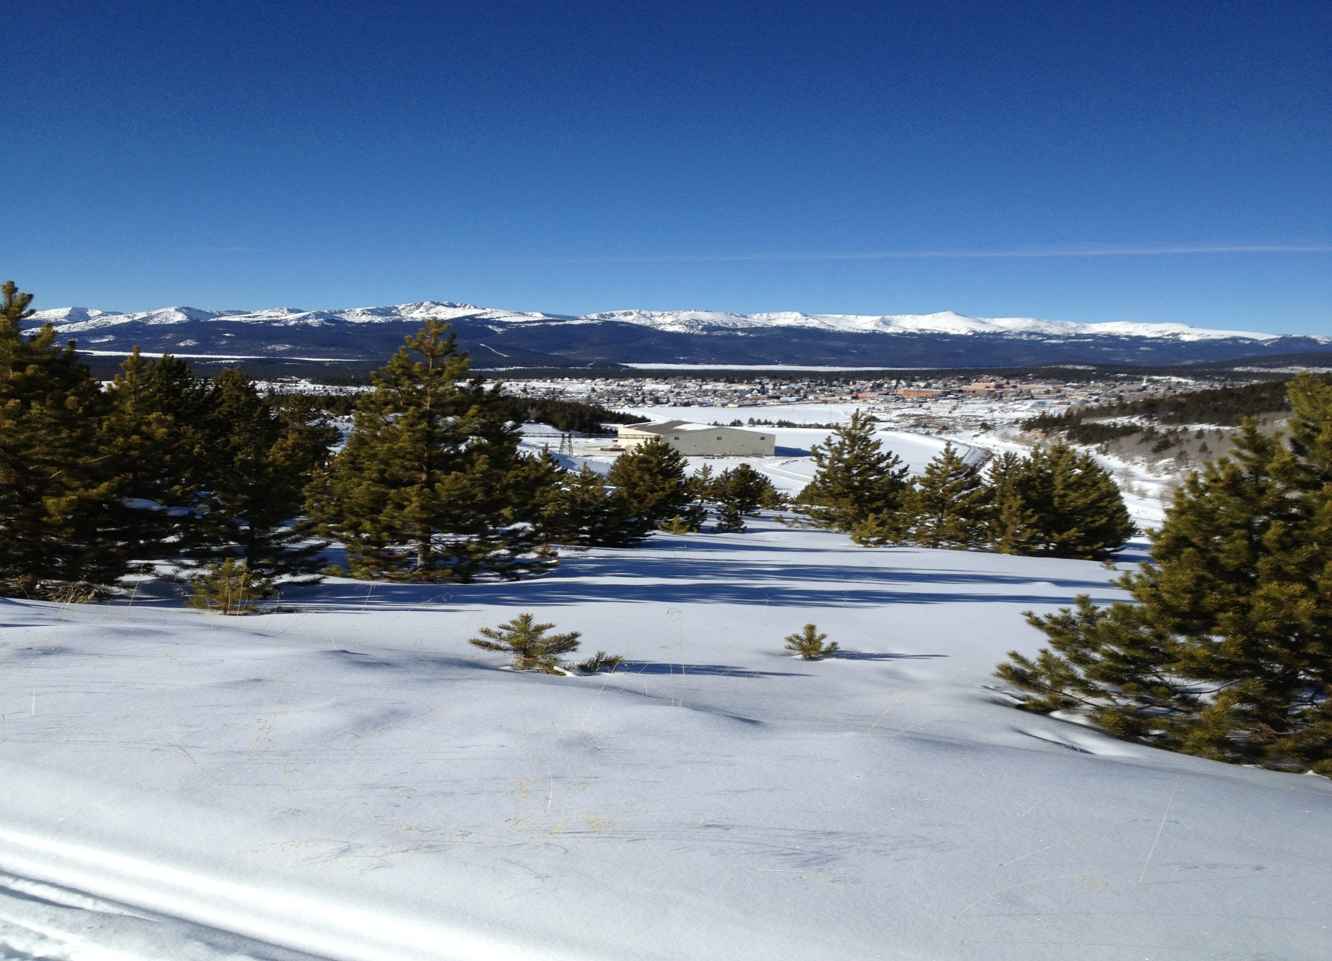
Notes:
Step back from the crowd. Think independently. Not just contrarian…

Slide 32

Notes:
The flat top mound on the right was a significant land mark for early pioneers heading west on the Santa Fe trail. When we are in the midst of complex or difficult problems it can be useful for us to have landmarks to help maintain proper orientation

Slide 33
Critical Skills
  Meetings are a poor place to brain storm
  Multi-tasking is a way to do several
  routine things at once. It is not a good
  way to do difficult things
  You can not force a good idea to pop
  into your head. But you can put yourself
  in situations where that is more likely
  But being right is not enough…

Slide 34
Important Habits
Calm. Relaxed. Mindful.
Walking to the student center
  Change in perspective when stuck, not brute force
Playing fetch with / walking Maggie
  Even when not stuck short breaks can recharge
Recharge
  I can do 12 months of work in 11 months but I can’t do 12 months of work in 12 months

Slide 35
Important Habits
  Make time to think – every day
  Recharge the batteries
  EQ
  Lincoln
    “It is better to sit in silence with those around
    you thinking you are a fool rather than to open
    your mouth and prove it so”
    “If I had 6 hours to chop down a tree I’d spend
    the first 4 hours sharpening the ax”

Slide 36
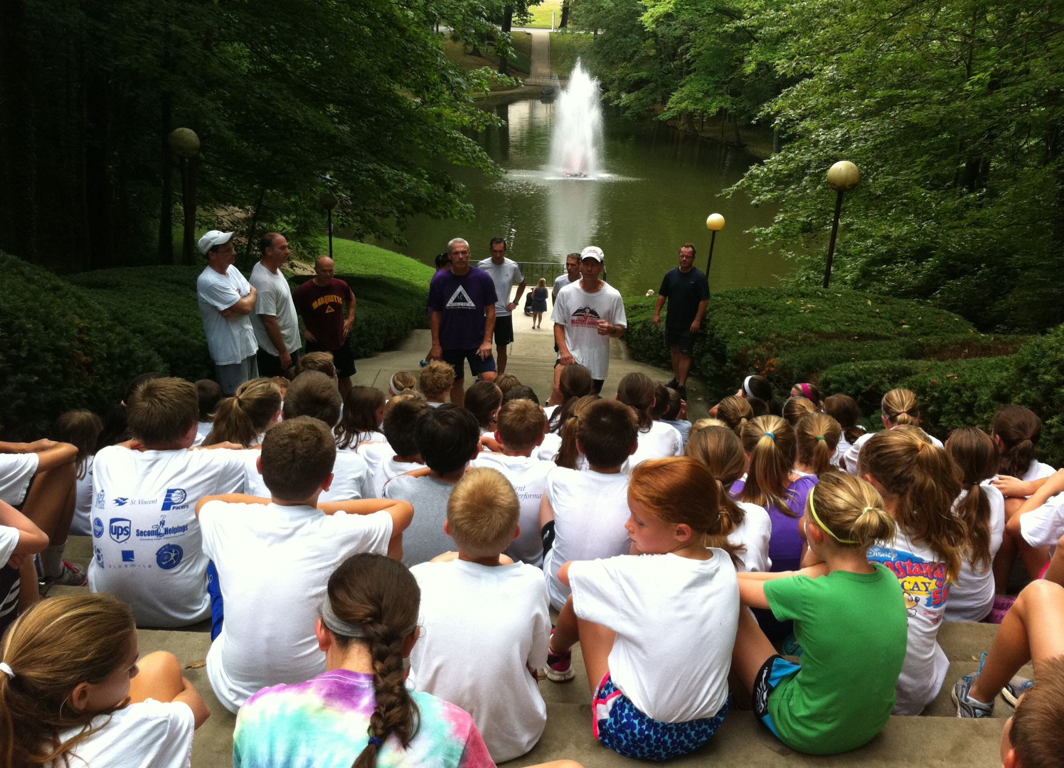

Slide 37

Notes:
You won’t get the shot if you don’t try. Don’t be afraid to try.

