Slide 1
A warm welcome to today’s Journal Club We aim to start promptly at 10am Your chair is Chris Skinner Professor of Statistics, London School of Economics & Political Science
Journal Club is sponsored by

Slide 2
During the Q & A sessions at the end of each presentation:
Press *6 on your phone to speak
Press *6 again after speaking
(to mute phone)

Slide 3
The item count method for sensitive survey questions: Modelling criminal behaviour
Jouni Kuha and Jonathan Jackson London School of Economics and Political Science
Journal of the Royal Statistical Society, Series C, 63, pp. 321–341 (2013)
RSS Journal Club Webinar, 20.11.2014
Modelling item count data

Slide 4
Motivation: A substantive research question
Predictors of criminal behaviour (today: buying stolen goods)
Mainly interested in the following predictors, and their relative importance:
Morality - how wrong is the crime
Financial need (also proxy for perceived benefits of crime)
Age as a control variable
Data from a 3-country survey, with n = 2549
Modelling item count data

Slide 5
Survey questions on sensitive topics
Direct questions on topics such as illegal behaviour may fail to elicit truthful answers
One alternative: Methods of questioning which hide the answer from the interviewer
Classical randomized response techniques (Warner 1965 onwards) Today: The item count (list experiment) technique (Miller 1984 onwards)
Modelling item count data

Slide 6
Our item count question
‘I am now going to read you a list of five [six] things that people may do or that may happen to them. Please listen to them and then tell me how many of them you have done or have happened to you in the last 12 months. Do not tell me which ones are and not true for you. Just tell me how many you have done at least once.’
[Items included in both the control and treatment groups]
Attended a religious service, except for a special occasion like a wedding or funeral.
Went to a sporting event.
Attended an opera.
Visited a country outside [your country]?
Had personal belongings such as money or a mobile phone stolen from you or from your house.
[Item included in the treatment group only]
Bought something you thought might have been stolen.
Respondents are randomly assigned to
control group: list of control items 1–5 only, or
treatment group: list of items 1–6, including sensitive item 6
Modelling item count data

Slide 7
Modelling item count data: Variables
Define
t is the group: t = 1 for treatment group, t = 0 for control
Y is answer to the sensitive item: Y = 1 for Yes, Y = 0 for No
Z is the total for the control items
S = Z + tY is the observed item count
... plus explanatory variables x
Modelling item count data

Slide 8
Counts in our data
Numbers of respondents who report different total counts:
Group
Item count
2 3
Total
0
1
4
5
6
Control | 269 | 472 | 257 | 133 | 54 | 21 | — | 1206
Treatment | 279 | 446 | 281 | 124 | 53 | 20 | 9 | 1212
Modelling item count data

Slide 9
Modelling item count data: Basic idea
S = reported item count; Z = count for the control items
Y = binary (0/1) variable of interest
In control group, S = Z , so this group give information on the distribution of Z
In treatment group, S = Z + Y
Using (1), we can separate distributions of Z and Y in (2), leaving an estimate of the distribution Y
Modelling item count data

Slide 10
Modelling item count data: Simple methods
S = reported item count
Y = binary (0/1) variable of interest
For example, difference of average counts between the groups
π˜_{y} = S¯₁ − S¯₀
is an estimate of π = p(Y = 1)
This idea can also be extended to model p(Y = 1) given x
However, such approaches can be inflexible and inefficient Better approach:
Treat this as a problem of incomplete categorical data
Modelling item count data

Slide 11
Modelling item count data: Models
Define two models:
p_{y} (y ) = P(Y = y Sx_{y} ): model of interest for Y (e.g. logistic)
p_{z} (z Sy ) = P(Z = z Sy , x_{z} ): model for the control count Z
where x_{y} and x_{z} are explanatory variables
Model for the observed count is
P(S = s) = p_{y} (1) p_{z} (sS1) + p_{y} (0) p_{z} (sS0)
[in control group]
P(S = s) = p_{y} (1) p_{z} (s − 1S1) + p_{y} (0) p_{z} (sS0) [in treatment group]
Modelling item count data

Slide 12
Modelling item count data: Estimation
A clear account of categorical-data modelling of item count data was first presented by Imai (2011)
EM algorithm for the estimation (and R package list; Blair and Imai 2011):
Numerical differantiation for estimated standard errors
In Kuha and Jackson (2014):
Newton-Raphson update instead of the M-step of EM (using a result by Oakes, JRSS B, 1999) — some improvement in speed
Closed-form expressions for estimated standard errors, as a by-product of the estimation
Modelling item count data

Slide 13
The control items
The nonsensitive (or “control”) items are the peculiar feature of an item count question — and potentially its Achilles’ heel
Need to satisfy certain assumptions for the method to be valid
Difficult or impossible to ensure in design, or to fix in analysis
For efficiency, control count Z should be independent of the sensitive item Y (given explanatory variables)
Estimates of model for Y are sensitive to the form of the model for Z
Modelling item count data

Slide 14
Models for the control items
Z is a discrete variable with values 0, . . . , J(= number of control items)
In Imai (2011), p_{z} (z Sy , x_{z} ) is assumed to be Binomial or Beta-binomial
In general, these distributions are too restrictive
Our recommendation is that p_{z} (z Sy , x_{z} ) should be specified as multinomial
...and the model for it conditional on explanatory variables as multinomial or ordinal logistic
The most important part for efficiency of estimation is whether
p_{z} (z Sy , x_{z} ) depends on y
If not, Z and Y are conditionally independent, and efficiency is highest
Modelling item count data

Slide 15
Sensitivity of estimates to model for Z
Consider π_{y} = P(Y = 1) in our example, without explanatory variables
Here Y is buying stolen goods.
Estimates of π_{y} are
between 1.7% and 14.9%, depending on assumptions about p_{z} (z Sy ) πˆ_{y} = 1.7% (with 95% CI 0.5%–5.8%) under the (multinomial) assumption preferred by model selection criteria.
See Kuha and Jackson (2014) for these results and some simulations
Modelling item count data

Slide 16
Example: Estimated models for Y and Z
Results for model 1 Results for model 2
Model for sensitive item Y (buying stolen goods)
Results for model 3
Constant Age | −2.97 −0.01 | (0.01) | −3.11 −0.01 | (0.01)
Morality | 2.23 | (0.95) | 1.72 | (1.48) | 0.71 | (0.64)
Need Morality x need | 1.05 | (1.04) | 1.60 | (1.21) | 2.22 | (0.86)
−3.82
Model for the total Z of the control items
Age
−0.02 (0.00)
−0.02
−0.28
(0.00)
(0.32)
−0.02
(0.00)
Morality
−0.17
(0.16)
Need | −1.38 | (0.16) | −1.60 | (0.28) | −1.71 | (0.21)
Y |  |  | 0.99 | (0.40) | 1.11 | (0.42)
Log-likelihood
−3226.5
−3222.5
−3223.8
Modelling item count data

Slide 17
Summary of the contributions of the article
Improvements to the estimation of models for item count data, treated as incomplete caregorical data
Proposals for models for the nonsensitive (control) items Example: Models for illegal behaviour
Here need (perceived benefits of crime) appears to be a stronger predictor than personal morality
Modelling item count data

Slide 18
We are now open for questions!
Use the Q&A icon (top of your screen) to write your question
or
Press *6 on your phone
(don’t forget to *6 again after speaking to mute)

Slide 19
Which method predicts recidivism best? A comparison of statistical, machine learning and data mining predictive models
Nikolaj Tollenaar
Research and Documentation Centre,
Ministry of Security and Justice, the Netherlands
Peter G.M. van der Heijden
Utrecht University and
University of Southampton

Slide 20
Outline
Introduction
Method
Performance
Models
Data
Model selection
Results
Conclusion

Slide 21
Introduction
Existing risk assessment:
Statrec-99 (Wartna & Tollenaar 2010, cf. OGRS in UK)
Adult offenders
6 variables scored by probation officer
logistic regression on 4y reconviction yes/no
Need to improve/update existing model
Data
Develop two more models for specific risk assessment
Violent recidivism
Sexual recidivism

Slide 22
Introduction
Risk assessment on suspect/convicts: mostly logistic regression used
Since 60’s Machine learning / data mining for classification
Advantages:
automatically handle non-linearity, complex interactions, variable selection
‘messy’ data with large #predictors
Disadvantage: - less interpretable

Slide 23
Research question:
Can predictive performance of standard statistical
methods in recidivism data be improved by using
machine learning and data mining models?

Slide 24
Previous comparisons
Machine learning domain:
Large meta study (Jamain & Hand, 2008).
Large comparative studies on ML repository data (Lim, Loh & Shih, 1998, 2000)
General conclusion: no best model for all data sets, overall good (across widely different data sets):
Linear discriminant analysis
Tree classifier
Notes:
30’

Slide 25
Dimensions of predictive performance
3 dimensions for evaluation
Calibration
Discrimination
‘Clinical’ usefulness
Notes:
Range of criteria from these dimensions

Slide 26
Dimensions of predictive performance
Calibration
Observed ≈ fitted
Criterion:
RMSE:
Recalibration (Platt, 2000):
Fit logistic regression of y on $\hat{p}$

Slide 27
Dimensions of predictive performance
Discrimination:
ROC-curve
AUC: % correct rankings of negative/positive pairs.
0.5: chance prediction.
Low cut-off
High cut-off
9

Slide 28
Dimensions of predictive performance
‘Clinical’ usefulness:
Decision making / classification
Percentage classified correctly
Requires cutoff-value
Usually: p = 0.5
Also: p = base rate (br)
Measure: ACC = (TP + TN)/Total

Slide 29
Method - criteria
Combination measure of each dimension
Caruana & Niculescu-Mizil (2004): different indicators are not always simultaneously optimal.
Proposal: SAR = (AUC + ACC + (1-RMSE))/3

Slide 30
Method - models
Classical statistics
logistic regression (logreg)
linear discriminant analysis (LDA)

Slide 31
Method - models
Predictive data mining / machine learning
Decision trees (rpart) recursive partitioning data
Multivariate Adaptive Regression Splines (MARS) logit
Flexible discriminant analysis (FDA) MARS basis
Adaptive boosting (Adaboost) weighted ensemble of trees
Logitboost weighted ensemble of stumps
Neural networks (nnet) overparameterised nonlinear model
Support Vector Machines (SVM) find max. separating hyperplane
K-nearest neighbour classification (K-nn)

Slide 32
Method - models
Modern statistics
Partial least squares regression (PLS) dependent/independent variables projected onto latent structure
All but classical models require tuning: 1 or more tuning parameters

Slide 33
Method: finding the best model
Split data in two parts:
Estimation (‘training’) data
Validation (‘testing’) data
Model (‘learner’) selection procedure:
For estimation data:
Fit models over grid of tuning parameters
For validation data
Establish fit model calibrated/uncalibrated
SAR at cut-off = .5 : leading

Slide 34
Three data sets
Data source: Dutch Offenders Index
Criminal record information
General recidivism = any to any type of crime
All offenders 2005 (N=159,298, base rate 40.1%)
Violent recidivism= violent to violent
All violent offenders 2005 (N=25,041, br 23.7%)
Sexual recidivism= sexual to sexual
All sexual offenders 2005/2006 (N=1,332, br 5.5%)
Model selection: sample of max. 20,000 (memory, CPU)

Slide 35
Variables (features) used
Gender | Country of birth (%)
Age | Netherlands
Age² | Morocco
Most serious offence type in case (%) | Neth. Antilles/Aruba
Violence | Surinam
Sexual | Turkey
Property with violence | Other Western countries
Property without violence | Other non-Western countries
Public order | Age at first conviction
Motoring offence Drug offence | $$\sqrt{\frac{\text{\#}\text{convictions}}{\text{career} \text{length}\text{+1}}}$$
Misc. offence | log_{e} #convictions
Offence type presence (%) | Number of previous disposals:
Counts of offence types | Fines
 | Community service orders
 | Custodial sentences
 | PPD’s

Slide 36
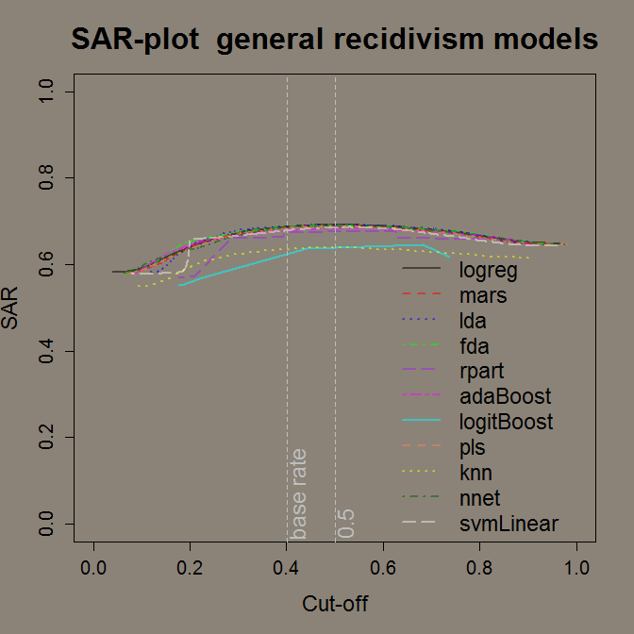
SAR = (AUC + ACC + (1-RMSE))/3

Slide 37
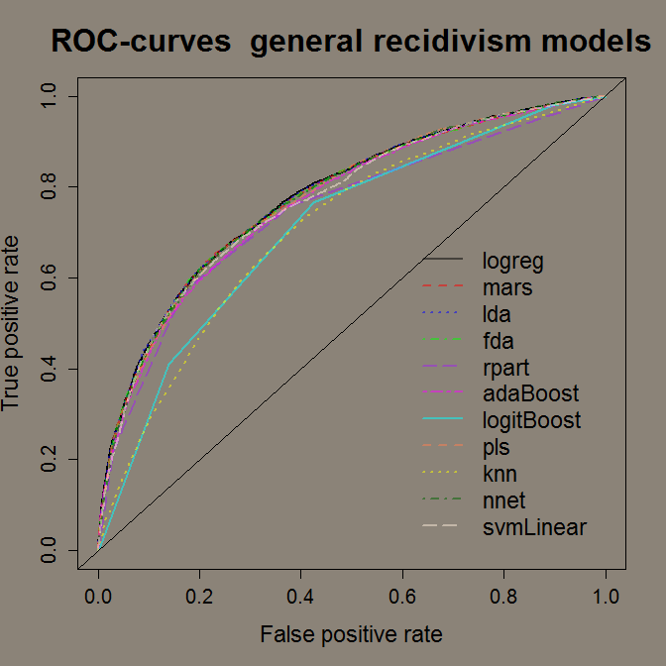

Slide 40
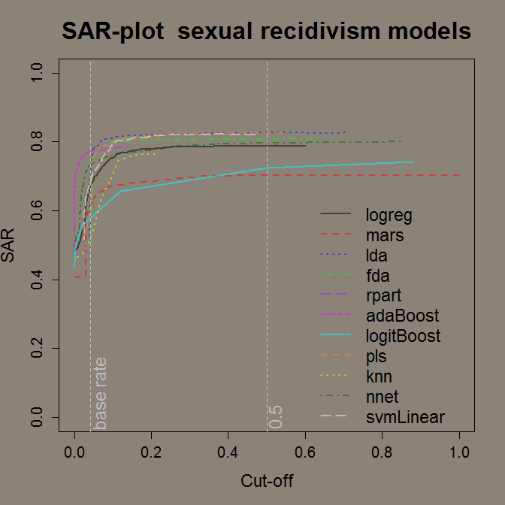

Slide 42
Conclusions
Best performers
General recidivism: logistic regression
Violent recidivism: logistic regression (cal.)
Sexual recidivism: LDA (cal.)
LDA top 2 in all data sets;
routine application advised
 | AUC | RMSE | ACC | SAR
General: logreg | .776 | .430 | .728 | .692
Violence: logreg cal. | .739 | .396 | .781 | .708
Sexual: LDA cal. | .725 | .202 | .955 | .826

Slide 43
Conclusions
Standard statistical modelling: - non-linearity checks (e.g. GAM) - transform covariates / add quadratic terms
This study: transformed variables as input nonlinear models
These data: no differences found with modern methods
Observation:
in comparison studies LDA/logreg vs ML:
Any manually applied transformations?
(Partial) source of performance difference methods?

Slide 44
Conclusions
Limitations:
Many variants of ML/DM algorithms
In nonlinear models: bound to grid search; trying all computationally unfeasible
Linear models: potential non-linear transformations of original continuous vars

Slide 45
Conclusions
Very different models, same performance, varying $\hat{p_{i}}$ across models
Alternative question:
which combination of models predicts best?
Stacked generalisation (Wolpert, 1992)/ Stacking / blending:
${\hat{p}}_{stack}$ $\sum{w_{m}{\hat{p}}_{m}}$
>= best model of subset
Preliminary analyses confirm improvement
Disadvantage: less transparancy / slow

Slide 46
We are now open for questions!
Use the Q&A icon (top of your screen) to write your question
or
Press *6 on your phone
(don’t forget to *6 again after speaking to mute)

Slide 47
Thank you for joining us today!
Please leave us some feedback:
use the Poll option (top of your screen)
or email journalclub@rss.org.uk

